Slide 1
hey Otis
From rupture to repair.
A private guide for couples in conflict.
Samantha Ahhee · Founder, Hey Otis · Amsterdam, 2026

Slide 2
THE HOOK
Every couple argues. The ones that last learn how to repair.
“Conflict in relationships is inevitable. It's not a sign that something is broken, it's a signal that something needs attention.”
— Esther Perel

Slide 3
THE PROBLEM
Conflict isn't the problem. Silence is.
69%
6 yrs
96%
5:1
of conflicts are perpetual, they never fully resolve
couples wait before seeking any help
of conversations are determined by how they start
positive to negative, the magic ratio
Most couples don't break up because they fight. They break up because they stop trying to understand each other.

Slide 4
WHY NOW
Therapy works. But most fights happen between sessions.
Therapy is expensive
Waitlists are months long
The damage is between sessions
$150 to $300 per session in most major cities. Most couples can't sustain weekly.
Couples in crisis wait 6 to 12 weeks for an opening. The fights don't wait.
Most ruptures happen at 11pm on a Tuesday, nine days from the next appointment.
AI has finally crossed the threshold to help people process emotion safely, privately, and in real time. The window to build this is open.

Slide 5
THE SOLUTION
Hey Otis is a private guide that walks couples from rupture to repair.
In your pocket. At 11pm. When your therapist doesn't pick up. Not a replacement for therapy. The thing that makes therapy work.

Slide 6
HOW IT WORKS
Four steps. One conversation at a time.
1
Vent
2
Understand
LET IT ALL OUT
WHAT'S REALLY GOING ON?
A private space to say exactly what you're feeling. Putting emotion into words reduces its intensity.
Most arguments aren't about what they seem. Hey Otis helps you find the unmet need underneath.
3
Prepare
4
Nurture
FIND THE RIGHT WORDS
HAVE THE CONVERSATION
Coaches you to frame what you want to say, so your partner hears you, not an attack.
Step by step support during the actual repair. How to open softly, what to say if it gets heated.

Slide 7
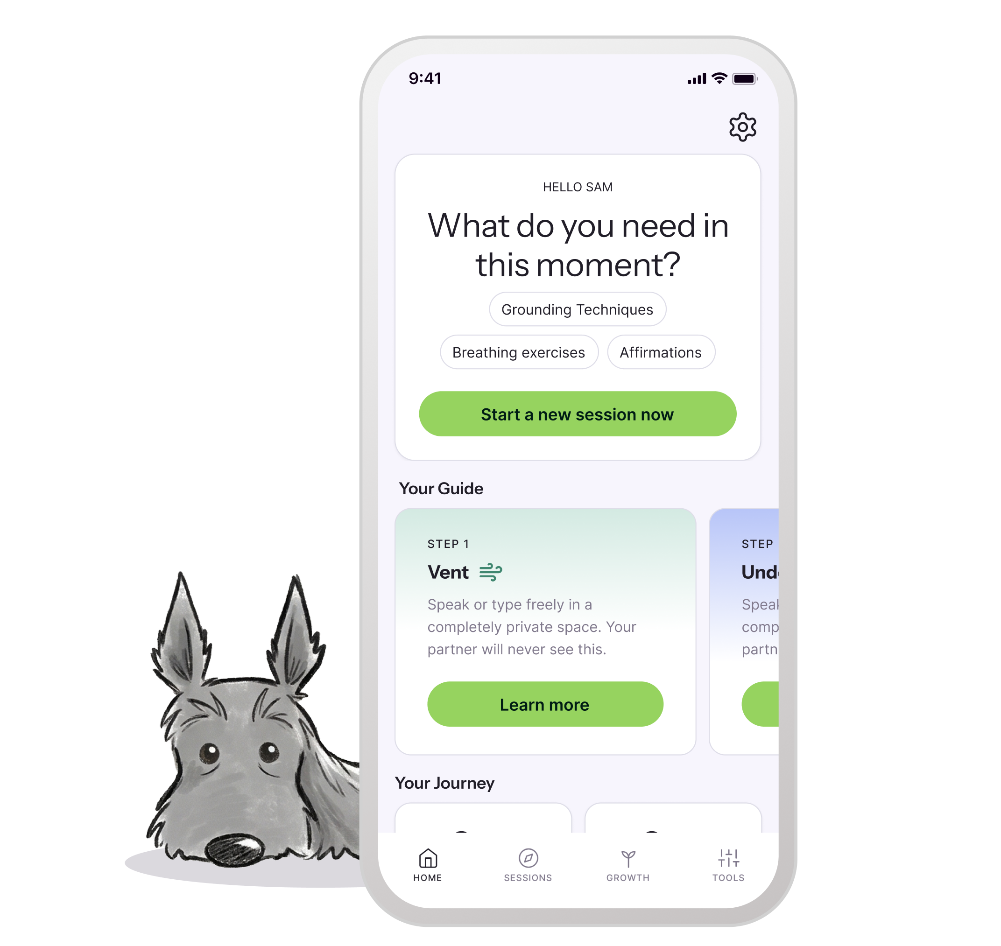
THE PRODUCT
A relationship that learns the more you share.
Short assessments map how each partner experiences love, conflict, and stress
Voice or text input. Use it solo or together
End to end private. We never train models on your data. We never sell it.
Available 24/7 on iOS, Android, and web

Slide 8
EVIDENCE BASED
Built on the same frameworks couples therapists use.
Gottman
Attachment
NVC
Love Languages
IFS
Conflict styles + sound relationship house
Anxious / avoidant / secure
Observation, feeling, need, request
How each partner gives + receives
Parts work for self understanding
Otis is not making it up. Every prompt, every reframe, every step is grounded in peer reviewed couples research.

Slide 9
THE MARKET
A massive, underserved category.
$1.2T
TAM
Global wellness market (Global Wellness Institute, 2024)
$58B
SAM
Mental health + relationship wellness, growing 17% YoY
$4B
SOM (Year 5)
English speaking couples 25 to 55 willing to pay for ongoing support
47M couples in the US alone are in long term relationships and not in therapy. We're not stealing share from BetterHelp. We're creating a new category.

Slide 10
BUSINESS MODEL
Subscription. Aligned with the long term work of a relationship.
FREE
HEY OTIS PLUS
COUPLES
$0
$14.99/mo
$22/mo
Daily check ins, one guided repair per month, basic insights
Unlimited repairs, partner sync, full assessment library
Both partners synced, shared history, deeper insight
Therapy is $200 a session. Hey Otis is less than two coffees a week, available the moment you need it.

Slide 11
TRACTION
Where we are today.
[X]
[X]
78%
WAITLIST SIGNUPS
SURVEY RESPONSES
SAID THEY'D TRY IT
from heyotis.app + organic Reddit + IG
primary research from real couples
from in-survey product validation
Beta launching Q3 2026 in EN speaking markets. Apple + Google submission ready. Brand identity, marketing site, and waitlist infrastructure all live.

Slide 12
TEAM
Built by people who've lived this.
Samantha Ahhee
[Add advisor name]
[Add advisor name]
FOUNDER + CEO
CLINICAL ADVISOR
TECHNICAL ADVISOR
Designer + builder. Previously [your prior role]. Built Hey Otis after experiencing first hand what was missing between therapy and the everyday.
Licensed couples therapist. Validates the frameworks, the prompts, the safety guardrails.
ML / AI background. Helps shape the model layer + private architecture.

Slide 13
THE ASK
Raising [€XXX]K pre seed
To launch publicly, hit 10,000 paying users in 18 months, and prove that couples will pay to learn how to repair.
samantha.ahhee@gmail.com
heyotis.app

