Slide 1
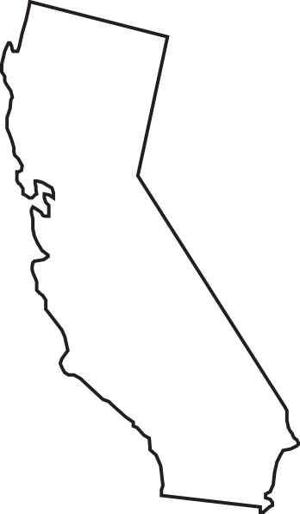
Sampling Event 1 Sampling Event 2 Sampling Event 3
(when migratory group returned) (after 1 month exposure)
STATIONARY YARD
STATIONARY YARD
STATIONARY YARD
Isolated
Stationary
Group
Migratory Group
Isolated
Stationary
Group
Isolated
Stationary
Group
~4,300 km
Exposed
Group
~4,300 km
~ 24 km
EXPOSED YARD
EXPOSED YARD
EXPOSED YARD
Migratory
Group
Exposed
Group
Migratory
Group
Exposed
Group

Slide 2
Experimental Design for Migratory/Stationary Honey Bee Experiment
= Sampled
= Not Sampled
Sampling Event 1 Sampling Event 2 Sampling Event 3
(when migratory group returned) (after 1 month exposure)
MIGRATORY HOLDING YARD
MIGRATORY HOLDING YARD
MIGRATORY HOLDING YARD
Migratory Group transported to CA and returned to NC. Exposed Group transferred to Exposed Yard
Migratory Group
Migratory Group transferred to Exposed Yard
STATIONARY YARD
Isolated
Stationary
Group
Migratory Group
STATIONARY YARD
STATIONARY YARD
Isolated
Stationary
Group
Isolated
Stationary
Group
Exposed
Group
EXPOSED YARD
EXPOSED YARD
EXPOSED YARD
Exposed
Group
Exposed
Group
Migratory
Group

Slide 3
Schematic showing experimental design. Three sampling events occurred during the experiment. Green boxes represent each group of 16 hives sampled during the specified sampling event. Slashed red boxes represent each group of 16 hives not sampled during that sampling event. Three experimental groups (Isolated Stationary Group, Migratory Group, and Exposed Group) are spread across three separate yards throughout the experiment: The Stationary Yard (where all groups begin and the Isolated Stationary Group remains for the duration of the experiment), the Migratory Holding Yard (where the Migratory Group is temporarily brought upon return from CA for sampling event 2), and the Exposed Yard (where the Exposed Group is exposed to the Migratory Group). Arrows represent tasks that occurred between each sampling event.

Slide 4
Experimental Design for Migratory/Stationary Honey Bee Experiment
= Sample
= Do Not Sample
Sampling Event 1 Sampling Event 2 Sampling Event 3
(when migratory group returns) (after 1 month exposure)
MIGRATORY HOLDING YARD
MIGRATORY HOLDING YARD
MIGRATORY HOLDING YARD
Send Migratory Group to Almonds and Return to NC. Move Exposed Group to Exposed Yard
Migratory Group
Move Migratory Group to Exposed Yard
STATIONARY YARD
Stationary
Group
(Control)
Migratory Group
STATIONARY YARD
STATIONARY YARD
Stationary
Group
(Control)
Stationary
Group
(Control)
Exposed
Group
EXPOSED YARD
EXPOSED YARD
EXPOSED YARD
Exposed
Group
Exposed
Group
Migratory
Group

Slide 5
Schematic showing experimental design. Three sampling events occur during the experiment. Green boxes represent each group of 16 hives sampled during the specified sampling event. Slashed red boxes represent each group of 16 hives not sampled during that sampling event. Three experimental groups (Stationary Group [control], Migratory Group, and Exposed Group) are spread across three separate yards throughout the experiment: The Stationary Yard (where all groups begin and the Stationary Group remains for the duration of the experiment), the Migratory Holding Yard (where the Migratory Group is temporarily brought upon return from CA for sampling event 2), and the Exposed Yard (where the Exposed Group is exposed to the Migratory Group). Arrows represent beekeeper tasks that occur between each sampling event.

