Slide 1
Battle of the neighborhoods
Coursera Capstone Project
March 30, 2019

Slide 2
introduction
"Would you recommend a location in Hong Kong to open a new cinema?"
My boss, the stakeholder wants to open a new cinema as company's new business.
He explains that watching movie is a part of whole afternoon or night activities. Cinema should has many restaurants and shopping places nearby. Transportation is also an important factor. Customer can walk to cinema within 5 minutes from public transport facilities is perfect.
He wants me concentrated on selection of cinema location according to its nearby environment. Cinema facility and rental price is not my concern. He lists out his top 10 favorite cinemas in Hong Kong with rating.
I work with my teammates and select 5 possible locations to build the cinema. Which location should be suggested to the stakeholder?

Slide 3
Data SOURCES
1. Geographic coordinate of Hong Kong cinemas: I need to compare 5 possible locations with current cinemas in Hong Kong. Therefore, I need to find a list of Hong Kong cinema and cinemas' geographic coordinates. Luckily, I can find the list and coordinates from the website https://hkmovie6.com/cinema .
2. Geographic coordinates of 5 possible cinema addresses: Geographic coordinates of 5 possible cinemas are required and I can use Google Map API to find this information
3. Favorite cinema list of stakeholder: The favorite cinema list of stakeholder is an important information that I can use it as profile to select the best location.
4. Eating, Shopping and Public transportation facility around cinema: The recommended cinema location needs to have many eating and shopping venues nearby. Convenient public transport is also required. These data can be found by using FourSquare API to find these venues around the location. The radius of exploration distance is set to 500 meters, which is about 5 minutes walking distance.

Slide 4
Exploratory data analysis
The majority of our exploratory data analysis focused on using longitude and latitude information to make maps and other visuals in order to better understand where landmarks and other points of interests were located
We utilized choropleth maps, dot maps, and content tables

Slide 5
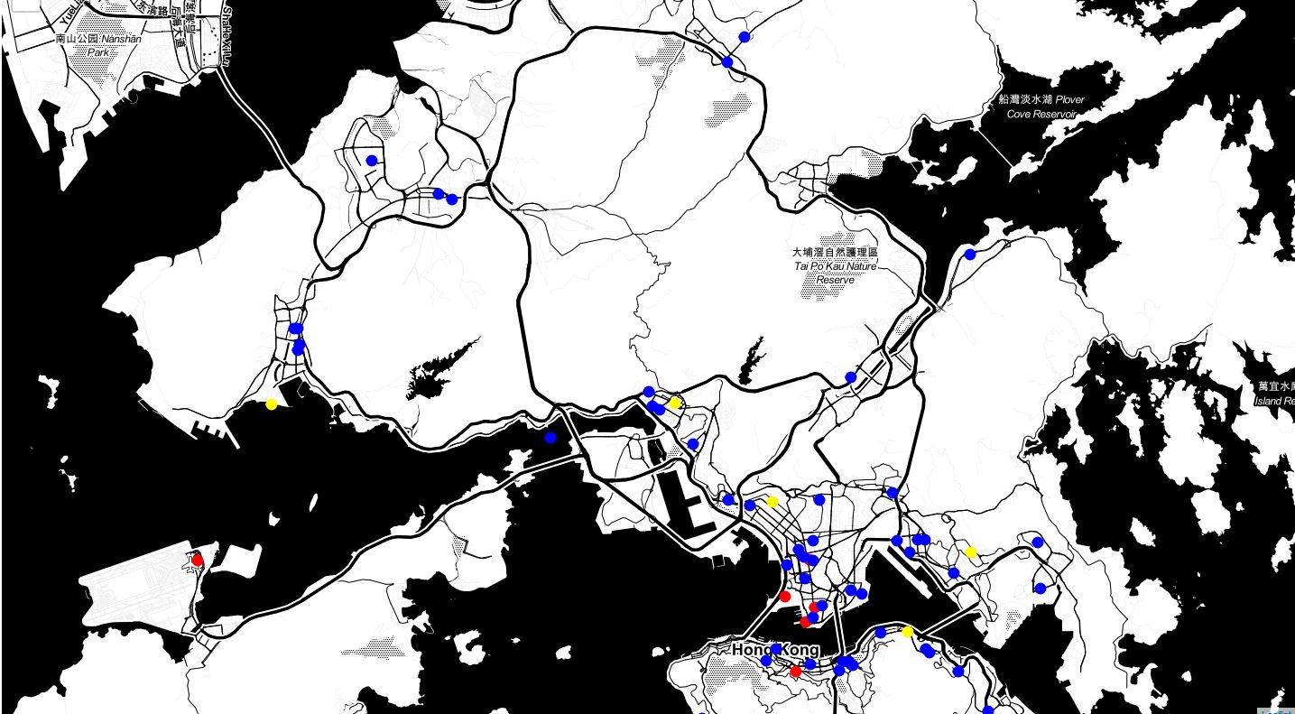
CINEMA MAP
Combine with FourSquare API which provides how many venues in different category of Hong Kong cinemas, a matrix which captured characteristic of venues nearby cinema are built. Stakeholder's favorite list is the profile to combine with the matrix to become a weighted matrix of favorite cinema.

Slide 6
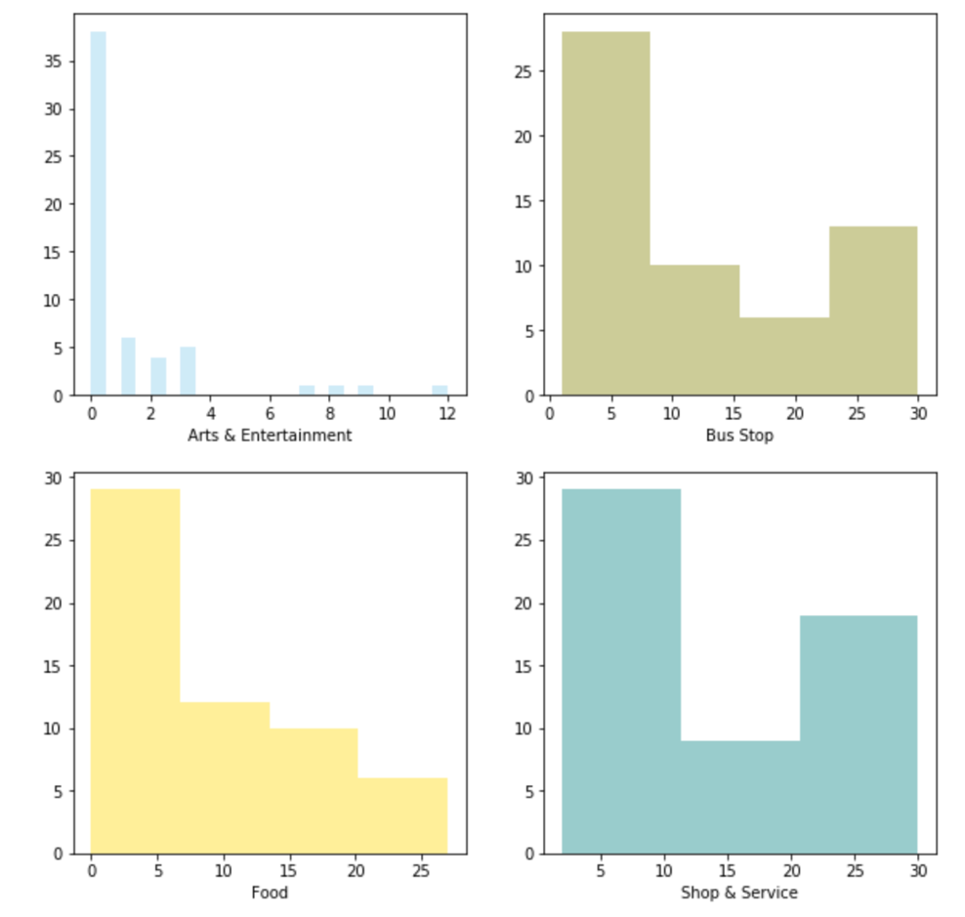
DISTRIBUTION OF VARIABLES
Now I can use the FourSquare API to explore nearby venues of Hong Kong cinemas: Cinema really has many 'Bus Stop', 'Food', 'Shop & Service' venues around. However, it is unusual that a cinema has 4 metro stations nearby (within 500 meters). One cinema contains 4 Metro Station around.

Slide 7
PEARSON CORRELATION
It seems that 'Bus Stop', 'Shop & Service' and 'Food' category are highly correlated.
The correlation between 'Bus Stop', 'Food', 'Metro Station' and 'Shop & Service' are statistically significant, and the coefficient of > 0.5 shows that the relationship is positive. Most of Hong Kong cinemas (blue circle) and stakeholder's favorite cinemas (red circle) location are built near main road, and centralized in urban area of Hong Kong. The target locations (yellow circle) of new cinema are not near to main road.

Slide 8
RESULTS
With the boss's profile and the complete list of cinemas and their venues count in hand, I am going to take the weighted average of every lcoation based on the profile and recommend the top location that most satisfy it.
The result is reasonable. Location "L5" has the most number of venues in category "Bus Stop", "Food", "Metro Station" and "Shop & Service".
Location "L5" should be recommeded to the stakeholder.

Slide 9
DISCUSSION / CONCLUSION
Number of venues of 5 target locations are actually below the average. I should contact local commercial property agents to find more suitable locations. Moreover, FourSquare is not popular in Hong Kong, the data maybe out-dated or unreliable, the report should gather more data from other location data source such as Google Place API.
The stakeholder's problem is resolved. Stakeholder wants to find the best place to build a new cinema in Hong Kong, and the factors of "best location" is based on the number of venues in eating, shopping, transportation category around the location. Stakeholder also provide his favorite list of cinema to further explain what the "best location" is. Content-based filtering machine learning technique is the most suitable method to resolve the problem. It combines stakeholder's preference and cinema profile to make the recommendation result.
The 5 target locations of new cinema may not be a good choices. As the weighting matrix is developed, I can quickly pick other locations and make the recommendation again.

