Slide 1

sim.glmm - Simulating Power for Generalized Linear Mixed Models
Sam Edds
Biostat 619

Slide 2
sim.glmm in R
Simulate power and sample size for Generalized Linear Mixed Models (GLMM)
Simulation approach helps account for:
Random Effects
Overdispersion
Linear and non-linear response distributions

Slide 3
When to use a GLMM?
Data are not…
linear
independent
homoscedastic
Data…
can be stratified by a large number of small blocks
have repeated and/or nested measures
Purpose...
Want to model fixed and random effects
Outcome of interest is change on the individual level
Notes:
GLMMs are typically used in Biostatistics because they allow one to understand how data are associated on the individual level- for the average individual, instead of the average member of the population (more often seen with Generalized Estimating Equation (GEE)). This is particularly useful in the context of personalized medicine. Additionally, because populations vary, there is typically some amount of heterogeneity to measure, for which GLMMs are well equipped.
Generalized Linear Mixed Models are typically used when there is heterogeneity in data, data are not independent, and the user is interested in individual level outcomes. GLMM can use data that are Gaussian, and also non-linear. GLMM include random effects, which account for heterogeneity in our data, but are never seen in the model, except through the variance term. This term denotes the amount of additional variance explained by the random effect grouping (previously unmeasured). Models can have random intercepts, or random slopes and intercepts. Exploratory analysis can help determine which better describes the data- does just the starting point vary and the slopes remain constant, or do slopes vary between subject as well? If the latter, a random slopes and intercept model is used. GLMM’s also include fixed effects (and allow for interaction terms), hence mixed models.

Slide 4
Examples for Clinical Trials
Evaluate the effectiveness of anticonvulsant medication: Simulate power for a study on the change in average treatment effect for repeated measures
Evaluate the difference between an inhaled drug given twice daily via an inhaler versus non-inhaled in patients with chronic obstructive pulmonary disease: Simulate power given some detectable effect size
Response-adaptive (binary) designs in multi-center clinical trials for premature birth medication: Simulate power based on expected outcomes

Slide 5
Advantages of sim.glmm
Accounts for random effects and overdispersion on power and precision estimates
More accurate sample sizes (typically higher) to obtain desired power
Utilizes output from well-known packages such as lme4

Slide 6
Example: Determining treatment effectiveness in a multi-clinic anticonvulsant clinical trial
Medical researchers want to test whether a new anticonvulsant drug can reduce a patient’s rate of epileptic seizures (compared to a placebo)
They are interested in the power required to see an effect size of 15% based on a known sample size
In order to do so, they use information from a previous randomized controlled trial that one of the researchers worked on, which is known to have similar types of patients and design
Notes:
Data from IBM. These data are not in any paper that I could find and appear to be simulated.

Slide 7
Data
Outcome of interest: Number of epileptic seizures experienced
Number of patients in the trial: 565 (275 control, 290 treatment)
Number of weeks followed: 1 week baseline, 5 weeks after treatment (drug or placebo)
Notes:
Data from IBM. These data are not in any paper that I could find and appear to be simulated.

Slide 8
Main Variables
Convulsions : Number of seizures experienced by a patient
After_t : Whether or not treatment has begun (factor variable)
0 - Baseline Week
1 - Weeks 1-5
Treatment : Experimental group (factor variable)
0 - Control group
1 - Treatment group
Notes:
Variables also include: Clinic ID, Attending Physician ID, Gender, Date of Birth, and Clinic Size. These are not directly used in the analysis. An additional note: because we create after_t as a binary variable, we assume the medication is not additive.

Slide 9
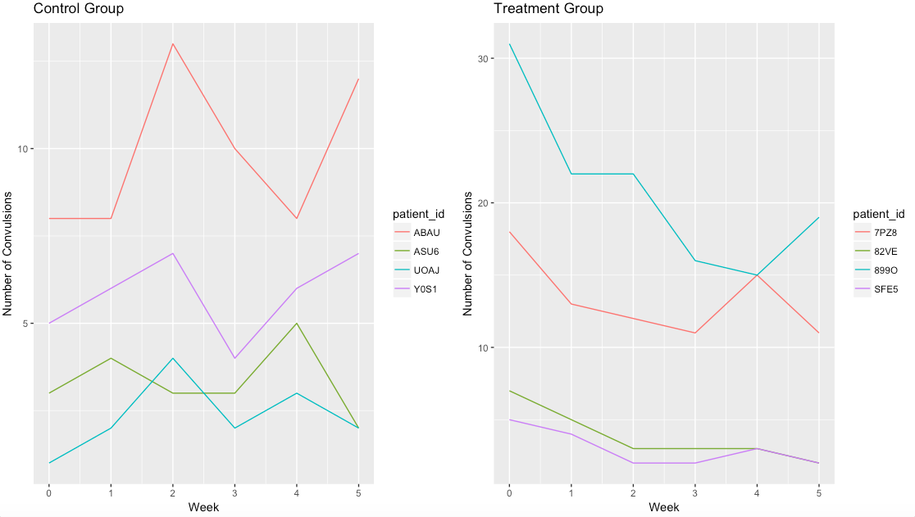
Exploratory Analysis
Treatment Begins
Different slopes
Different Intercepts
Notes:
We see that patients have differing baseline number of seizures and their number of seizures over time varies from patient-to-patient as well. This led us to choose a model with random intercepts and random slopes for after_t grouped by patient.

Slide 10

GLMM with Poisson link function

Slide 11
Our Example in Code
Packages Needed
Pre-processing Steps
sim.glmm Power Analysis
Interpretation of Output
Potential Modifications
Key takeaways

Slide 12
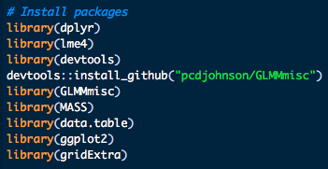
Packages Needed
GLMMmisc contains sim.glmm
Resources for lme4 (required for initial glmm modeling)
lme4 in R
Resources for sim.glmm
sim.glmm Documentation on Github

Slide 13
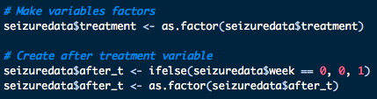
Pre-Processing Steps
Treatment must be a factor
Create post-treatment indicator
Post treatment indicator variable need to be a factor

Slide 14
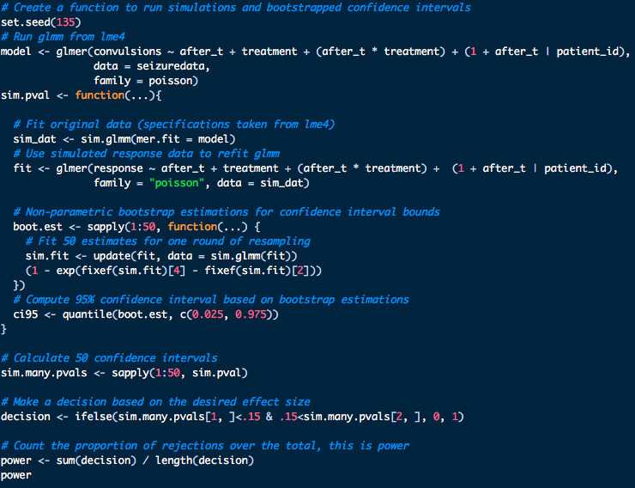
sim.glmm: Function To Simulate Power
Run GLMM in lme4
Simulate Many Estimates
Bootstrap Confidence Intervals
Make Decision: Reject or Fail to Reject H0
Calculate Power
Notes:
100 feet above roadmap; details to follow

Slide 15

Run GLMM in lme4
Fixed Effects
Interaction Term
Random Intercept and Slope Effects
Specify Distribution
Response Variable

Slide 16
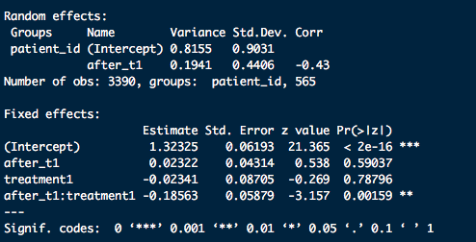
Initial Output (one run):
Expected Counts: All interpretations are based on an individual person’s random effects
3.74, expected seizure count in the control group, pre-treatment
Amount of remaining variation in expected seizure count explained by after_t for patients
Patients in the control group are expected to have 1.023 times as many seizure compared to pre-treatment (2.35% increase in expected seizure counts)(e^.02322)
Patients in the treatment group are expected to have .821 times the number of seizures as the control group (16.9% decrease in expected seizure counts)(1-e^-.18563)
Treatment group are expected to have .9769 times as many seizures compared to control at baseline

Slide 17

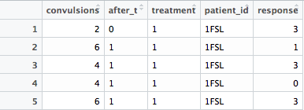
Fit GLMM On Simulated Data
sim.glmm outputs the original dataframe with a column of fitted y-values
Extracted results from glmer
Fitted y-values from sim.glmm
Notes:
Note: Just for the one-time simulation I set the seed. Above the first line set.seed(99), then to set.seed(234), which we do not do

Slide 18

Required Inputs For sim.glmm: 1 of 2
If mer.fit specifies a model from glmer/lmer leave everything else blank
Dataframe containing all data except responses (can include offset)
Random Effects must be simulated (can input a vector of variances or a list of variance-covariance matrices)
Specify a list of fixed effects. Example: list(intercept = 10, sex=c(“Male”=0, “Female”=2), age=0.5) would correspond to y ~ 10 + 2*(sex == “Female”) + 0.5*age
Notes:
See documentation online- this is very involved
sim.glmm Documentation on Github

Slide 19
Required Inputs For sim.glmm: 2 of 2
Must specify for NBD
Response values will be simulated through a named distribution from the linear predictor (sum of Fixed and Random Effects)
Must specify for Gaussian
*See documentation online for more details
sim.glmm Documentation on Github

Slide 20
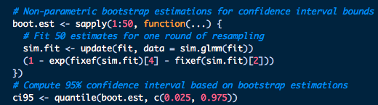
Average Treatment Effect Of Interest
Our average treatment effect is defined as the coefficient for
(after_t * treatment) - the coefficient for after_t. This accounts for any natural changes or improvements in the control group due to potential changes in standard of care, or otherwise. Taking 1 minus this gives us the percentage decrease in expected epileptic seizure counts (based on each patient’s random effects).

Slide 21
Non-Parametric Bootstrap Confidence Intervals For Poisson Distributed Data
Sample with replacement from the simulated model 50 times to generate one confidence interval
Resample and fit model each iteration
1 - value(<1) to calculate the percentage decrease in expected convulsions
Coefficient for after_t
Exponentiate coefficients (Poisson link function)
Coefficient for after_t * treatment

Slide 22


Non-Parametric Bootstrap Confidence Intervals For Poisson Distributed Data
boot.est outputs 50 estimates
Compute 2.5th and 97.5th percentiles based on boot.est estimates to form a 95% confidence interval
Notes:
This is an example for one bootstrapped confidence interval. This is done for every simulation run. This takes a bit of time to run; I used flux to speed up the run time instead of doing it locally, but both work.

Slide 23
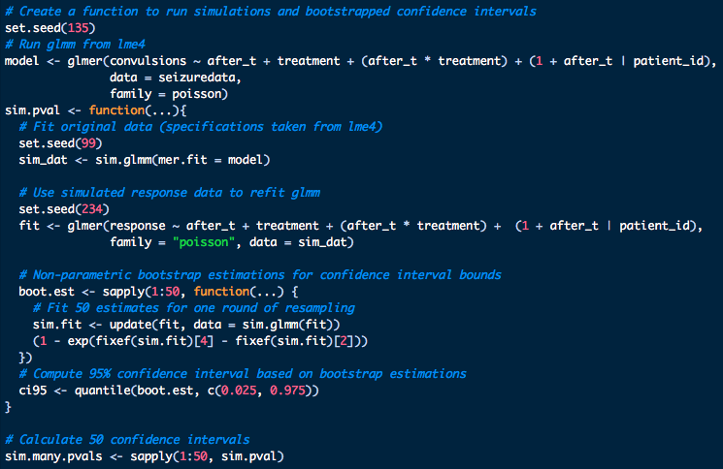
Simulate 50 Bootstrapped
Confidence Intervals
Each of the 50 confidence intervals are estimated through 50 rounds of bootstrap estimating

Slide 24
Make Decision (for each simulation):
Reject Or Fail To Reject H0
Take the output from our sim.pval function that runs all of the modeling and bootstrapping, which output a matrix of 95% confidence intervals
If desired effect size is in between the confidence interval bounds, fail to reject, otherwise, reject
Outputs a vector of 0 and 1 decisions
Delta- Note: This is based on our original dataset, and the ability to see an effect size
* If a different delta is desired and cannot be seen based on current data, the original dataset must be altered

Slide 25

Calculate Power
Count of total decisions
Count of decisions that reject H0
With a Delta of 15% we can see our simulation is 76% powered.
Notes:
As noted power can only be estimated based on the detectable effect size in the data. In our case, a delta = .10 would lead to power of 96%, a delta = .12 = 94% powered, and finally a delta = .15 = 76% powered.

Slide 26
Modifications For Rigid Code: 1 of 3
Robustness can be adjusted easily by changing the number of:
Simulations
Bootstraps per simulation
Power can only be estimated based on the detectable effect size in the data
If a different delta is desired and cannot be seen based on current data / simulations, the original dataset must be altered
Changes for sample size must also be made in the original data
Notes:
As noted power can only be estimated based on the detectable effect size in the data. In our case, a delta = .10 would lead to power of 96%, a delta = .12 = 94% powered, and finally a delta = .15 = 76% powered. However, if someone is interested in other data and detectable effective sizes the original data need to be altered. Because of this, and given the data set, I did not alter my dataset. As the data are Poisson distributed, altering the mean also alters the variance and will cause issues. This further shows the importance of thinking through modifications.

Slide 27
Modifications For Rigid Code: 2 of 3
Robustness
Changing my number of simulations to 10, and my number of bootstrap sampling also to 10 impacts the robustness of my results, and power drops to 20%
20 simulations with 10 bootstrapped estimates drops power to 15%
Lower number of simulations and less bootstrapped estimates leads to more fluctuations in power and less robust results
Ideally the number of simulations would be 100 or even 1,000+ and the number of times an estimate is bootstrapped 100 as well (this takes a lot of computing power and time)
Notes:
As noted power can only be estimated based on the detectable effect size in the data. In our case, a delta = .10 would lead to power of 96%, a delta = .12 = 94% powered, and finally a delta = .15 = 76% powered. However, if someone is interested in other data and detectable effective sizes the original data need to be altered. Because of this, and given the data set, I did not alter my dataset. As the data are Poisson distributed, altering the mean also alters the variance and will cause issues. This further shows the importance of thinking through modifications.

Slide 28
Modifications For Rigid Code: 3 of 3
Power can only be estimated based on the detectable effect size in the data
In our case, a delta = .10 would lead to power of 96%, a delta = .12 is 94% powered, and delta = .15 is 76% powered
Because the data are Poisson distributed, altering the mean also alters the variance, so I did not change my data to test power for altered datasets
Notes:
As noted power can only be estimated based on the detectable effect size in the data. In our case, a delta = .10 would lead to power of 96%, a delta = .12 = 94% powered, and finally a delta = .15 = 76% powered. However, if someone is interested in other data and detectable effective sizes the original data need to be altered. Because of this, and given the data set, I did not alter my dataset. As the data are Poisson distributed, altering the mean also alters the variance and will cause issues. This further shows the importance of thinking through modifications.

Slide 29
sim.glmm Main Takeaways
Accounts for random effects and overdispersion on power and precision estimates
Provides more accurate sample sizes (typically higher) to obtain desired power
Actual simulation can be one line of code...utilizes output from glmer/lmer
+
Code is fairly rigid...changes in delta and sample size must be done in the original dataset
Estimating confidence intervals requires a bit more code and must be coded by hand
-
Notes:
One of the only packages to run simulations for glmm! Will better account for issues of overdispersion etc on power and precision so sample sizes will be more accurate (and will often be higher).

