Slide 1
Are Amazon Prices Influenced by Reviews?
July 10, 2015

Slide 2
General Business Question
Business Proposal:
Customer reviews are becoming increasingly abundant in the online retail market. With many consumers looking at product reviews online and then deciding to complete purchases either online or in stores, it seems as though customer sentiment can have a somewhat substantial impact on demand and potential customers’ willingness to pay. With this is mind, there could be some room for retailers to optimize product pricing and/or influence demand based on some measure of customer sentiment.
Proposed Solution:
Text mining for sentiment analysis is becoming an increasingly popular method of analyzing user sentiments beyond typical product numerical score methods (1-5). One aspect of this project is to determine if text sentiment provides more or additional information than the typical numeric product ranking when explaining product price changes. Perhaps another feature of this analysis can be to identify “topics” in reviews that seem to affect score or price of the product.

Slide 3
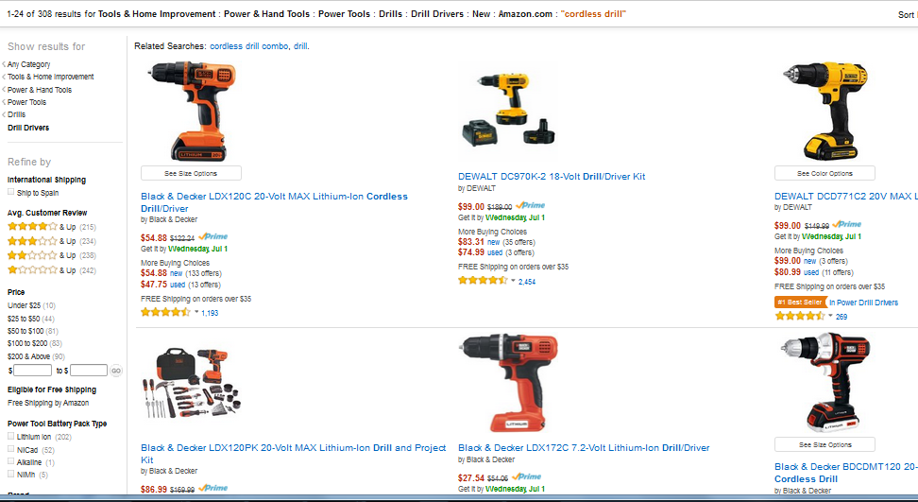
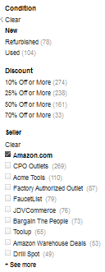
Data Collection: Identifying Target Products and Collecting Amazon Product Ids
Notes:
Scraped in the 000_data_collection.py code
<number>

Slide 4
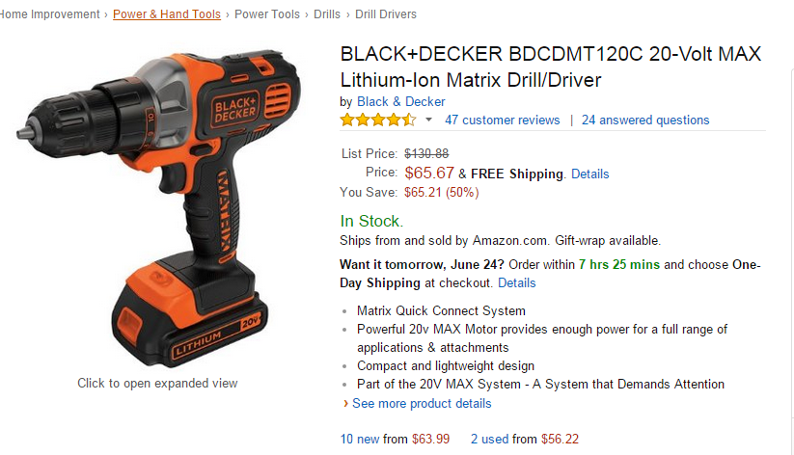
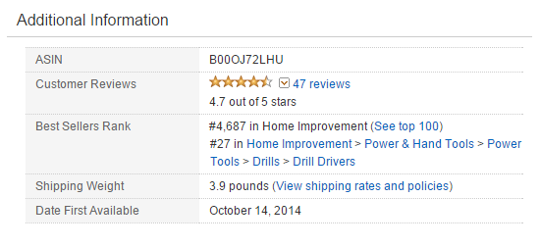
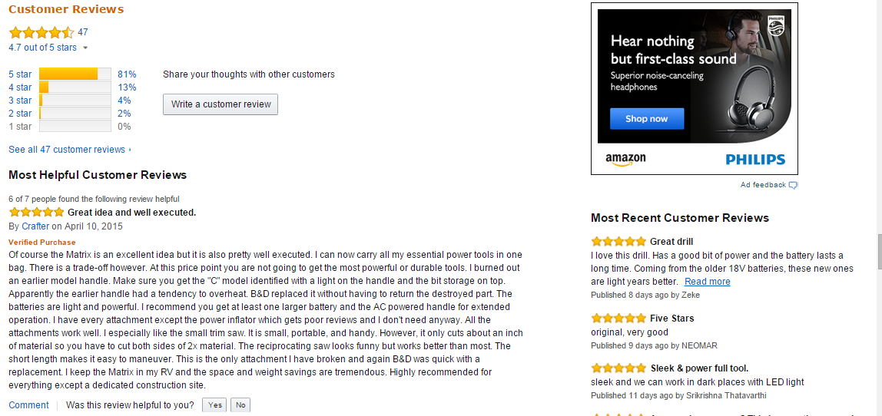
Data Collection: Collecting Amazon product information
Notes:
Prices and Ranks and Product description Scraped in the 000_data_collection.py code
<number>

Slide 5
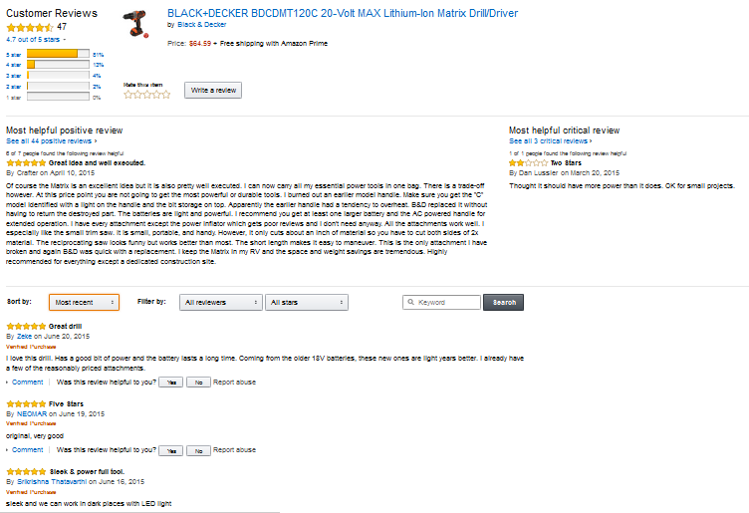
Data Collection: Collecting Amazon review information

Slide 6

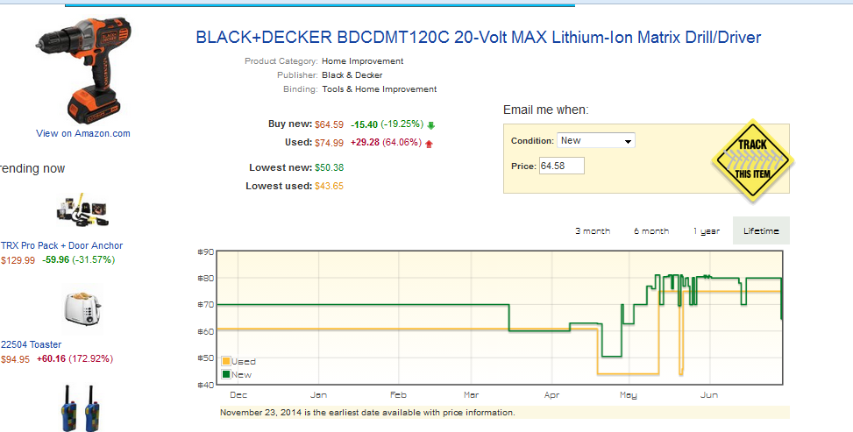
Data Collection: Collecting Amazon historical price information
Notes:
Use tracktor_amazon_prices.ipynb or .py to gather prices from tracktor after doing 001_data_collection to get products with more than 20 reviews
<number>

Slide 7
ETL Process
Identified 111 products (all with over 20 reviews each) that had price information available on Traktor.com
All scraped data was stored in .json file and loaded into MongoDB (a document-oriented database)

Slide 8
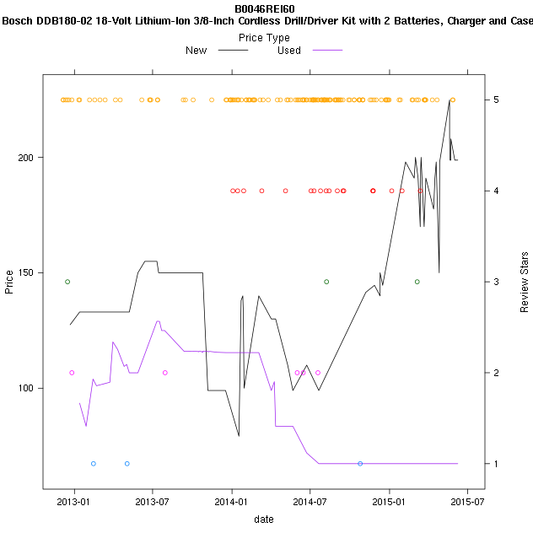
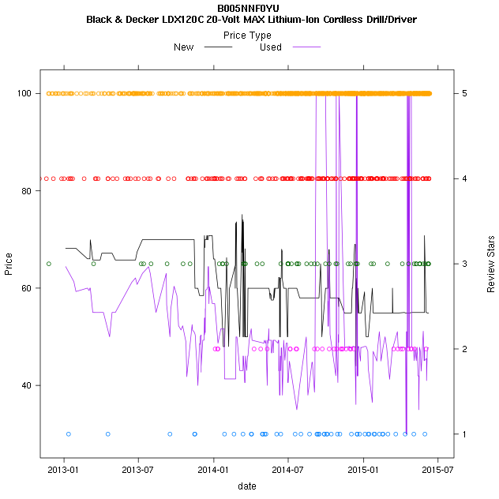
Price Changes and Review Scores Over Time
Notes:
Charts created by exploratory_analysis_prices_reviews.Rmd
<number>

Slide 9
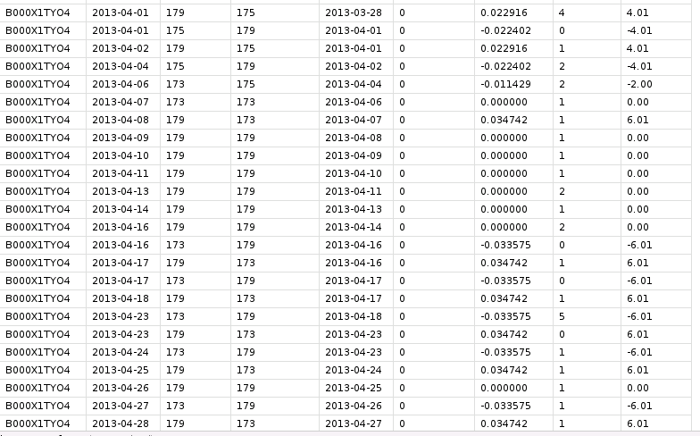
Data Analysis: Prices
Created business rules to smooth prices over time
Flash Sales
If price change was exact opposite value of previous period’s price change (up to 3 days), then both price changes were excluded
More than one price capture in a day
The largest price change in a day was considered the price change for that day
Notes:
Data collapse created in data_processing_prices_reviews.R (image from head(prices) )
<number>

Slide 10
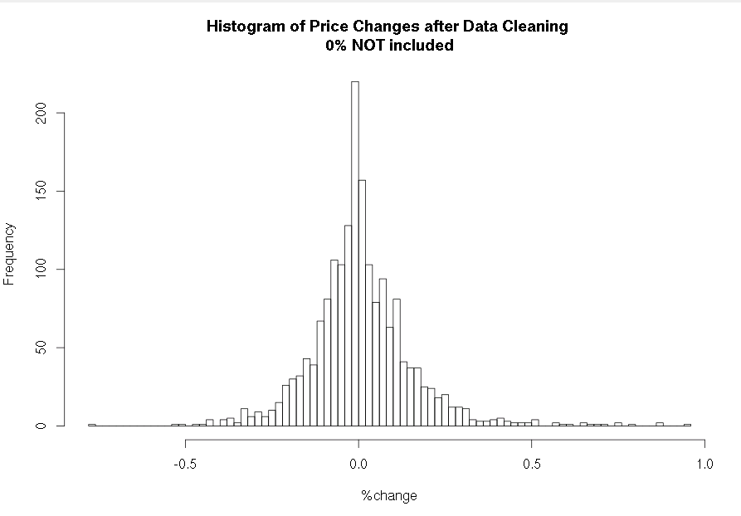
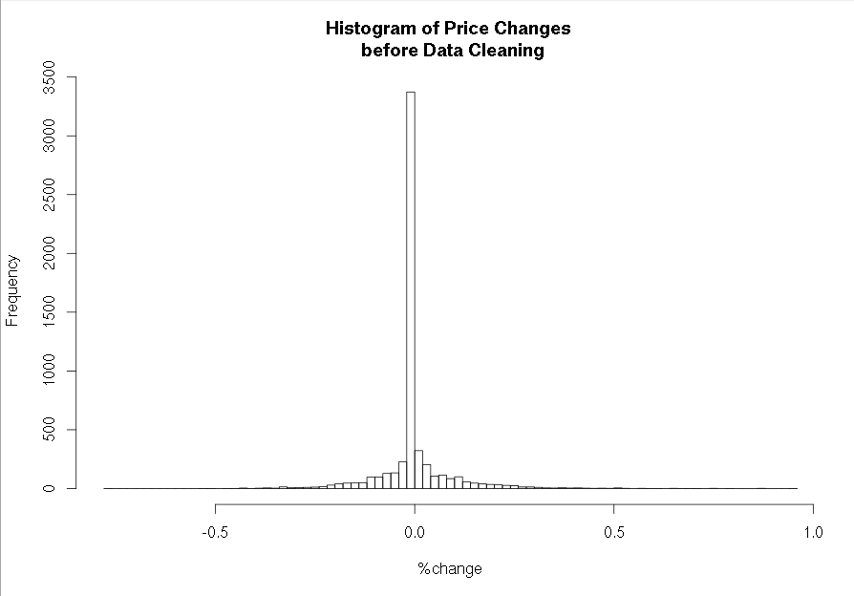
Data Analysis : Prices

Slide 11
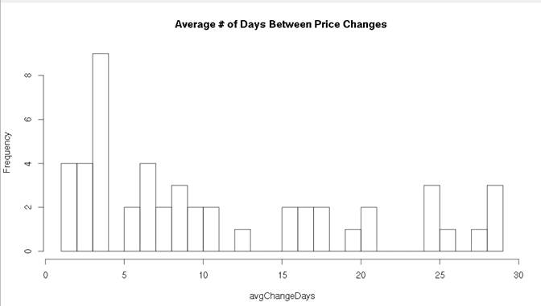
Data Analysis : Prices
Tracktor.com’s frequency of price captures vary by product
Notes:
Created from exploratory_analysis_prices.Rmd
<number>

Slide 12
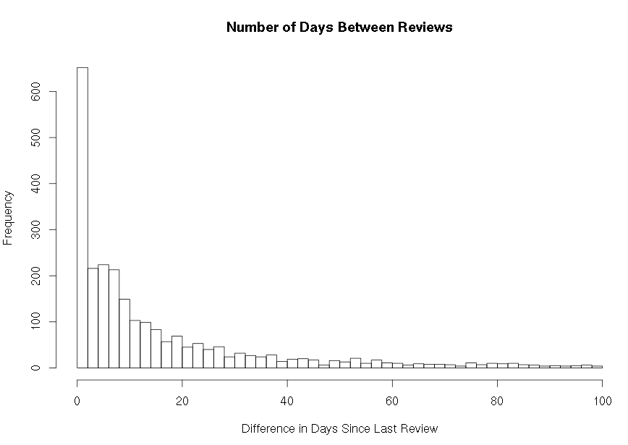
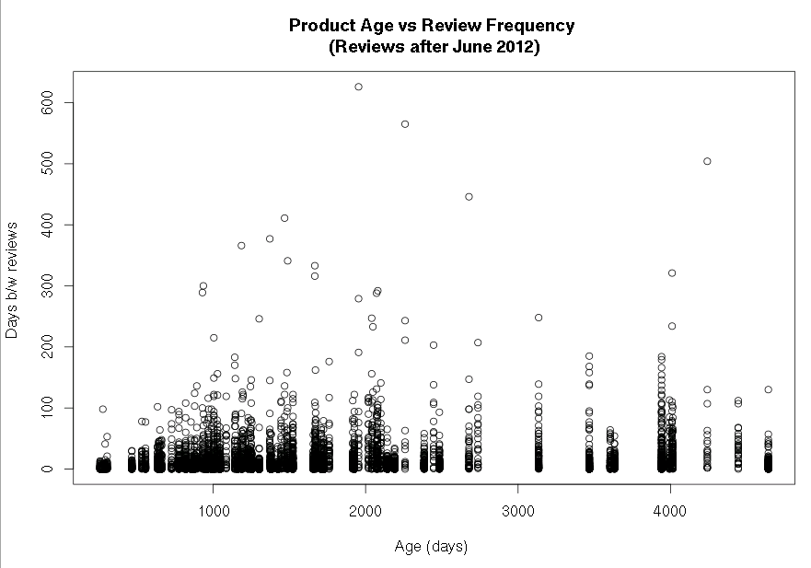
Data Analysis
The literature suggests that new review information has a larger impact on demand for products with few reviews or new reviews
Here we see that the time period between most reviews is pretty low and that the time in between reviews is slightly increasing with product age (as expected)
Notes:
Created in data_processing_prices_reviews.R code
<number>

Slide 13
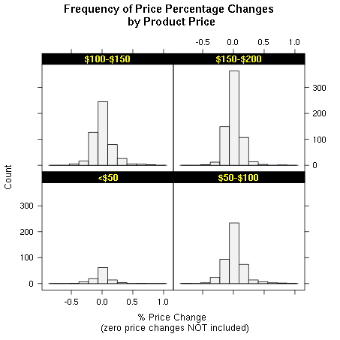
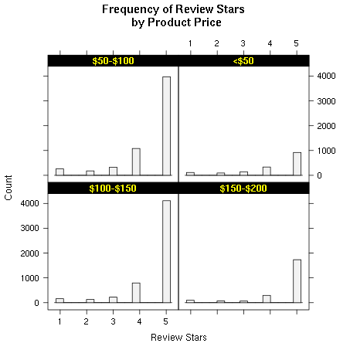
Data Analysis
Price Changes seem to be similarly distributed across product price groups
Most reviews are positive across price categories
Price Group | Product Count | Price Change Count | Review Count
<$50 | 14 | 225 | 5,420
$50-$100 | 43 | 831 | 2,261
$100-$150 | 31 | 901 | 5,822
$150-$250 | 22 | 874 | 1,607
Notes:
Created in data_processing_prices_reviews.R code
<number>

Slide 14
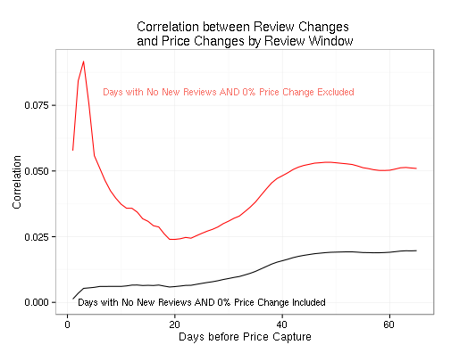
Correlation between Price % Change and Review Score Changes by Review Window Period (days)
The chart shows the correlation between the % price change and the change in star rankings (rankings from 1-5) over different time windows.
The first and last date of available prices by product were used to construct a template of daily prices (along with new price changes from tracktor) and then reviews were matched to these dates.
The daily price (either from tracktor or from the day before if that date’s price is not on tracktor) and the price from the beginning of the window (subtract the number of days in the window (1-65) from date) are identified and used calculate the % change in price.
Review scores are calculated by matching the same dates as the price dates and then computing the difference between the new cumulative review score and the old cumulative review scores.
The red line excludes any days where the price did NOT change in the window period AND there were no new reviews in the window period. The black line includes these days in the correlation calculation.
Notes:
Created in data_processing_prices_reviews.R code
Created in data_processing_prices_reviews.R code
Created in data_processing_prices_reviews.R code
<number>

Slide 15
Sentiment Analysis
Sentiment dictionary: AFINN-111
2477 words and phrases scored on a scale [-5,5]
“SMART” stopwords list from R’s tm package
Simple (and flawed) linear regression gives R² ~0.125
Try to regress review stars on some measure of text sentiment at the individual review level

Slide 16
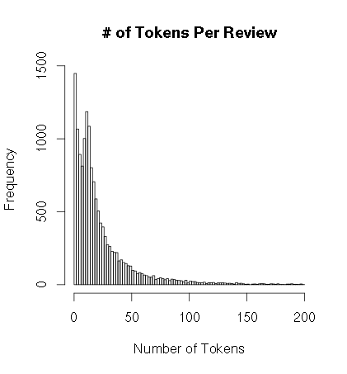
Text Analysis - Tokenization
Stop words
Python’s NLTK package
Product specific stop words:
Drill, tool, amazon
Stop words added into token list:
Not, don, again, very only
Porter Stemming to stem tokens
14,257 reviews in the corpus with
at least one word/ token in review body
9,079 total tokens in the corpus
75% of reviews had fewer than 30 tokens

Slide 17
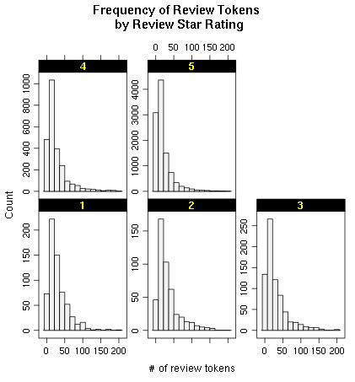
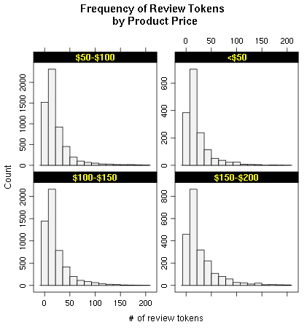
Distribution of Review Tokens

Slide 18
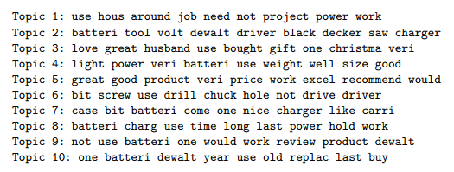
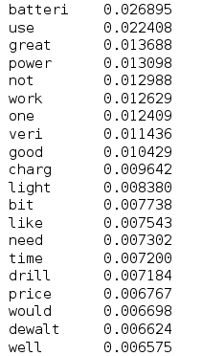
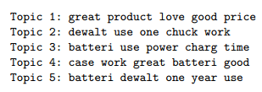
LDA for Product Feature Extraction?
Top 20 Words in Corpus

Slide 19
Steps for Replicating this Project Across Larger Segments
Collecting Pricing Data:
Amazon
Collect price and sales rank information daily for 30-60 days from Amazon
Run the 000_data_collection._meta py (or ipynb) daily (or more frequently if desired, but need to change filename to include hours)
Output file with prices is:
“/media/jupiter/hadoopuser/amazon/data”+category_name + "_final_“+time.strftime("%Y%m%d") + ".json"
Tracktor.com
Run the tracktor_amazon_prices.ipynb or .py files
Output file:
“/media/jupiter/hadoopuser/amazon/data”+ category_name +”prices.json”
Both files methods produce .json files which are easy to upload to mongodb

Slide 20
Collect Reviews
Collect reviews at a less frequent period
Ideally at the end of price gathering collection period
Use the 001_data_collection_get_reviews .ipynb or .py files
Personally prefer the ipython notebook for this because the process sometimes halts and it’s easier to troubleshoot with the segment I commented out (troubleshooting is only included in this file, not the .py script)
Final output file is:
“/media/jupiter/hadoopuser/amazon/data”+category_name+"_reviews_" + time.strftime("%Y%m%d") + ".json", "w")
Upload this .json file to mongoDB

Slide 21
Data Manipulation
Collect reviews at a less frequent period
Ideally at the end of price gathering collection period
Use the 001_data_collection_get_reviews .ipynb or .py files
Personally prefer the ipython notebook for this because the process sometimes halts and it’s easier to troubleshoot with the segment I commented out (troubleshooting is only included in this file, not the .py script)
Final output file is:
“/media/jupiter/hadoopuser/amazon/data”+category_name+"_reviews_" + time.strftime("%Y%m%d") + ".json", "w")

Slide 22
Supporting Material
Supporting exploratory analysis

