Slide 1
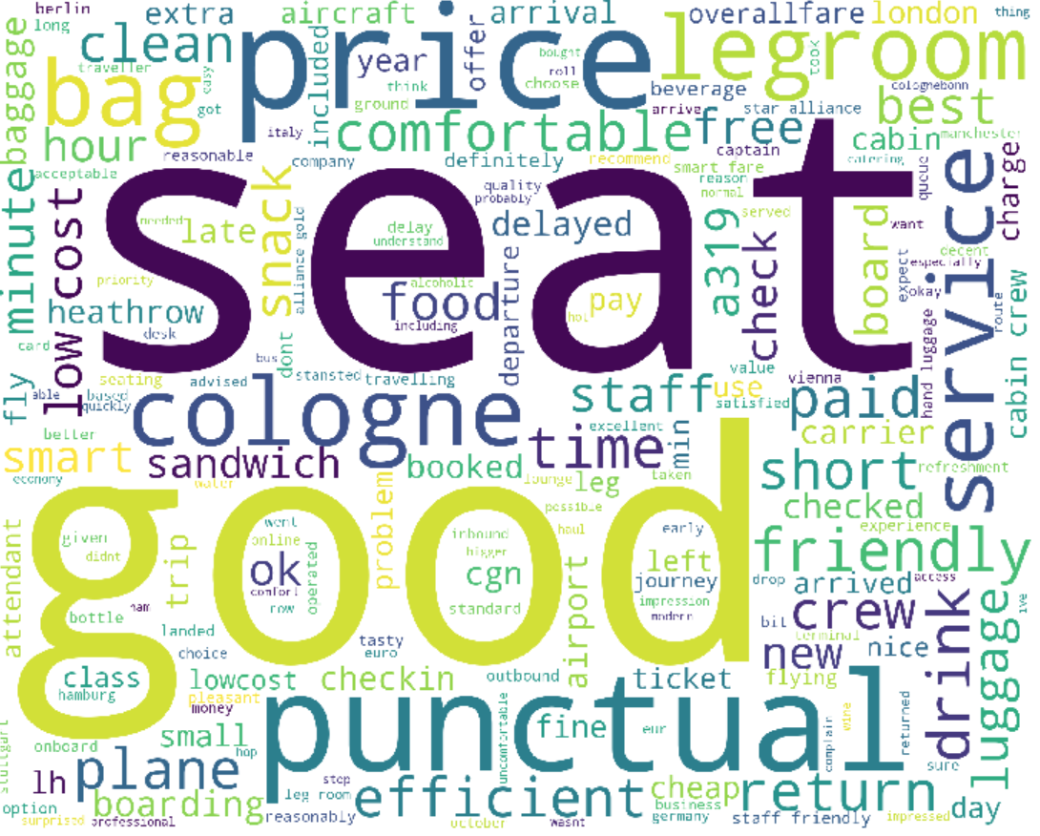
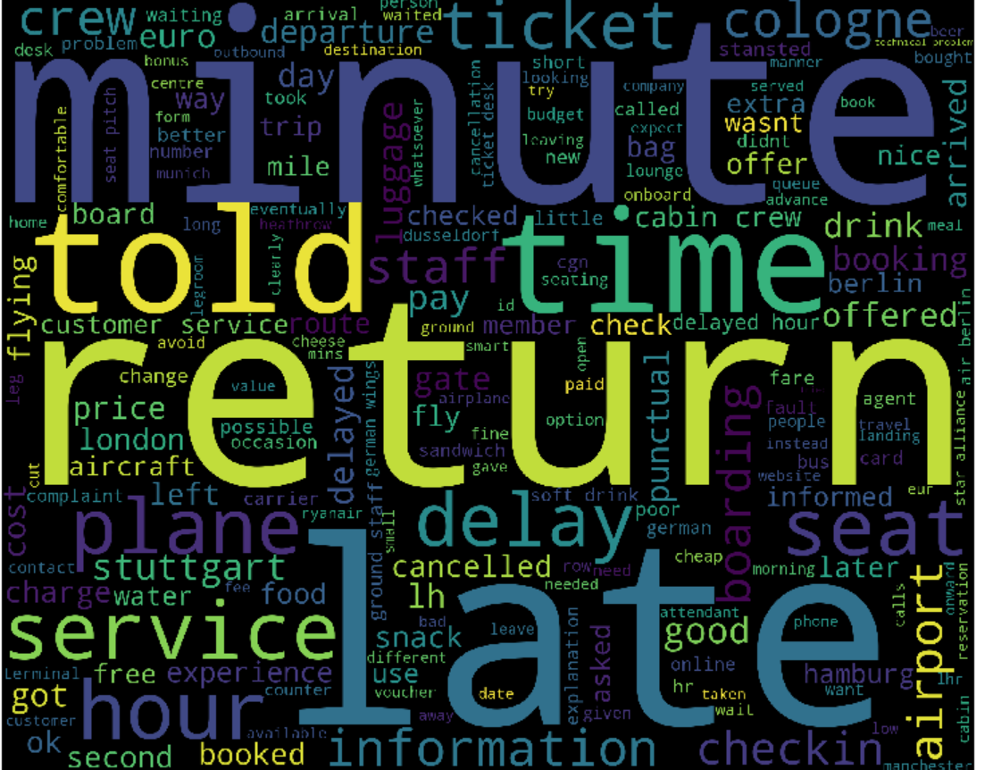
Germanwings
Analyzing Customer Satisfaction from Customer Reviews
February 15, 2019 Samantha Dalton

Slide 2
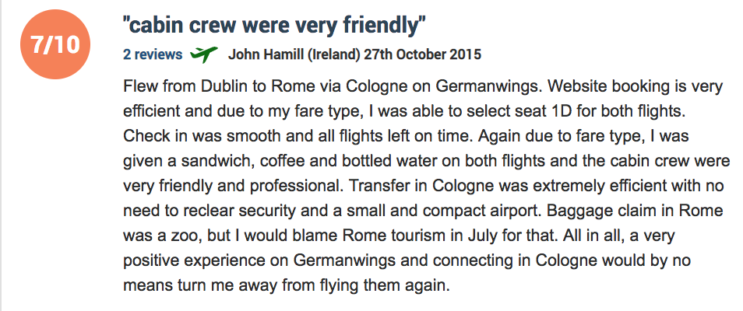
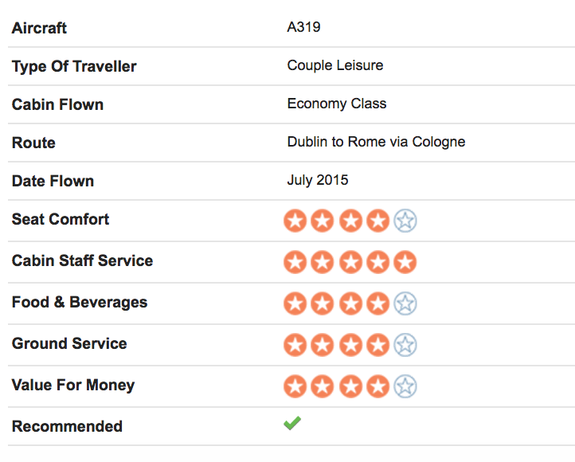
Overview of Customer Review Data Structure
Mandatory Fields
Review Date
Optional Fields
Cabin Flown
Type of Traveler
Optional Numeric Score Fields
(No values reported)
Cabin Staff Service
Recommended
Review Text
Reviewer Country
Food & Beverages
Ground Service
Inflight Entertainment
Seat Comfort
Value For Money
Wifi & Connectivity
Route Flown
Date Flown
Aircraft
Review Score (after 2008)

Slide 3
High Level Overview of Customer Review Scores
127 customer reviews

Slide 4
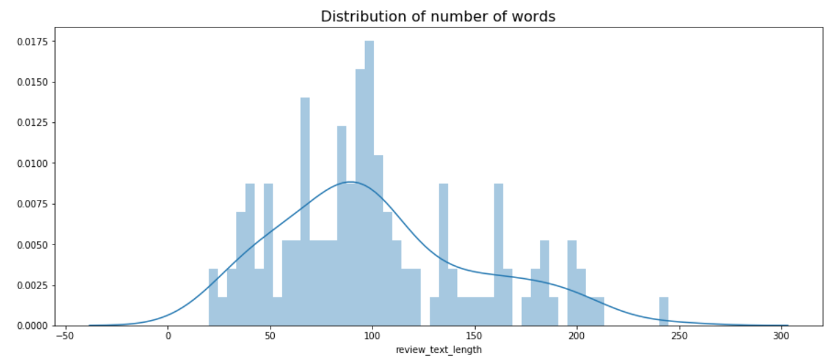
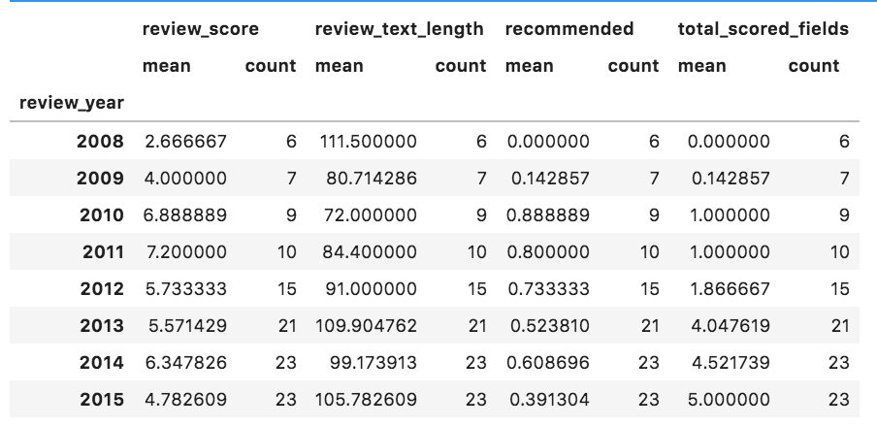
Analysis of Customer Reviews
Correlations

Slide 5
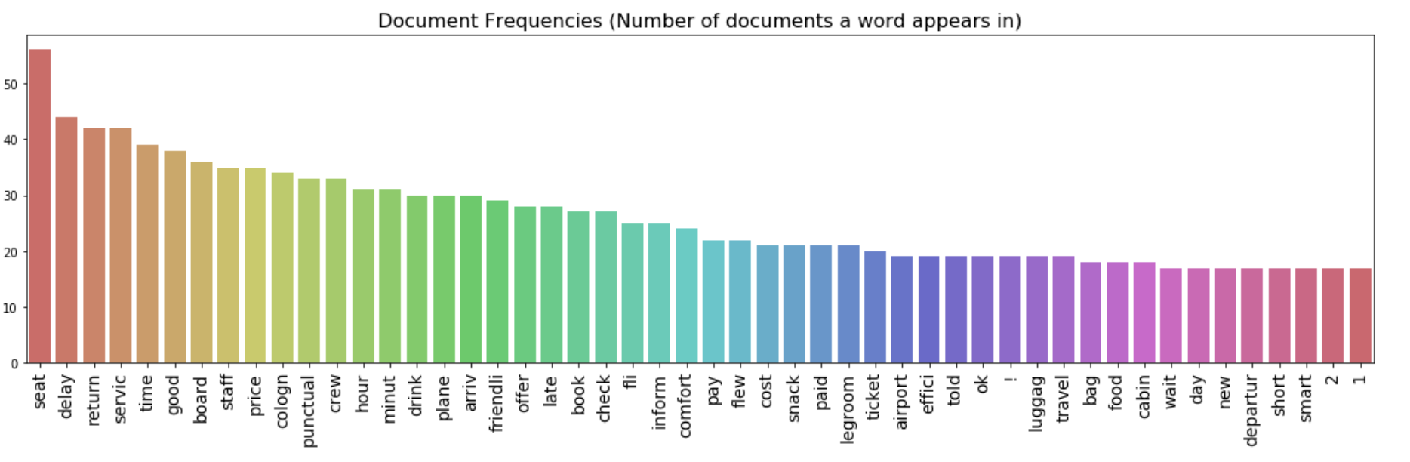
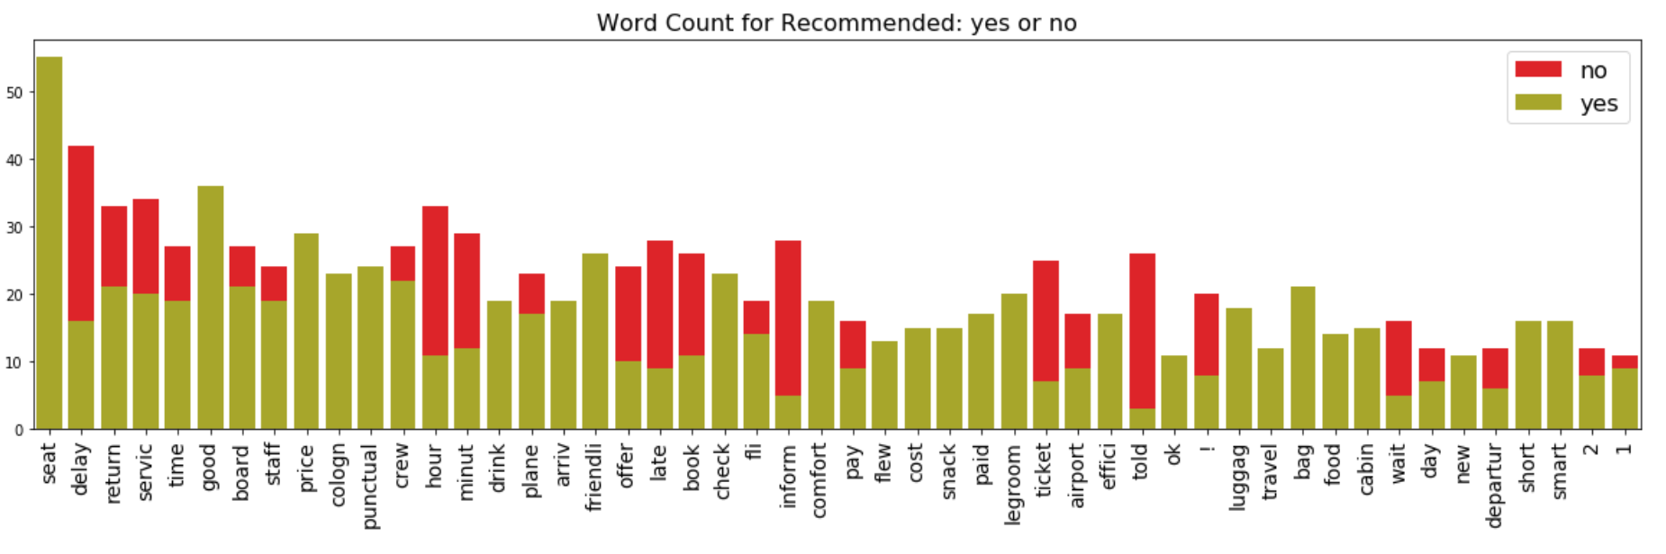
Analysis of Words used in Customer Review Text
Unhappy customers
review on:
Delays, Waiting
Told/Informed
Booking/Ticket Issues
Happy customers
review on:
Seat
Price
Punctuality
Crew/staff, cabin

Slide 6
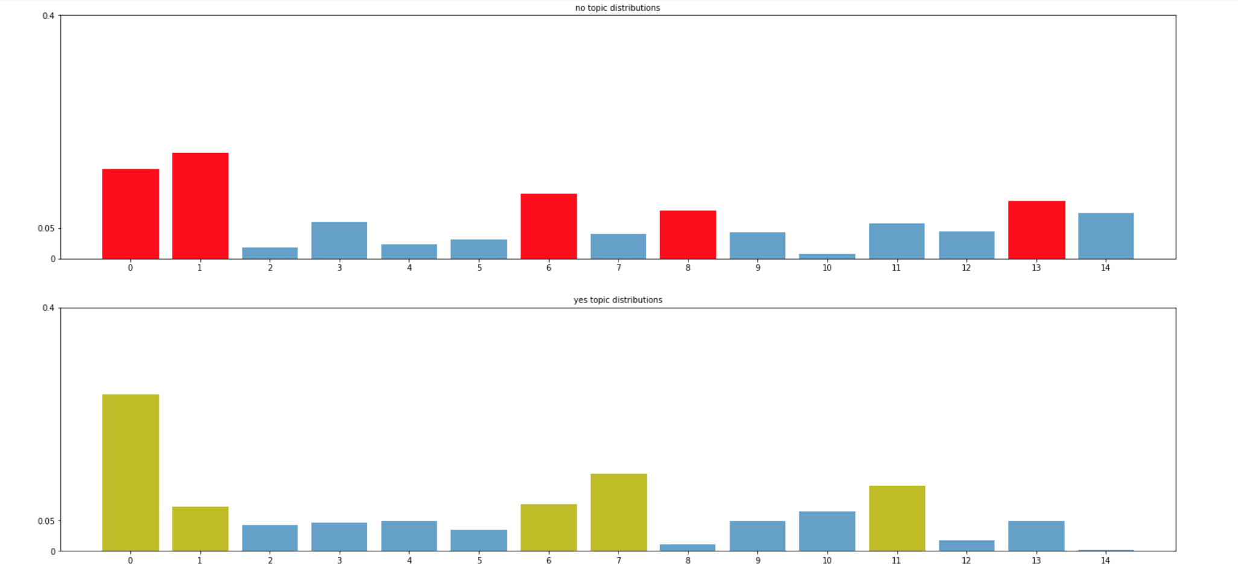
LDA for Topic Analysis of Customer Review Text
TOP 5 “NO” TOPICS
Topic 0: good, time, seat, punctual, staff. Topic 1: servic, told, custom, luggag, delay. Topic 6: board, lh, seat, delay, minut. Topic 8: water, seat, board, servic, fare. Topic 13: ticket, 2, book, delay, seat.
TOP 5 “YES” TOPICS
Topic 0: good, time, seat, punctual, staff. Topic 1: servic, told, custom, luggag, delay. Topic 6: board, lh, seat, delay, minut. Topic 7: seat, check, bag, reason, fli Topic 11: good, seat, check, bag, staff

Slide 7
Next Steps:
Correct route information and identify distance flown over route
Analysis of sentiment and topic by customer segment
Tune hyper parameters of models
Better word2vec analysis
Use LDA and word2vec features, sentiment scores and other features combined into one model to identify which items make a customer most likely to not recommend flying Germanwings

