Slide 1
2026
Shark Tank
Final Project
CS 341
FITMATCH
PRESENTED BY
Samantha Robinson

Slide 2
THE PROBLEM
THE SOLUTION
PRODUCT FEATURES
Table
of Contents
TECHNICAL IMPLEMENTATION
BUSINESS VALUE
CONCLUSION
DEMO

Slide 3
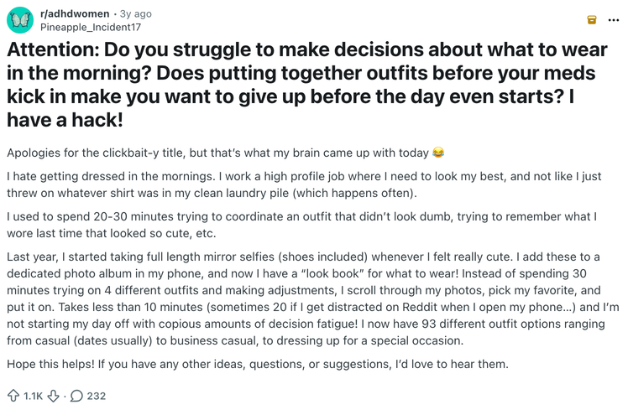
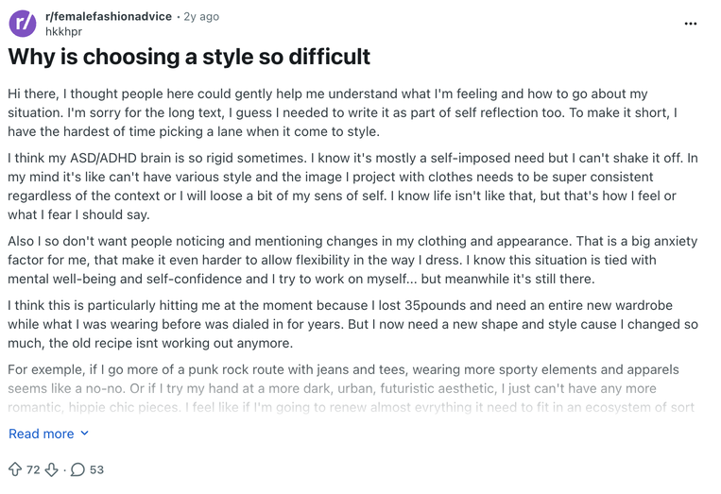
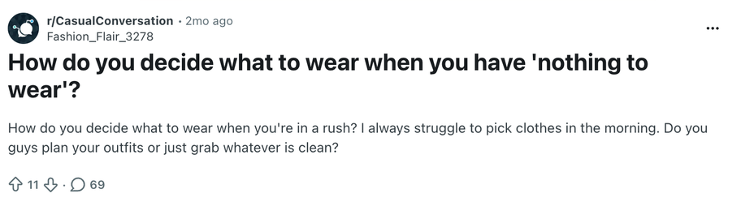
The Problem
01
A common problem people face is deciding what to wear, even when they have a full closet.
Users often feel like they have “nothing to wear” because they can’t visualize outfits.
There’s also no easy way to organize clothing digitally or generate outfit ideas automatically.
Hard to decide what to wear
Closet overload
Lack of outfit inspiration
A FEW ONLINE QUERIES

Slide 4
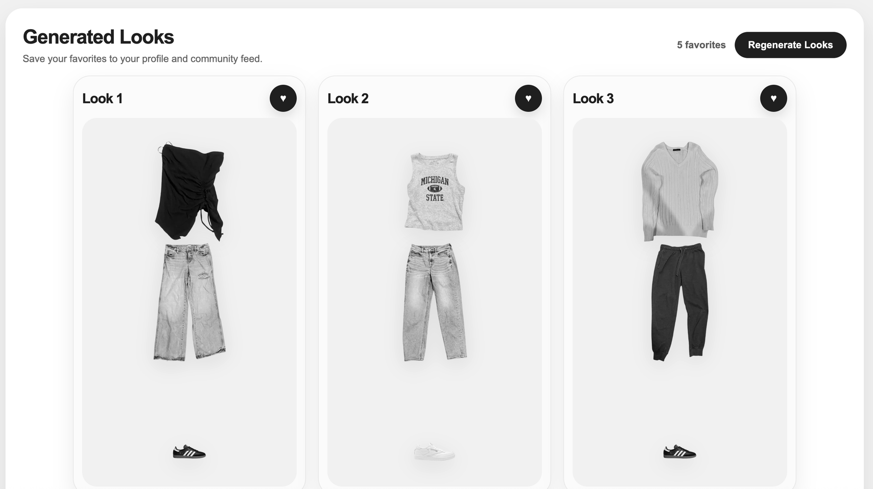
The Solution
02
FitMatch solves this by allowing users to upload their clothing items into a digital closet.
The app then generates complete outfits using those items.
Users can also save their favorite looks and explore outfits from other users.
What makes this unique is that the outfits are generated from your actual wardrobe, not generic suggestions.
Upload your closet
Generate outfits instantly
Save + explore looks

Slide 5
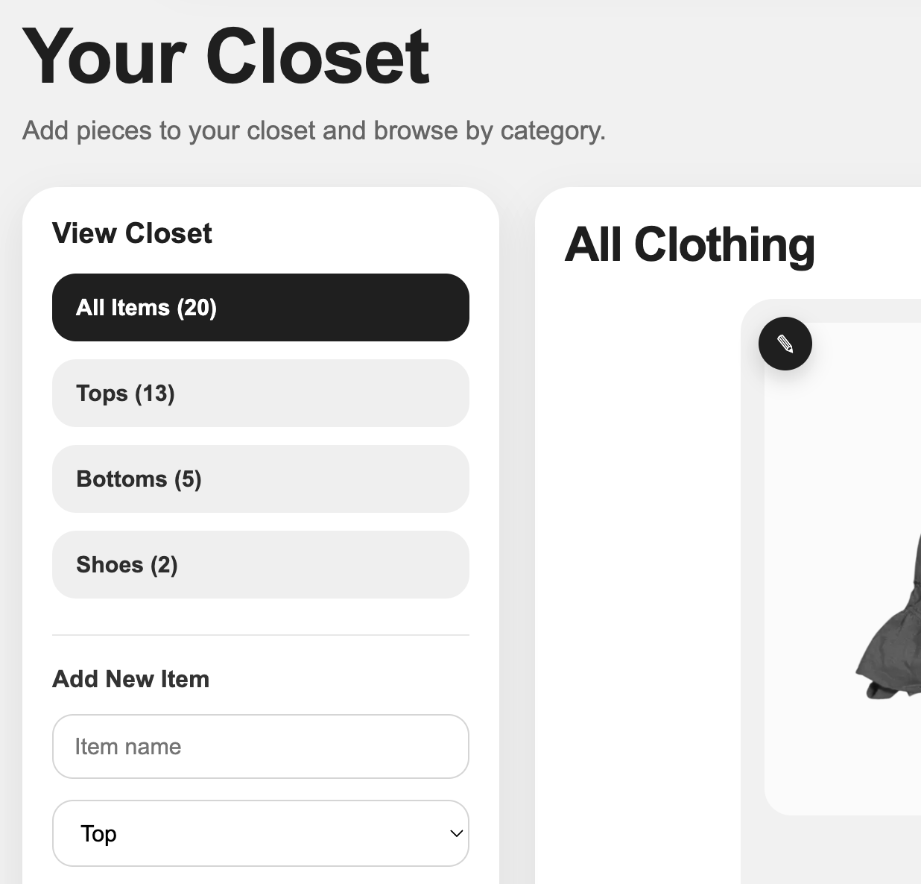
Product Features
04
CLOSET UPLOAD & IMAGE PROCESSING
OUTFIT GENERATOR
FAVORITES PROFILE & COMMUNITY FEED

Slide 6
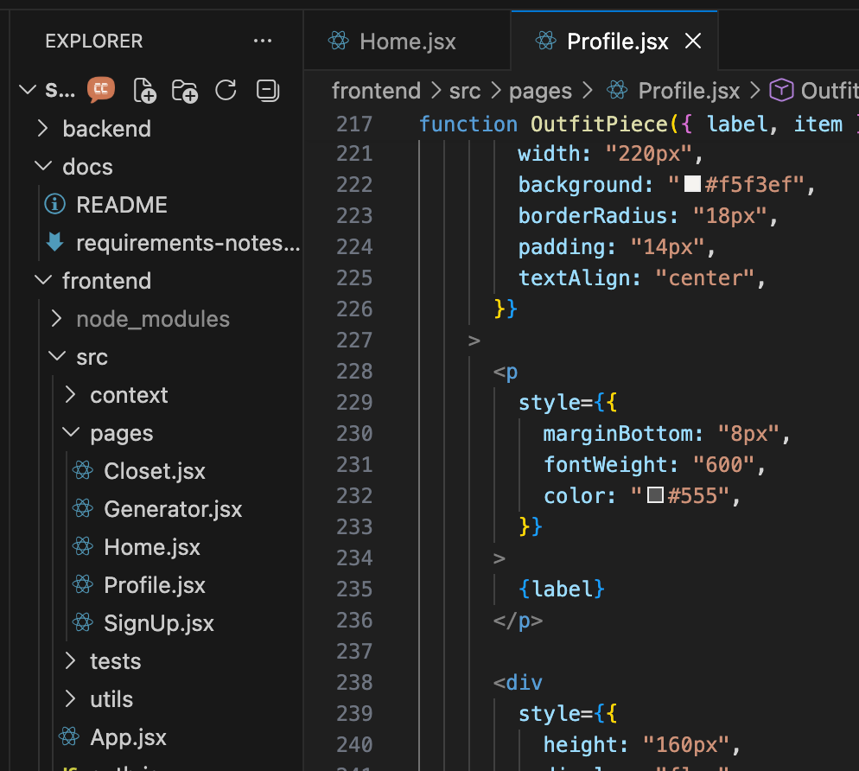
Technical Implementation
05
React frontend
Node.js + Express backend
MongoDB database
Image processing (Sharp + rembg)

Slide 7
Business Value
07
TARGET USERS: STUDENTS, YOUNG ADULTS
POTENTIAL FASHION INTEGRATION
Potential to expand into a full styling platform or fashion app.
This product would be useful for students, young adults, and anyone interested in fashion or organization.
SCALABLE
It has strong potential for growth, such as integrating with online shopping, AI recommendations, or social features.

Slide 8
Conclusion & Demo
https://shark-tank-final-project.vercel.app/

