Slide 1

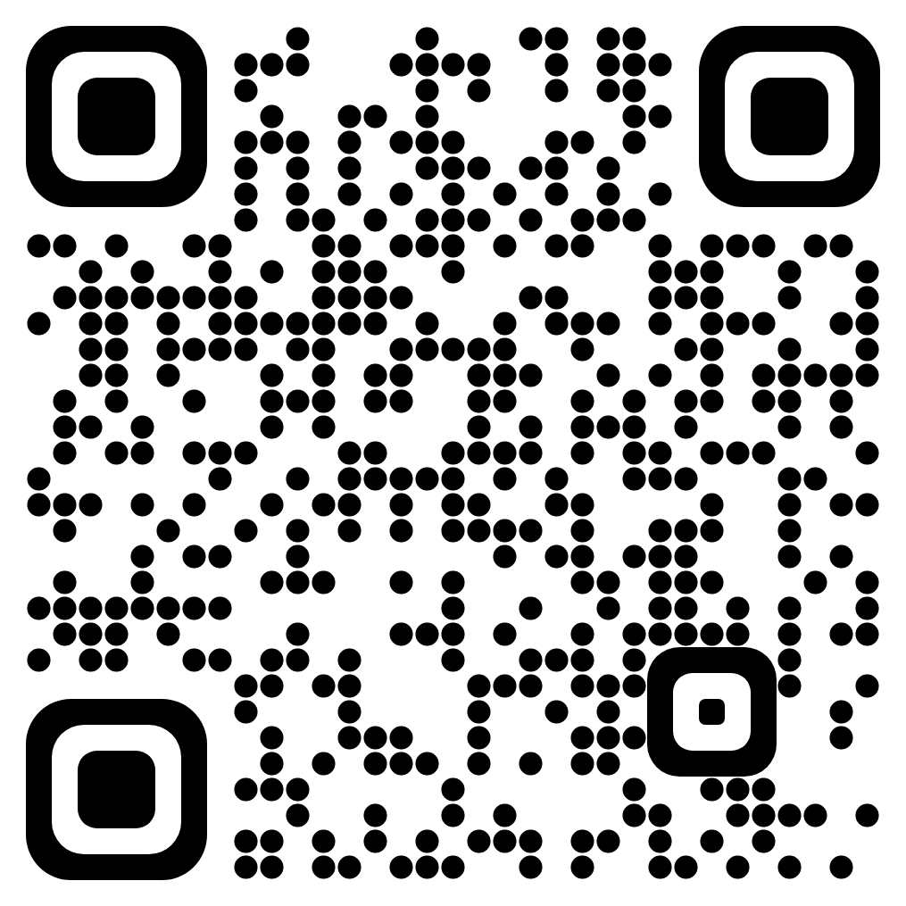








Adapting to novel talkers in speech perception: Balancing
generalization and individuation
Samantha Chiu¹, Bob McMurray¹, Joe Toscano², Cheyenne Munson Toscano²
¹University of Iowa and ²Villanova University
Introduction
Experiment 1: Distributional Learning of Multiple Talkers (n=160)
Experiment 2: Interference or Decay? (n=160)
Listeners need to account for variability due to talker and coarticulation to categorize speech sounds.
Listeners can account for variability from differences in gender¹, speaking rate², accent³, and individual voices^{4,5} by generalizing speech across individuals⁴ and separating speech information between individuals⁵.
How do listeners account for variability from novel talkers?
Without interference of learning Talker B, will listeners retain Talker A?
Session 1: Talker A
Session 1: Talker B
Session 1
Session 1
Session 1
Session 2
1.00
Trained
Untrained
1.00
0.75
0.75
Listeners can learn a new talker but learning decays over time.
0.50
Proportion /p/ response
0.50
Experiment 1 & 2: Methods
0.25
0.25
Participants were recruited using Prolific (www.prolific.co)
In two sessions, participants learned two novel talkers with two unique VOT categories.
Each session included a half-hour training block for one talker then one test block for each talker.
Session 1: Do listeners generalize or separate information to a novel talker?
Session 2: Do listeners separate information between two novel talkers?
0.00
Session 2: Talker B
Session 2: Talker A
0.00
Proportion /p/ response
Session 2
Session 2
3
4
5
6
7
8
9
10
3
4
5
6
7
8
9
10
Trained
Untrained
VOT Step
1.00
FullTrainedDirection
L
R
0.75
Experiment 3 & 4: Learning Two Talkers (n=64)
0.50
R
L
Test
R
L
Test
0.25
Will learning occur with both talkers present?
Experiment 3: Interleaved Exposure
Will learning occur with both talkers present and with feedback?
Experiment 4: Supervised Learning
L
0.00
3
4
5
6
7
8
9
10
3
4
5
6
7
8
9
10
TalkerStatus
Trained
VOT Step
FullTrainedDirection
L,R
R,L
Untrained
Experiment 1 Conclusions:
Listeners can learn a talker’s VOTs from distributional learning (Session 1: Talker A)
Listeners generalize VOT boundaries to a novel talker (Session 1: Talker B)
Listeners do not retain VOT boundaries of multiple talkers (Session 2)
Talker A: Interference from Talker B or decay of learning over time?
Talker B: Need stronger learning cue?
1.00
1.00
R
0.75
0.75
Proportion /p/ response
0.50
direction
0.50
L
Talker A
Talker B
R
L
Test (both talkers)
R
Test (both talkers)
0.25
0.25
0.00
3
4
5
6
7
8
9
10
0.00
3
4
5
6
7
8
9
10
VOT Step
VOT Step
L
R
Listeners do not appear to learn two distinct talkers at all.
References
Strand, E. A., & Johnson, K. (1996). Gradient and Visual Speaker Normalization in the Perception of Fricatives. Natural Language Processing and Speech Technology, 14–26. https://doi.org/10.1515/9783110821895-003
Miller, J.L., Volaitis, L.E. Effect of speaking rate on the perceptual structure of a phonetic category. Perception & Psychophysics 46, 505–512 (1989). https://doi.org/10.3758/BF03208147
Bradlow, A. R., & Bent, T. (2008). Perceptual adaptation to non-native speech. Cognition, 106(2), 707–729. https://doi.org/10.1016/j.cognition.2007.04.005</div>
Kraljic, T., & Samuel, A. G. (2006). Generalization in perceptual learning for speech. Psychonomic Bulletin & Review, 13(2), 262–268. https://doi.org/10.3758/BF03193841
Eisner, F., & McQueen, J. M. (2005). The specificity of perceptual learning in speech processing. Perception and Psychophysics, 67(2), 224–238. https://doi.org/10.3758/BF03206487
Conclusions & Future Directions
R
L
Listeners can adapt to, but not learn or retain, a novel talkers’ VOT categories.
Listeners will continually adjust their VOT boundary to match the current voice
R
L
Notes:
Introduction
Listeners account for variability in speech that come from differences in gender, speaking rate, age, accent, and unique voices
Listeners account for variability by generalizing speech across individuals AND separating speech information between individuals
How do listeners account for variability from a novel talker?
Experiment 1: Talker Adaptation
Methods:
Have listeners learn a talker’s voice, then encounter a new talker. Then on day 2, listeners learn the new talker, and then hear the first talker’s voice again
Talkers will learn a new voice through distributional learning
Have a plot with distributional learning + the boundaries based on it
Hypotheses: we should see learning across subjects (left goes left, right goes right)
Between trained and untrained voice, we should see a similar effect of training direction if generalization, and no effect of training direction if individuation
Results:
Learning in day 1, no learning day 2
The first talker was learned, but then not retained
The second talker was generalized from the first, but then shifted back to the center after learning
Seems like overall shifting between talkers & no real retention of anything; just one boundary movement
Experiment 2: Talker A’s weakened retention: decay of learning or interference?
Methods: same as Exp1, but no second talker learning, just test again after a couple days
Result: Is actually decay of learning; same weakened effect
Experiment 3 & 4: can Talker B be learned at all?
Methods: Exp 3, distributional learning, but both distributions at once, then test; Exp 4: supervised learning for both participants
Result: answer is no

