Slide 1



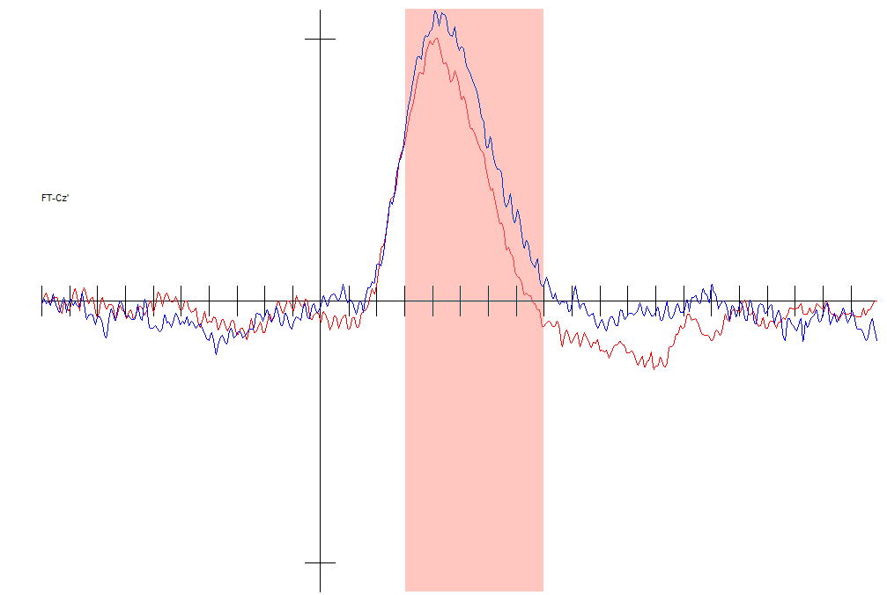
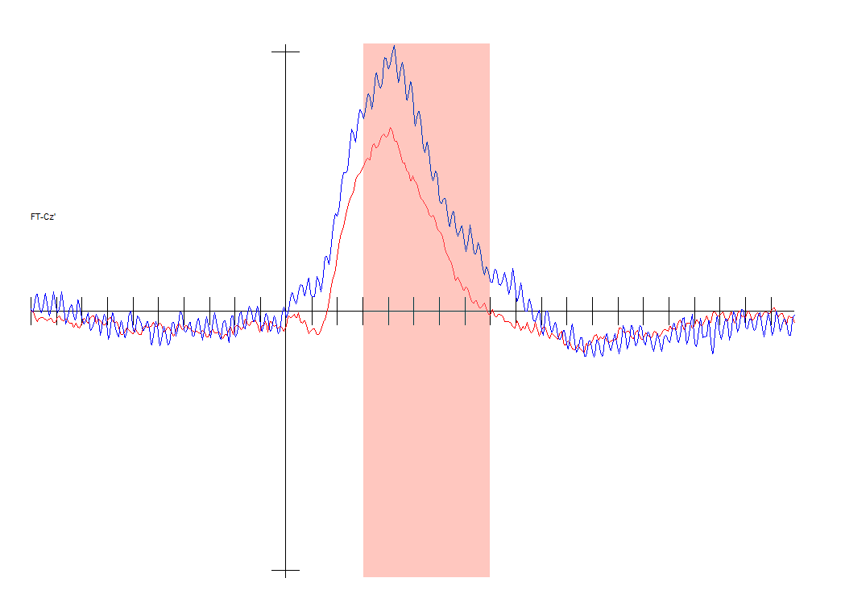
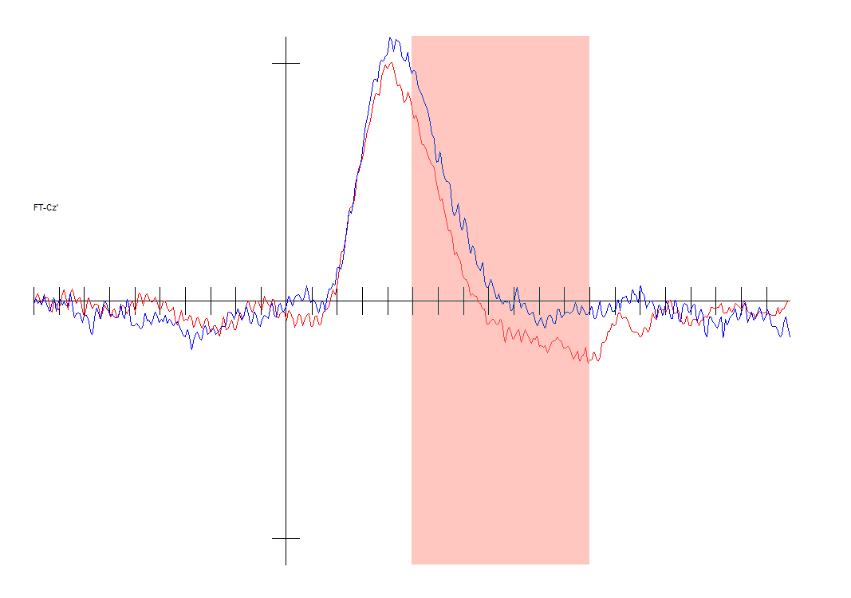
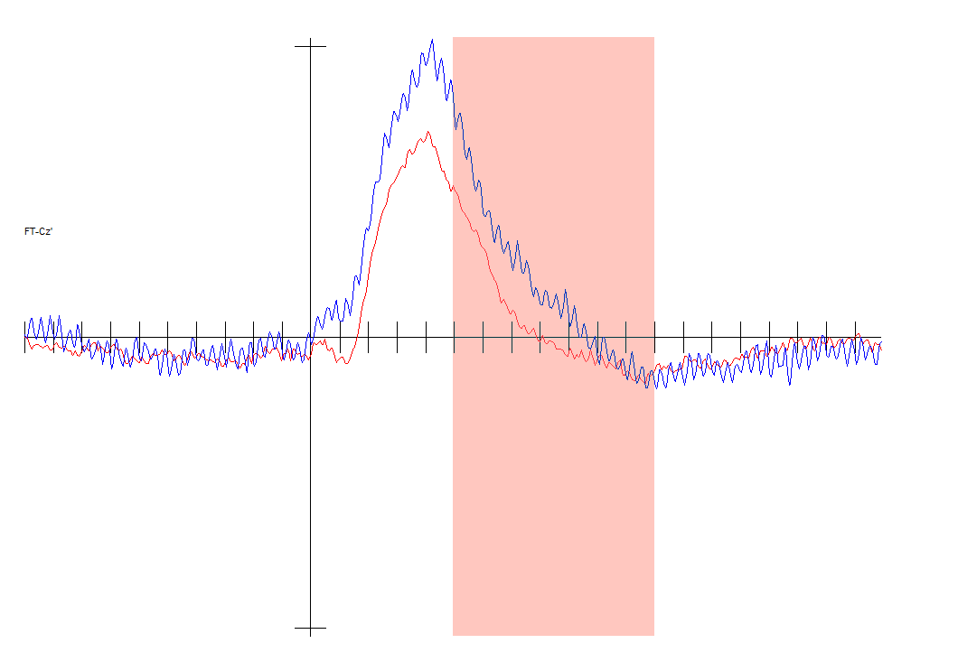
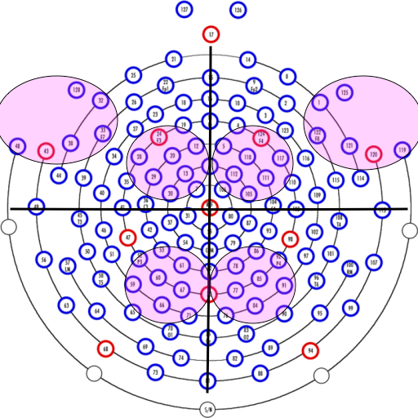


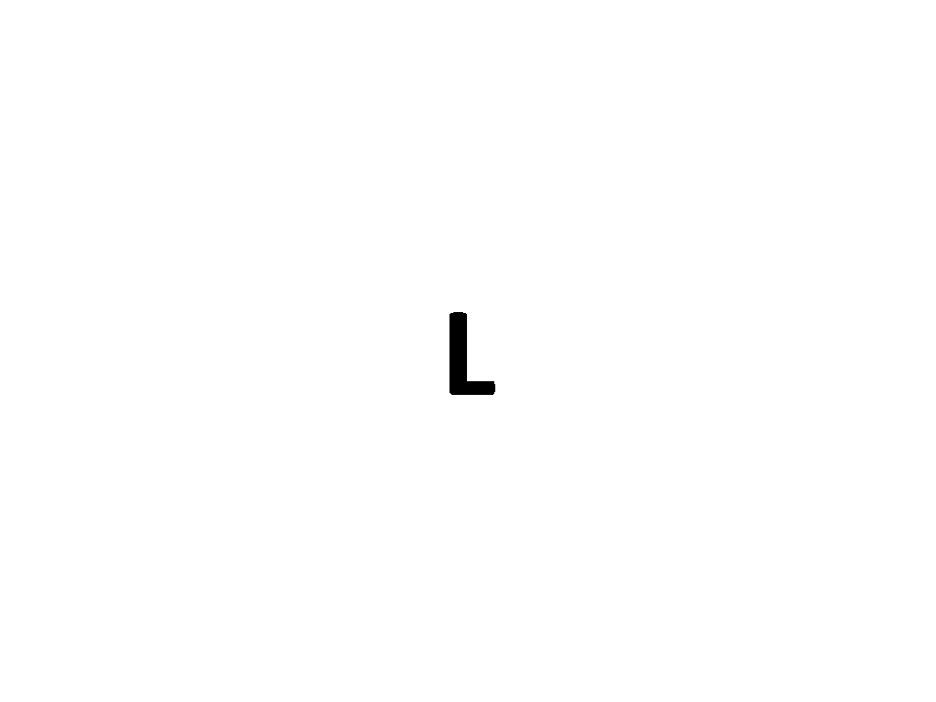
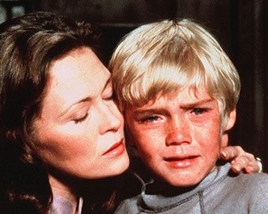
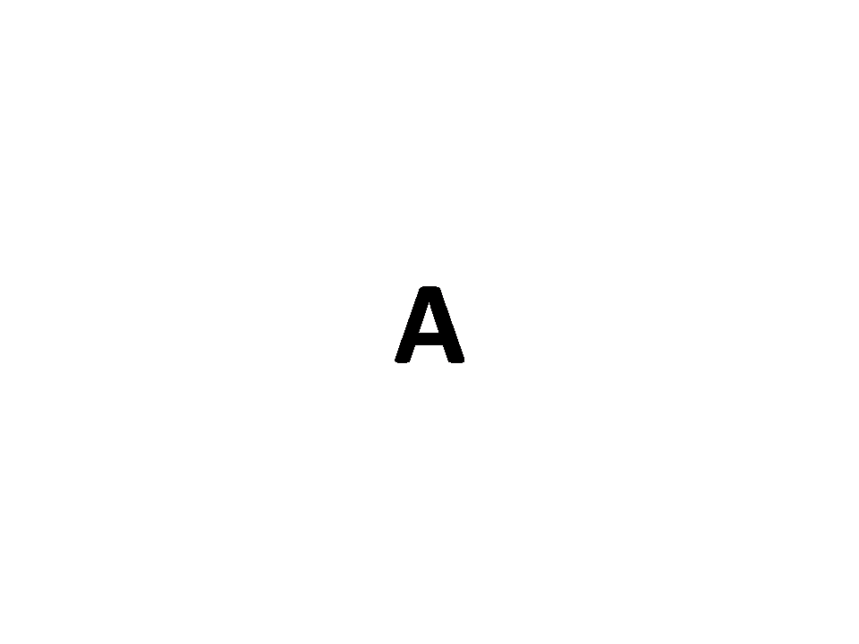
Do Happy Versus Sad States Influence Bio-Behavioral Markers of Inhibition? Jordan Wylie^{1,3}, Samantha Chiu^{2,3}, Jennifer Stewart^{1,3}, Justin Storbeck^{1,3} The Graduate Center, CUNY¹, Macaulay Honors College², CUNY & Queens College³
Introduction
Research has repeatedly demonstrated that emotions have considerable influence on executive functioning (EF). However, exactly how EF is composed, which systems allow individuals to update, inhibit, and shift, and how emotions interact with these potentially different systems remains unclear (Bandura, 1991; Banich, 2009; Miyake et al., 2000; Duncan et al., 1996). Moreover, research has established priotization of emotional content on EF, thus positioning emotion, both state and trait, to greatly impact subsequent performance (e.g., Coan & Allen, 2004; Pessoa, 2009).
The present study utilized electroencephalogram (EEG) technology to investigate some of these lingering questions about emotion and EF. Specifically, inhibition is now thought to be a critical component of general executive functioning (Miyake & Friedman, 2012), and yet, very little research has examined how emotion interacts with such a critical EF process of inhibition. Inhibition is critical for suppressing behaviors that are inappropriate, unsafe, or no longer required and prevent interference from non-goal relevant stimuli (Miyake & Friedman, 2012; Nigg, 2000).
Primary Aims:
Evaluate the influence emotional states have on the executive function, inhibition. Specifically, the ability to stop a dominant response.
Examine how valence (happy vs. sadness) impacts behavioral inhibition.
Identify whether sadness and happiness have unique influences on bio-markers reflective of successful inhibition.
Hypotheses:
It was predicted that: 1. Sadness (relative to happiness) would enhance No-Go behavioral inhibition accuracy; 2. Sadness would reduce Go behavioral reaction time (RT); 3. Sadness would amplify No-Go N200 ERP amplitude; 4. Sadness would reduce Go and No-Go P300 ERP amplitudes.
Effects of Emotion on Bio-Behavioral Indices of Inhibition
Results
Main Effects:
N200 amplitudes were higher for No-Go versus Go trials, F(1,26) = 27.23, p<.001
N200 amplitudes were stronger over frontal compared to centro-parietal regions, p<.001
P300 amplitudes were higher for No-Go versus Go trials, F(1,26) = 14.94, p=.001
P300 amplitudes differed by condition, F(1,26) = 6.81, p=.015
There was no effect of emotion on Go/No-Go Reaction Time.
There was no effect of emotion on Go/No-Go accuracy.
Emotion by Trial Type:
Sadness increased N200 amplitudes of No-Go trials, F(1,26) = 6.46, p=.02
There was no effect of emotion on P300 amplitudes by trial type.
Trial Type by Location:
N200 amplitudes were highest for No-Go trials in right (versus left) frontotemporal as opposed to frontocentral regions, p<.001.
Discussion
Emotions have a considerable influence on a number of psychological processes - one such influence is on the executive function inhibition. Overall, we found support for increased N200 amplitudes and decreased P300 amplitudes induced by sadness in the go/nogo paradigm, aligning with prior evidence that emotional and motivational content affects behavioral performance (Pessoa, 2009). Thus, findings suggest sadness enhances inhibition, which can be beneficial for high-level cognition (problem solving) and goal achievement (reducing undesirable behavior). The findings also provide insight into how overall executive functioning can be influenced by emotions, as inhibition shares EF capacity with other functions. The neurological findings complement behavioral and spatial findings and strengthens the correlation between emotion and inhibition.
Future Directions
To better understand how exactly emotions interact with and influence EF and inhibitory processes, future research should study emotions that include other important factors of emotion, such as motivational direction and arousal. Moreover, while Go/No-Go paradigms explicate behavioral inhibition, future research should examine such relationships between emotion and EF in socially/motivationally complex situations, as they more accurately reflect the conflict-laden inhibition experienced in everyday life. Such conflicts may elicit different cognition and deplete resources in a way that diverge from studying the emotions in isolation.
Go/NoGo Task Performance
Event-Related Potential Components
N200 Component
P300 Component
NoGo
Go
NoGo
Go
Design
Participants (N=39) from Queens College were recruited to participate for course credit. Only participants (N=28) who met an accuracy cutoff of 60%
were included in analyses.
Using a 2 between-subjects by 2 within-subjects design, suppression of dominant responses was tested with a Go/No-Go task. Consenting Ps were randomly assigned to emotion condition (happy or sad). Movie clips used in previous research was utilized for the Induction, each lasted 5-minutes in total. Following induction and practice trials, Ps completed 200 experimental trials of the Go/No-Go task. This was followed by the mood manipulation check and demographic, and personality questionnaires.
EEG Data Analysis
ERP data were filtered at 1.-30Hz, blink-corrected, artifact-rejected, baseline corrected and re-referenced (average reference). Electrodes from three scalp locations (fronto-temporal, fronto-central, centro-parietal) were pooled for analysis.
References
Bandura, A. (1991). Social cognitive theory of self-regulation. Organizational behavior and human decision processes, 50(2), 248-287.
Banich, M. T. (2009). Executive function: The search for an integrated account. Current directions in psychological science, 18(2), 89-94.
Duncan, J., Emslie, H., Williams, P., Johnson, R., & Freer, C. (1996). Intelligence and the frontal lobe: The organization of goal-directed behavior. Cognitive psychology, 30(3), 257-303.
Hofmann, W., Schmeichel, B. J., & Baddeley, A. D. (2012). Executive functions and self-regulation. Trends in cognitive sciences, 16(3), 174-180.
Friedman, N. P., & Miyake, A. (2004). The relations among inhibition and interference control functions: a latent-variable analysis. Journal of experimental psychology: General, 133(1), 101.
Miyake, A., Friedman, N. P., Emerson, M. J., Witzki, A. H., Howerter, A., & Wager, T. D. (2000). The unity and diversity of executive functions and their contributions to complex “frontal lobe” tasks: A latent variable analysis. Cognitive psychology, 41(1), 49-100.
Mitchell, R. L., & Phillips, L. H. (2007). The psychological, neurochemical and functional neuroanatomical mediators of the effects of positive and negative mood on executive functions. Neuropsychologia, 45(4), 617-629.
Nigg, J. T. (2000). On inhibition/disinhibition in developmental psychopathology: views from cognitive and personality psychology and a working inhibition taxonomy. Psychological bulletin, 126(2), 220.
Pessoa, L. (2009). How do emotion and motivation direct executive control?. Trends in cognitive sciences, 13(4), 160-166.
Storbeck, J. (2016). Is happiness a cure-all for mental fatigue?: mood interacts with situational requirements in predicting performance. Motivation and Emotion, 40(3), 489-497.
Method
EEG RECORDING
Resting State Baseline
Mood Induction Condition (B/W) – Video Clip
Block 1 (100 trials)
Go/No-Go Task* (W/IN)
Manipulation Check
*Go/NoGo Task
m
6 participants were excluded for performance below 60%. Following 20 practice trials, Ps completed a total of 200 trials. In random order, 100 trial long blocks were presented, which either had the ‘A’ key denoting Go or the ‘L’ key. 70% of the trials within each block were associated with the Go response. Presentation duration of cued letter was from from 200 ms, which followed a 500 ms fixation cross. After 200 ms, a blank screen was displayed for 500 ms for Go response and 1500 ms for No Go response to encourage responding. 1000 ms delay between trials
Go Trial (70%)
PANAS: Questions assessing emotional states (happy, cheerful, sad, unpleasant)
Mood induction was successful if participants in the happy condition endorsed positive emotions more than the sad condition; and the sad condition endorsed negative emotions more than the happy condition.
Manipulations were successful ps<.01
Happy:
“Seinfeld”
No Go Trial (30%)
Questionnaires
Demographic and Personality Questionnaires
Sad:
“The Champ”
Block 2 (100 trials)
Go Trial (70%)
Fixation cross for 5 minutes
No Go Trial (30%)

