Slide 1
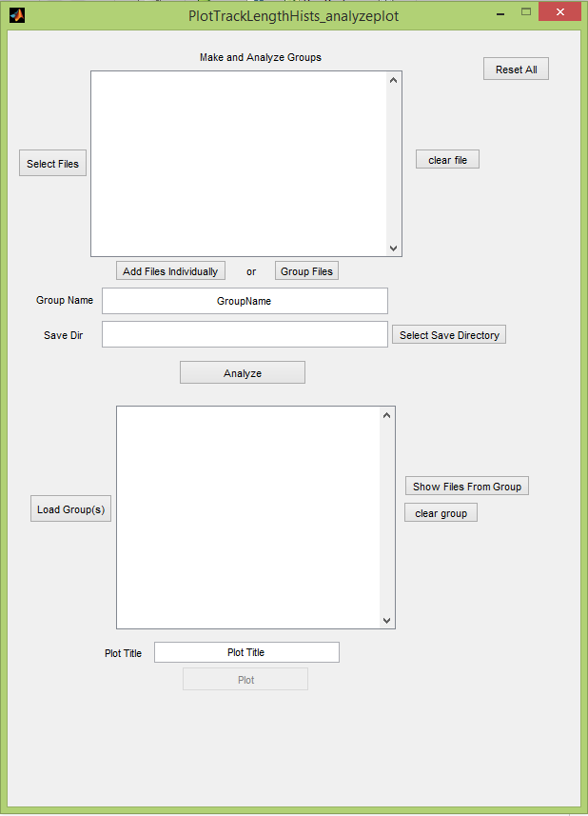
Main Analysis Steps :
test=HistPlotter();
1) Load in tracked .spt datafiles you would like to analyze. You can select multiple files.
2) Determine if you would like to analyze each file individually or group them together. Note that you can select some files, add them, and then search again and add more.
4) Default save directory is subdirectory of the directory of the .spt file titled ‘TrackLengthGroups’. Change this here if manually, or search for an existing directory using the button if you would like a different save directory
3) If you choose to ‘Group Files’ you must give the group a name. Default is GroupName
5) Click the ‘Analyze’ button to extract the track lengths. This will create and save a file in the Save Dir titled with the GroupName or the original file name if ‘Add Files Individually’ was used.
6) Select a title for the plot. This will also be the saved figure name.
7) Plots all the data groups/files listed in the listbox above. Note that this is only available when there are analyzed files in the list box- not before the ‘Analyze’ has been run.
15-01-14

Slide 2
Extra Features
a) This resets everything.
b) You can remove a file by highlighting it (clicking it in the list) and pushing the ‘clear file’ button.
e) You can load in previously analyzed datasets here for plotting. This is a little buggy currently if you have files you just analyzed in the listbox and then try and add more. Hopefully I’ll fix this soon.
c) If you are curious which .spt files were used to make a certain grouping, selecting the group in the list and pressing this button displays them in the top list box. Note this is an easy way to modify groups.
d) You can remove an analyzed group/file by highlighting it (clicking it in the list) and pushing the ‘clear group’ button.

Slide 3
Everything Together
1) Load in tracked .spt datafiles you would like to analyze. You can select multiple files.
a) This resets everything.
b) You can remove a file by highlighting it (clicking it in the list) and pushing the ‘clear file’ button.
2) Determine if you would like to analyze each file individually or group them together. Note that you can select some files, add them, and then search again and add more.
4) Default save directory is subdirectory of the directory of the .spt file titled ‘TrackLengthGroups’. Change this here if manually, or search for an existing directory using the button if you would like a different save directory
3) If you choose to ‘Group Files’ you must give the group a name. Default is GroupName
5) Click the ‘Analyze’ button to extract the track lengths. This will create and save a file in the Save Dir titled with the GroupName or the original file name if ‘Add Files Individually’ was used.
e) You can load in previously analyzed datasets here for plotting. This is a little buggy currently if you have files you just analyzed in the listbox and then try and add more. Hopefully I’ll fix this soon.
c) If you are curious which .spt files were used to make a certain grouping, selecting the group in the list and pressing this button displays them in the top list box. Note this is an easy way to modify groups.
6) Select a title for the plot. This will also be the saved figure name.
d) You can remove an analyzed group/file by highlighting it (clicking it in the list) and pushing the ‘clear group’ button.
7) Plots all the data groups/files listed in the listbox above. Note that this is only available when there are analyzed files in the list box- not before the ‘Analyze’ has been run.

