Slide 1
Using Python to extract a .gbk file into excel
Gong chen
10/11/2019

Slide 2
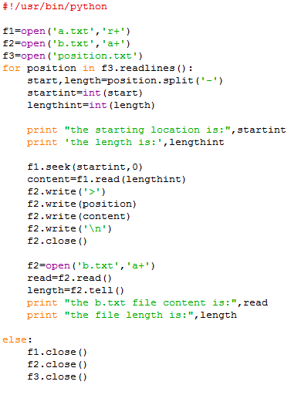
How I wrote my first python program
I want to get the nucleotide sequences using their coordinates in the genome
I could do it on NCBI manually (so are a lot of tasks I did with python, but there are many advantages using a program)
My friend in the bioinformatics department refused to write it for me and encouraged me to write it myself
Took me several days, but built my confidence

Slide 3
Two approaches in learning coding
Follow the textbook step by step
Only learn what I need for my task
Pros:
Systemic, organized learning
Become a real programmer
Cons:
Takes time and patience
One may never start (or finish)
Cons:
Fragmented knowledge
Dumb program
Pros:
Easier to begin
Get your task accomplished
Its Okay to choose the one that begins easier and set a lower goal! The important part is you started coding!

Slide 4

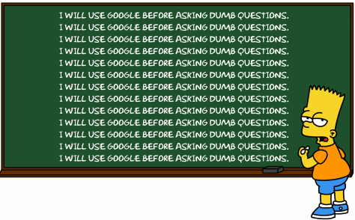
http://www.giybf.com/, http://www.giyf.com/, https://www.google.com/
Form your question accurately
Break down compound questions into singular ones
Try to understand the error message
Instead of throwing the whole line into google, just look up the key word

Slide 5
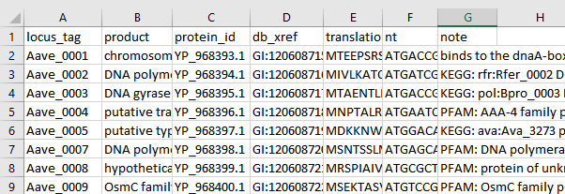
Extract a .gbk file into excel
I have a list of genes (from RNAseq), I want to know what they are, get their DNA and Protein sequences.
Easier to look at them in an excel file
Demonstrate how it works

Slide 6
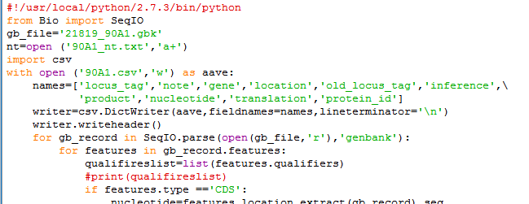
Use it with your data
Name of your .gbk file
Install python 2.7
Install package “biopython ”
Modify the file name
Run!
Name of your nucleotide output file
Name of your excel output file

Slide 7

Break down of the code
this line is needed for linux systems, but not needed for windows
SeqIO is a module in package Biopython, works with "SeqRecord" objects
tell the program that I define a document with the name of 21819_90A1.gbk as an object called gb_file
create and open a file, "a+" means open in a manner that allows both appending and reading
with open" is different from "open" in the way that it will close the file for you automatically
create a csv file, ‘w’ means writing permission; the opened file is an object called aave
csv is another package that works with excel

Slide 8

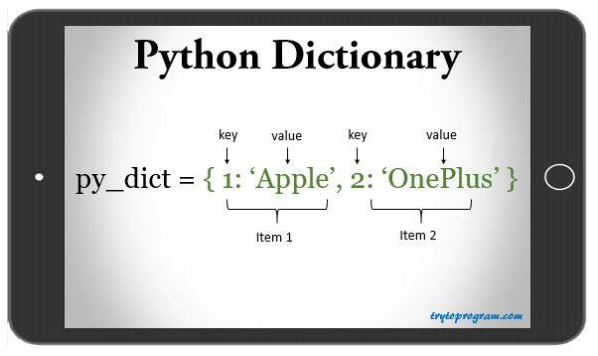
object "names" is a list consisted with these strings that may appear in a gbk record
Csv.dictwriter is a function that write into csv files :
The csv file to write into is the object aave (file 90A1.csv);
Dict is short for dictionary, which is a list with names:
the “keys” of this dictionary will be object
“names”
I write each record into one line of excel, using
‘\n’ to mark the end of line
I ask the writer to write its header, which will be
everything in “names”

Slide 9
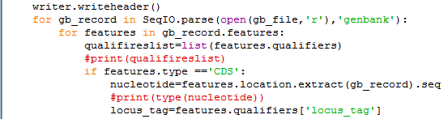
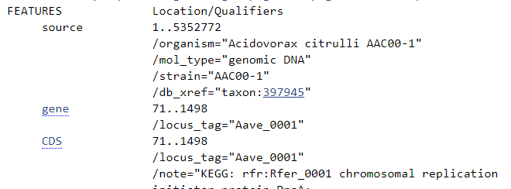
A “for” loop will go through each item in a list until finish
Here the item is a “gb_record,” this name is changeable, you can name it anything
The whole list is SeqIO.parse(open(gb_file,’r’),’genbank’):
SeqIO.parse is a function of SeqIO (not changable)
It parse through the object “open the gb_file as read only” understanding that it is in the format of ‘genbank’, which is defined by Biopython
The item “gb_record” has structures
“Features”: source, gene, cds
Each item that start with ‘/’ is a “qualifier”, like ‘/organism’, ‘/mol_type’, etc.

Slide 10
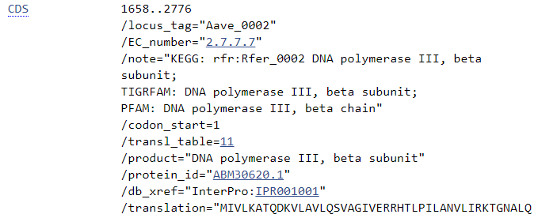
Obtain a list of all the qualifiers
“#”means comment
I only want the “CDS” feature
Use the biopython function to extract the nucleotide and put them into object “nucleotide”
Extract from this feature (‘CDS’), the content with its qualifier’s name is ‘locus_tag’, and put into object locus_tag

Slide 11
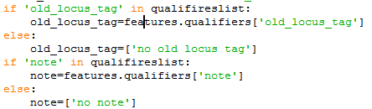
Different genbank file have different qualifiers, some have “old_locus_tag”, some have ‘note’, and others. I am sure I can obtain the nucleotide sequence and the locus tag, but not sure about these, so I always ask the program to check if it is in the qualifierslist (that I just created) before trying to extract the content; if it was absent, then just write “no such thing” into my object.

Slide 12

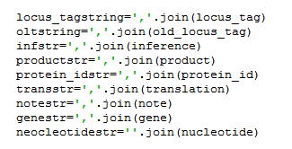

What I extracted and put into my own object was an item in square bracket, which is a list
But I want strings
So convert a list into
a string (googled)
Check the data type

Slide 13
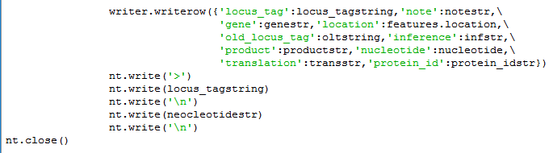
Ask the writer to write a row: the green part is the “key” of the dictionary, and the black part is the value, in string format;
Write in my nucleotide file into fasta format
Loop through all “CDS” feature
When finished, close the nt file.

