Slide 1

Samantha Ramsey Multi-body Dynamics Research Group
Presentation 16
9/14/2023

Slide 2
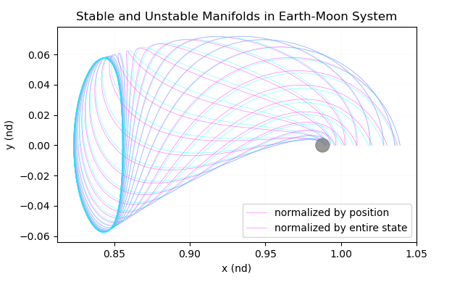
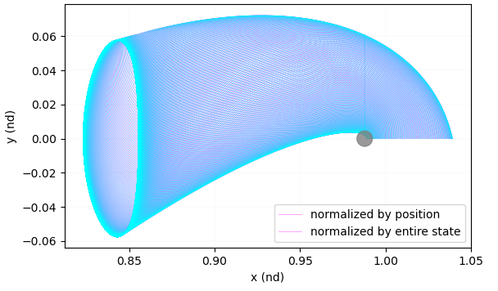



Manifold follow up
Does it matter if you normalize the step off from the orbit onto the eigenvector using the only the position elements of the eigenvector vs the entire state?
At first glance – maybe?
$$\overline{v_{s}}= \left[x_{s},y_{s},z_{s},{\dot{x}}_{s}{,\dot{y}}_{s}{, \dot{z}}_{s}\right]$$
$${\overline{V}}^{W^{s}}= \frac{\overline{v_{s}}}{\sqrt{{x_{s}}^{2}+{y_{s}}^{2}+{z_{s}}^{2}}}$$
$$\overline{x_{s}}={\overline{x_{i}}}^{PO}±k {\overline{V}}^{W^{s}}$$
But if we add in more manifolds the overall surface they cover looks the same

Slide 3
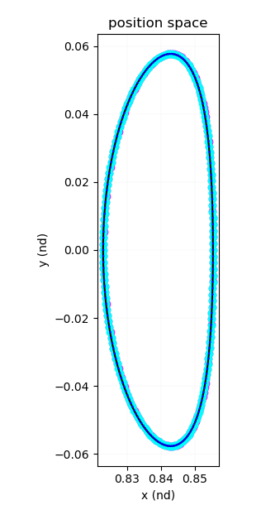
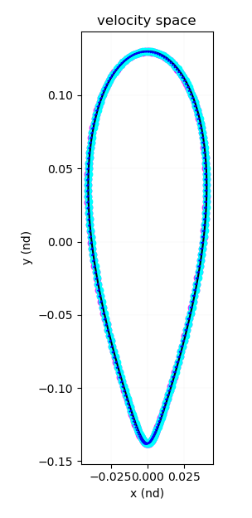
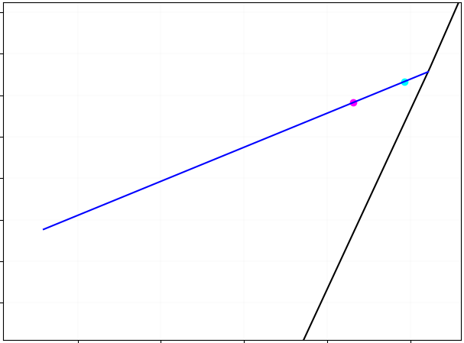
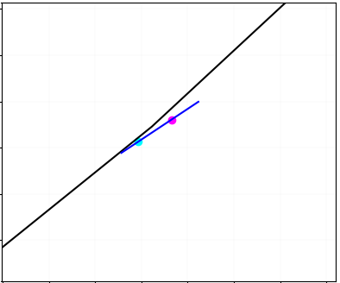

Initial conditions for the manifolds
Blue line is the stable eigenvector
Notes:
The solution being periodic means that the rates of contraction or expansion along the orbit are the same so we can transition the eigenvectors using the STM at a series of points around the orbit equally spaced in time

Slide 4
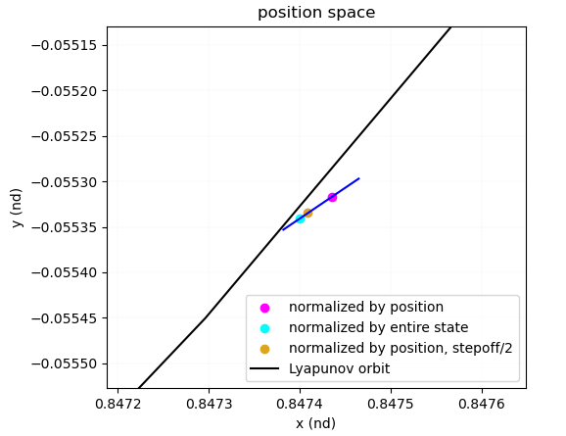

Initial conditions for the manifolds
Choice between position and full state only effects the magnitude of the step off onto the eigenvector
Added as an input to the manifold function but have to be extra careful of step off distance
Using full state to normalize and a smaller step off could lead to more numerical error build up
$$\overline{v_{s}}= \left[x_{s},y_{s},z_{s},{\dot{x}}_{s}{,\dot{y}}_{s}{, \dot{z}}_{s}\right]$$
$${\overline{V}}^{W^{s}}= \frac{\overline{v_{s}}}{\sqrt{{x_{s}}^{2}+{y_{s}}^{2}+{z_{s}}^{2}}}$$
$$\overline{x_{s}}={\overline{x_{i}}}^{PO}±\frac{k}{\sqrt{{x_{s}}^{2}+{y_{s}}^{2}+{z_{s}}^{2}}}\overline{v_{s}}$$
Blue line is the stable eigenvector
Notes:
The solution being periodic means that the rates of contraction or expansion along the orbit are the same so we can transition the eigenvectors using the STM at a series of points around the orbit equally spaced in time

Slide 5
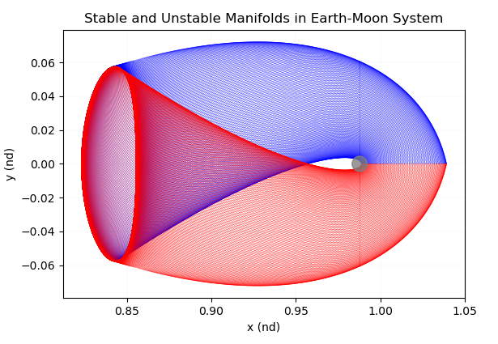
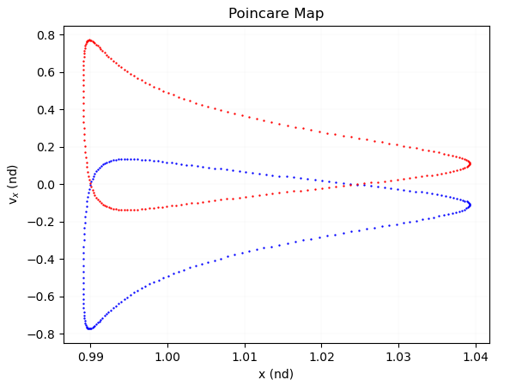
Homoclinic Trajectories
Exist where stable and unstable manifolds of an orbit meet tangentially
Depart the orbit asymptotically on an unstable manifold
Travel along it and eventually transition onto the stable manifold at a tangential crossing
Asymptotically re-approach the periodic orbit
Can be identified using Maps
Select a hyperplane and plot the states of the manifold at the crossing
Look for places where the stable and unstable manifolds cross
Shown is a map for the first x-axis crossing on the Lunar side for manifolds propagated from an L1 Lypaunov orbit
Two potential transfer locations
Notes:
The solution being periodic means that the rates of contraction or expansion along the orbit are the same so we can transition the eigenvectors using the STM at a series of points around the orbit equally spaced in time

Slide 6
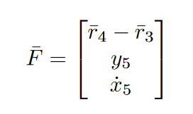
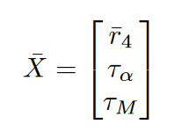








Targeting: Tau-Alpha
$${\overline{r}}_{4}$$
$${\overline{r}}_{2}$$
$${\overline{r}}_{5}$$
$${\overline{r}}_{1}$$
Want: continuity at ${\overline{r}}_{4}$ and ${\overline{r}}_{3}$, perpendicular
crossing at y=0
Controls: time traveled along PO, ${\overline{r}}_{4}$, time traveled along manifold
$${\overline{r}}_{3}$$
$$τ_{M}$$
$$τ_{α}$$

Slide 7
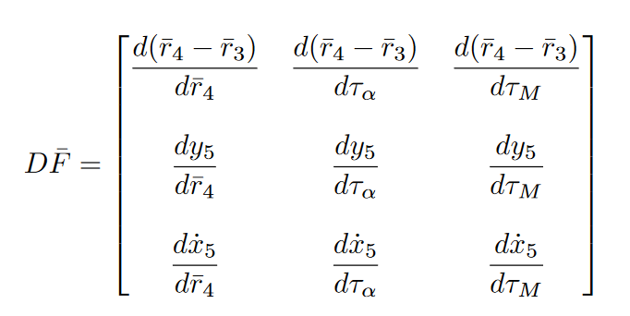




Targeting: Tau-Alpha
$${\overline{r}}_{4}$$
$${\overline{r}}_{2}$$
$${\overline{r}}_{5}$$
$${\overline{r}}_{1}$$
Update matrix is the derivative of the constraints wrt
the free variables
$${\overline{r}}_{3}$$
$$τ_{M}$$
$$τ_{α}$$
$1$ (but actually $I_{6}$)
$$0$$
This one was the fun term – derivation in back up slides
$$0$$
$$0$$
Time derivatives
Relate final state to changes in initial state – STM!

Slide 8

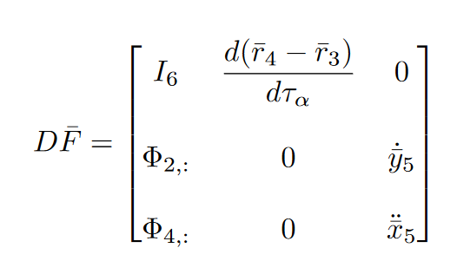
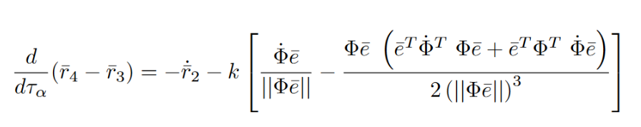
Targeting: Tau-Alpha
$${\overline{r}}_{4}$$
$${\overline{r}}_{2}$$
$${\overline{r}}_{5}$$
$${\overline{r}}_{1}$$
Constraints equal to the number of free variables:
Unique solution! ☺
$${\overline{r}}_{3}$$
$$τ_{M}$$
$$τ_{α}$$

Slide 9
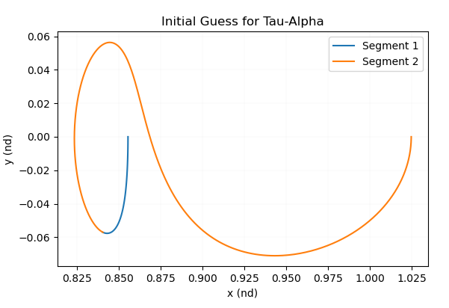

Current Progress
Segment 1 integrated from $t=0$ to $t=τ_{α}$on periodic orbit
Segment 2 integrated from $t=0$ to $t=τ_{M}$ along manifold
Notes:
The solution being periodic means that the rates of contraction or expansion along the orbit are the same so we can transition the eigenvectors using the STM at a series of points around the orbit equally spaced in time

Slide 10
Moving forward
Some suspicious eigenvalues in stored data for previously computed orbit families
Recompute to check these + store additional information
L1 Lyapunov orbit Homoclinic connection
Maps
Tau-Alpha
L1 to L2 Lyapunov Heteroclinic connection
Fixed JC targeter

Slide 11
Non-Research
Research Goals
Continue exploration of the problem space
Manifolds from wide range of orbit families
Stability investigation
Stretching directions
Stable vs unstable orbits
Tool development along the way
Multi-processing/GPU processing
Multiple shooting
Tau-alpha
ATD
Learn to use and validate results
Look into Java under the hood to learn how to write software for exploration
Bi-circular restricted 4 body model
Class
AAE 590 (Spaceflight Operations)
Literature review
Improve methods for finding relevant technical papers, close reading, and organization
Personal
Work more efficiently
And hopefully less
Go to at least 2 group outings

