Slide 1
SQL

Slide 2
The plan for today
SQL Basics
UNION, INTERSECT, EXCEPT
Nested Queries
ANY, ALL operators
Aggregate Operators
Some SQL Examples

Slide 3
Querying Concepts
Querying should be:
Reliable: provides correct results
Efficient: Computation of results should be fast
Queries can be defined using:
Relational Algebra
Specialized Query Languages

Slide 4
Query Languages
Specialized language for Querying the data in a database
In this class, we will study the query language called SQL (Structured Query Language) used in most DBMSs.

Slide 5
Basic form of SQL Queries
SELECT target-list
FROM relation-list
WHERE qualification
target-list A list of attributes of output relations in relation-list
relation-list A list of relation names (possibly with a range-variable after each name)
e.g. Sailors S, Reserves R
qualification Comparisons (Attr op const or Attr1 op Attr2, where op is one of <, >, ≤, ≥, =, ≠) combined using AND, OR and NOT.

Slide 6
What’s contained in an SQL Query?
Every SQL Query must have:
SELECT clause: specifies columns to be retained in result
FROM clause: specifies a cross-product of tables
The WHERE clause (optional) specifies selection conditions on the tables mentioned in the FROM clause
SELECT target-list
FROM relation-list
WHERE qualification

Slide 7
Table Definitions
We will be using the following relations in our examples:
Sailors(sid:integer, sname:string, rating:integer, age:real)
Boats(bid:integer, bname:string, color:string)
Reserves(sid:integer, bid:integer, day:date)

Slide 8
Relation Instances…1
sid | sname | rating | age
22 | Dustin | 7 | 45.0
29 | Brutus | 1 | 33.0
31 | Lubber | 8 | 55.5
32 | Andy | 8 | 25.5
58 | Rusty | 10 | 35.0
64 | Horatio | 7 | 35.0
71 | Zorba | 10 | 16.0
74 | Horatio | 9 | 35.0
85 | Art | 3 | 25.5
95 | Bob | 3 | 63.5
An Instance of Sailors

Slide 9
Relation Instances…2
sid | bid | day
22 | 101 | 10/10/04
22 | 102 | 10/10/04
22 | 103 | 10/08/04
22 | 104 | 10/07/04
31 | 102 | 11/10/04
31 | 103 | 11/06/04
31 | 104 | 11/12/04
64 | 101 | 09/05/04
64 | 102 | 09/08/04
74 | 103 | 09/08/04
An Instance of Reserves

Slide 10
Relation Instances…3
An Instance of Boats
bid | bname | Color
101 | Interlake | Blue
102 | Interlake | Red
103 | Clipper | Green
104 | Marine | red

Slide 11
A Simple SQL Query
Find the names and ages of all sailors
sid | sname | rating | age
22 | Dustin | 7 | 45.0
29 | Brutus | 1 | 33.0
31 | Lubber | 8 | 55.5
32 | Andy | 8 | 25.5
58 | Rusty | 10 | 35.0
64 | Horatio | 7 | 35.0
71 | Zorba | 10 | 16.0
74 | Horatio | 9 | 35.0
85 | Art | 3 | 25.5
95 | Bob | 3 | 63.5
SELECT S.sname, S.age
FROM Sailors S

Slide 12
Result of Previous Query
SELECT S.sname, S.age
FROM Sailors S
sname | age
Dustin | 45.0
Brutus | 33.0
Lubber | 55.5
Andy | 25.5
Rusty | 35.0
Horatio | 35.0
Zorba | 16.0
Horatio | 35.0
Art | 25.5
Bob | 63.5
Duplicate Results

Slide 13
Preventing Duplicate Tuples in the Result
Use the DISTINCT keyword in the SELECT clause:
SELECT DISTINCT S.sname, S.age
FROM Sailors S

Slide 14
Results of Original Query without Duplicates
sname | age
Dustin | 45.0
Brutus | 33.0
Lubber | 55.5
Andy | 25.5
Rusty | 35.0
Horatio | 35.0
Zorba | 16.0
Horatio | 35.0
Art | 25.5
Bob | 63.5
Appears only once

Slide 15
Example SQL Query…1
Find the names of sailors who have reserved boat 103
Relational Algebra:
π_{sname} ((σ_{bid=103}Reserves) Sailors)
SQL:
SELECT S.sname
FROM Sailors S, Reserves R
WHERE S.sid=R.sid AND R.bid=103

Slide 16
Result of Previous Query
sid | bid | day
22 | 103 | 10/08/04
31 | 103 | 11/06/04
74 | 103 | 09/08/04
sid | sname | rating | age
22 | Dustin | 7 | 45.0
29 | Brutus | 1 | 33.0
31 | Lubber | 8 | 55.5
32 | Andy | 8 | 25.5
58 | Rusty | 10 | 35.0
64 | Horatio | 7 | 35.0
71 | Zorba | 10 | 16.0
74 | Horatio | 9 | 35.0
85 | Art | 3 | 25.5
95 | Bob | 3 | 63.5
sname
Dustin
Lubber
Horatio
Result:

Slide 17
A Note on Range Variables
Really needed only if the same relation appears twice in the FROM clause. The previous query can also be written as:
SELECT S.sname
FROM Sailors S, Reserves R
WHERE S.sid=R.sid AND R.bid=103
OR
SELECT sname
FROM Sailors, Reserves
WHERE Sailors.sid=Reserves.sid AND bid=103
However, it is a good
style to always use
range variables!

Slide 18
Example SQL Query…2
Find the sids of sailors who have reserved a red boat
SELECT R.sid
FROM Boats B, Reserves R
WHERE B.bid=R.bid AND B.color=‘red’

Slide 19
Example SQL Query…3
Find the names of sailors who have reserved a red boat
SELECT S.sname
FROM Sailors S, Boats B, Reserves R
WHERE S.sid=R.sid AND B.bid=R.bid AND B.color=‘red’

Slide 20
Example SQL Query…4
Find the colors of boats reserved by ‘Lubber’
SELECT B.color
FROM Sailors S, Reserves R, Boats B
WHERE S.sid=R.sid AND R.bid=B.bid AND S.sname=‘Lubber’

Slide 21
Example SQL Query…5
Find the names of sailors who have reserved at least one boat
SELECT S.sname
FROM Sailors S, Reserves R
WHERE S.sid=R.sid
(Would adding DISTINCT to this query make a difference?)
(What is the effect of replacing S.sname by S.sid in the SELECT clause? Would adding DISTINCT to this variant of the query make a difference?)

Slide 22
Expressions and Strings
AS and = are two ways to name fields in result.
LIKE is used for string matching. ‘_’ stands for exactly one arbitrary character and ‘%’ stands for 0 or more arbitrary characters.

Slide 23
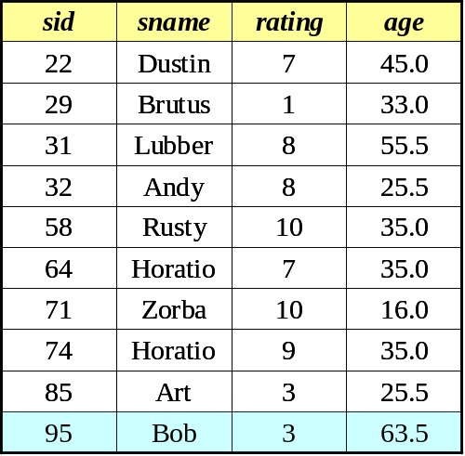
Expressions and Strings Example
Find triples (of ages of sailors and two fields defined by expressions, i.e. current age-1 and twice the current age) for sailors whose names begin and end with B and contain at least three characters.
SELECT S.age, age1=S.age-1, 2*S.age AS age2
FROM Sailors S
WHERE S.sname LIKE ‘B_%B’
Result:
age | age1 | Age2
63.5 | 62.5 | 127.0

Slide 24
UNION, INTERSECT, EXCEPT
UNION: Can be used to compute the union of any two union-compatible sets of tuples (which are themselves the result of SQL queries).
EXCEPT: Can be used to compute the set-difference operation on two union-compatible sets of tuples.
INTERSECT: Can be used to compute the intersection of any two union-compatible sets of tuples.

Slide 25
Illustration of UNION…1
Find the sids of sailors who have reserved a red or a green boat
Intuitively, we would write:
SELECT S.sid
FROM Sailors S, Boats B, Reserves R
WHERE S.sid=R.sid AND R.bid=B.bid
AND (B.color=‘red’ OR B.color=‘green’)

Slide 26
Illustration of UNION…2
We can also do this using a UNION keyword:
SELECT S.sid
FROM Sailors S, Boats B, Reserves R
WHERE S.sid=R.sid AND R.bid=B.bid
AND B.color=‘red’
UNION
SELECT S.sid
FROM Sailors S, Boats B, Reserves R
WHERE S.sid=R.sid AND R.bid=B.bid
AND B.color=‘green’

Slide 27
Illustration of INTERSECT…1
Find names of sailors who’ve reserved a red and a green boat
Intuitively, we would write the SQL query as:
SELECT S.sname
FROM Sailors S, Boats B1, Reserves R1, Boats B2,
Reserves R2
WHERE S.sid=R1.sid AND R1.bid=B1.bid
AND S.sid=R2.sid AND R2.bid=B2.bid
AND (B1.color=‘red’ AND B2.color=‘green’)

Slide 28
Illustration of INTERSECT…2
We can also do this using a INTERSECT keyword:
SELECT S.sname
FROM Sailors S, Boats B, Reserves R
WHERE S.sid=R.sid AND R.bid=B.bid AND B.color=‘red’
INTERSECT
SELECT S.sname
FROM Sailors S2, Boats B2, Reserves R2
WHERE S2.sid=R2.sid AND R2.bid=B2.bid AND B2.color=‘green’
(Is this correct??)

Slide 29
Correct SQL Query for the Previous Example
SELECT S.sid
FROM Sailors S, Boats B, Reserves R
WHERE S.sid=R.sid AND R.bid=B.bid
AND B.color=‘red’
INTERSECT
SELECT S2.sid
FROM Sailors S2, Boats B2, Reserves R2
WHERE S2.sid=R2.sid AND R2.bid=B2.bid
AND B2.color=‘green’
(This time we have actually extracted the sids of sailors, and not their names.)

Slide 30
Illustration of EXCEPT
Find the sids of all sailors who have reserved red boats but not green boats:
SELECT S.sid
FROM Sailors S, Boats B, Reserves R
WHERE S.sid=R.sid AND R.bid=B.bid AND B.color=‘red’
EXCEPT
SELECT S2.sid
FROM Sailors S2, Boats B2, Reserves R2
WHERE S2.sid=R2.sid AND R2.bid=B2.bid AND B2.color=‘green’

Slide 31
Nested Queries
A nested query is a query that has another query embedded within it; this embedded query is called the subquery.
Subqueries generally occur within the WHERE clause (but can also appear within the FROM and HAVING clauses)
Nested queries are a very powerful feature of SQL. They help us write short and efficient queries.
(Think of nested for loops in C++. Nested queries in SQL are similar)

Slide 32
Example of a Nested Query
Find names of sailors who have reserved boat 103
SELECT S.sname
FROM Sailors S
WHERE S.sid IN ( SELECT R.sid
FROM Reserves R
WHERE R.bid=103 )

Slide 33
Another Example of a Nested Query
Find names of sailors who have not reserved boat 103
SELECT S.sname
FROM Sailors S
WHERE S.sid NOT IN ( SELECT R.sid
FROM Reserves R
WHERE R.bid=103 )

Slide 34
Correlated Nested Queries…1
Thus far, we have seen nested queries where the inner subquery is independent of the outer query.
We can make the inner subquery depend on the outer query. This is called correlation.

Slide 35
Correlated Nested Queries…2
Find names of sailors who have reserved boat 103
SELECT S.sname
FROM Sailors S
WHERE EXISTS (SELECT *
FROM Reserves R
WHERE R.bid=103 AND R.sid=S.sid)
Tests whether the set is nonempty
(For finding sailors who have not reserved boat 103, we would use NOT EXISTS)

Slide 36
UNIQUE operator
When we apply UNIQUE to a subquery, it returns true if no row is duplicated in the answer to the subquery.
What would the following SQL query return?
SELECT S.sname
FROM Sailors S
WHERE UNIQUE (SELECT R.bid
FROM Reserves R
WHERE R.bid=103
AND R.sid=S.sid)
(All sailors with at most one reservation for boat 103.)

Slide 37
ANY and ALL operators
Find sailors whose rating is better than some sailor named Horatio
SELECT S.sid
FROM Sailors S
WHERE S.rating > ANY (SELECT S2.rating
FROM Sailors S2
WHERE S2.sname=‘Horatio’)
(Can you find the probable bug in this SQL query??)
Hint: what if there’re several sailors named Horatio?

Slide 38
Using ALL operator
Find sailors whose rating is better than every sailor named Horatio
SELECT S.sid
FROM Sailors S
WHERE S.rating > ALL(SELECT S2.rating
FROM Sailors S2
WHERE S2.sname=‘Horatio’)

Slide 39
Aggregate operators
What is aggregation?
  Computing arithmetic expressions, such as Minimum or Maximum
The aggregate operators supported by SQL are:
  COUNT, SUM, AVG, MIN, MAX

Slide 40
Aggregate Operators
COUNT(A): The number of values in the column A
SUM(A): The sum of all values in column A
AVG(A): The average of all values in column A
MAX(A): The maximum value in column A
MIN(A): The minimum value in column A
(We can use DISTINCT with COUNT, SUM and AVG to compute
only over non-duplicated columns)

Slide 41
Using the COUNT operator
Count the number of sailors
SELECT COUNT (*)
FROM Sailors S

Slide 42
Example of SUM operator
Find the sum of ages of all sailors with a rating of 10
SELECT SUM (S.age)
FROM Sailors S
WHERE S.rating=10

Slide 43
Example of AVG operator
Find the average age of all sailors with rating 10
SELECT AVG (S.age)
FROM Sailors S
WHERE S.rating=10
(Shouldn’t we use DISTINCT in this case to take care of duplicated sailor ages??)

Slide 44
Example of MAX operator
Find the name and age of the oldest sailor
SELECT S.sname, MAX(S.age)
FROM Sailors S
But this is illegal in SQL!!

Slide 45
Correct SQL Query for MAX
SELECT S.sname, S.age
FROM Sailors S
WHERE S.age = ( SELECT MAX(S2.age)
FROM Sailors S2 )
(Should we have used DISTINCT before MAX in the above Query??)

Slide 46
Another Aggregate Query
Count the number of different sailors
SELECT COUNT (DISTINCT S.sname)
FROM Sailors S

Slide 47
BETWEEN and AND operators
The BETWEEN and AND operator selects a range of data between two values.
These values can be numbers, text, or dates.

Slide 48
BETWEEN and AND Example
Find the names of sailors whose age is between 25 and 35
SELECT sname
FROM Sailors
WHERE age BETWEEN 25 AND 35
(In the Query above, why have I used age and not S.age??)

Slide 49
SQL Examples…1
What does the following SQL Query do:
SELECT sid, sname
FROM Sailors
WHERE age= 25.5
Finds the sids and names of all sailors whose age is 25.5 years

Slide 50
SQL Examples…2
SELECT COUNT(*)
FROM Sailors
WHERE age = 25.5
Counts the number of sailors whose age is 25.5

Slide 51
SQL Examples…3
SELECT *
FROM Sailors
WHERE sname NOT BETWEEN 'Hansen' AND 'Pettersen'
Finds all sailors whose name is not (alphabetically) between Hansen and Pettersen

Slide 52
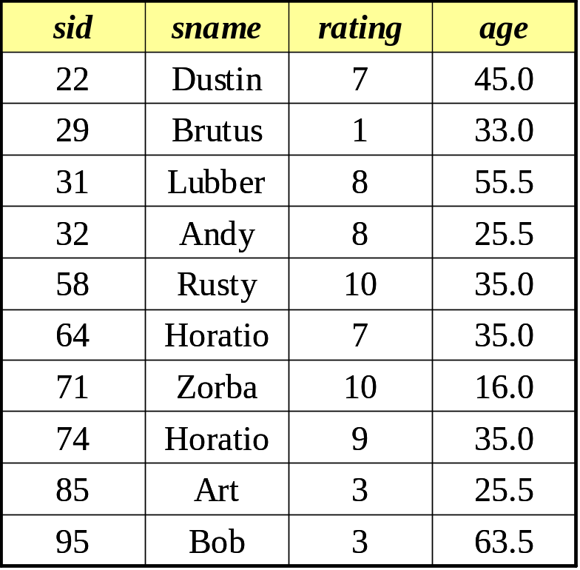
SQL Examples…4
SELECT *
FROM Sailors
WHERE sname LIKE ‘A%’
sid | sname | rating | age
32 | Andy | 8 | 25.5
85 | Art | 3 | 25.5
Finds all sailors whose name begins with ‘A’ and is at least 1-character long

Slide 53
SQL Examples…5
SELECT SUM(age)
FROM Sailors
WHERE age>20
Finds the sum of ages of all sailors whose age is greater than 20

Slide 54
SQL Examples…6
SELECT MIN(age)
FROM Sailors
WHERE age>20
Finds the minimum age from the ages of all sailors whose age is greater than 20

Slide 55
SQL Examples…7
What does the following SQL query do:
SELECT S.sname, MAX(S.age)
FROM Sailors S
(Isn't this illegal in SQL??) Nested query must be used here

Slide 56
More to come…
Advanced SQL concepts :
GROUP BY
ORDER BY
HAVING

