Slide 1
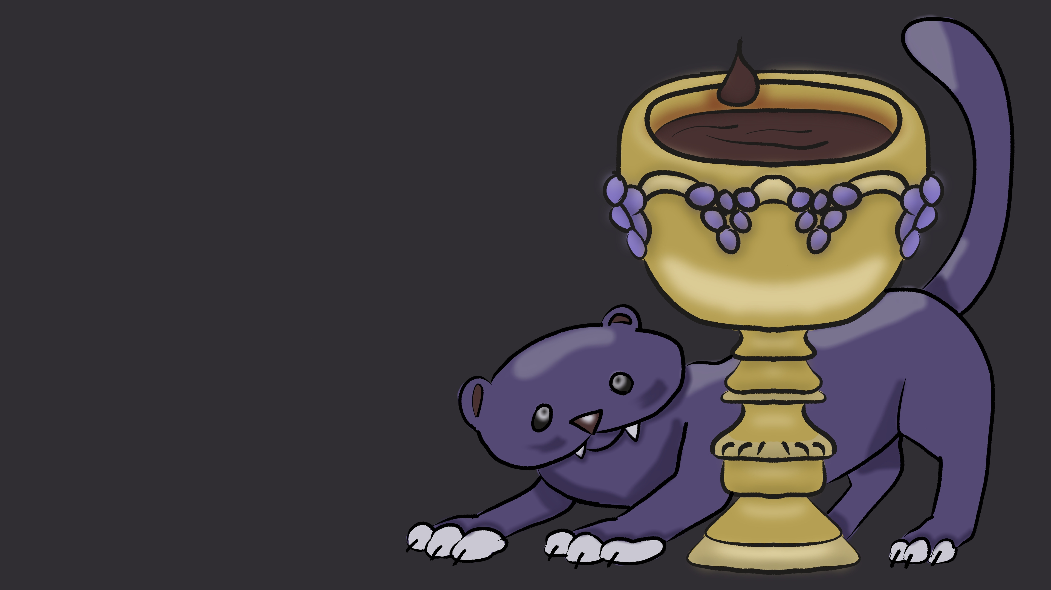
Call of Dionysus
Sam Hallam

Slide 2
Summary
Hades has kidnapped your beloved! In order to reach her, you must trade your sanity to your patron, Dionysus, god of madness, in order to obtain power ups to keep you in one piece as you descend through the Underworld. Your goal? Make it out of there alive with your dearest in your arms.

Slide 3
Inspirations
Greco-Roman mythology
Undertale and @porcirelius (stylization)

Slide 4
Early Concepts

Slide 5
Current Progress- Design

Slide 6
Current Progress- Programming

Slide 7
Current Progress- Sprites/Tiles

Slide 8
Current Progress- Audio

Slide 9
Goals for Next Update
Primary Goals:
Implement the sanity trade mechanic
Implement spawners
Create tutorial UI
Begin playtesting
Begin designing other levels
Secondary Goals:
Begin sprite animations
Work on SFX for the player and monsters
Begin playtesting
Begin designing other levels
Implement projectile attack

