Slide 1

Bellevue University
DSC640-Data Presentation & Visualizat
Fall-2021 Session
Arindam Samanta

Slide 2
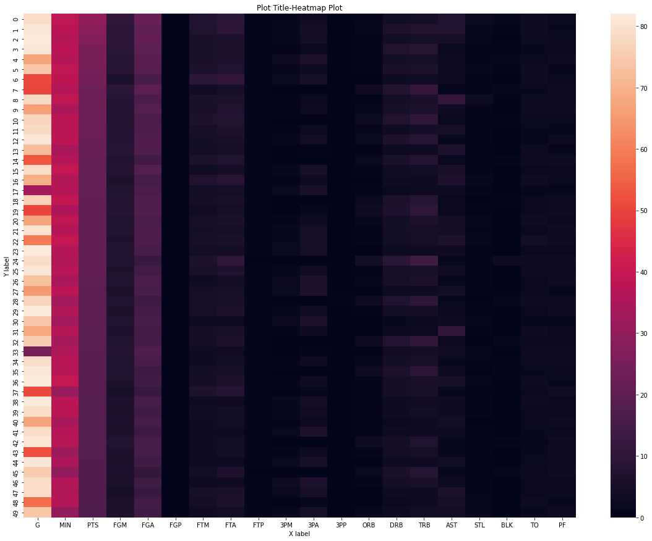
Python-Charts
Heat Map

Slide 3
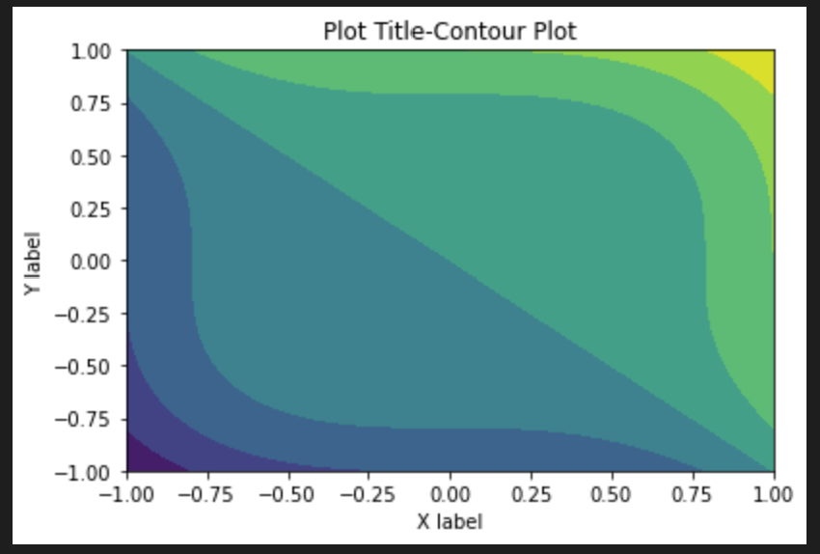
Python charts
Contour Chart

Slide 4
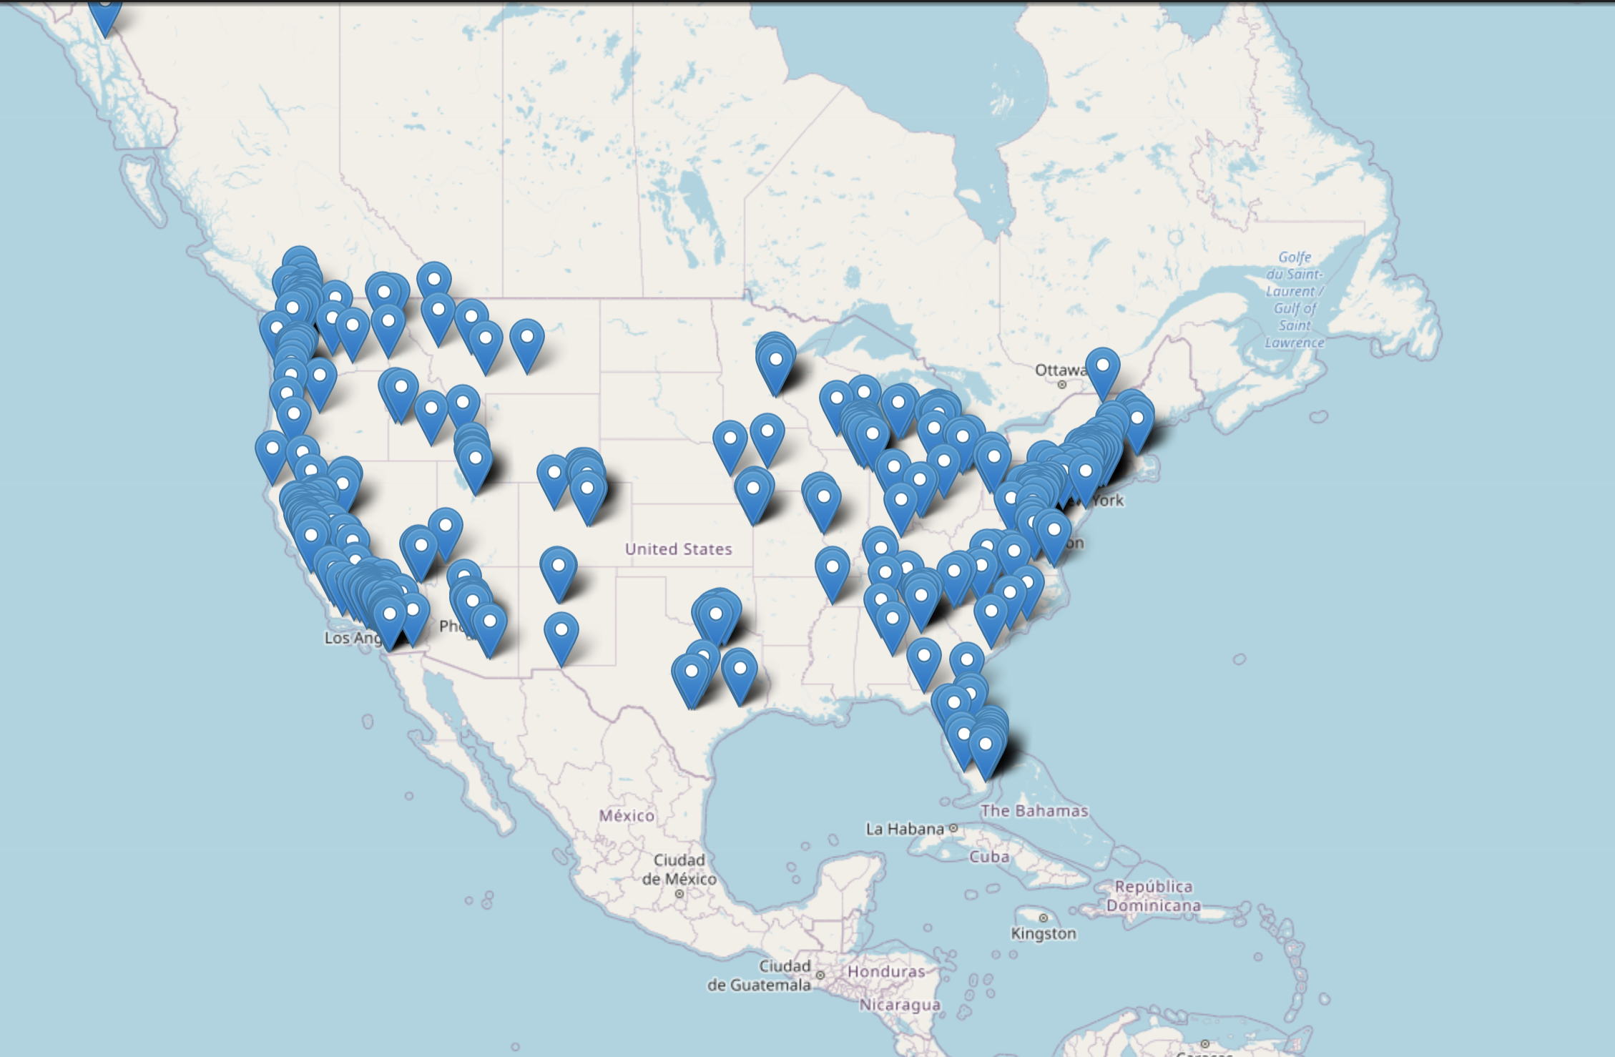
Python Charts
Spatial Chart

Slide 5
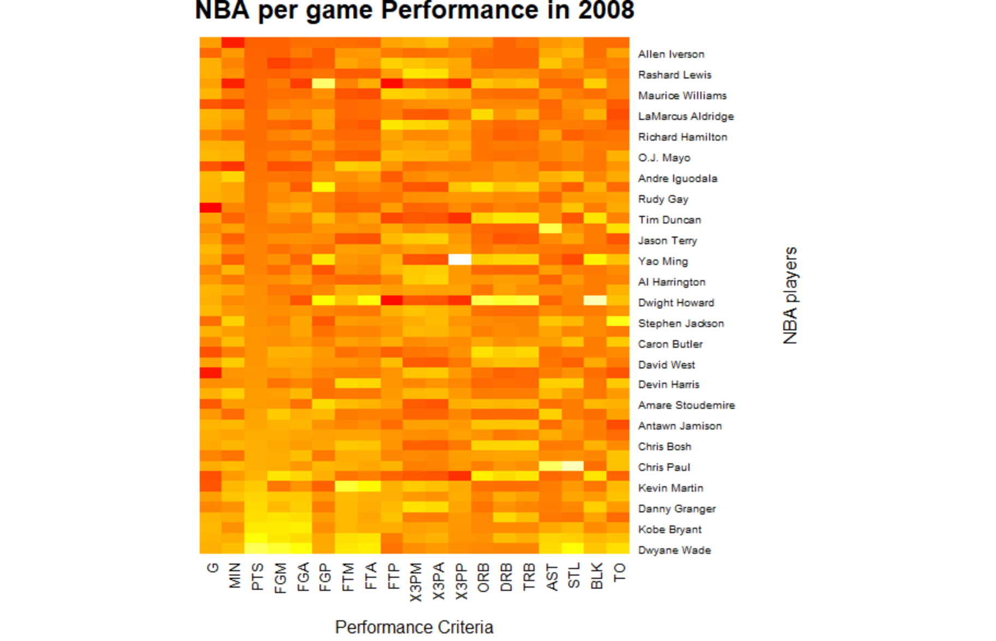
R-charts
Heat Map

Slide 6
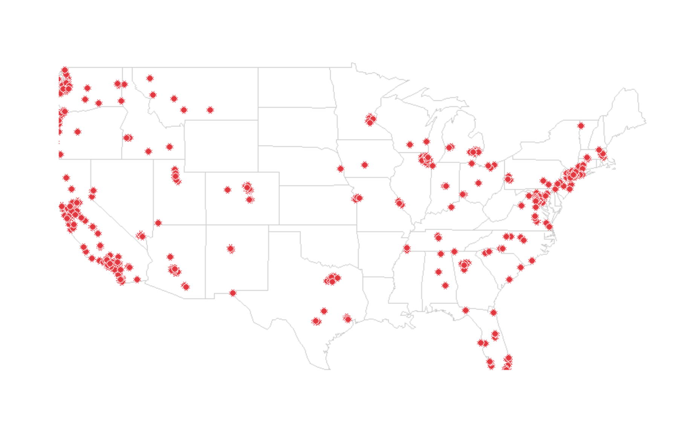
R charts
Spatial Chart
Costco Locations Across the USA

Slide 7
R Charts
Contour Chart

Slide 8
Tableau Heat Map,Spatial Chart Funnel or Violin Chart

