Slide 1
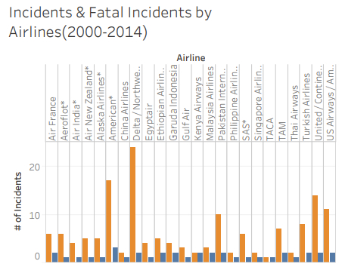
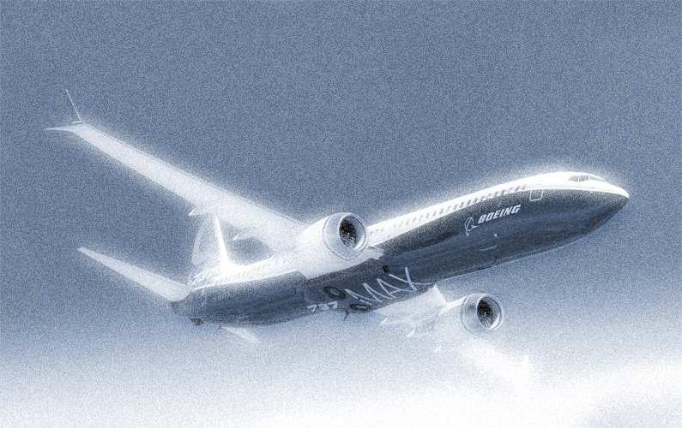
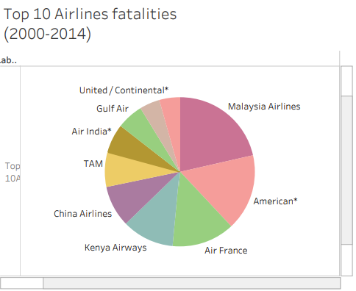
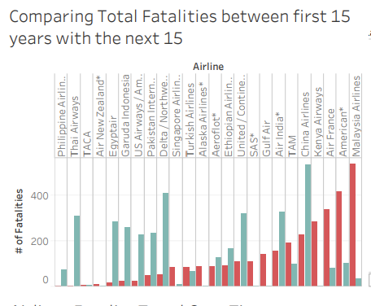
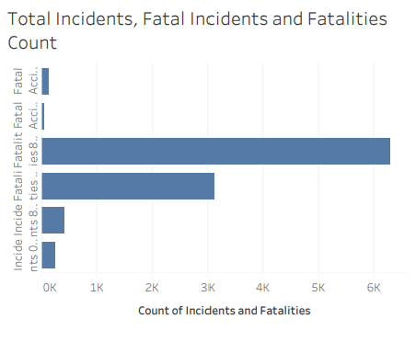
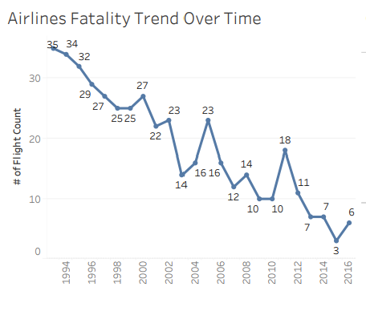
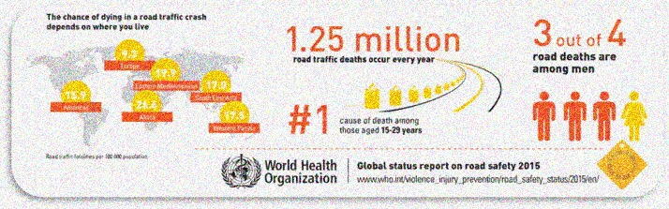
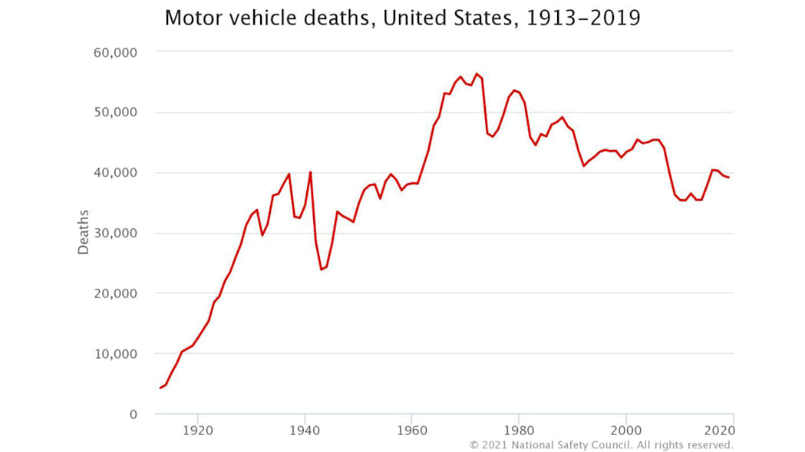
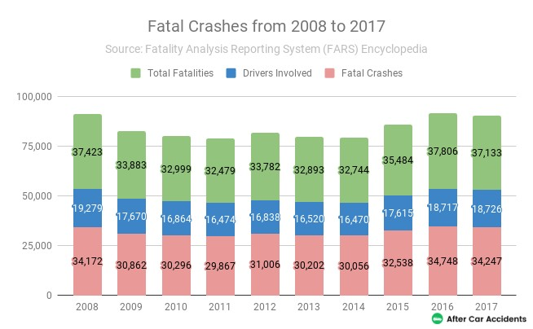
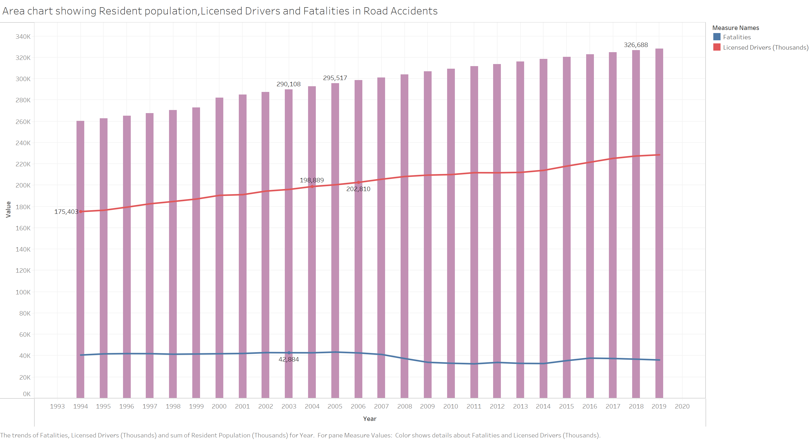
Arindam Samanta
Bellevue University
DSC640: Data Visualization
Is Flying more fatal than driving
Despite the recent tragic loss activity, flying is often said to be the safest form of transport, and this is at least true in terms of fatalities per distance travelled. According to the Civil Aviation Authority, the fatality rate per billion kilometres travelled by plane is 0.003 compared to 0.27 by rail and 2.57 by car. In absolute numbers, driving is more dangerous, with more than 5 million accidents compared to 20 accidents in flying. A more direct comparison per 100 million miles pits driving's 1.27 fatalities and 80 injuries against flying's lack of deaths and almost no injuries, which again shows air travel to be safer.
Airlines fatality is much lower compared to the incidents
Handful of Airlines share of fatality in the incidents
Airlines fatality reducing with improving of technology
Fatal Incidents are much lower compared to Incidents
Airlines fatality coming down over time
odds of dying in a motor vehicle accident is 1 in 98
Upward trend of vehicular accidents
References
https://commetric.com/wp-content/uploads/2019/04/Boeing-Ethiopian-Crash-795x500.jpg
https://github.com/fivethirtyeight/data/tree/master/airline-safetyhttps://github.com/fivethirtyeight/data/tree/master/airline-safety
http://www.informationisbeautiful.net/visualizations/plane-truth-every-single-commercial-plane-crash-visualized/

