Slide 1

Bellevue University
DSC640-Data Presentation & Visualizat
Fall-2021 Session
Arindam Samanta

Slide 2
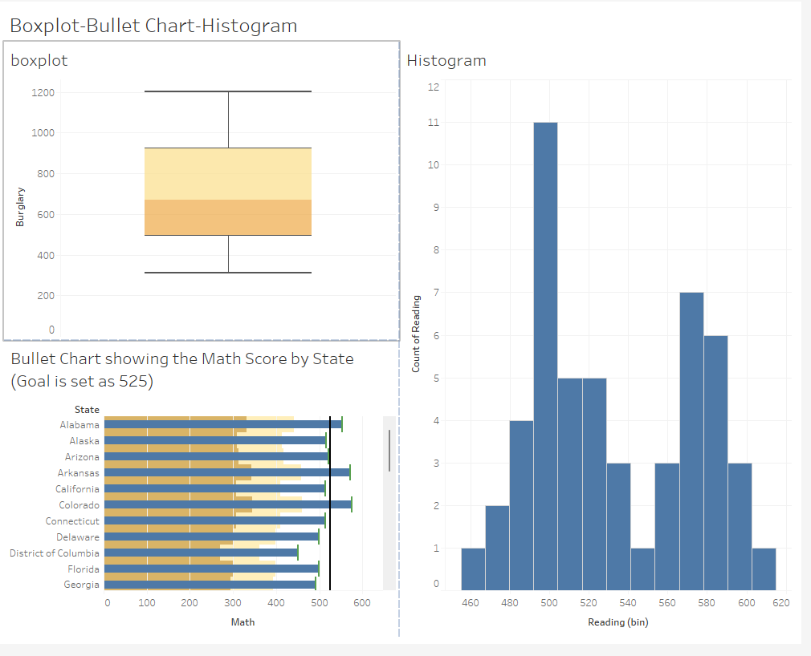
Tableau-Charts

Slide 3
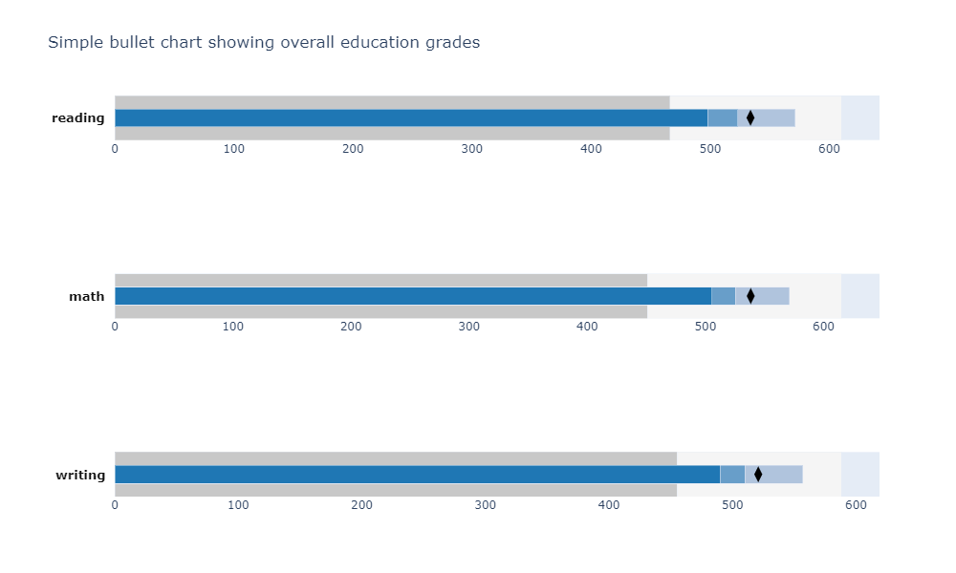
Python-Charts
Bullet Chart

Slide 4
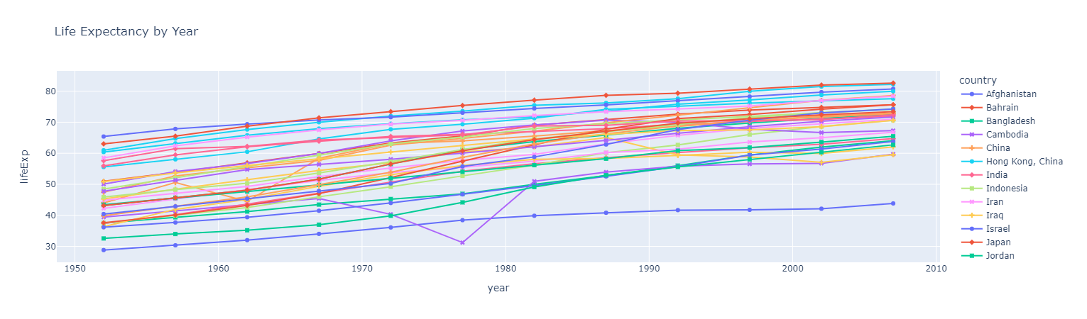
Python charts
Line Chart

Slide 5
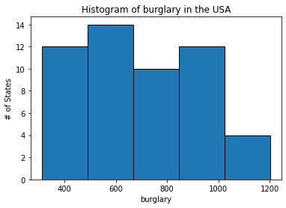
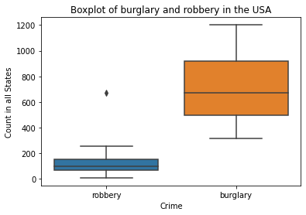
Python Charts

Slide 6
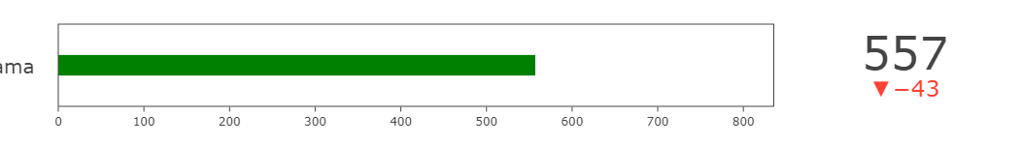
R-charts
Bullet Chart
Alaba

Slide 7
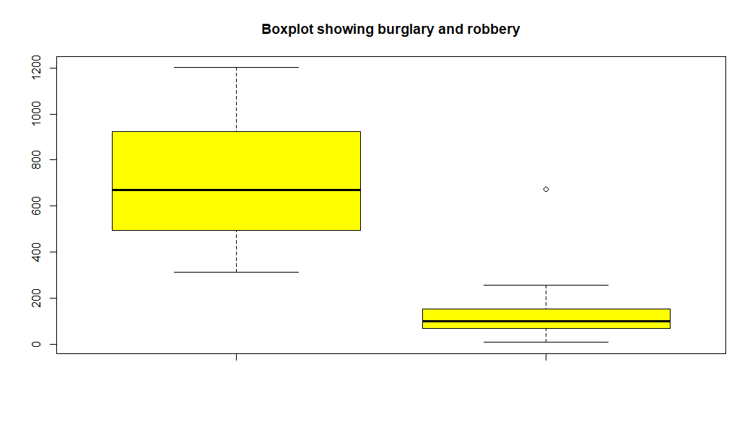
R-charts
Box Plot

Slide 8
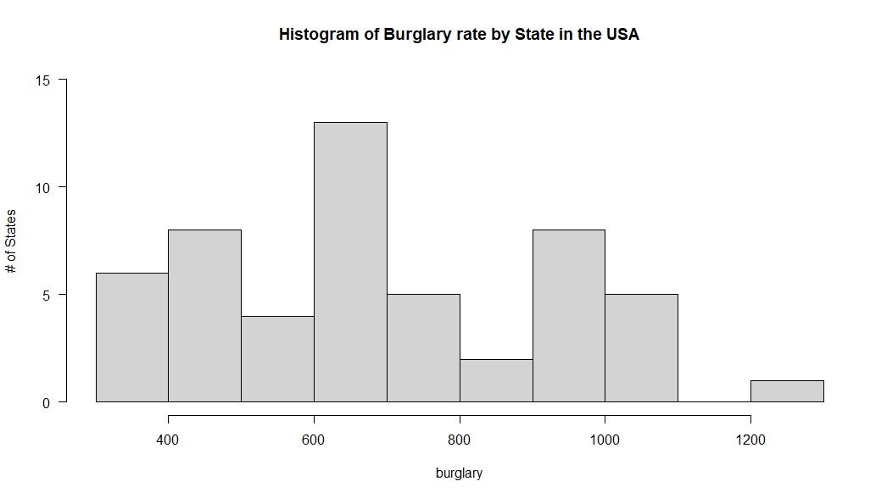
R-charts
Histogram

Slide 9
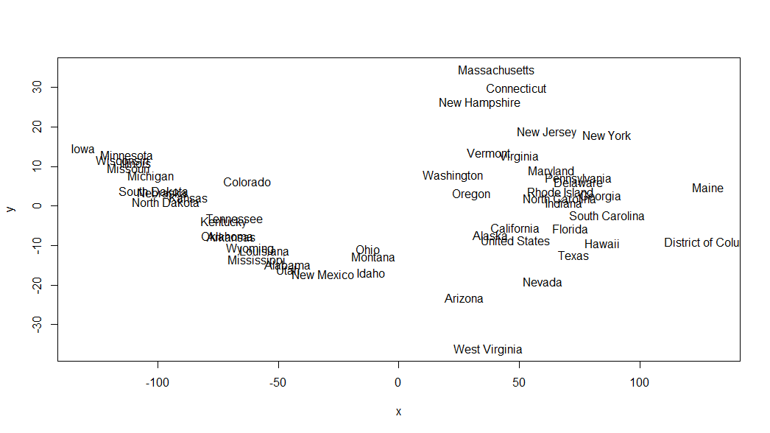
R charts
Chart Showing the position of the states in USA based on education

