Slide 1

Bellevue University
DSC640-Data Presentation & Visualizat
Fall-2021 Session
Arindam Samanta

Slide 2
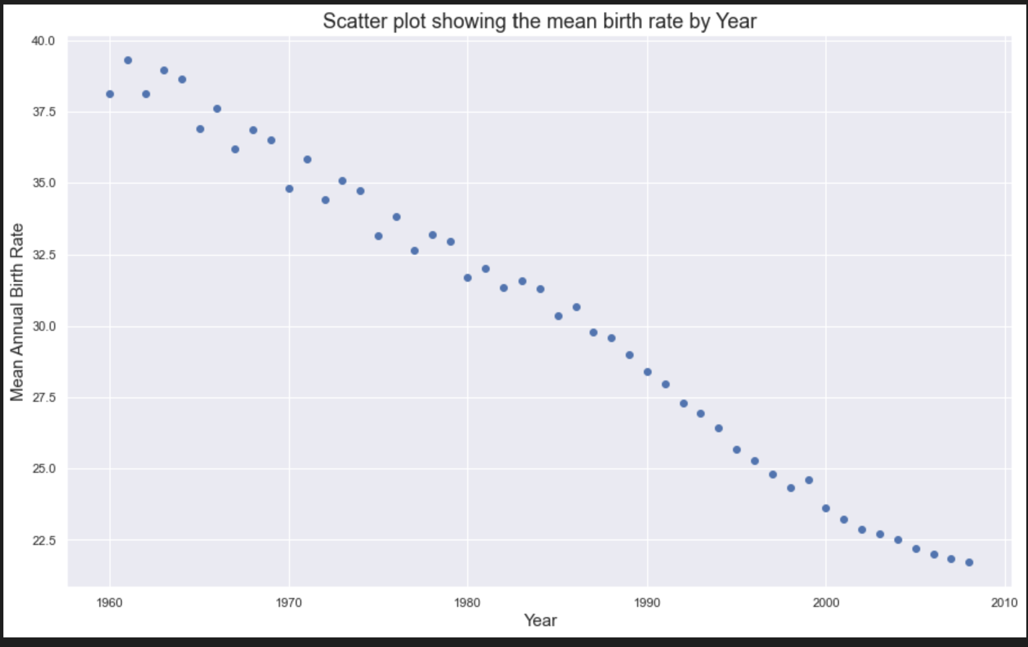
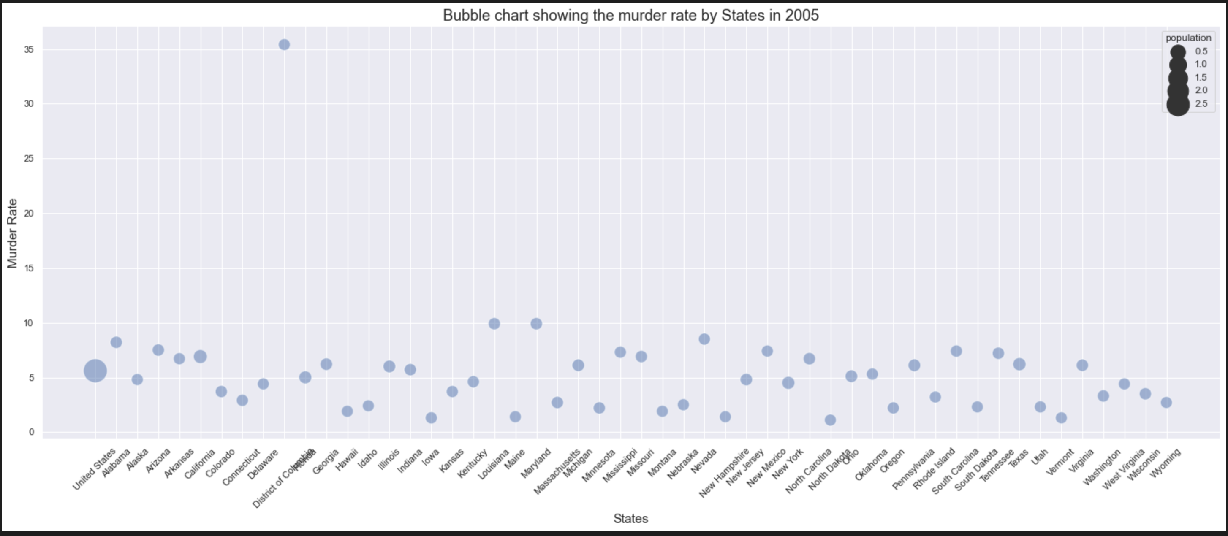
Python-Charts
Scatter Plot
Bubble Chart

Slide 3
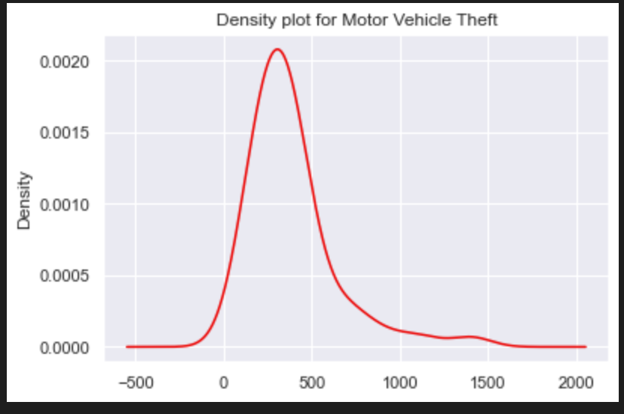
Python charts
Density Plot

Slide 4
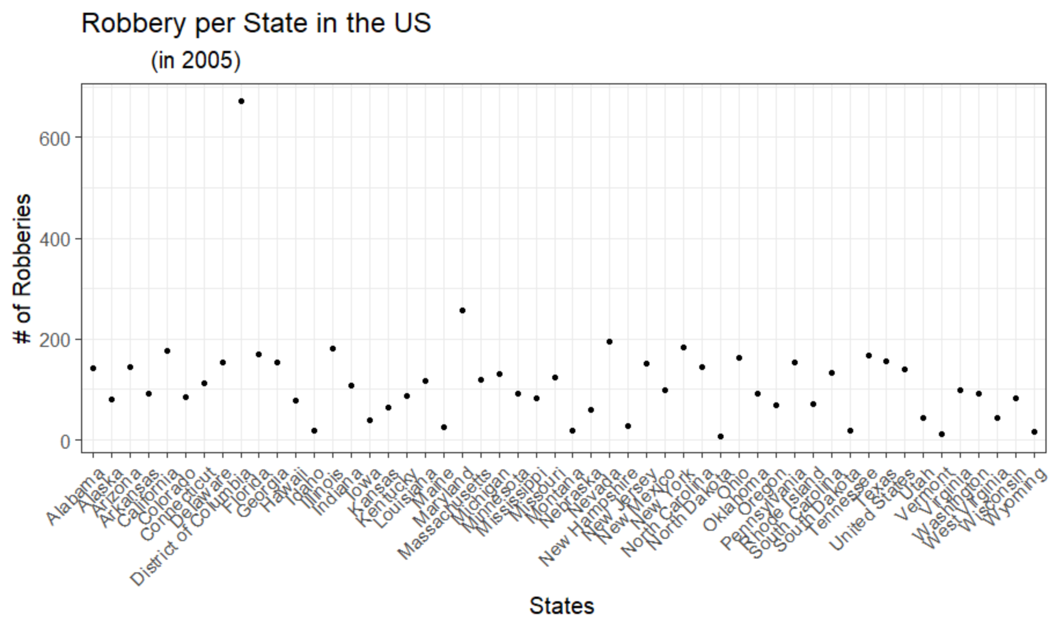
R-charts
Scatter Plot

Slide 5
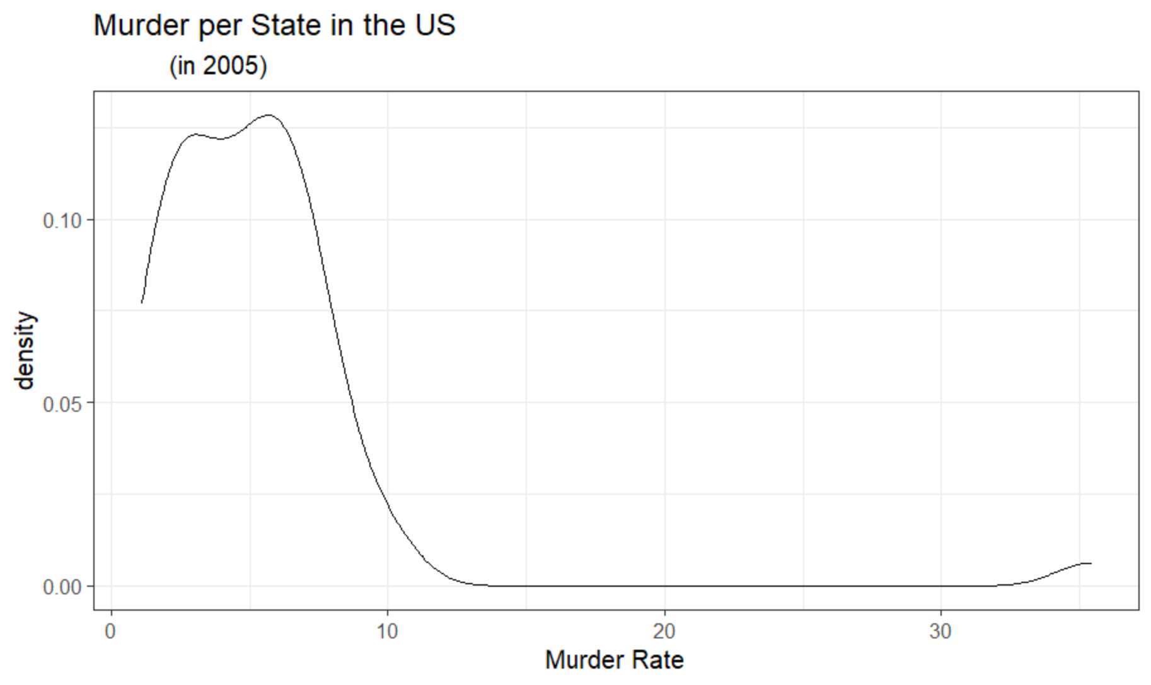
R charts
Density Plot

Slide 6
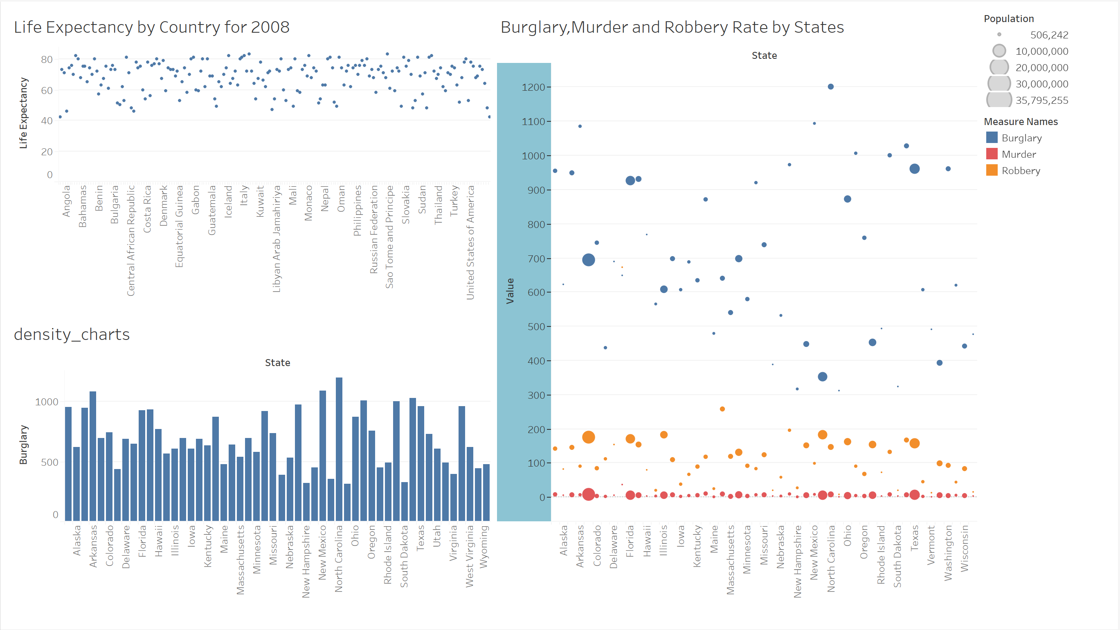
Tableau Dashboard

