Slide 1

Bellevue University
DSC640-Data Presentation & Visualizat
Fall-2021 Session
Arindam Samanta

Slide 2
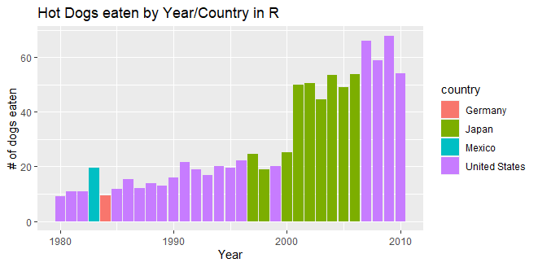
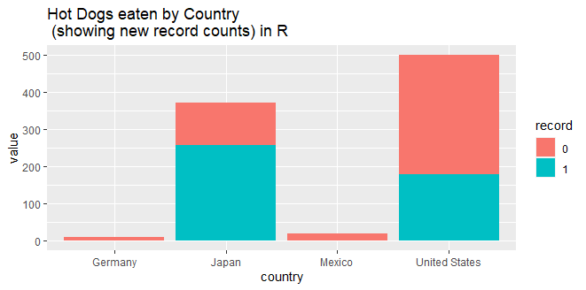
R-Charts
Bar Chart
Stacked Bar Chart

Slide 3
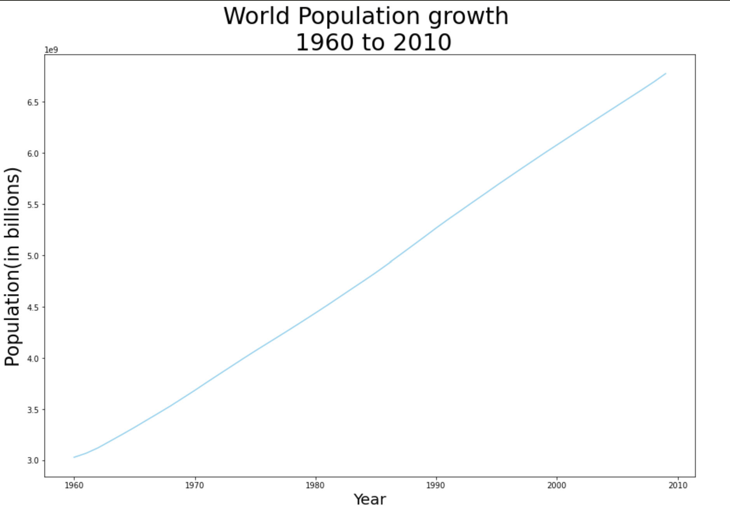
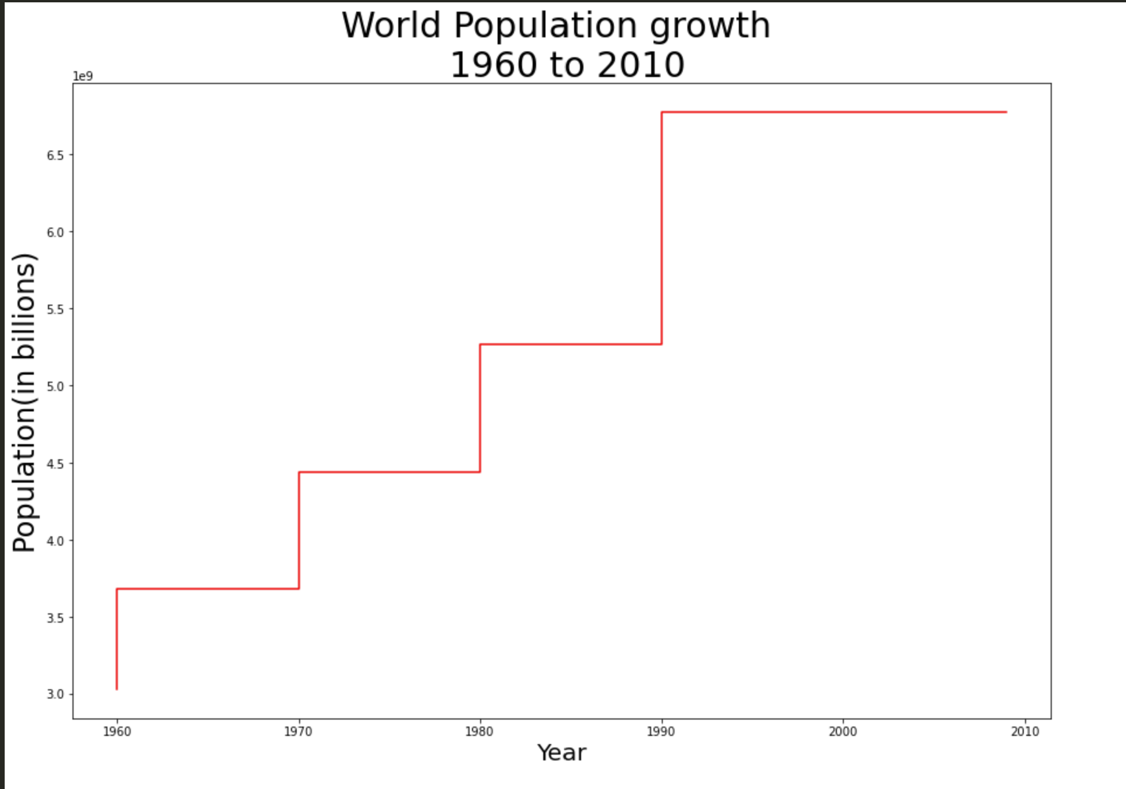
Python charts
Line Chart - Python
Step Chart - Python

Slide 4
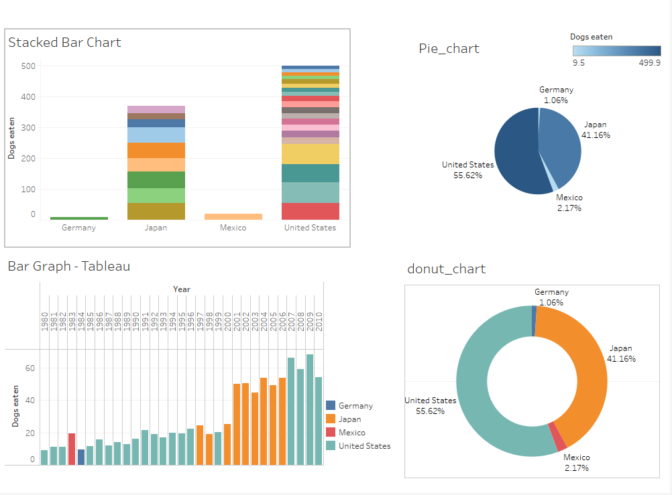
Tableau Dashboard

