Slide 1

Bellevue University
DSC640-Data Presentation & Visualizat
Fall-2021 Session
Arindam Samanta

Slide 2
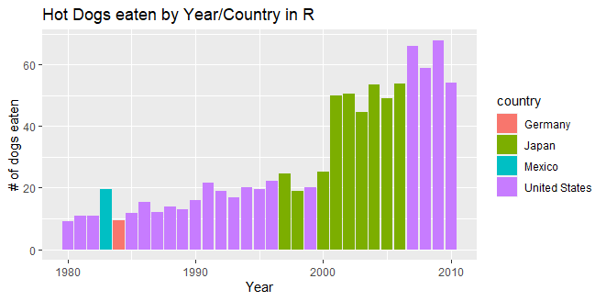
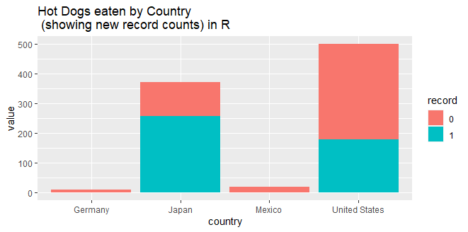
R-Charts
Bar Chart
Stacked Bar Chart

Slide 3
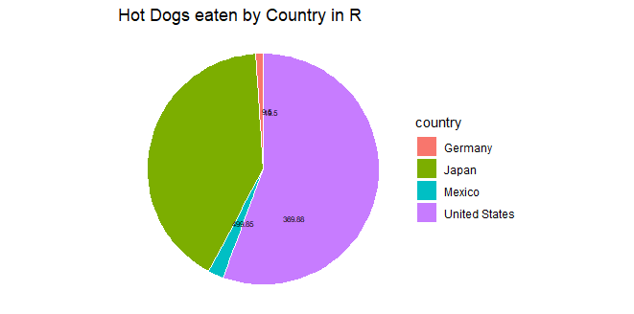
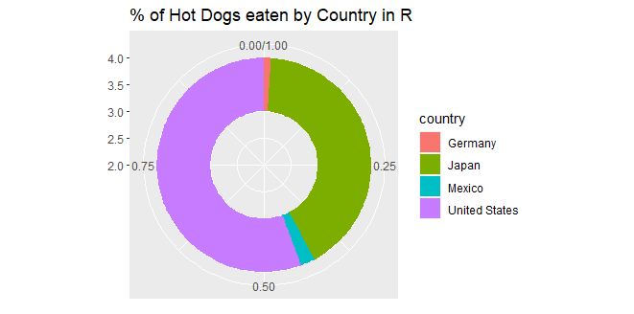
R Charts-Contd.
Pie Chart – RStudio
Donut Chart - RStudio

Slide 4
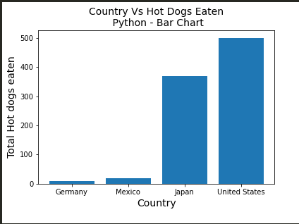
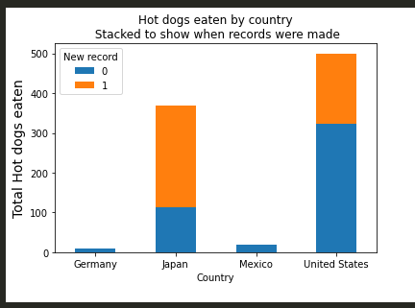
Python charts
Bar Chart - Python
Stacked Bar Chart - Python

Slide 5
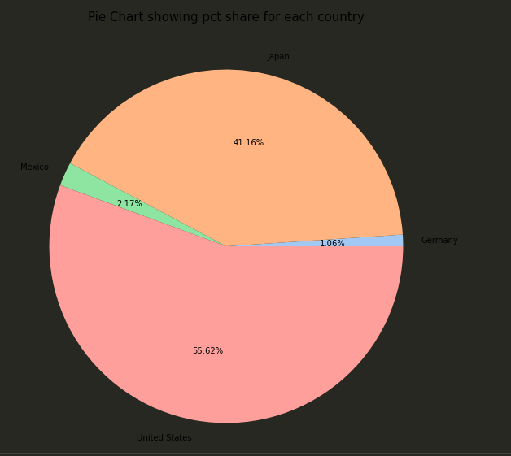
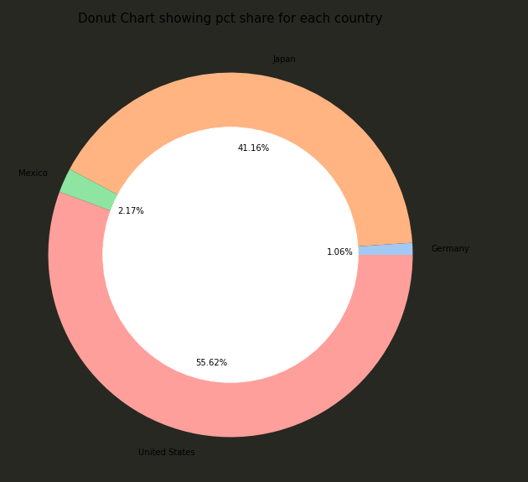
Python Chart Contd..
Pie Chart - Python
Donut Chart - Python

Slide 6
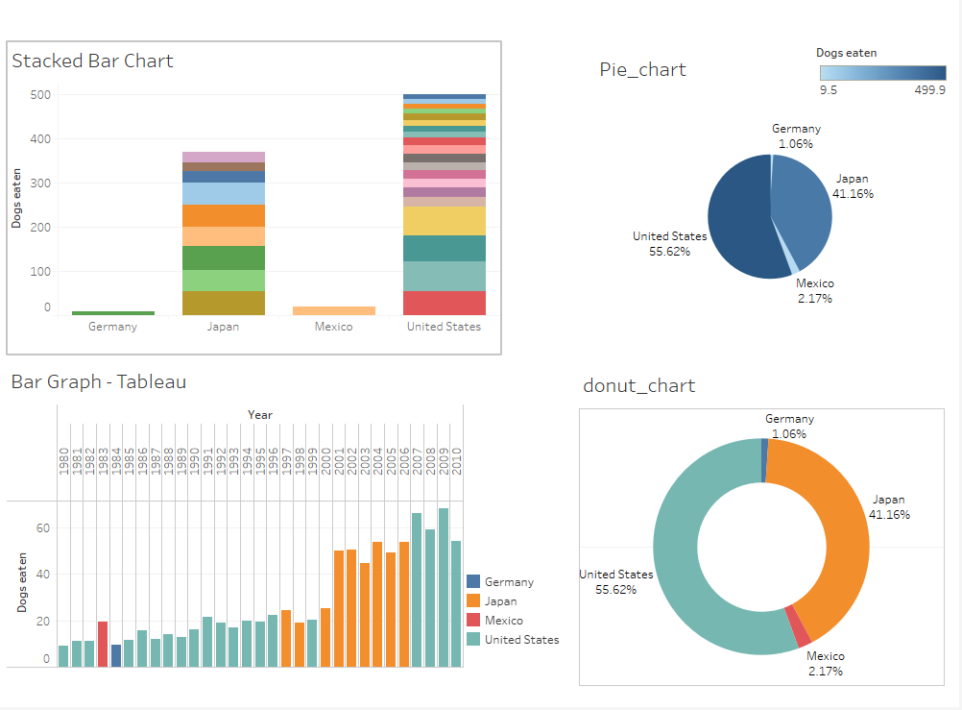
Tableau Dashboard

