Slide 1

Bellevue University
DSC640-Data Presentation & Visualizat
Fall-2021 Session
Arindam Samanta

Slide 2
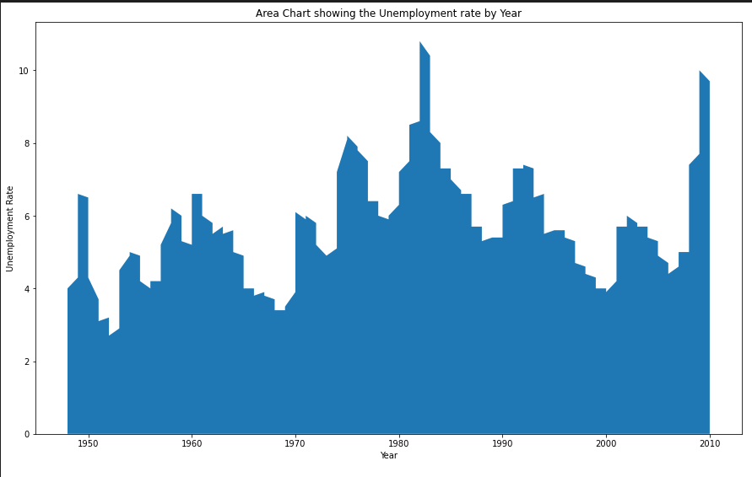
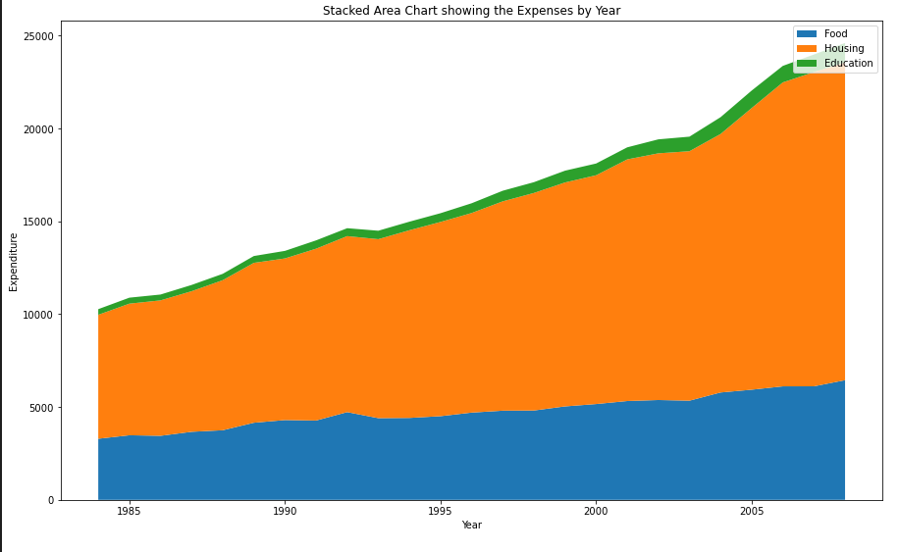
Python-Charts
Area Chart
Stacked Area Chart

Slide 3
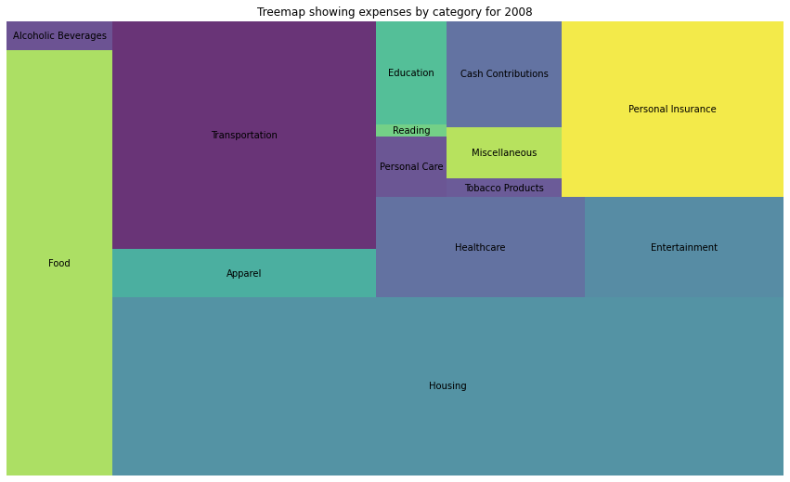
Python charts
Treemap

Slide 4
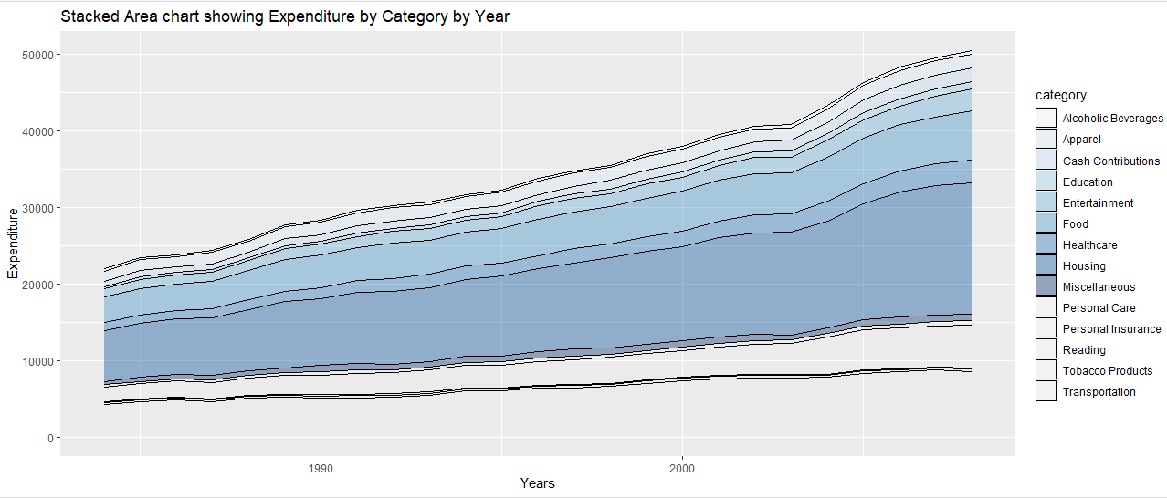
R-charts
Stacked Area Chart

Slide 5
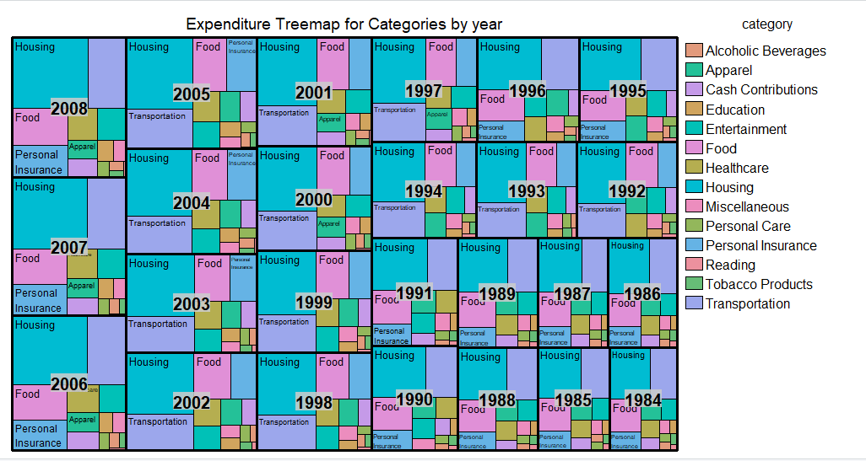
R charts
Treemap

Slide 6
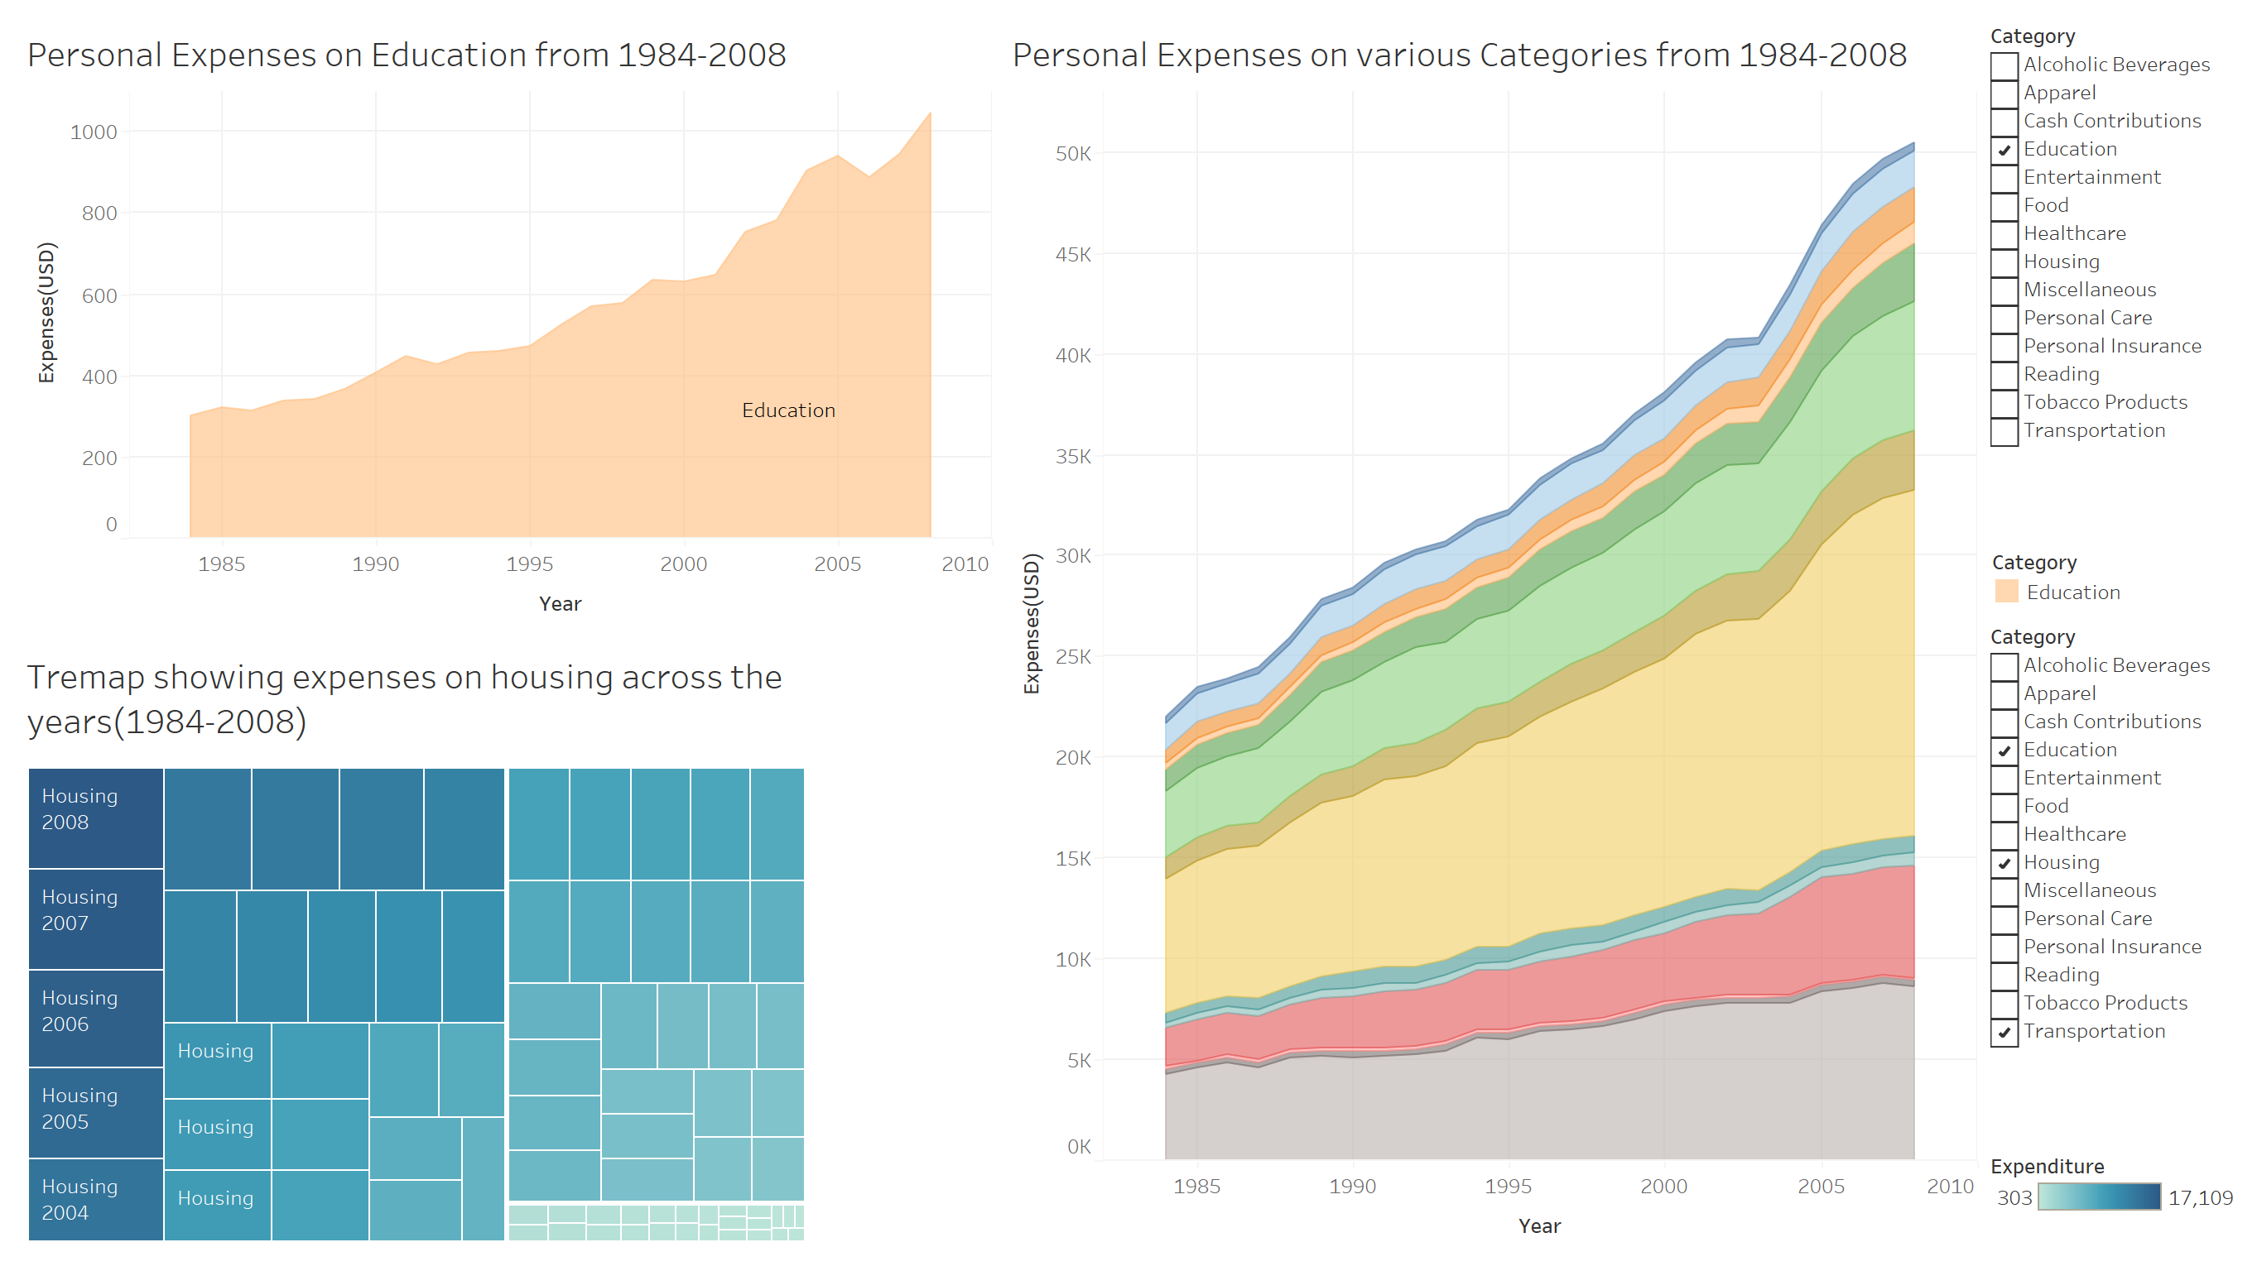
Tableau Dashboard

