Slide 1
Context Aware Text Analysis
Arindam Samanta
Bellevue University
MS-DSC

Slide 2
Business Problem / Background
During Enron’s rise to the top, they were intertwined with multiple counts of fraudulent activity that could have been detected years before Enron’s fall if investigators had the right tools. I am trying to solve the problem by proposing a text analytics solution to it. In order to understand the motives of the fraudsters we have to analyze unstructured data, such as emails and memos. Finding the relevant information quickly from the huge pile of textual data is a daunting task for the auditors.
Enron Corporation was an American energy, commodities and services company based out of Houston, Texas. In 2001, they filed for bankruptcy. Before their Dec. 2, 2001 bankruptcy filing, Enron employed 20,000 staff. They were one of the world’s leading electricity, natural gas, communications and pulp and paper companies, with claimed revenues of nearly $101 billion in 2000. Later it was revealed that its reported financial condition was sustained substantially by an institutionalized, systematic, and creatively planned accounting fraud, known since as Enron scandal.

Slide 3
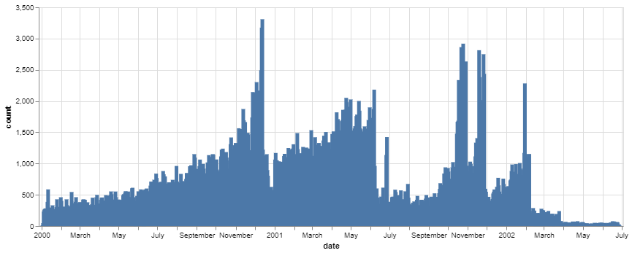
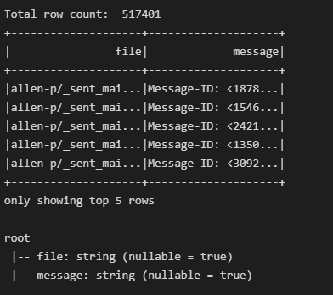
Data Explanation
The Data set contains roughly 500,000 emails of around 150 people related to Enron
The dataset was made public by the Federal Energy Regulatory Commission (FERC)
The Kaggle dataset stores the final collection in CSV format and this is what I have used for my analysis.
The Data set contains roughly 500,000 emails of around 150 people related to Enron
The below diagram shows the volume of emails sent during the last few months leading to the bankruptcy. The peaks are vital months

Slide 4
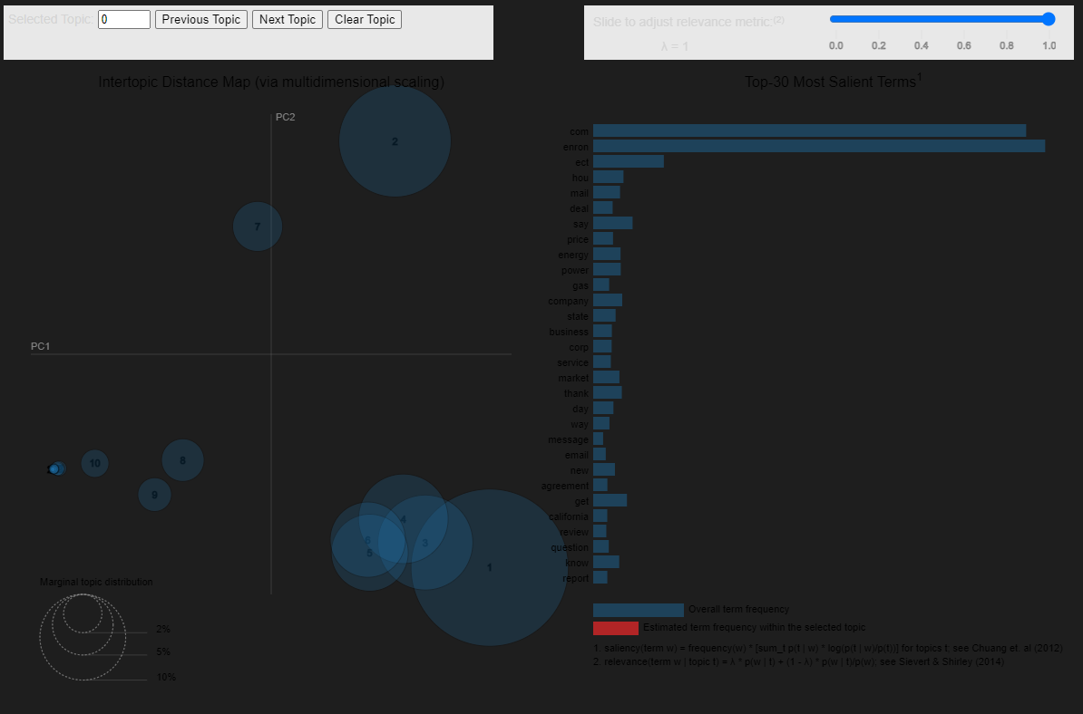
Topic Modeling with LDA / Analysis of the Outcome
I have used my personal laptop with VSC as the IDE to perform the analysis. I am giving below the steps upto the modelling:
Loaded the dataset(emails.csv) into the pandas dataframe
Used the helper functions to parse the raw messages
Next I extracted some key portions of the message like(‘msg_id’,‘from’,’To’,’body’)

Slide 5
Challenges / Ethical Assessment
Although topic modelling and sentiment analysis do provide some insight into the data, but I still think it is not an ethical investigating tool
Although I was lucky to get the Kaggle dataset and it was nicely arranged, but I do understand that looking at the corpus it is a huge dataset to be handled in a laptop.
Ethically assessing some of the emails was very difficult as they were very much personal in nature.

Slide 6
References and Acknowledgement
References:
Finally we would like to acknowledge Bellevue University for giving us this opportunity to present this academic project for the 2021 academic year as part of our MS Data Science course(MS DSC 630).
Additionally we would like to thank our Professor Fadi Alsaleem for his expert advice and guidance. Lastly we would also like to thank our class mates and our team members for continuous support and encouragement.
Abbott, David. Applied Predictive Analytics: Principles and Techniques for the Professional Data Analyst
https://www.kaggle.com/datasets/wcukierski/enron-email-dataset
https://www.cs.cmu.edu/~enron/enron_mail_20150507.tar.gz

