Slide 1
STARTUP MODE · VISIONFLOW AI
Visual operations.
Human-controlled.
Approve a visual rule. Inspect every event.
Teach a small model for one repeatable task.

Slide 2
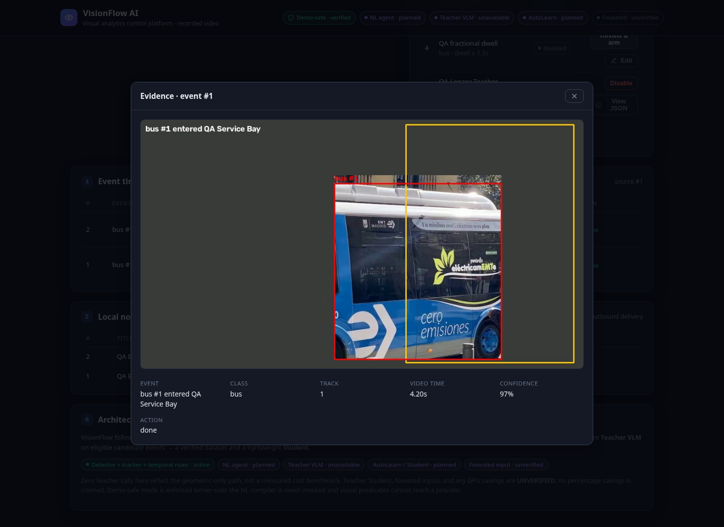
Know why an alert fired.
For service-centre operators
Recorded footage needs an operational rule, a clear approval boundary, and evidence that a manager can inspect.
A real geometric event
with a saved evidence frame
and a local notification.
2

Slide 3
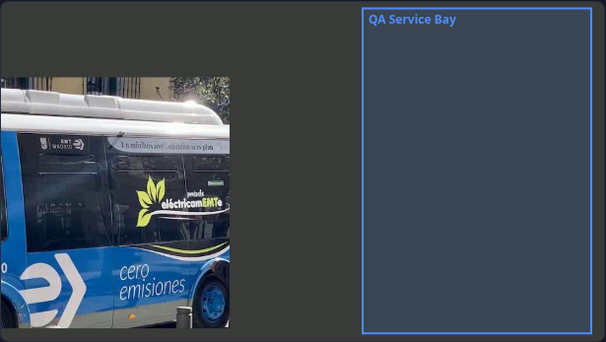
Configure, approve, observe.
1 Select a recorded MP4
2 Draw a polygon and set a rule
3 Review the validated JSON
4 Approve, run, inspect evidence
Edit · disable · review and re-enable
3

Slide 4
Observe cheaply. Learn selectively.
Observe
Understand
Specialize
Detector + tracker
Temporal rules
Selected candidate events
Private image Teacher
Strict label validation
Human review and correction
Frozen image embeddings
Small fitted Student
Shadow → manual activation
Verified geometric demo
24 human-verified images;
12 Teacher corrections
Real fit + reload + shadow;
QA corrections still required
4

Slide 5
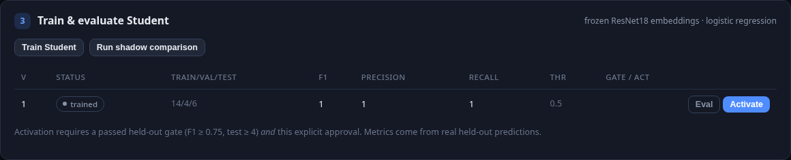
A measured synthetic pilot.
Local GPU Teacher
CPU Student
3 / 6 correct · recall 1.0
432.8 ms mean wall latency
18 requests · 36 model forwards
6 / 6 correct · recall 1.0
40.2 ms mean wall latency
0 Teacher requests
6 unique synthetic inputs; 18 timing samples. Experimental QA: CHANGES_REQUIRED. Natural quality / costs: UNVERIFIED.
5

Slide 6
Price the operational benefit.
Pricing hypothesis
Measure the unit cost
Per-camera / site subscription.
One repeatable workflow first.
Willingness to pay and pricing
remain UNVERIFIED.
GPU rental + storage + network.
CPU inference + support.
Cost per event from actual
runtime and processed events.
Vast closed: $0.001 rounded disk charge. Final invoice UNVERIFIED; no remote inference.
ROI = observed staff time saved × actual labour rate − measured system expense.
6

Slide 7
A three-month pilot.
Month 1
Month 2
Month 3
Define one task
Validate in shadow
Approve a rollout
Partner footage and consent
Agree event definitions
Collect reviewed examples
Held-out sessions
Measure missed/false events
Measure GPU cost and latency
Manual activation gate
Persist the prior version
Verify rollback and support
Proposed pilot. Adoption, willingness to pay, and ROI have not been measured.
7

Slide 8
Start with one accountable task.
Pilot a repeatable service-bay event
with a manager who owns the decision.
Today: approved geometric analytics and inspectable evidence.
Experimental: local Teacher and human-gated AutoLearn.
Unavailable: unsafe agent actions and public integrations.
A reliable demo first. Adaptive automation earns activation through measured quality.
8

