Slide 1
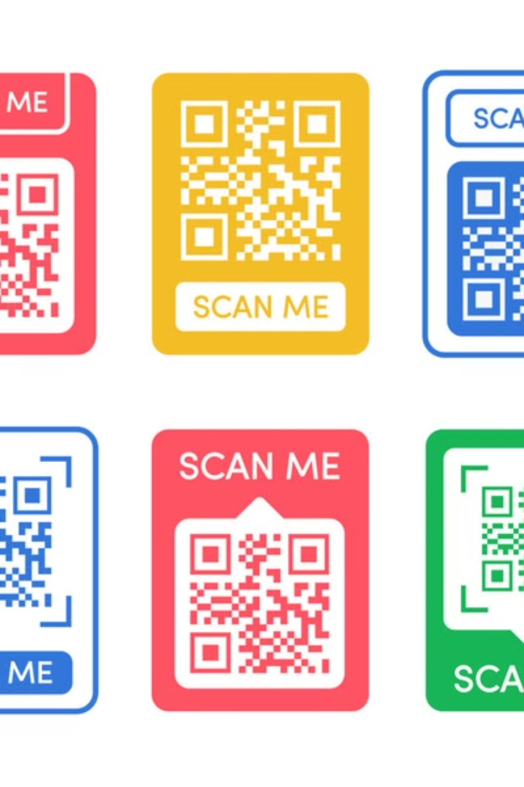
Generating QR Codes with Python
Welcome to this tutorial where we'll learn how to generate QR codes using Python. We'll cover everything from installing the necessary libraries to generating a QR code and saving it as an image.

Slide 2
Setting Up the Environment
Python Installation
Installing Libraries
Make sure you have Python 3.6 or later installed on your system. You can download it from the official Python website. Once installed, you can check your Python version by running the following command in your terminal:
We'll need two libraries to generate and save QR codes. These libraries are not part of the Python standard library, so we'll use the pip command to install them:
pip install qrcode
pip install pypng
python --version

Slide 3

Import the Library
1
Import the qrcode Library
2
Create a QR Code Object
Start by importing the qrcode library. This library provides the necessary functions to create QR codes in Python.
Create a qrcode object using the qrcode.QRCode class. This object will represent the QR code you're about to generate.
3
Set Parameters
Customize the QR code by setting parameters like version, error correction level, box size, and border width. These parameters affect the size, data capacity, and visual appearance of the QR code.

Slide 4
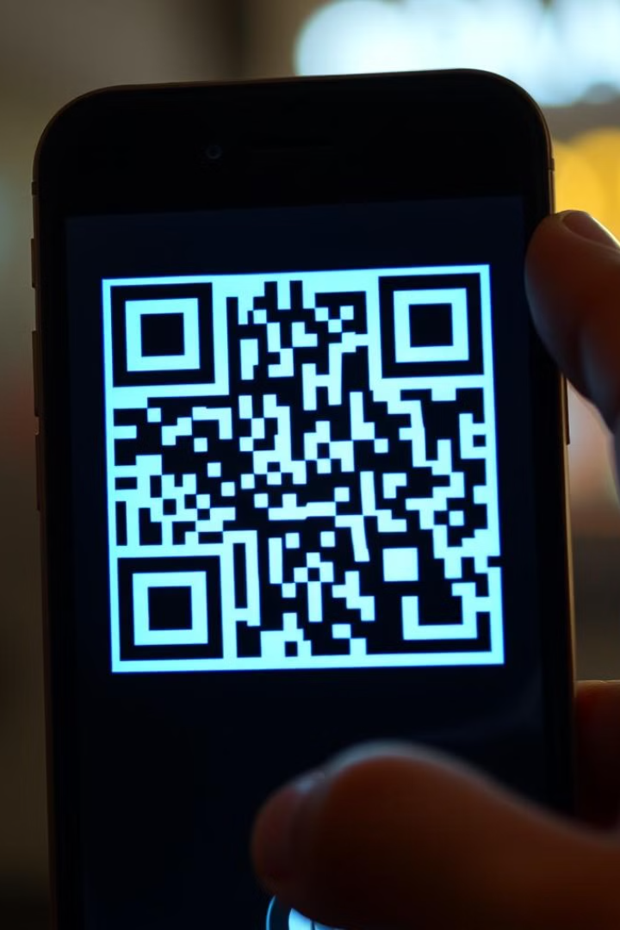



Add Data to the QR Code
Add Data
Use the `add_data` method of the QR code object to add the data you want to encode into the QR code. This could be a URL, text, or any other information.
Make the QR Code
Call the `make` method of the QR code object to finalize the QR code. This method adjusts the dimensions of the QR code to fit the data you provided.
Create the Image
Use the `make_image` method to create the QR code as an image. You can customize the image by setting the fill and background colors.

Slide 5



Save the QR Code Image
Use the 'save' Method
Filename and Format
The `save` method writes the QR code image to a file. You need to specify a filename for the image. The image will be saved as a PNG file by default.
You can choose a filename and specify the format of the image file using the optional format parameter of the `save` method. For example, you can save the QR code as a JPEG file by setting format="jpeg".

Slide 6





Example QR Code Generator
1
Import Library
2
Define Function
3
Create QR Code Object
4
Add Data and Make
5
Generate Image and Save

Slide 7
Understanding the Code
1
Importing Library
Import the `qrcode` library. This provides the necessary functions for creating QR codes.
2
Defining a Function
Define a function called `generate_qr_code` to encapsulate the code for generating a QR code and saving it to a file.
3
Creating a QR Code Object
Create a `QRCode` object with specific parameters like version, error correction level, box size, and border width.
4
Adding Data and Finalizing
Use the `add_data` method to add the information you want to encode. Then, use the `make` method to finalize the QR code.
5
Generating Image and Saving
Use the `make_image` method to create the image representation of the QR code and save it using the `save` method. This saves the QR code as a PNG file.

Slide 8

Conclusion
1
2
Install
Import
Make sure to install Python and necessary libraries.
Import the QR code library in your code.
3
4
Generate
Save
Create QR code objects, add data, and generate the QR code.
Save the QR code image in your preferred format and file name.

Slide 9
Citation-s
Generate QR codes in Python in 2 minutes[With Code] - YouTube
python_best_practice/QR_code_gen.py at master · Spidy20/python_best_practice · GitHub

