Slide 1
Author Linkage!
Sam Anzaroot
Jiaping Zheng

Slide 2
Problem
David Smith – UMass Amherst
David Smith - George Washington University
David Smith – Northeastern
Cluster publications under correct author entities.

Slide 3
Methodology – Pipeline
Blocking (smaller decision space)
Pointwise classifier
Merge
The goal is to build a better classifier.

Slide 4
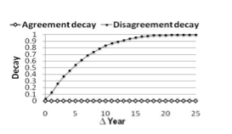
Methodology - Features
String similarity (names, venues, coauthors..)
Jaro-Winkler
Coauthorship graphs
Temporal Information
Picture from Linking Temporal Records, Pei Li et. al

Slide 5
Methodology - Classifier
Consider pairs of author mentions <Ai, Aj>
Compatibilities of
Name
Venue
Affiliation
Coauthors
Time difference

Slide 6
Evaluation
Simple accuracy is not accurate
a1 = a2, a2 = a3, a1 ≠ a3
Use metrics from coreference resolution
Cluster textual mentions into entities (compare to: cluster author mentions to author entities)
MUC
B3

