Slide 1
DB!

Slide 2
Problem
David Smith – UMass Amherst
David Smith - George Washington University
David Smith – Northeastern
Cluster publications under correct author entities.

Slide 3
Methodology – Pipeline
Blocking (smaller decision space)
Pointwise classifier
Merge
The goal is to build a better classifier.

Slide 4
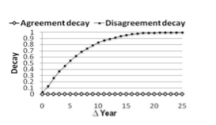
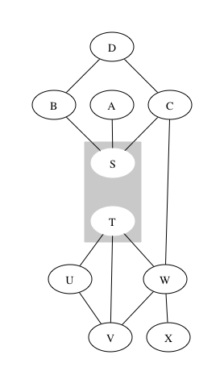
Methodology - Features
String similarity (names, venues, coauthors..)
Jaro-Winkler
Coauthorship graphs
Temporal Information
Picture from Linking Temporal Records, Pei Li et. al

