Slide 1
Author Linkage!
Sam Anzaroot
Jiaping Zheng

Slide 2
Problem
DBLP bulk loads publications
Author entities are not well clustered
Useful for downstream tasks
Find the most prolific author
Accurate citation networks
Cluster publications under correct author entities

Slide 3
Related Work
``Multi-Relational Record Linkage’’ Pedro Domingos and Parag Singla.
Modeled the record linking problem as a conditional random field
Observations use similarity functions.
Gain of F1 measure of 6%
``Linking Temporal Records'' Pei Li et. Al.
Temporal information
Example of such a case is affiliation information in the task of author linking in papers.
``A Comparison of String Metrics for Matching Names and Records’’ W.W. Cohen et. Al.
Using string distance functions.
Distance functions: edit-distance, token based methods, and hybrid methods.
SoftTFIDF is a hybrid. Highest performing.

Slide 4
David Smith
David Bamman, David Smith: Extracting two thousand years of latin from a million book library. JOCCH 5(1): 2 (2012)
Amer Khan, David Smith, Sayed Hussein, Hermann Helgert: Performance analysis of VoIP codecs over multi-rate EDCA. CCNC 2012: 110-115
Freeborn Bobor-Oyibo, Stephen J. Foti, David Smith, O. Yurduseven: Modelling and analysis of a smart antenna system with sub-sector dynamic capacity enhancement for mobile telecommunication networks. CSNDSP 2012: 1-4
37 publications
21 authors
David A. Smith, David B. Smith, etc

Slide 5
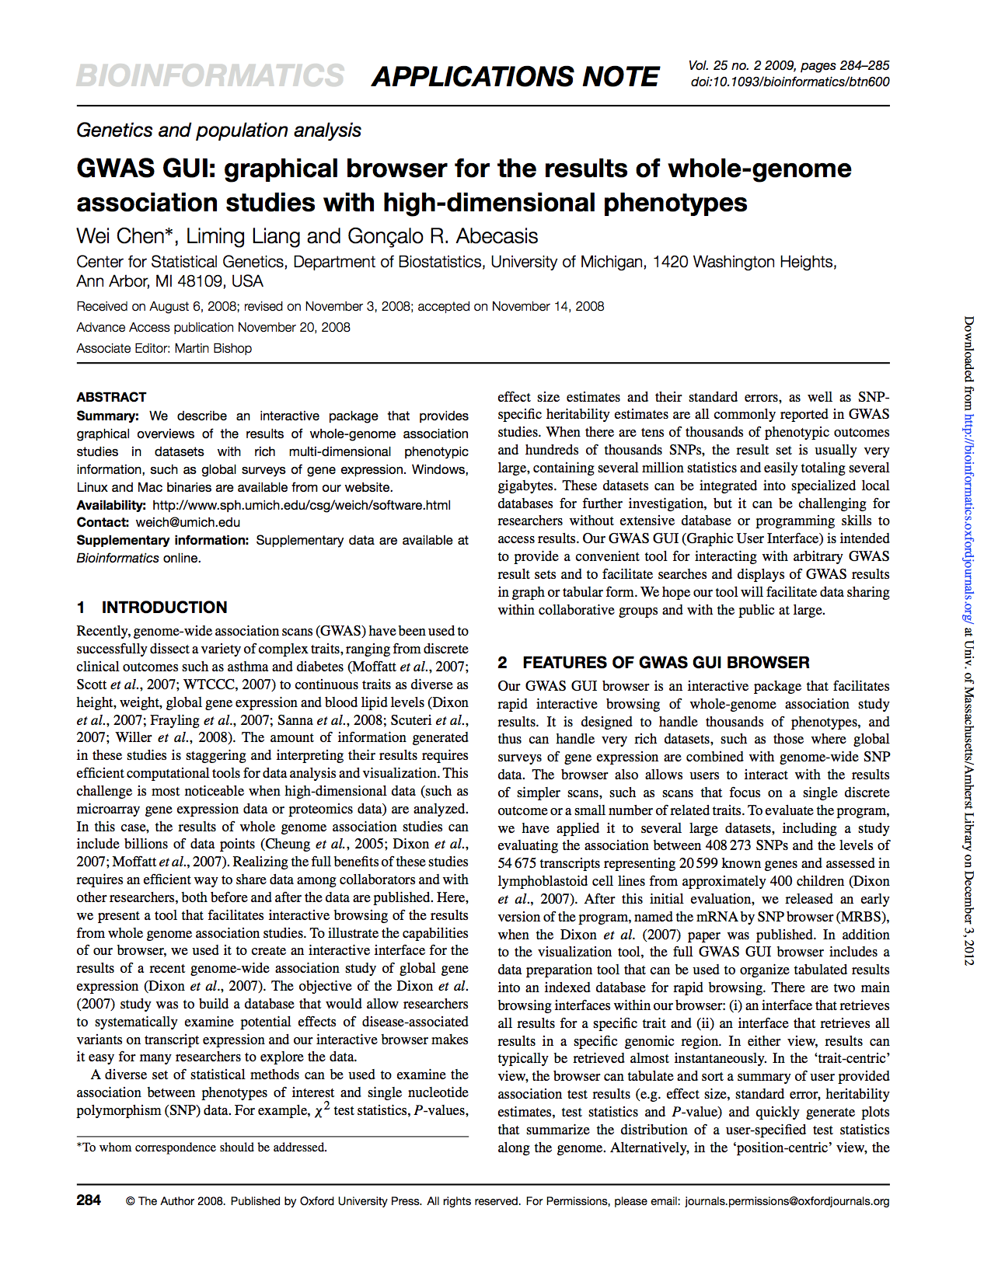
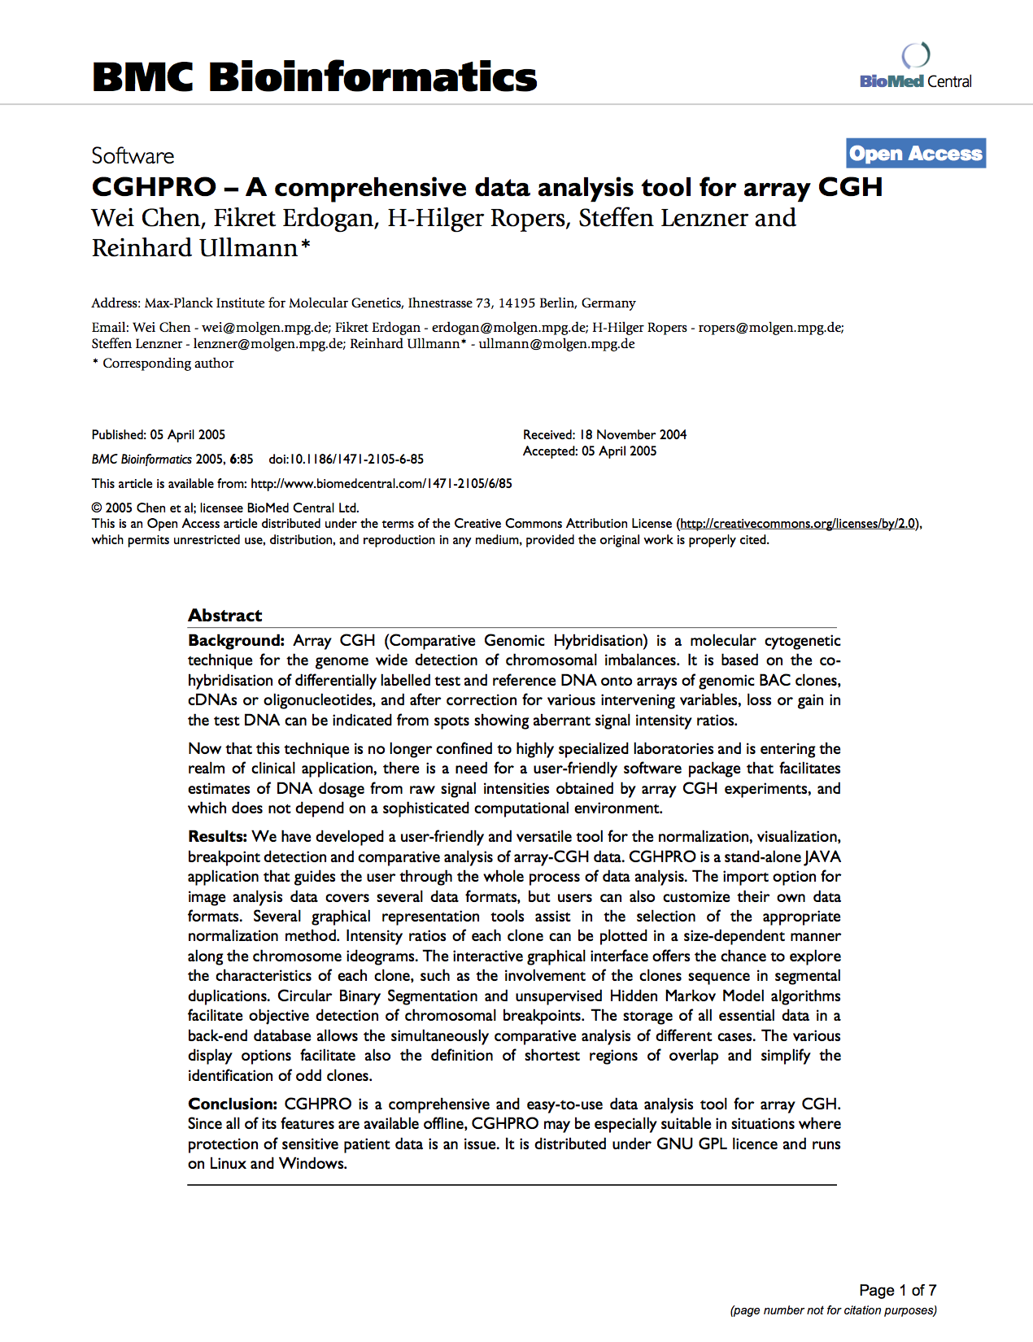
Wei Chen

Slide 6
Methodology – Pipeline
Blocking (smaller decision space)
It’s unlikely that David Smith and Wei Chen are the same person
Only compare authors that have the same first and last names
Pairwise classifier
Merge
The goal is to build a better classifier.
David Smith 1
David Smith 2
David Smith 3

Slide 7
Methodology – Classifier
Consider pairs of author mentions
How likely are they the same person based on
Name
Venue
Affiliation
Coauthors

Slide 8
Data
Annotations
Group the same authors together
Add affiliation information
Annotated 700 publications

Slide 9
Features
Affiliation
Are the authors from the same institution?
Venue
How likely is it that one author published in the two venues?
Coauthors
Do they collaborate with the same people?

Slide 10
Coauthorship Features

Slide 11
Evaluation
Classification accuracy not enough
We can deduce that DS2=DS3 despite classification error
David Smith 1
David Smith 2
David Smith 3

Slide 12
Evaluation
Measure how similar the predicted clusters are to the true clusters.
MUC
B3

Slide 13
Preliminary Results
Training
 | Precision | Recall | F1
B3 | 98.814 | 76.673 | 86.347
MUC | 98.489 | 80.785 | 88.763
Testing
 | Precision | Recall | F1
B3 | 100.000 | 69.788 | 82.206
MUC | 100.000 | 56.757 | 72.414

