Slide 1




Unlocking Sales Insights: A Dynamic Revenue Dashboard for a Sales Head for Hardware Business
In the fast-paced world of hardware equipment supply, data-driven decision-making is the key to sustained growth and profitability. Introducing our comprehensive Sales Dashboard, a Tableau-powered solution that provides your sales team and leadership with real-time insights into the critical KPIs driving the business. From granular revenue breakdowns to top customer and product trends, this dynamic dashboard will empower the users to make informed decisions, identify opportunities, and stay ahead of the competition.
by Samar kumar sharma

Slide 2

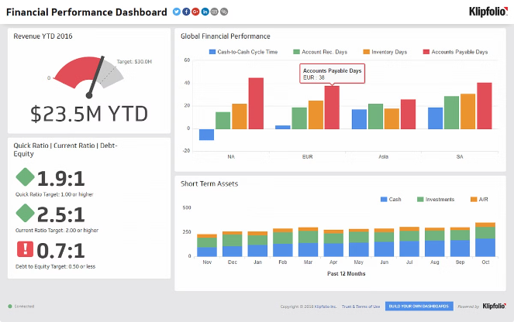
Tracking the Pulse of Sales Performance
1
Sales Overview
Throughout the project we gained a high-level understanding of sales performance with Year-over-Year and Month-over-Month revenue analysis. Quickly identify growth patterns, seasonal trends, and potential areas for improvement.
2
Product Insights
Dive deep into product portfolio to understand which items are driving the most revenue and volume. Identify top-selling products, track inventory levels, and make data-backed decisions to optimize your product mix.
3
Customer Spotlight
Understand your customer base like never before. Analyze sales by customer segment, identify your most valuable accounts, and uncover new opportunities to deepen customer relationships and drive repeat business.

Slide 3
A Deeper Dive into Revenue Analysis
Sales by City
Sales by Product
Sales by Customer
In the project we gained visibility into the revenue performance of various locations. Identify high-performing and underperforming regions, and use these insights to optimize sales strategies and resource allocation across the network of cities.
Analyzed product portfolio in depth to understand which items are driving the most revenue. Identify top sellers, track inventory levels, and make data-backed decisions to optimize the product mix and capitalize on emerging trends.
Understood customer base like never before. Analyzed sales by customer segment, identify the most valuable accounts, and uncover new opportunities to deepen customer relationships and drive repeat business.

Slide 4

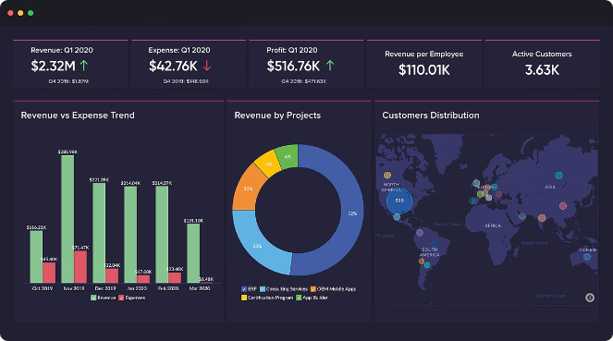
Uncovering Hidden Trends and Opportunities
1
Seasonal Insights
Identify patterns and fluctuations in your sales data across different seasons and months. Use these insights to plan for peak demand, optimize inventory, and execute targeted marketing campaigns to drive sales during slow periods.
2
Emerging Product Demand
Stay ahead of the curve by monitoring the performance of new and emerging products in your catalog. Quickly identify high-potential items and adjust your supply chain and sales strategies to capitalize on these opportunities.
3
Customer Segmentation
Dive deep into customer data to identify unique segments with distinct buying behaviors and preferences. Tailor your sales, marketing, and customer service strategies to each segment, fostering stronger relationships and driving higher lifetime value.
4
Market Shifts and Competitive Landscape
Keep a pulse on the broader market trends and your competitive environment. Leverage your sales data to identify shifting customer demands, emerging competitors, and new opportunities to differentiate your offering and stay ahead of the curve.

Slide 5


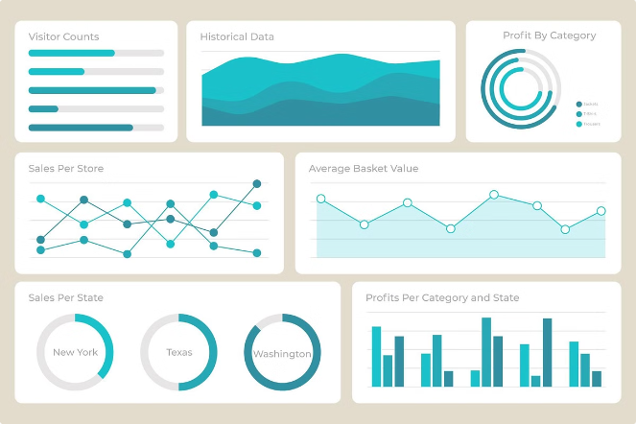



Visualizing the overall analysis
Revenue Tracking
Monitored overall sales performance with real-time revenue tracking, empowering you to make data-driven decisions and maintain a competitive edge.
Product Analysis
Dive deep into product portfolio to uncover insights that drive strategic inventory management and optimized sales strategies.
Customer Insights
Now the Sales Head can understand your customer base like never before, identifying your most valuable accounts and unlocking new opportunities for growth.
Predictive Forecasting
Leverage advanced analytics to predict future sales trends and make proactive, data-driven decisions to stay ahead of the curve.

Slide 6


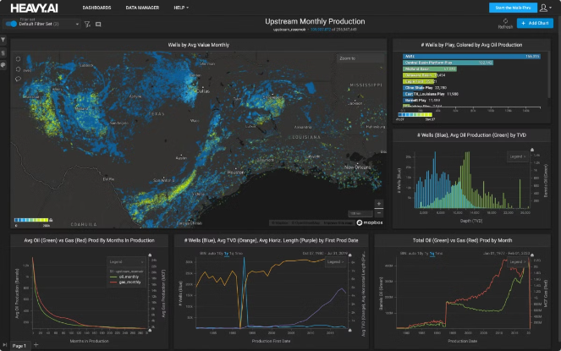



Driving Actionable Insights
Identify
Uncover hidden trends, emerging opportunities, and areas for improvement within your sales data.
Analyze
Dive deep into the underlying drivers of your sales performance, leveraging advanced analytics and visualizations.
Strategize
Translate data-driven insights into actionable strategies to optimize your sales processes, product mix, and customer engagement.
Execute
Implement your data-backed strategies and continuously monitor their impact to drive sustainable growth and profitability.

Slide 7


Empowering Your Sales Team
Real-Time Visibility
Provide your sales team with instant access to the latest sales data, empowering them to make informed, data-driven decisions at every customer touchpoint.
Personalized Insights
Tailor the dashboard to the unique needs and responsibilities of each sales rep, ensuring they can easily identify and act on the insights most relevant to their territory and accounts.
Collaborative Workflows
Foster a data-driven sales culture by integrating the dashboard into your team's existing workflows, facilitating collaboration, and aligning everyone around a shared understanding of performance and goals.
Continuous Improvement
Leverage the dashboard's advanced analytics and customization capabilities to continuously refine your sales strategies, address emerging challenges, and capitalize on new opportunities as they arise.

