Slide 1
APIs
DS3500: Advanced Programming with Data
GitHub

Slide 2
Intro to APIs
Application programming interface
Send and receive data across the web
Allows two applications to ‘talk’ to each other using a software interface
REST – Representational State Transfer
Architecture style with constraints
RESTful API
Notes:
REST constraints:
Client-server architecture
Stateless communication
Cacheable label – either implicit or explicit
Layered (hierarchical) system
Uniform interface
Code-on-demand
https://www.ics.uci.edu/~fielding/pubs/dissertation/rest_arch_style.htm - Architecture Styles and the Design of Network-based Software Architecture by Roy Thomas Fielding

Slide 3
APIs vs Web Scraping
APIs have an enforced set of rules
Scraping is usually less scalable
APIs tend to provided better quality data

Slide 4
Terminology
Client: application making a service request at an endpoint
Endpoint: URL for a service on the server
HTTP: application-layer protocol for hypermedia transmission
Request methods: the type of ‘action’ (transmission) being performed
Resource: the server-side data
Response: the result of the request
Server: runs a set of services

Slide 5
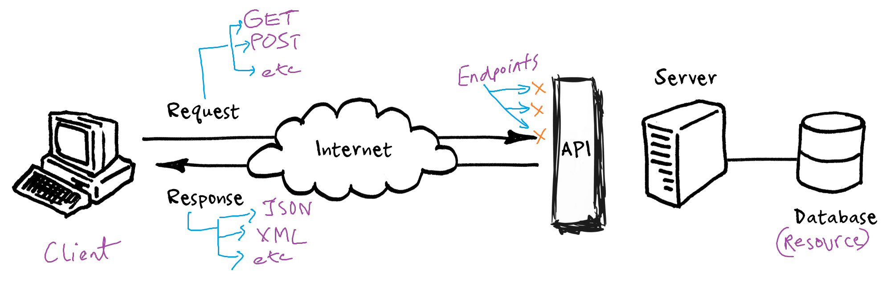
APIs: End-to-end

Slide 6
Requests
GET: retrieve resources
POST: submit resources
DELETE: delete resources
PUT: update all resource attributes
PATCH: update some resource attributes
HEAD, CONNECT, TRACE
Notes:
https://developer.mozilla.org/en-US/docs/Web/HTTP/Methods

Slide 7
Endpoints and Authentication
Point of interaction between applications
‘Door’ to the server
Lock the door – authenticate requests:
Basic Auth: username and password
API keys: unique string for each client
JSON Web Token (JWT): signed and encoded string
OAuth2

Slide 8
API Key Authentication
Client registers with the service provider and receives a unique key
Client sends a request:
API key in the header
Service requested
Server verifies key
If valid, server continues on to request fulfilment

Slide 9
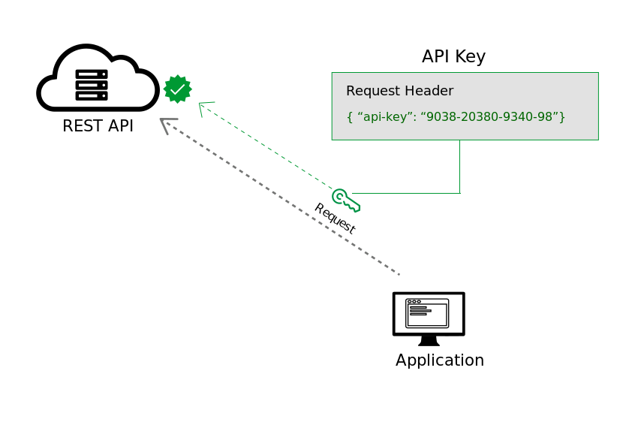
API Key Authentication

Slide 10
JWT Authentication
JWT structure: hhhh.pppp.ssss
h: header
p: payload
s: signature
Header and payload are encoded using Base64Url encoding
Signature = HashingAlgorithm(EncodedHeader, EncodedPayload, SecretKey)
Notes:
https://jwt.io/

Slide 11
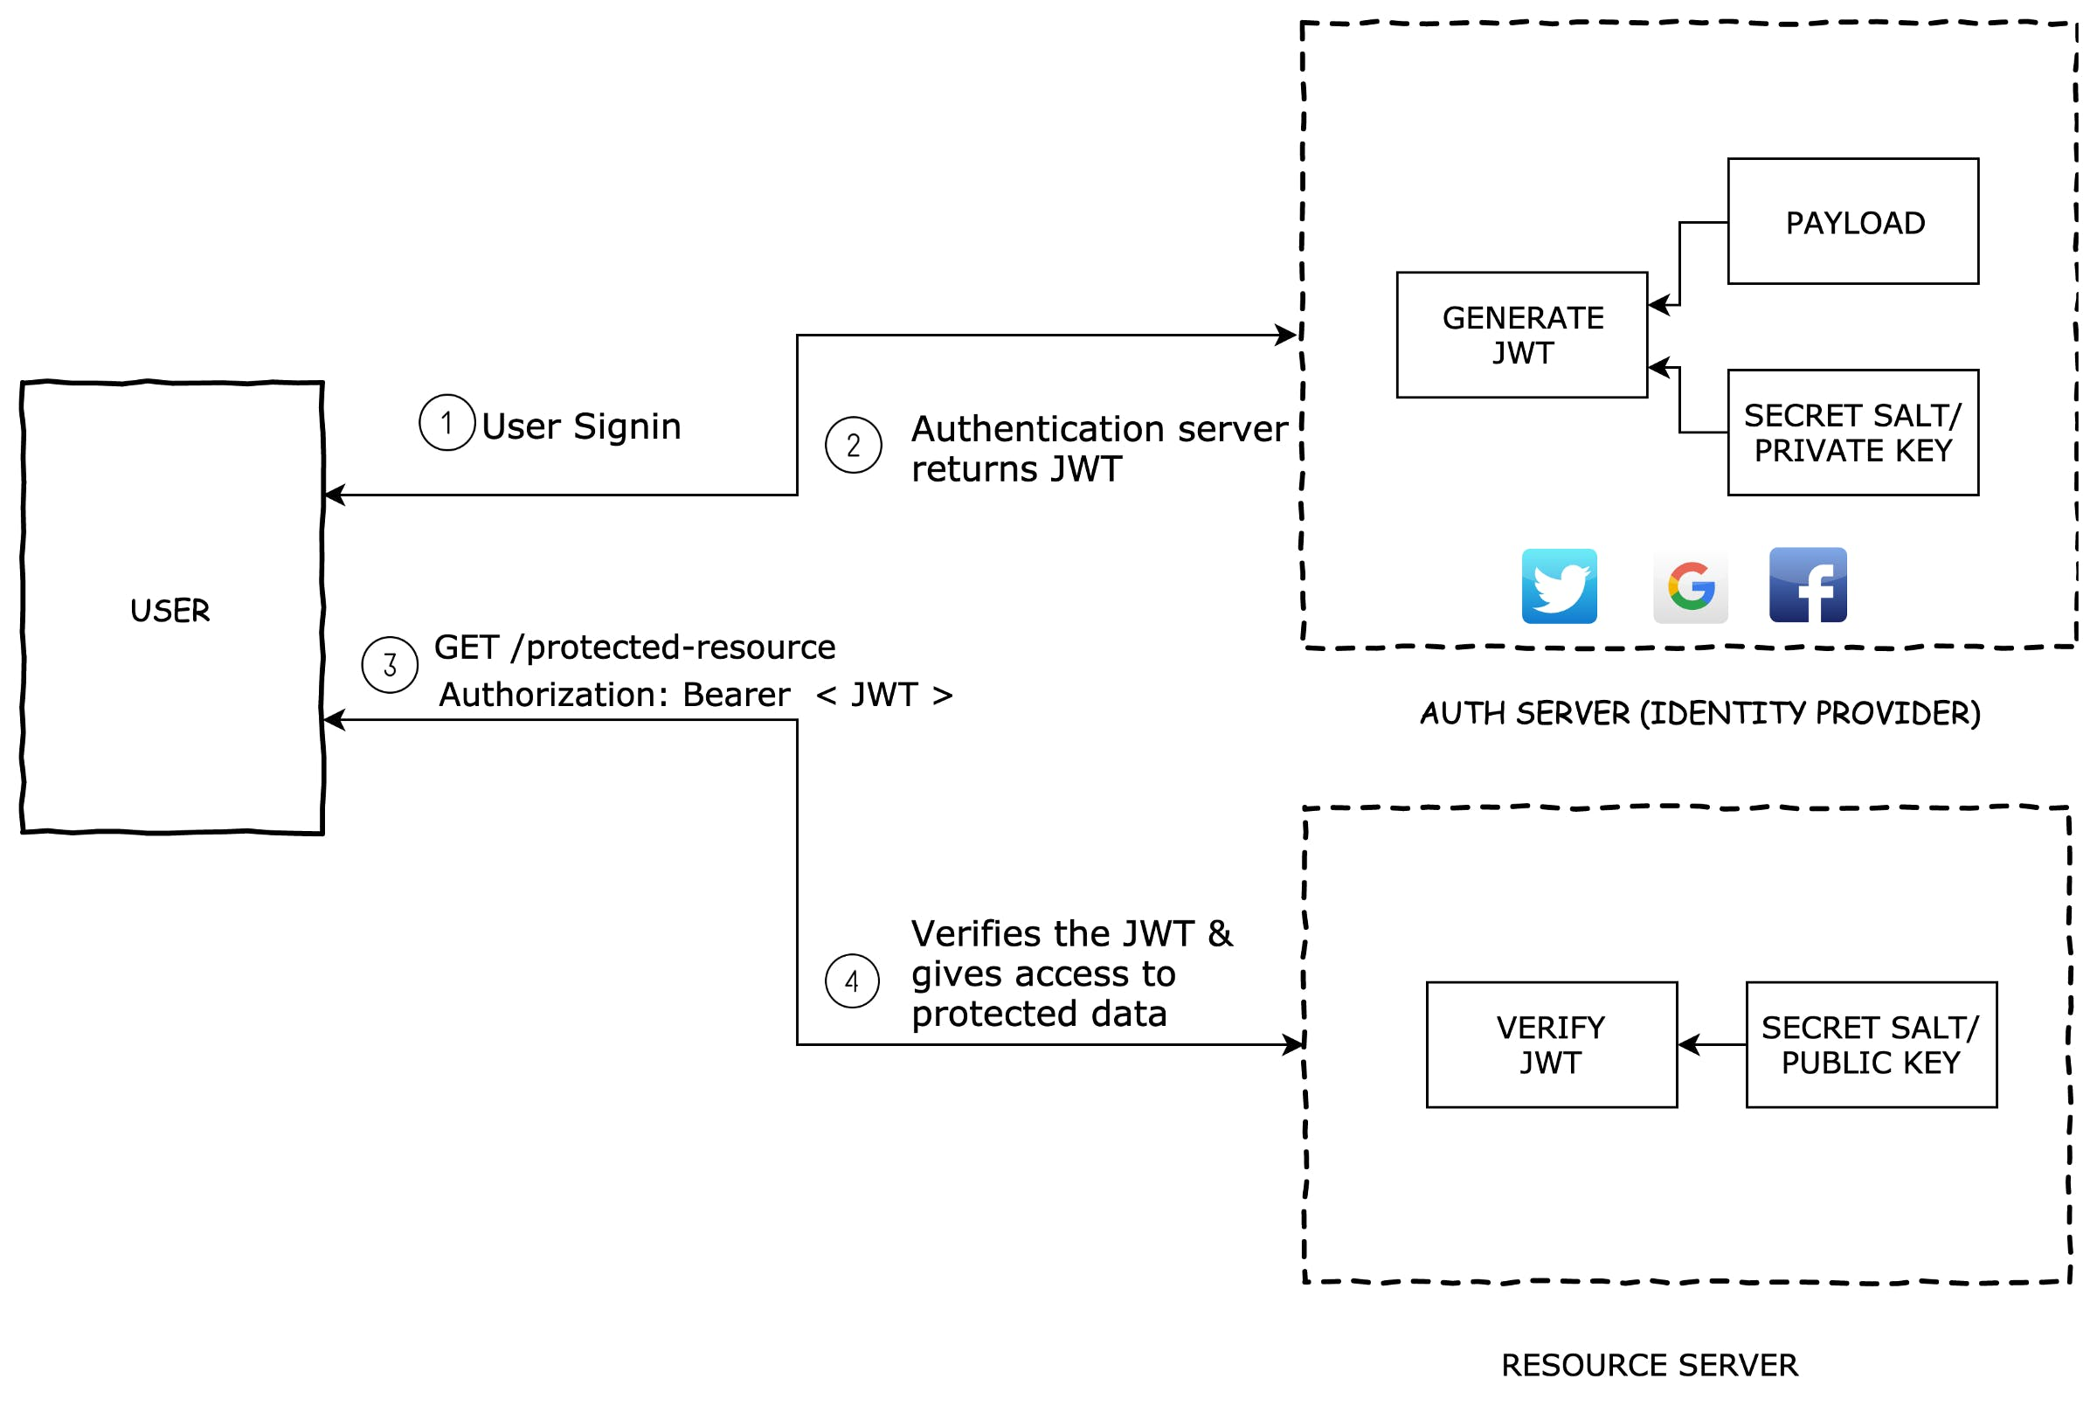
JWT Authentication

Slide 12
Service Fulfilment and Response
Service fulfilment – Part I:
Check authorisation: can the client access this data?
Rate limiting: is the client within their request limit?
Check other client parameters specific to your API e.g. location
If any of these answers are FALSE, don’t process the request

Slide 13
Service Fulfilment and Response
Service fulfilment – Part II:
Process the request
Access the resource i.e. data – normally in some kind of database
Generate a response JSON – formats include JSON:API, JSend
Reply with the JSON and a status code
Notes:
https://jsonapi.org/
https://github.com/omniti-labs/jsend

Slide 14
HTTP Status Codes
2xx: Success
200: OK
202: Created (for POST and PUT)
204: No Content
3xx: Redirection
4xx: Client errors
400: Bad Request
401: Unauthorized (authentication failed)
403: Forbidden (request understood but not accepted)
404: Not Found
429: Too Many Requests
5xx: Server errors
500: Internal Server Error
Notes:
https://developer.mozilla.org/en-US/docs/Web/HTTP/Status

Slide 15
Demo - Postman
Nothing to see here

Slide 16
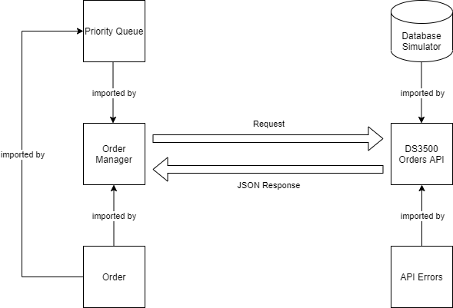
Build an API
Required features:
GET all orders
GET an order by ID
GET orders by priority
POST a new order – v2
Authentication – v2
Error 400, 401, 404 handling
Notes:
https://stackoverflow.blog/2020/03/02/best-practices-for-rest-api-design/

