Slide 1
Car–Bus Game Overview
Two-player zero-sum grid game
Car vs Bus (pursuit-evasion)
3x3 grid, sequential decisions
Notes:
Introduce Car-Bus as extension of RPS.

Slide 2
State & Actions
State = (car position, bus position)
Actions: up, down, left, right
Simultaneous moves
Notes:
Explain multi-agent state.

Slide 3
Rewards
Reward = value(car) - value(bus)
Crash penalty = -10
Zero-sum setting
Notes:
Explain incentives.

Slide 4
Models Compared
REINFORCE (high variance)
A2C (actor-critic)
Compare stability
Notes:
Explain purpose.

Slide 5
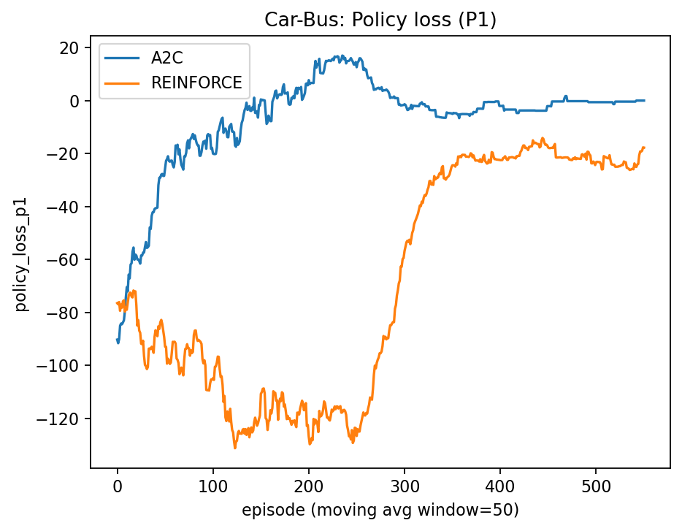
Policy Loss
A2C stabilizes
REINFORCE noisy
Variance difference
Notes:
Explain learning stability.

Slide 6
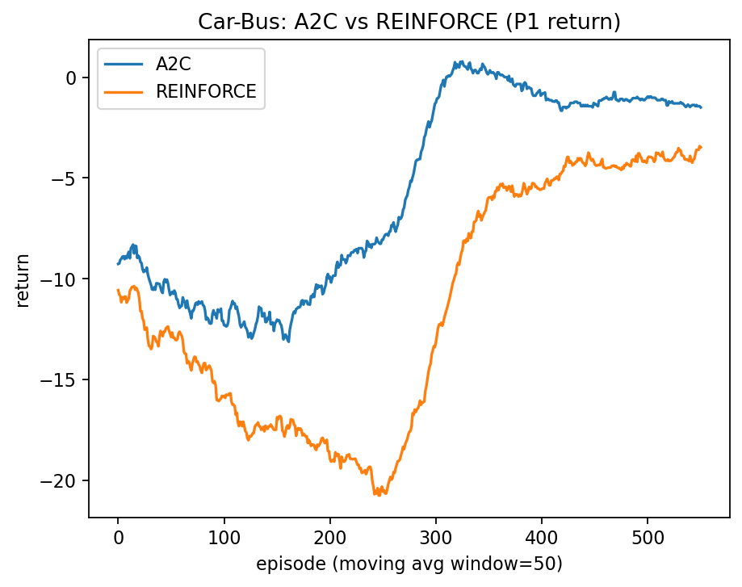
Return Comparison
A2C higher return
REINFORCE worse
Better strategy learning
Notes:
Main result.

Slide 7
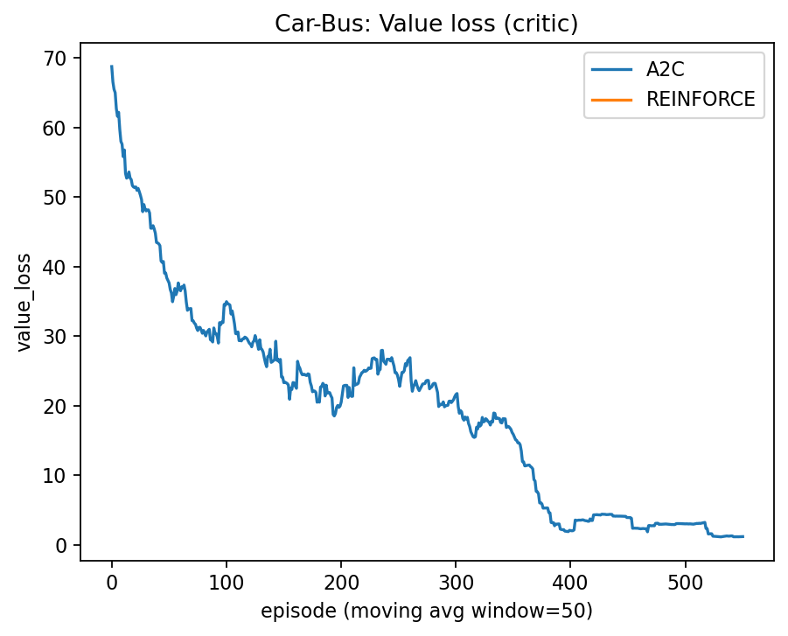
Value Loss
Decreasing trend
Critic learns
Stabilizes A2C
Notes:
Explain critic.

Slide 8
Conclusion
A2C more stable
Better in sequential games
Matches theory
Notes:
Final takeaway.

