Slide 1
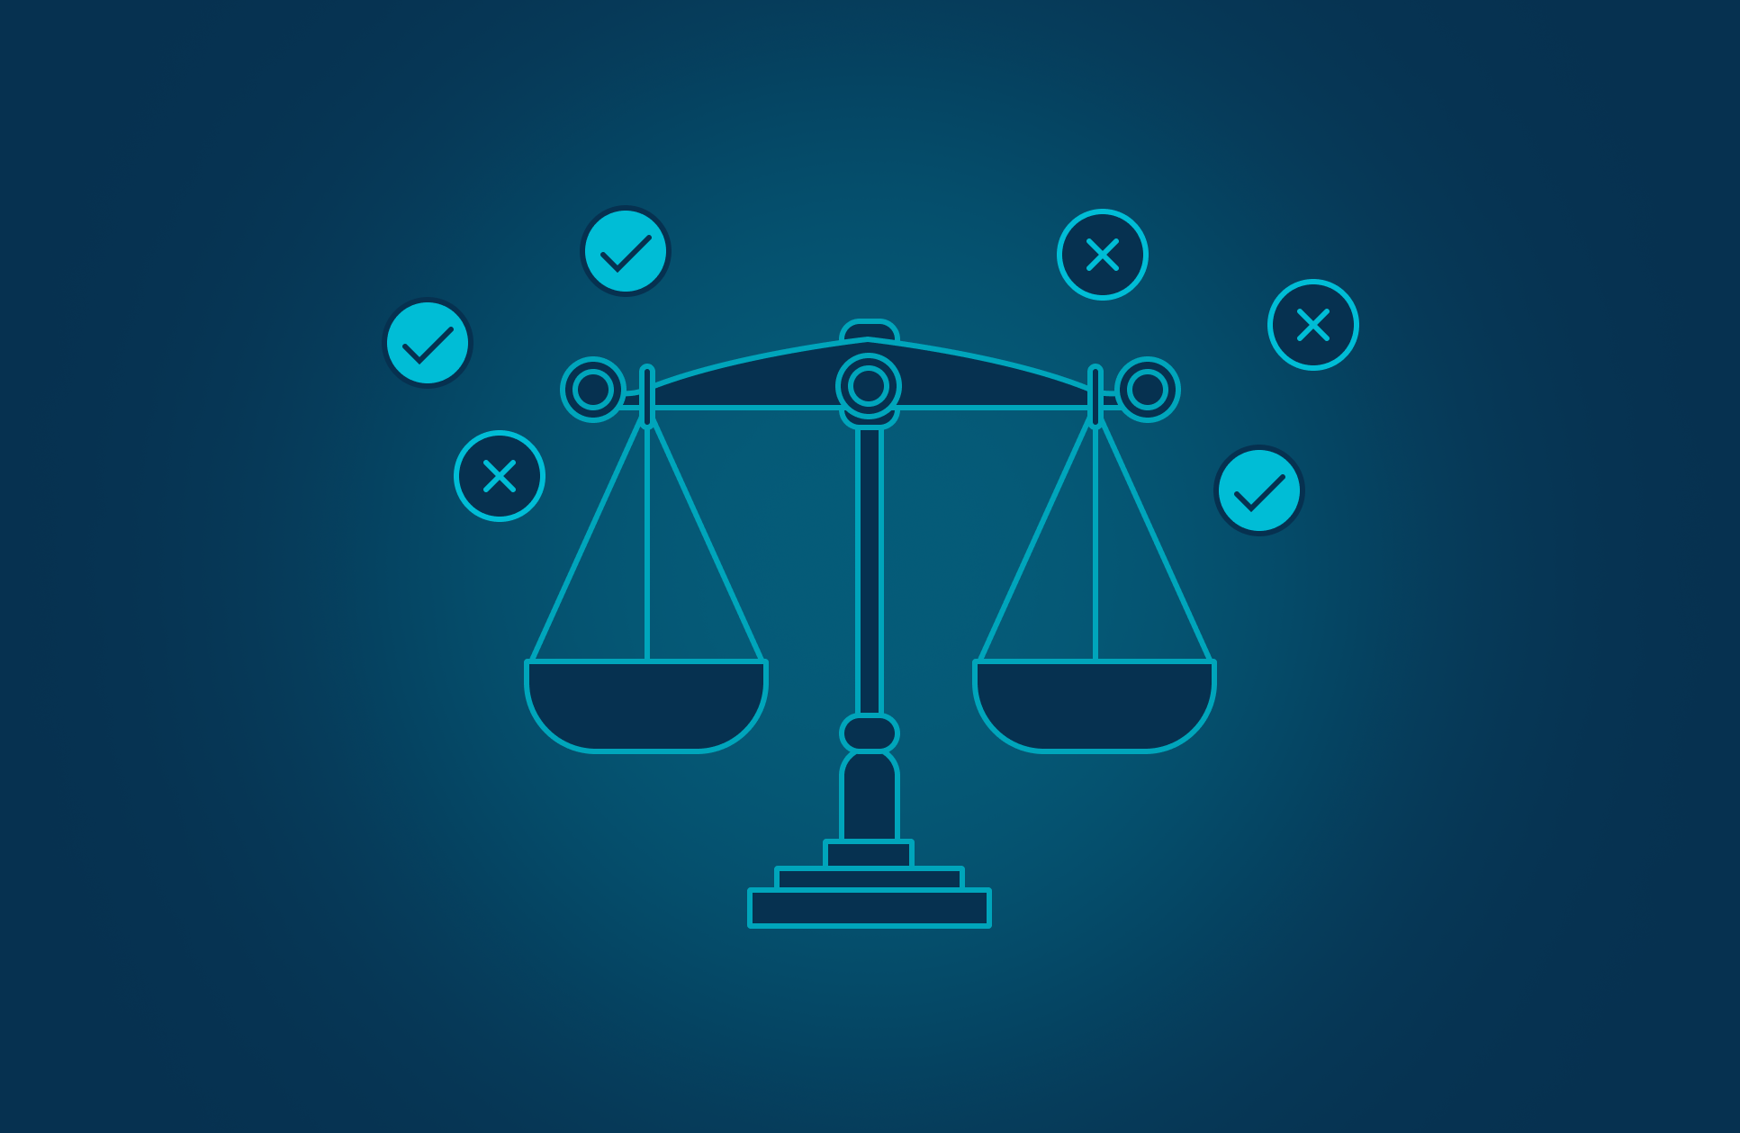
PROJECT 7
Algorithmic Bias
Audit & Mitigation
A fairness audit of a recidivism-risk classifier using explicit subgroup confusion matrices, fairness metrics, and mitigation tradeoffs.
Samarah Hiba • COMPAS Dataset • July 2026

Slide 2
The problem: accuracy can hide unfairness
Audit target
66.6%
Build a competent classifier, then ask: who receives errors, and at what rate?
Baseline accuracy
Compute demographic parity, equal opportunity, equalized odds, calibration, and disparate impact.
But the model predicts “high risk” for African-American defendants at nearly 2× the Caucasian high-risk rate.
Mitigate with reweighting and group thresholds; defend the ethical tradeoff.
Key claim: fairness is not a single score — it is a defended operating choice.
Algorithmic Bias Audit • 2

Slide 3
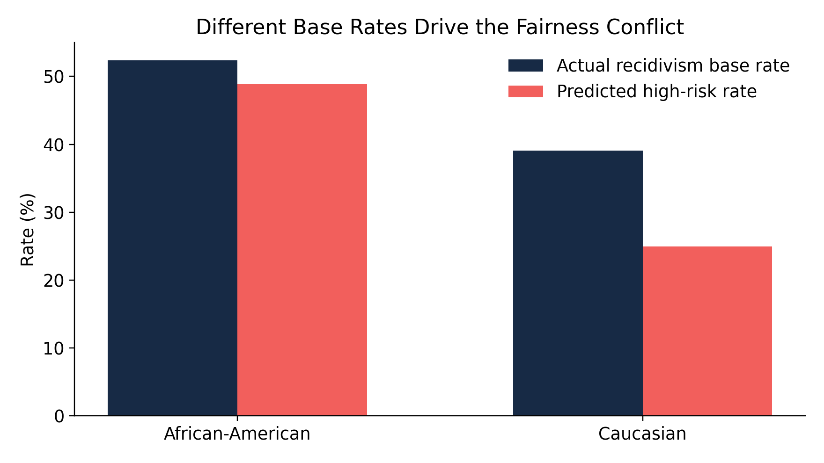
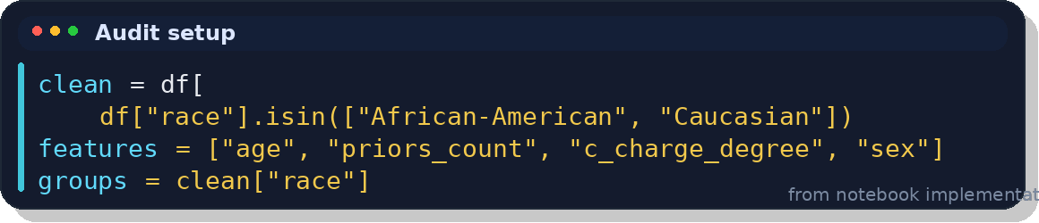
Dataset and modeling design
ProPublica COMPAS two-year recidivism dataset: https://github.com/propublica/compas-analysis/blob/master/compas-scores-two-years.csv
5,278
1,584
filtered cases after cleaning
held-out test rows
Setup
Target: two-year recidivism
Protected attribute: race
Groups: African-American vs Caucasian
Model: logistic regression pipeline
Features: age, priors, juvenile counts, charge degree, sex
Important design choice
implementation
Race is excluded from the model input, but the audit still checks whether proxy variables create unequal outcomes.
Algorithmic Bias Audit • 3

Slide 4
Baseline result: competent, but not fair
BASELINE
0.666
0.721
0.613
Accuracy
ROC-AUC
F1 score
Group | Base rate | High-risk rate | TPR | FPR | Precision
African- American | 0.524 | 0.489 | 0.659 | 0.302 | 0.706
Caucasian | 0.391 | 0.250 | 0.369 | 0.173 | 0.579
Even without race as an input, the baseline model creates unequal error rates and unequal high-risk classifications.
Algorithmic Bias Audit • 4

Slide 5
Subgroup confusion matrices expose the harm
Matrix Cell | Meaning | African-American | Caucasian
Actual 0, Pred 0 | True Negative — correctly predicted not high risk | 315 | 321
Actual 0, Pred 1 | False Positive — incorrectly predicted high risk | 136 | 67
Actual 1, Pred 0 | False Negative — missed someone who did recidivate | 169 | 157
Actual 1, Pred 1 | True Positive — correctly predicted high risk | 327 | 92
What changes by group?
African-American defendants have both more true positives and more false positives. That means the model is more active for one group — not just more accurate or less accurate.
False positives matter in criminal justice because “high risk” can influence supervision, detention, or perceived dangerousness.
0 = did not recidivate / not high risk, and 1 = recidivated / high risk. The key fairness issue is the false positive cell: Actual 0, Pred 1. African-American defendants had 136 false positives, while Caucasian defendants had 67. This means the model labeled more non-recidivating African-American defendants as high risk.
Audit rule
Always inspect subgroup confusion matrices before trusting an overall accuracy score.
Algorithmic Bias Audit • 5

Slide 6
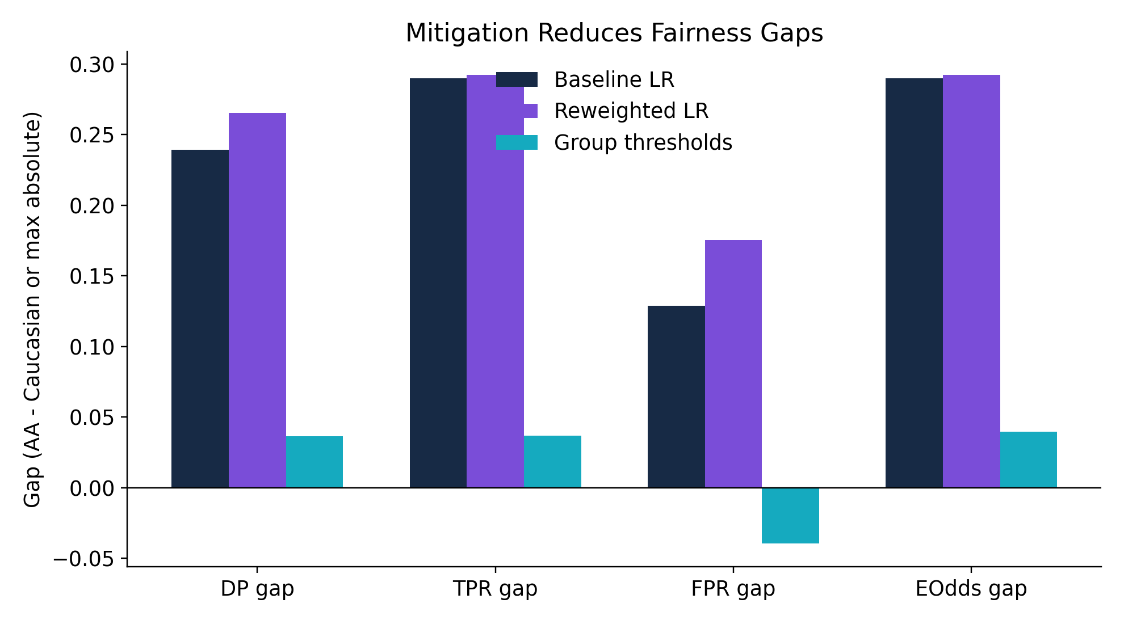
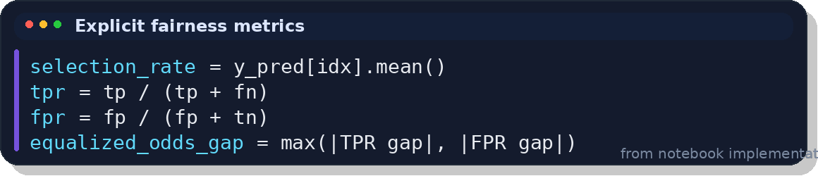
Fairness metrics: one model, multiple definitions
Metric | Simple meaning | Baseline result | What it means
DP gap | Difference in how often each group is predicted high risk | 0.239 | African-American defendants are predicted high risk about 23.9 percentage points more often.
TPR gap | Difference in recall: among people who actually recidivated, how often did the model correctly catch them? | 0.290 | The model catches actual recidivism much more often for African-American defendants.
FPR gap | Difference in false alarms: among people who did not recidivate, how often were they wrongly labeled high risk? | 0.129 | African-American defendants have more false positives. This is the main harm concern.
EOdds gap | Equalized-odds gap: combines TPR and FPR unfairness | 0.290 | Error rates are not balanced across groups.
Baseline gaps
0.239
Demographic parity gap
0.290
Equalized odds gap
1.959×
AA / Caucasian high-risk ratio
Method | What it does | Result
Baseline LR | Original logistic regression model | Has large fairness gaps.
Reweighted LR | Gives different training examples more/less weight to balance group-label patterns | Helps some things, but does not really fix equalized odds.
Group thresholds | Uses different decision thresholds by group | Reduces the fairness gaps the most. Best technical fairness improvement.
Mitigation should be judged by the fairness metric that matches the deployment harm.
Algorithmic Bias Audit • 6

Slide 7
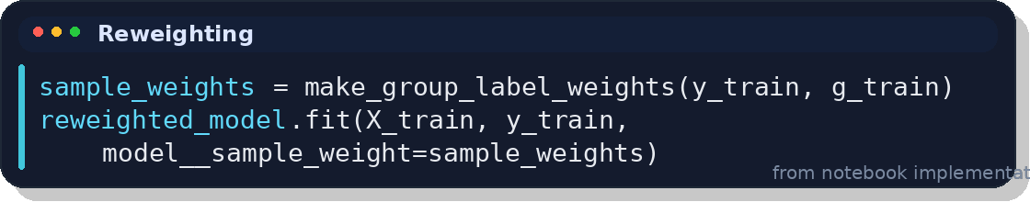
Project 7
Mitigation 1: reweighting the training data
Training-time mitigation.
Reweighting gives more influence to underrepresented group-label cells during training. It is attractive because the final model still uses one shared decision rule.
Interpretation
Metric | Baseline | Reweighted | Meaning
Accuracy | 0.666 | 0.659 | Accuracy dropped slightly, so the model became a tiny bit less correct overall.
Recall | 0.562 | 0.648 | Recall improved, meaning the model caught more actual recidivism cases.
High-risk ratio | 1.959× | 1.824× | The high-risk prediction imbalance improved slightly. African-American defendants were still labeled high risk more often, but the gap became smaller.
EOdds gap | 0.290 | 0.292 | Equalized odds did not improve. The error-rate imbalance stayed almost the same.
Reweighting improved recall and slightly reduced the adverse high-risk ratio.
It did not solve equalized odds, proving that one mitigation method does not satisfy every fairness definition.
This is a useful finding, not a failure: the report explains why fairness must be tied to the harm being reduced.
Algorithmic Bias Audit • 7

Slide 8
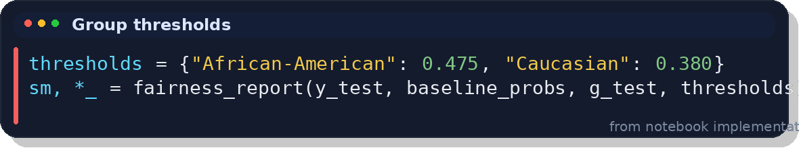
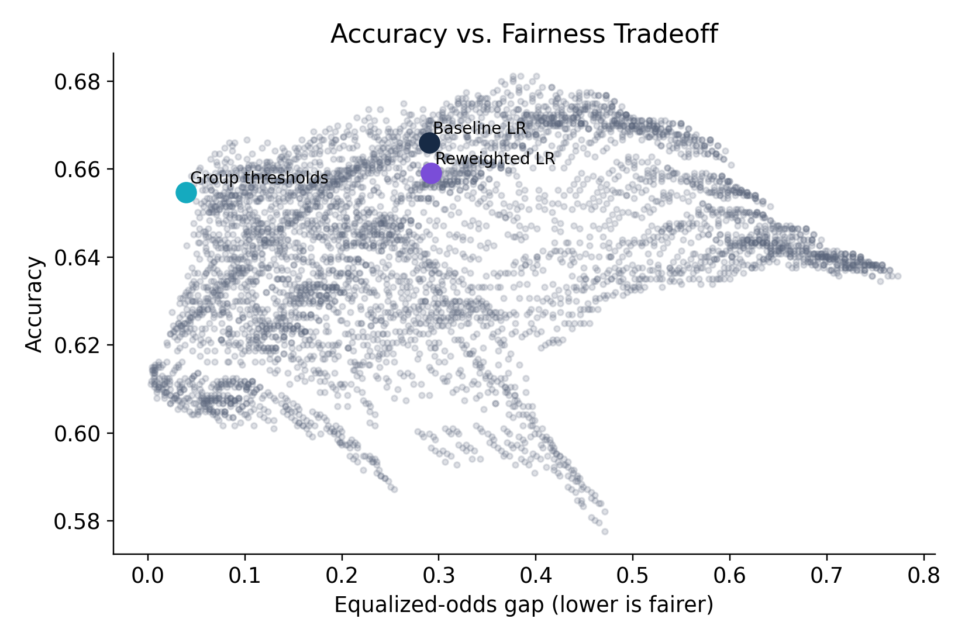
Project 7
SELECTED THRESHOLDS
Mitigation 2: threshold adjustment
Selected thresholds
Group
Threshold
African-American
0.475
Caucasian
0.380
Fairness improvement
0.290 → 0.040
Equalized-odds gap falls sharply, while accuracy only moves from 0.666 to 0.655.
Each dot represents something like:
AA threshold = 0.45 Caucasian threshold = 0.40
or:
AA threshold = 0.55 Caucasian threshold = 0.35
For every pair, the code calculated:
Accuracy
TPR gap
FPR gap
Equalized-odds gap
Best technical trade-off in this run — but it requires defending group-aware thresholds ethically.
Algorithmic Bias Audit • 8

Slide 9
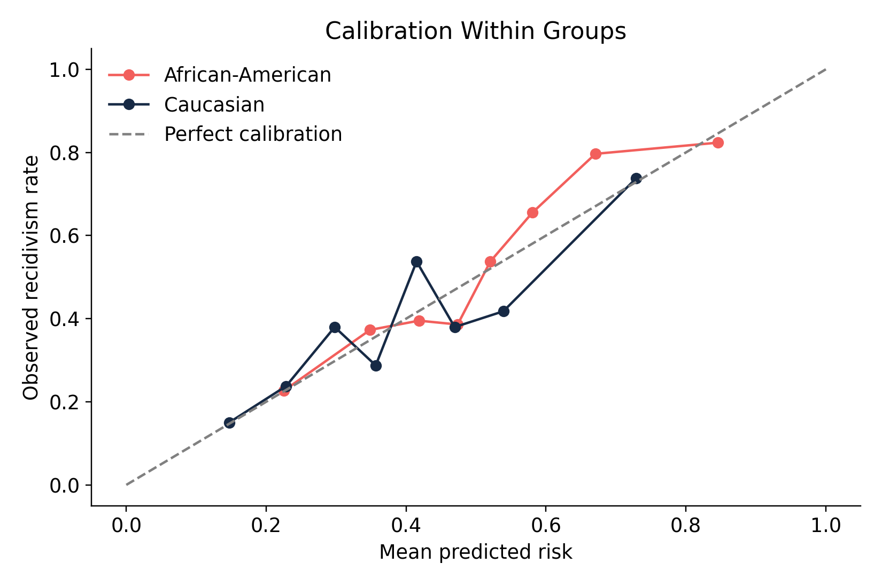
Project 7
Calibration and equalized odds conflict
0.133
African-American observed recidivism rate: 0.524
Caucasian observed recidivism rate: 0.391
Base-rate difference
When base rates differ, a calibrated model can preserve meaningful probabilities within each group, but equalized odds demands matched TPR and FPR across groups.
Unless the model is nearly perfect or base rates are equal, both goals cannot be fully satisfied at the same time.
That is why the final recommendation is not “maximize accuracy,” but choose and justify the fairness tradeoff.
Algorithmic Bias Audit • 9

Slide 10
FINAL RECOMMENDATION
Do not use as an
automated decision-maker.
Use only as decision support with human review, transparent documentation, subgroup monitoring, and recurring re-audits.
Technically strongest mitigation: group thresholds reduce equalized-odds gap to 0.040.
Ethical caveat: group-aware thresholds require stakeholder approval and explicit justification.
Core lesson: fairness is a defended operating choice, not a single accuracy number.
Data: ProPublica COMPAS two-year recidivism dataset

