Slide 1
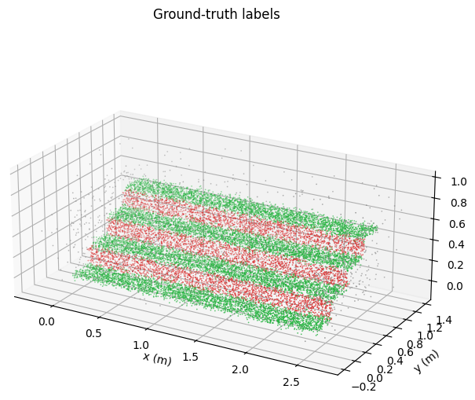
MINI PROJECT · POINT-CLOUD PERCEPTION
Robust Treadable Surface Segmentation of a Simulated 4-Step Staircase Point Cloud Using RANSAC, PCA-Normal Analysis, and DBSCAN
A Comparative Evaluation for Stair-Climbing Robot Perception
NAME:Samar Gamil Ahmed Aqlan Aldubai
NRP:1225800014
Dept. of Information & Computer Engineering, PENS

Slide 2
The Problem: Where Can a Robot Step?
A stair-climbing robot must turn a raw LiDAR scan into a decision about where a foot can land safely. Every point is labelled as one of three classes:
STEPPABLE - horizontal tread, safe to step on
RISER - vertical face between steps
OTHER - edges, sensor noise, outliers
Why it is safety-critical
The error cost is asymmetric. Calling a riser or edge “steppable” can cause a misstep; missing a valid tread only wastes a foothold. So steppable PRECISION matters more than raw accuracy.
~18k-point staircase, coloured by ground-truth class
Notes:
Stress the asymmetry: false positives (stepping where there is no tread) are dangerous; false negatives are merely conservative. This framing justifies why we later prefer a high-precision method.

Slide 3
Synthetic Data from Mathematical Equations
Parametric generator
4 steps · width 2.5 m · tread depth 0.30 m · step height 0.18 m
Tread (steppable)
Riser (vertical)
x ~ U(0, w)
y ~ U(i·d, (i+1)·d)
z = i·h + εz, εz~N(0, 0.02²)
x ~ U(0, w)
y = i·d + εy, εy~N(0, 0.02²)
z ~ U((i-1)·h, i·h)
Plus realistic corruption: isotropic LiDAR noise, uniform outliers, and edge clutter at every tread/riser join.
18,270 labelled points
12,000 steppable · 5,400 riser · 870 other
Each point carries an exact ground-truth label
Notes:
The whole cloud is generated from these equations, so we know the true label of every point. i indexes the step (0..3). The 0.02 m Gaussian jitter on treads is mandated by the brief and turns out to matter a lot for noise sensitivity later.

Slide 4
Four Geometric (Non-Learning) Methods
1
PCA Normal Analysis
2
Multi-Plane RANSAC
Estimate each point's surface normal from a local k-NN PCA; classify by the angle of the normal to the z-axis.
Iteratively fit planes - vertical risers first, then horizontal treads - with tight orientation tolerances.
3
Normal-Augmented DBSCAN
4
Height-Histogram
Cluster in [x, y, z, w·n] space so perpendicular surfaces separate; classify each cluster by its plane slope.
Detect tread elevations as peaks in the z-histogram; label points within a band around each peak.
Notes:
The brief asked for at least two methods; we implemented four so we can compare. They encode the same geometric priors differently: per-point (1), global planes (2), clustering (3), and a 1-D height signal (4).

Slide 5
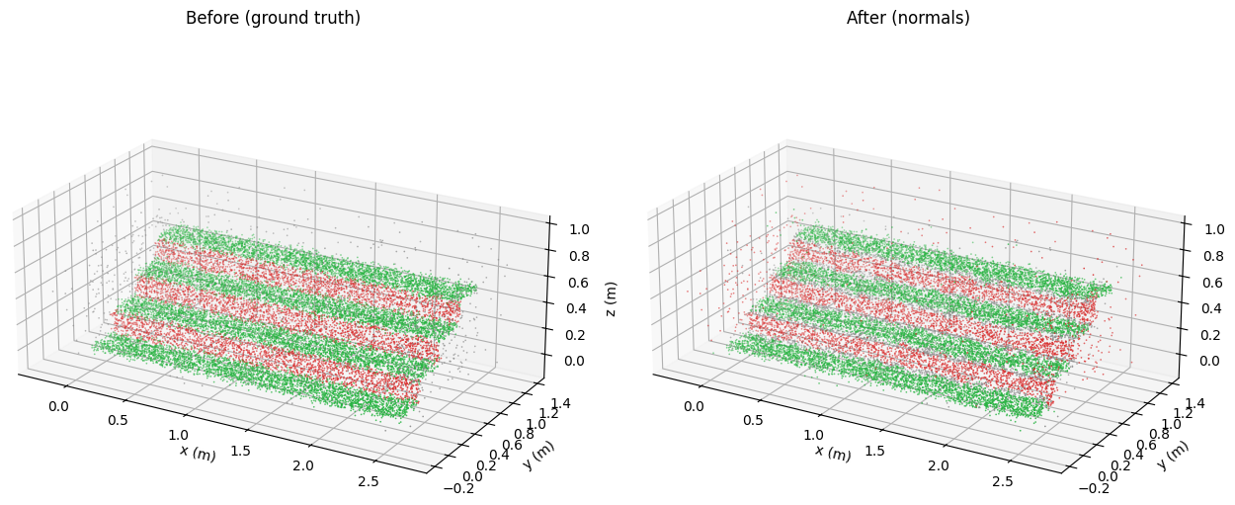
Result: Best Method - PCA Normals
0.913
F1 (steppable)
0.966
Precision (steppable)
0.840
IoU (steppable)
Before (ground truth) vs. after (predicted) - green steppable, red riser, grey other
Notes:
The normals method recovers nearly all treads (recall 0.865) at high precision. Visually the predicted cloud matches the ground truth closely; the main loss is some tread-edge points dropped into 'other'.

Slide 6
Comparing All Four Methods
What the numbers say:
Normals : best F1 / IoU and best recall.
DBSCAN & Histogram: highest precision (~0.98) - the safety metric.
RANSAC: fast but lowest -plane leakage near step edges.
All run in well under one second.
Notes:
Point out the trade-off: the normals method wins on overall F1, but DBSCAN and the histogram reach ~0.98 precision. For a robot, that precision is the more important axis.

Slide 7
Robustness to Noise & Outliers
LiDAR noise = the binding constraint
F1 falls 0.92 → 0.58 as σ grows to 0.05 m. Per-point normals inherit the surface jitter, so local quality degrades fast.
Outliers are tolerated well
F1 only drops 0.92 → 0.875 as outliers rise to 20%, since stray points rarely form coherent planar support.
Notes:
Two separate sweeps. Noise hurts a lot because it corrupts the local normals the methods rely on. Outliers barely matter. This tells a robot designer that sensor quality, not stray points, is the thing to control.

Slide 8
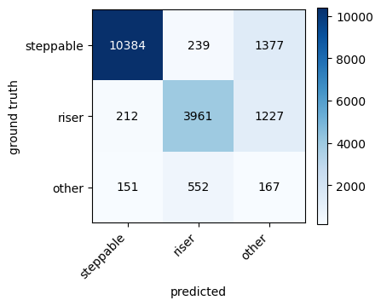
Is It Safe for a Stair-Climbing Robot?
Precision first
Pick a high-precision method (DBSCAN / histogram, ~0.98) so the robot is almost never told to step on a non-tread.
Clean–moderate noise
At σ ≤ 0.02 m, a precision-oriented pass plus a planner that commits only to confident treads is a sound basis for a cautious controller.
High noise
At σ ≥ 0.05 m a single geometric pass is not enough - add temporal fusion across frames or a learned refinement stage.
Confusion matrix (PCA normals): main error is tread→other near edges, not riser confusion.
Notes:
Tie it back to the asymmetric-cost framing from slide 2. The confusion matrix shows the dominant error is dropping tread-edge points into 'other' (conservative, safe), rather than mislabelling risers as steppable (dangerous).

Slide 9
Conclusion & Future Work
CONCLUSION
Four geometric methods compared on a fully-labelled synthetic staircase.
PCA normals best overall (F1 0.913, IoU 0.840).
DBSCAN & histogram give the highest precision (~0.98) -best for foothold safety.
LiDAR noise, not outliers, is the limiting factor.
FUTURE WORK
Evaluate on real LiDAR scans with occlusion and clutter.
Temporal fusion across frames for high-noise robustness.
Hybrid: high-precision geometric prior supervising a learned segmenter.
Integrate with a footstep planner on the robot.

Slide 10
Code, Paper & Repository
What's included
src/ - generator, 4 methods, evaluation, viz
notebooks/mini_project.ipynb - runnable end-to-end
paper/ -IEEE LaTeX + compiled PDF + figures
results/ - figures + metrics.json
README + GITHUB_SETUP guide
Repository
github.com/<Samaraqlan-G
staircase-pointcloud-segmentation
Thank you

