Slide 1

Jenkins Workshop Introduction
Business Area Smart Mobility (SMY)
www.continental-corporation.com

Slide 2
Historical overview
Jenkins project started in 2004 under the name Hudson
Idea and development came from Kohsuke Kawaguchi
He wanted to create a method to perform continuous integration
Kohsuke Kawaguchi created the Jenkins project and open-sourced the program

Slide 3
Introduction
Simpler definition would be that Jenkins is automation server
Jenkins is a platform for creating a Continuous Integration/Continuous Delivery (CI/CD) environment.
Jenkins is open-source tool released under MIT licence
It is used to automate various tasks related to building, testing, delivering or deploying software.
Main implementation is in area od Continuous Integration and Continuous Delivery of projects

Slide 4
Advantages of Jenkins
Current usage estimates are over 1.6 million users
Jenkins has a large support community and thorough documentation
Over 1800 plugins for Jenkins enrich the software integration, automation, and delivery processes
These plugins give us great flexibility in creating customizable environment
Jenkins is open-source tool released under MIT licence

Slide 5
CiCd - Continuous Integration
Continuous Integration (CI) is a software development practice where members of a team frequently integrate their code changes into a central code repository. Usually each person integrates at least daily - leading to multiple integrations per day.
This code changes trigger automated builds and tests runs.
CI helps find and address bugs quicker, improve software quality, and reduce the time it takes to validate and release new software updates.

Slide 6
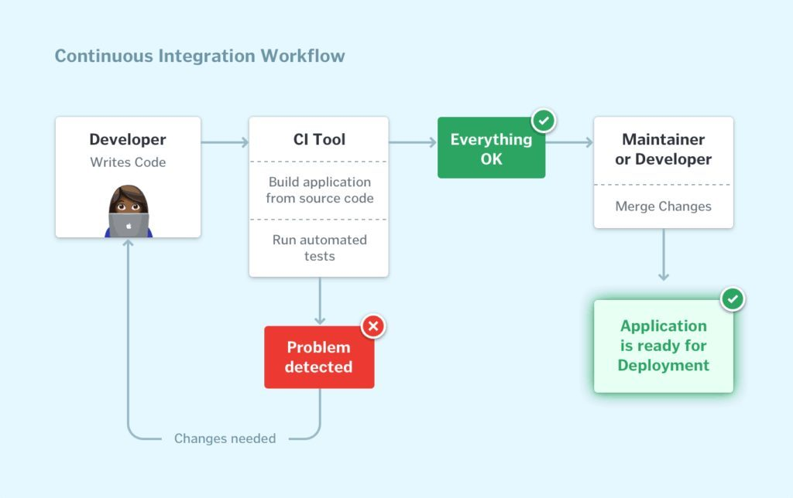
Continuous Integration

Slide 7
CiCd - Continuous Delivery
Continuous delivery is a software development practice where code changes are automatically prepared for a release to production.
A pillar of modern application development, continuous delivery expands upon continuous integration by deploying all code changes to a testing environment and/or a production environment after the build stage.
When properly implemented, developers will always have a deployment-ready build artifact that has passed through a standardized test process.

Slide 8
Jenkins local setup

Slide 9
Jenkins local setup – Download Jenkins
Create local folder: c:\jenkins_workshop\
Download Jenkins server: https://get.jenkins.io/war/2.340/jenkins.war
Copy jenkins.war file to folder: c:\jenkins_workshop\

Slide 10
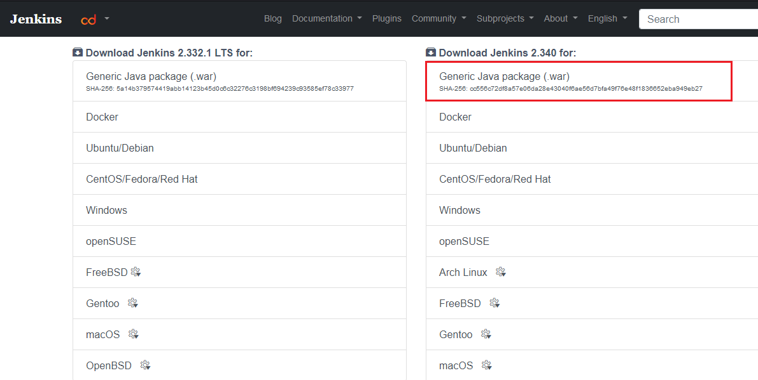
Jenkins local setup – Download Jenkins

Slide 11
Jenkins local setup – Start Jenkins server
Open command prompt or power shell
Start Jenkins server:
java -jar c:\ jenkins_workshop\jenkins.war --enable-future-java

Slide 12
Jenkins local setup – Get unlock code from CLI log
From command prompt log copy initial password to Jenkins login

Slide 13
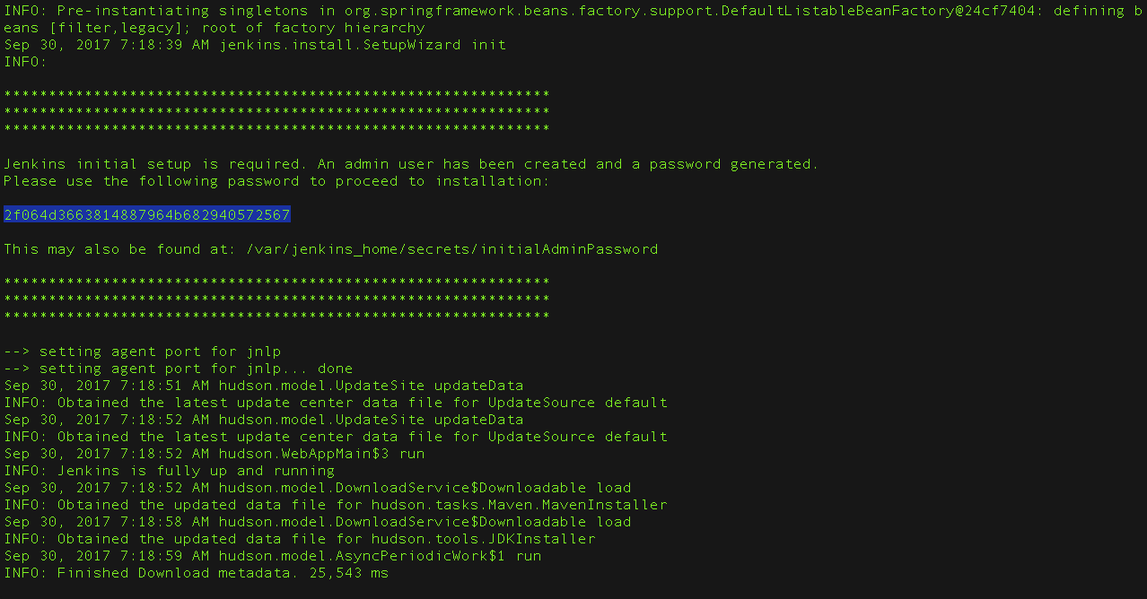
Jenkins local setup – Get unlock code from CLI log

Slide 14
Jenkins local setup – Unlock Jenkins
In browser navigate to local URL: http://localhost:8080/
Paste copied unlock code from command prompt to Jenkins login page

Slide 15
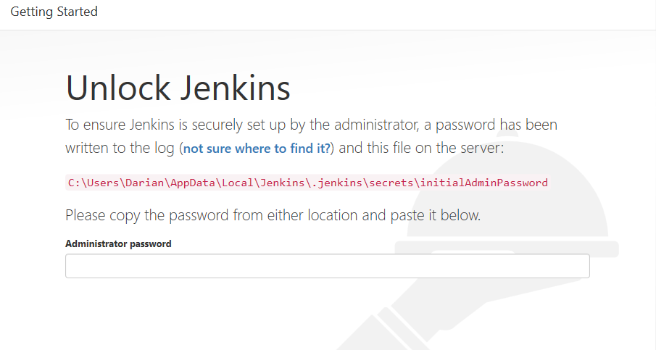
Jenkins local setup – Unlock Jenkins

Slide 16
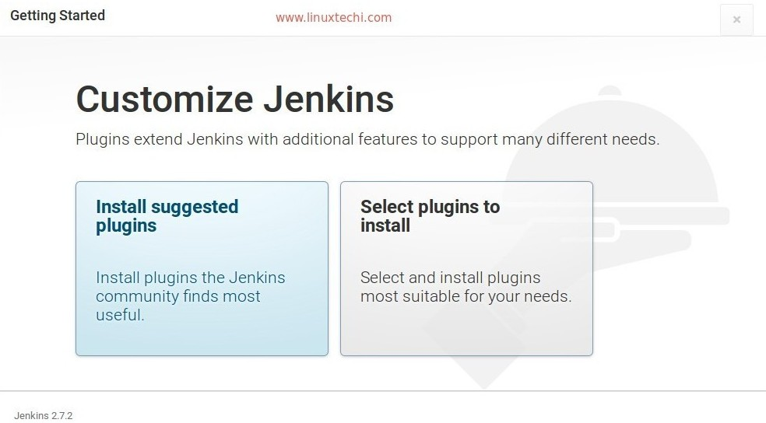
Jenkins local setup – Install suggested plugins

Slide 17
Jenkins local setup – Jobs
Create simple Jenkins job

Slide 18


