Slide 1
GUYANA OFFSHORE
DRILLING ANALYTICS
Operational Performance, NPT Root Cause
& Economic Impact
Power BI • SQL • Python • DAX • Operational Analytics
952,078.8 ft
4,008 hr
$198.15M
Total Footage
NPT Hours
Rig Economic Impact
Portfolio Case Study

Slide 2
The Business Challenge
Turning drilling-performance data into actionable operational visibility.
PERFORMANCE
DOWNTIME
ROOT CAUSE
ECONOMICS
How efficiently?
Where is time lost?
Why?
What is the impact?
Drilling efficiency and ROP
NPT hours and NPT/day
Categories and root causes
Cost and economic exposure
The analytical objective
Transform drilling-performance data into a decision-support framework that connects operational performance, NPT drivers and economic consequence.
•
Establish consistent project-wide KPIs and definitions.
•
Trace NPT from category to root cause.
•
Identify where drilling performance and downtime vary.
•
Translate operational loss into economic impact.
Guyana Offshore Drilling Analytics | Portfolio Case Study
02

Slide 3
From Operational Data to Decision Support
A multi-layer analytics workflow behind the Power BI experience.
SOURCE DATA
PYTHON
SQL
POWER BI + DAX
DECISION SUPPORT
Well • Rig • Drilling • NPT
Data preparation / generation
Analytical layer / benchmarking
Semantic model / KPI logic
Performance • NPT • Economics
Validation layer
QA was applied across KPI reconciliation, filter context, rig-level NPT behavior, page consistency and visual presentation before finalizing the dashboard.
DATA QUALITY
CONTEXT
VISUAL QA
Reconciliation
Filter behavior
Release control
Totals and KPI consistency
Rig / well / scenario context
Consistent layout and units
Guyana Offshore Drilling Analytics | Portfolio Case Study
03

Slide 4
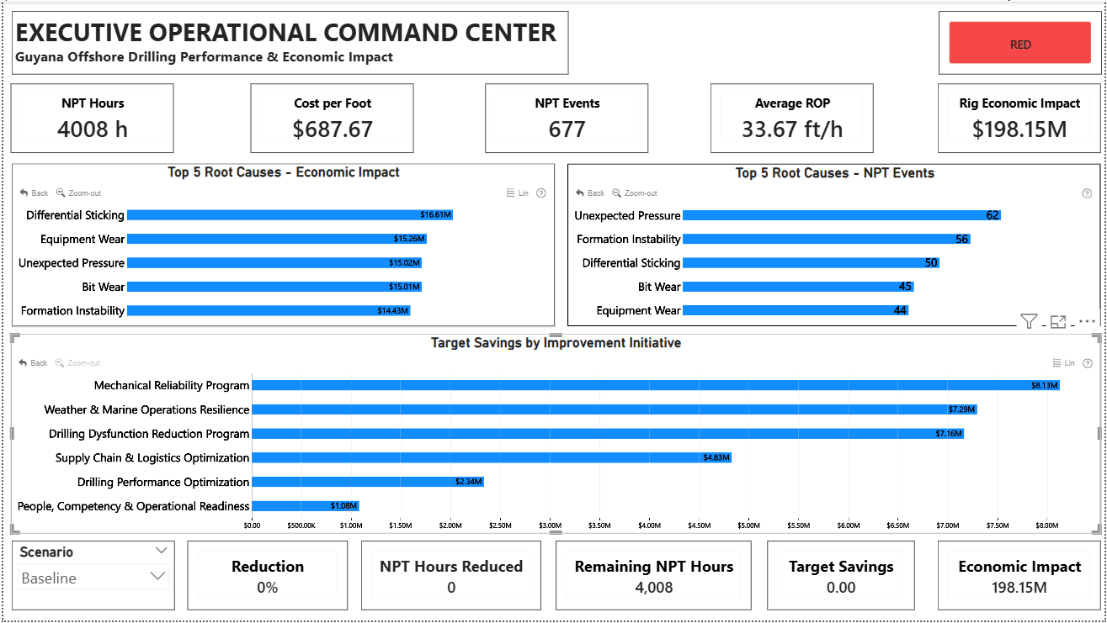
Dashboard — Executive Operational Command Center
Executive status, operational risks, root causes and improvement initiatives.
Guyana Offshore Drilling Analytics | Portfolio Case Study
04

Slide 5
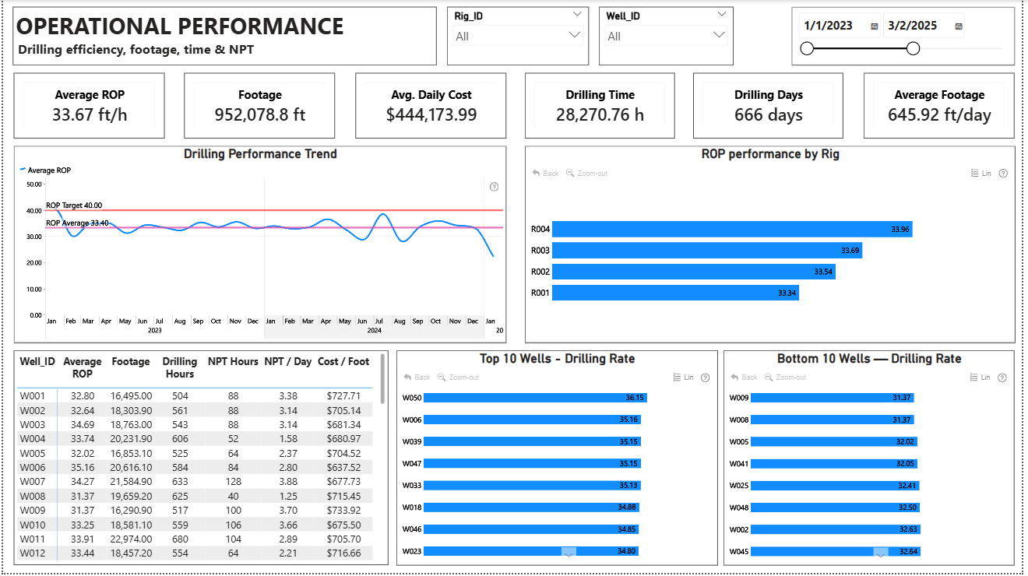
Dashboard — Operational Performance
Drilling efficiency, ROP, footage, drilling time and NPT performance.
Guyana Offshore Drilling Analytics | Portfolio Case Study
05

Slide 6
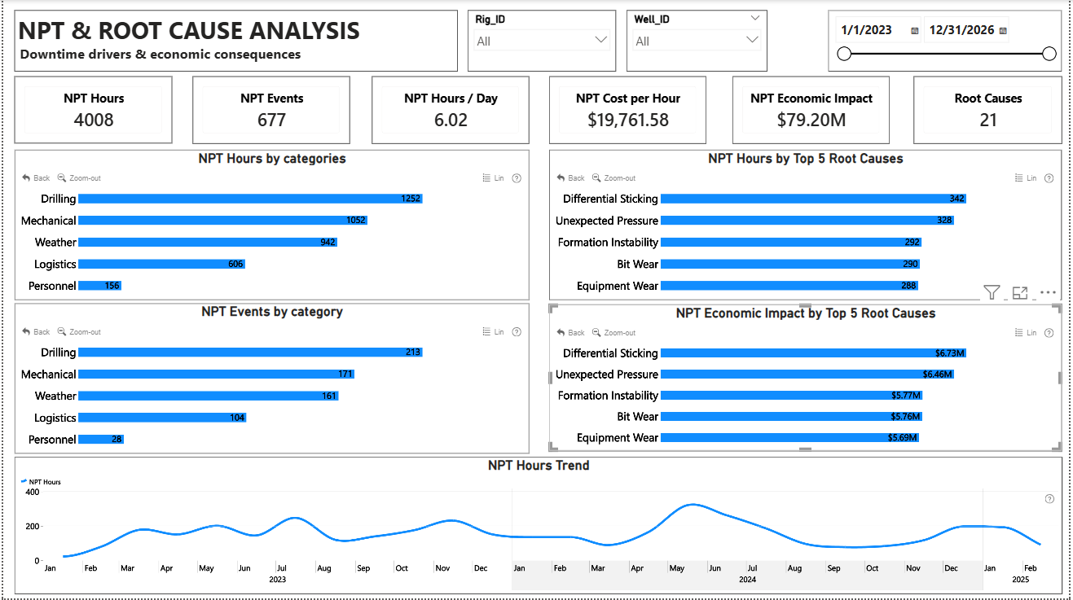
Dashboard — NPT & Root Cause Analysis
Downtime, root causes, NPT categories, economic consequence and trend.
Guyana Offshore Drilling Analytics | Portfolio Case Study
06

Slide 7
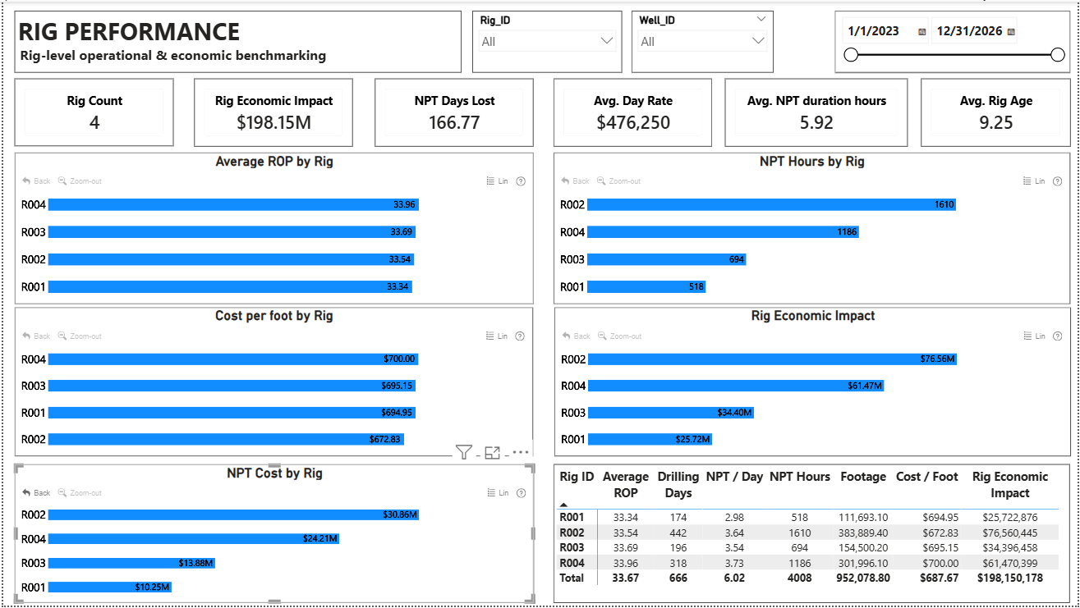
Dashboard — Rig Performance
Rig-level benchmarking across ROP, NPT, footage, cost and economic impact.
Guyana Offshore Drilling Analytics | Portfolio Case Study
07

Slide 8
From Data to Operational Insight
The dashboard connects performance, downtime, root cause and economics.
PERFORMANCE
DOWNTIME
ROOT CAUSE
NPT ECONOMIC IMPACT
33.67 ft/hr
4,008 hours NPT
Category → Cause
$79.20M NPT impact
The analytical chain
Drilling Performance → NPT → Root Cause → Economic Consequence → Operational Action
•
Project-level benchmarks provide the reference point.
•
Root-cause analysis provides an investigation path.
•
Rig-level analysis reveals where performance differs.
•
Economic metrics connect engineering performance to business consequence.
Guyana Offshore Drilling Analytics | Portfolio Case Study
08

Slide 9
Operational Improvement Framework
Six initiatives are surfaced in the executive layer for scenario-based decision support.
INIT-001
INIT-002
INIT-003
Mechanical Reliability Program
Weather & Marine Operations Resilience
Drilling dysfunction reduction program
INIT-004
INIT-005
INIT-006
Supply chain & logistics optimization
Drilling performance optimization
People, competency & operational readiness
Scenario logic
Baseline • Conservative • Target • Stretch
Initiative IDs and scenario structure are preserved from the finalized dashboard.
Guyana Offshore Drilling Analytics | Portfolio Case Study
09

Slide 10
Decision Support by User
The same analytical model supports different operational questions.
EXECUTIVE
Where is the economic exposure?
DRILLING ENGINEER
Where is operational performance changing?
PERFORMANCE ENGINEER
Which rig / well requires investigation?
OPERATIONS
Which NPT drivers should be addressed?
MANAGEMENT
What is the potential business consequence?
Guyana Offshore Drilling Analytics | Portfolio Case Study
10

Slide 11
Technical Implementation & QA
Data engineering, analytics, modeling and validation.
PYTHON
SQL
POWER BI + DAX
QA
Data layer
Analytical layer
Decision layer
Release control
Preparation / structured datasets
NPT analysis / benchmarking
Semantic model / interactive KPIs
Reconciliation / filter-context validation
Key QA example
Rig Performance NPT Hours initially repeated the project total across every rig row. The filter-context issue was isolated and corrected so rig-level NPT reconciles to the 4,008-hour project total.
Final benchmark reconciliation
33.67 ft/hr • 6.02 hr/day • 4,008 hr • 952,078.8 ft • $687.67/ft • 666 days • $198.15M
Guyana Offshore Drilling Analytics | Portfolio Case Study
11

Slide 12
PROJECT OUTCOME
From Operational Data
to Decision Support
A multi-layer drilling analytics solution connecting operational performance, NPT drivers, root causes, rig benchmarking and economic consequence.
DATA
PERFORMANCE
NPT
ROOT CAUSE
ECONOMICS
ACTION
Portfolio positioning
Drilling / Wells Engineering • Operational Performance Analytics • Power BI / SQL / Python
FINAL PORTFOLIO CASE STUDY

Slide 13
LAYER 2
Technical Appendix
Engineering traceability from source data to decision support
01
Data model
02
SQL architecture
Semantic structure and grain
Analytical layer and benchmarking
03
DAX KPI definitions
04
NPT calculation logic
Measures, denominators and context
Event → hours → economic impact
05
Rig / well relationships
06
QA methodology
Filter propagation and reconciliation
Validation and release controls
07
Scenario methodology
08
Metric definitions
Baseline → Stretch framework
Reference definitions for portfolio use
GUYANA OFFSHORE DRILLING ANALYTICS | TECHNICAL APPENDIX
13

Slide 14
01 / DATA MODEL
Semantic model architecture
Star-schema design separates reusable dimensions from operational fact tables.
Dim_Date
Dim_Scenario
Fact_Drilling_Daily_Report
Date / calendar attributes
Baseline / Conservative / Target / Stretch
Daily drilling performance grain
Dim_Well
Dim_KPI
Well ID / status / water depth
KPI catalog / definitions
Fact_NPT_PBI
Enriched NPT event grain
Dim_Rig
Power BI semantic layer
Rig / day rate / capability
Measures + visuals + drill-through
Design principle
Dimensions provide stable filter context.
Facts retain the operational grain.
Scenario and KPI catalogs remain explicit rather than embedded in visual logic.
GUYANA OFFSHORE DRILLING ANALYTICS | TECHNICAL APPENDIX
14

Slide 15
02 / SQL ARCHITECTURE
Analytical pipeline
SQL converts operational records into reconciled benchmarks, NPT diagnostics and decision-ready tables.
01
02
03
04
05
SOURCE
PROFILE
ANALYZE
RECONCILE
SERVE
SQLite tables
→
Quality checks
→
Operational SQL
→
Benchmark layer
→
Power BI inputs
Dim_Date · Dim_Well · Dim_Rig · Fact_Drilling · Fact_NPT
Counts · keys · duplicates · nulls · referential integrity
NPT by category · root cause · rig · well · monthly trend
ROP · NPT/day · NPT hours · footage · cost/ft · economic impact
Enriched facts · scenario outputs · KPI / decision catalogs
Reconciliation anchor
33.67 ft/hr • 6.02 NPT h/day • 4,008 NPT hr • 952,078.8 ft • $687.67/ft • 666 drilling days • $198.15M rig economic impact
GUYANA OFFSHORE DRILLING ANALYTICS | TECHNICAL APPENDIX
15

Slide 16
03 / DAX KPI DEFINITIONS
Measure logic and denominator control
KPI definitions are designed to remain stable under well, rig, date and scenario filters.
KPI
Definition / logic
Control point
Total Footage
SUM(Drilling[Footage_ft])
Additive drilling output
Drilling Hours
SUM(Drilling[Drilling_Hours])
Additive active drilling time
Average ROP
DIVIDE([Total Footage],[Drilling Hours])
ft/hr; weighted by hours
NPT Hours
SUM(NPT[Duration_hr])
Event duration, not event count
NPT / Day
DIVIDE([NPT Hours],[Drilling Days])
NPT hours per active drilling day
Cost / Foot
DIVIDE([Drilling Cost],[Total Footage])
Economic intensity of drilled footage
Rig Economic Impact
SUM(NPT[Rig_Economic_Impact_USD])
Rig-level economic consequence
NPT Event Count
DISTINCTCOUNT(NPT[NPT_ID])
Unique NPT events
GUYANA OFFSHORE DRILLING ANALYTICS | TECHNICAL APPENDIX
16

Slide 17
04 / NPT CALCULATION LOGIC
Event-to-impact calculation chain
The NPT layer preserves event grain while exposing operational and economic consequences.
NPT event
Duration
Severity
Rig cost
Deferred production
Total impact
Date · Well · Rig · Category · Root Cause
→
2 / 4 / 6 / 8 / 12 / 18 / 24 hr
→
Low ≤4 hr · Medium ≤12 hr · High >12 hr
→
Duration × rig day-rate / 24
→
Event duration × production-value proxy
→
Rig cost + deferred production
Why this matters
NPT is not treated as a single KPI: the same event can be traced from hours → cause → rig / well context → direct cost → total economic exposure.
GUYANA OFFSHORE DRILLING ANALYTICS | TECHNICAL APPENDIX
17

Slide 18
05 / RIG & WELL RELATIONSHIPS
Filter propagation and reconciliation
Rig and well context must filter both drilling and NPT facts consistently.
Dim_Well
Fact_Drilling
1 well → many drilling rows
1 well → many NPT events
Daily performance grain
Dim_Date
Visual / Drill-through
Calendar context
Rig / well investigation
Dim_Rig
Fact_NPT_PBI
1 rig → many drilling rows
1 rig → many NPT events
NPT event grain
QA reconciliation rule
At project scope, rig-level NPT must reconcile to 4,008 hours. The corrected filter context prevents the project total from repeating on every rig row.
GUYANA OFFSHORE DRILLING ANALYTICS | TECHNICAL APPENDIX
18

Slide 19
06 / QA METHODOLOGY
Release-control framework
Validation covers source integrity, calculations, filter context, dashboard architecture and final presentation.
01
Source integrity
SQLite tables, counts, keys, duplicates
CRITICAL
02
Economic reconciliation
NPT cost + deferred impact + total impact
HIGH
03
Semantic model
Tables, relationships, KPI catalog
HIGH
04
DAX dependency integrity
Measures and denominator behavior
HIGH
05
Scenario architecture
4 scenarios and improvement logic
MEDIUM
06
Dashboard / drill-through
Visual catalog, six drill-throughs, decisions
HIGH
07
Executive baseline
Project-level benchmark consistency
HIGH
Final QA principle: a visual is released only when its number, filter behavior and business meaning reconcile.
GUYANA OFFSHORE DRILLING ANALYTICS | TECHNICAL APPENDIX
19

Slide 20
07–08 / SCENARIO & METRIC METHODOLOGY
Scenario framework and reference definitions
Scenarios translate improvement assumptions into comparable operational and economic views.
Baseline
Conservative
Target
Stretch
0%
20%
40%
60%
Current-state reference
Partial realization
Planned improvement case
Upper-bound improvement case
Reference metric definitions
NPT Hours
Sum of event durations
NPT / Day
NPT hours ÷ drilling days
Cost / ft
Drilling cost ÷ footage
Economic Impact
Rig cost + deferred production impact
Average ROP
Footage ÷ drilling hours
Drilling Days
Distinct active drilling dates
Scenario interpretation: scenario percentages represent assumed realization of improvement potential; they are not forecasts.
GUYANA OFFSHORE DRILLING ANALYTICS | TECHNICAL APPENDIX
20

