Slide 1
OFFSHORE FIELD DEVELOPMENT
ECONOMICS INTELLIGENCE
Executive investment comparison | Standalone FPSO vs Subsea Tieback
EXECUTIVE PORTFOLIO PRESENTATION
Synthetic analytical case study • Illustrative economics • October 2026

Slide 2
01 | EXECUTIVE FRAMING
The decision question
The solution combines production assumptions, annual economics, scenario analysis, database outputs, and Power BI decision support.
• How do two offshore development concepts compare under a consistent set of economic assumptions?
• Which concept produces more absolute value, and which uses capital more efficiently?
• How sensitive are the conclusions to oil-price assumptions and model behavior?
• What evidence supports the analytical outputs—and what limitations remain?
OFFSHORE FIELD DEVELOPMENT ECONOMICS INTELLIGENCE
02

Slide 3
01 | EXECUTIVE FRAMING
Executive summary
Base-case results at a 10% discount rate
FPSO NPV
TIEBACK NPV
FPSO CAPEX
TIEBACK IRR
$7.73B
$4.80B
$4.0B
62.44%
Higher absolute modeled value
Lower capital requirement
Larger modeled investment
Higher modeled return rate
• Standalone FPSO leads on absolute NPV and cumulative production.
• Subsea Tieback leads on IRR and payback timing in the modeled base case.
• The appropriate choice depends on capital availability, risk, infrastructure, schedule, and commercial terms—not one metric alone.
OFFSHORE FIELD DEVELOPMENT ECONOMICS INTELLIGENCE
03

Slide 4
02 | DEVELOPMENT CONCEPTS
Development concepts compared
The concepts represent different capital and infrastructure strategies.
• Standalone FPSO: a more capital-intensive concept with greater modeled production and absolute NPV.
• Subsea Tieback: a lower-CAPEX concept that depends on suitable host infrastructure and tie-in feasibility.
• The comparison is economic and illustrative; it does not establish technical feasibility for any real asset.
• Real project selection would require reservoir, subsea, host-capacity, flow assurance, metocean, fiscal, and execution inputs.
OFFSHORE FIELD DEVELOPMENT ECONOMICS INTELLIGENCE
04

Slide 5
02 | DEVELOPMENT CONCEPTS
Model assumptions
Common scenario framework used for the comparison
Assumption | Modeled setting | Interpretation
Evaluation horizon | 25 years | Long-term annual cash-flow model
Discount rate | 10% | Present-value benchmark
Low oil-price case | $55/bbl | Downside price assumption
Base oil-price case | $75/bbl | Reference price assumption
High oil-price case | $95/bbl | Upside price assumption
Important: these are synthetic case-study assumptions, not market forecasts or sanctioned project parameters.
OFFSHORE FIELD DEVELOPMENT ECONOMICS INTELLIGENCE
05

Slide 6
03 | ECONOMIC RESULTS
Base-case economics
A multi-metric comparison prevents over-reliance on a single indicator
Metric | Standalone FPSO | Subsea Tieback | Read-through
NPV @ 10% | $7.729B | $4.797B | FPSO higher absolute value
IRR | 39.62% | 62.44% | Tieback higher rate of return
Discounted payback | 6.91 years | 5.01 years | Tieback recovers discounted investment sooner
Undiscounted payback | 6.44 years | 4.77 years | Tieback recovers nominal investment sooner
Breakeven oil price | $29.11/bbl | $32.03/bbl | FPSO lower modeled breakeven
Cumulative production | 481.50 MMbbl | 294.09 MMbbl | FPSO has larger modeled volume
CAPEX | $4.0B | $1.3B | Tieback has lower modeled capital
OFFSHORE FIELD DEVELOPMENT ECONOMICS INTELLIGENCE
06

Slide 7
03 | ECONOMIC RESULTS
How to interpret the trade-off
The model supports structured comparison; it does not replace a full field-development evaluation.
• Absolute value: the FPSO case has the higher modeled NPV, reflecting a larger modeled production and cash-flow base.
• Capital efficiency: the Tieback case has a higher modeled IRR and shorter payback, alongside lower CAPEX.
• Price resilience: compare the Low, Base, and High cases rather than assuming the Base case will occur.
• Decision discipline: include execution risk, schedule, fiscal terms, host access, and uncertainty before making a real investment decision.
OFFSHORE FIELD DEVELOPMENT ECONOMICS INTELLIGENCE
07

Slide 8
04 | SCENARIOS & DECISION SUPPORT
Scenario framework
Scenario analysis is a controlled stress test, not a probability-weighted forecast.
• Low case: $55/bbl oil price.
• Base case: $75/bbl oil price.
• High case: $95/bbl oil price.
• Scenario calculations are generated from the modeled economic framework and made available for comparison.
• Scenario-specific outputs should be interpreted alongside the assumptions and numerical status of each metric.
OFFSHORE FIELD DEVELOPMENT ECONOMICS INTELLIGENCE
08

Slide 9
04 | SCENARIOS & DECISION SUPPORT
Power BI decision-support experience
Use the dashboard to explore the model—not as a substitute for checking definitions and assumptions.
• Oil-price scenario selection supports comparison of Low, Base, and High cases.
• Development concept selection supports FPSO-versus-Tieback analysis.
• The report is intended to connect headline economics to supporting comparison views.
• Documented regression QA reported 10/10 checks passed, including scenario slicers, cross-visual behavior, and report consistency.
• Final publication should include screenshots from the actual PBIX so visual claims can be verified directly.
OFFSHORE FIELD DEVELOPMENT ECONOMICS INTELLIGENCE
09

Slide 10
05 | ENGINEERING CONFIDENCE
Solution architecture at a glance
A layered workflow separates calculation, persistence, validation, and presentation.
• Python generates and transforms the synthetic input data and computes annual economics and scenario outputs.
• Validation scripts test assumptions, annual model outputs, investment metrics, scenario behavior, and IRR diagnostics.
• SQLite persists analytical outputs and exposes six analytical SQL views.
• Independent SQL checks reconcile analytical results across layers.
• Power BI provides the semantic model, DAX measures, scenario interactions, and decision-facing visuals.
OFFSHORE FIELD DEVELOPMENT ECONOMICS INTELLIGENCE
10

Slide 11
05 | ENGINEERING CONFIDENCE
Quality-assurance evidence
Recorded results from the documented end-to-end run
PIPELINE
ASSUMPTIONS
ANNUAL MODEL
INVESTMENT METRICS
14/14
81/81
34/34
17/17
steps completed
checks passed
checks passed
checks passed
SCENARIO QA
IRR QA
SQL VIEWS
SQL RECONCILIATION
16/16
9/9
15/15
10/10
checks passed
checks passed
checks passed
checks passed
These are recorded QA outcomes; a clean-checkout rebuild has not yet been performed.
OFFSHORE FIELD DEVELOPMENT ECONOMICS INTELLIGENCE
11

Slide 12
05 | ENGINEERING CONFIDENCE
Numerical integrity: IRR diagnostics
A blank or unavailable IRR can be the correct result when a single meaningful IRR cannot be established.
• IRR can be ambiguous when cash flows produce multiple mathematical roots.
• Some Low-price cases include a root near −100% that is numerically ill-conditioned.
• The model intentionally avoids presenting a misleading single scalar IRR when the root structure is ambiguous.
• This behavior is a model-governance choice: explain the limitation rather than forcing an apparently precise number.
OFFSHORE FIELD DEVELOPMENT ECONOMICS INTELLIGENCE
12

Slide 13
06 | CONCLUSIONS
Limitations and appropriate use
Transparency about boundaries is part of the analytical deliverable.
• The dataset is synthetic and is not calibrated to a real field, reservoir, contract, or operator.
• The modeled cash flows do not constitute a bankable economic evaluation or investment recommendation.
• Results depend on the assumed production, cost, price, timing, and discounting framework.
• Real decisions require fiscal and contractual terms, uncertainty ranges, technical feasibility, abandonment, and risked scenarios.
• Reproducibility QA documents that a clean-checkout rebuild has not yet been performed.
OFFSHORE FIELD DEVELOPMENT ECONOMICS INTELLIGENCE
13

Slide 14
06 | CONCLUSIONS
Decision framework and next steps
The next maturity step is stronger uncertainty treatment and reproducibility evidence.
• Use NPV to compare absolute modeled value, while considering IRR and payback as complementary metrics.
• Stress-test oil prices, production performance, CAPEX, OPEX, schedule, and discount rate.
• Add probability-weighted or risked scenarios before using the framework for real investment screening.
• Complete a clean-clone rebuild and capture final Power BI screenshots before public portfolio release.
• Keep all executive claims traceable to a documented calculation or QA result.
OFFSHORE FIELD DEVELOPMENT ECONOMICS INTELLIGENCE
14

Slide 15
06 | CONCLUSIONS
What this project demonstrates
The project demonstrates an integrated engineering analytics workflow—not merely a dashboard.
• Engineering-oriented economic modeling with explicit assumptions and cash-flow logic.
• A reproducible Python pipeline with layered validation and reconciliation.
• Relational data design and analytical persistence using SQLite and SQL views.
• Power BI semantic modeling, DAX measures, scenario interaction, and regression testing.
• Numerical judgment around IRR root ambiguity and responsible presentation of uncertainty.
OFFSHORE FIELD DEVELOPMENT ECONOMICS INTELLIGENCE
15

Slide 16
KEY TAKEAWAY
A sound investment comparison needs more than one headline metric.
The modeled FPSO case leads on absolute NPV; the Tieback case leads on capital efficiency indicators. Scenario analysis, validated calculations, and transparent limitations make the comparison more useful.
Offshore Field Development Economics Intelligence • Synthetic case study
16

Slide 17
APPENDIX | COMPANION DECK
Technical companion presentation
Executive deck = decision story. Technical deck = calculation, architecture, and verification story.
• The companion technical deck documents the economic engine, data architecture, scenario logic, SQL views, Power BI model, and QA evidence.
• It distinguishes validated implementation facts from recommended future enhancements.
• Detailed formulas and code excerpts should be cross-checked against the repository before final external publication.
OFFSHORE FIELD DEVELOPMENT ECONOMICS INTELLIGENCE
17

Slide 18
APPENDIX | COMPANION DECK
Evidence and reproducibility status
Keep the presentation aligned with the latest repository evidence.
• Repository QA documentation includes Power BI scenario economics QA and repository reproducibility QA.
• Recorded end-to-end pipeline completed 14/14 steps; SQLite integrity check returned “ok”.
• The clean-checkout rebuild remains outstanding and should be completed before describing the pipeline as independently reproducible from a fresh clone.
• Presentation metrics are sourced from the project’s previously validated base-case results.
OFFSHORE FIELD DEVELOPMENT ECONOMICS INTELLIGENCE
18

Slide 19
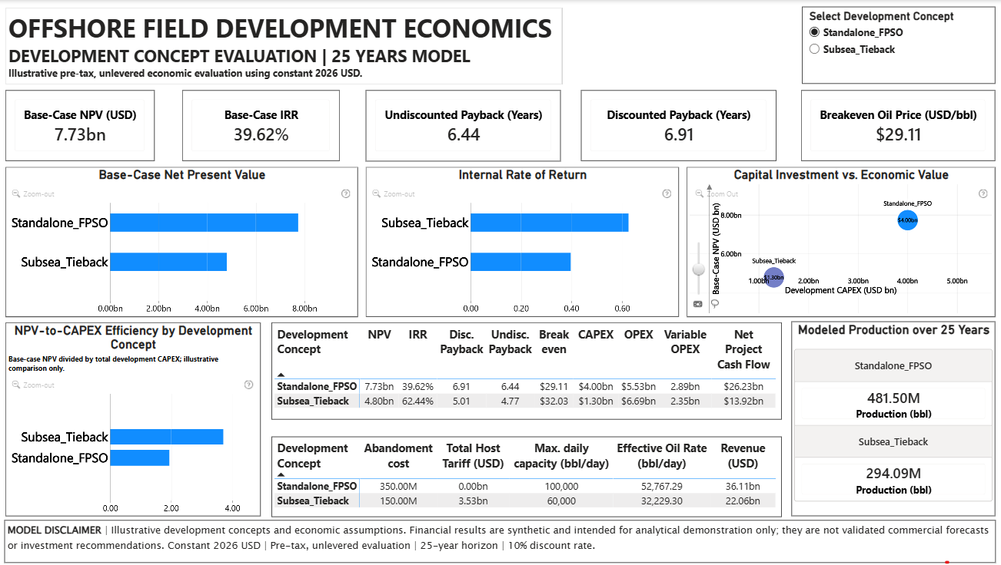
Power BI evidence | Executive economics dashboard
Actual report screenshot supplied for this project • Selected concept: Standalone FPSO • Base-case headline metrics
Portfolio note: All economic results are illustrative outputs from a synthetic offshore field development model. Values are expressed in constant 2026 USD unless otherwise indicated. Base-case evaluation uses a 10% discount rate over a 25-year horizon. Results are not investment recommendations or validated commercial forecasts..
19

Slide 20
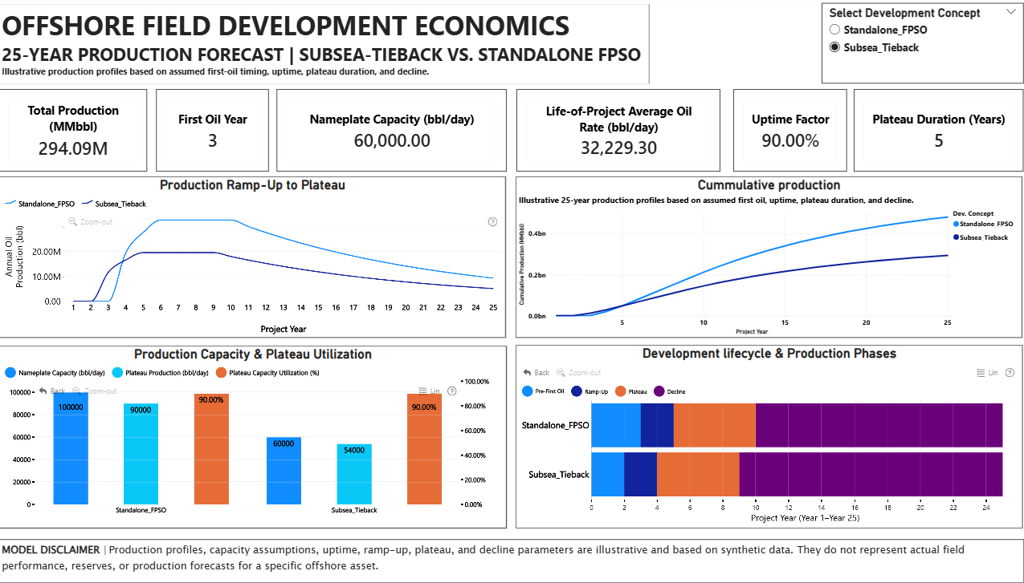
Power BI evidence | Production forecast
Actual production dashboard • Illustrative 25-year profiles, capacity assumptions, and cumulative modeled production
Production profiles, first-oil timing, capacity, uptime, ramp-up, plateau duration, and decline assumptions are synthetic and illustrative. Cumulative production represents modeled volumes over the 25-year evaluation horizon and does not represent actual reserves or production forecasts for a specific offshore asset..
20

Slide 21
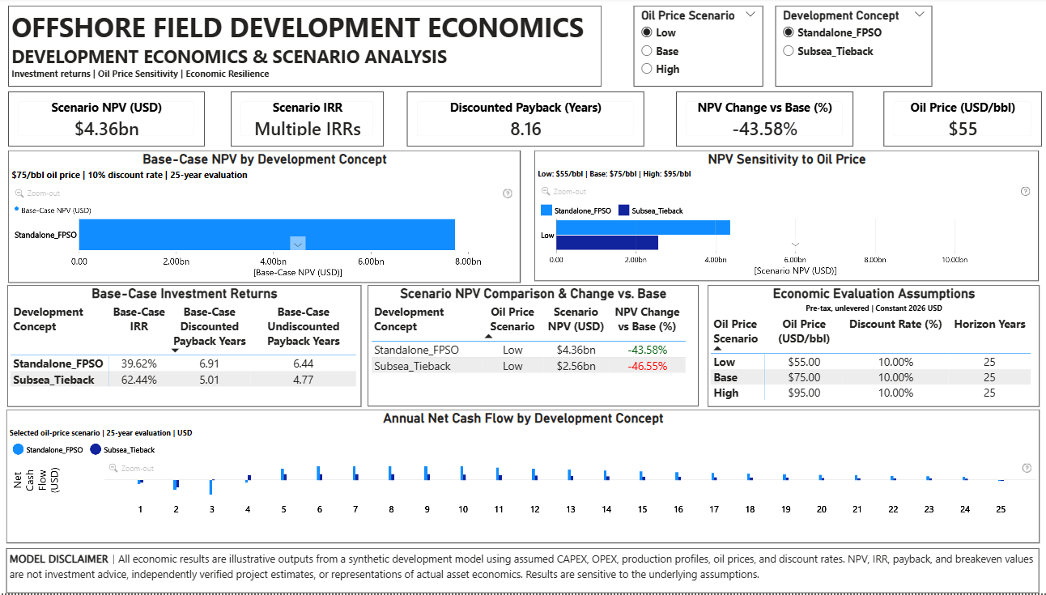
Power BI evidence | Scenario analysis
Actual scenario report screenshot • Low oil-price case ($55/bbl) • Selected concept: Standalone FPSO
Oil-price scenarios are assumed at $55/bbl (Low), $75/bbl (Base), and $95/bbl (High). Economic outputs depend on the modeled production, capital, operating cost, and discounting assumptions. IRR may be unavailable where multiple or numerically ill-conditioned roots prevent reliable identification of a single meaningful value..
21

Slide 22
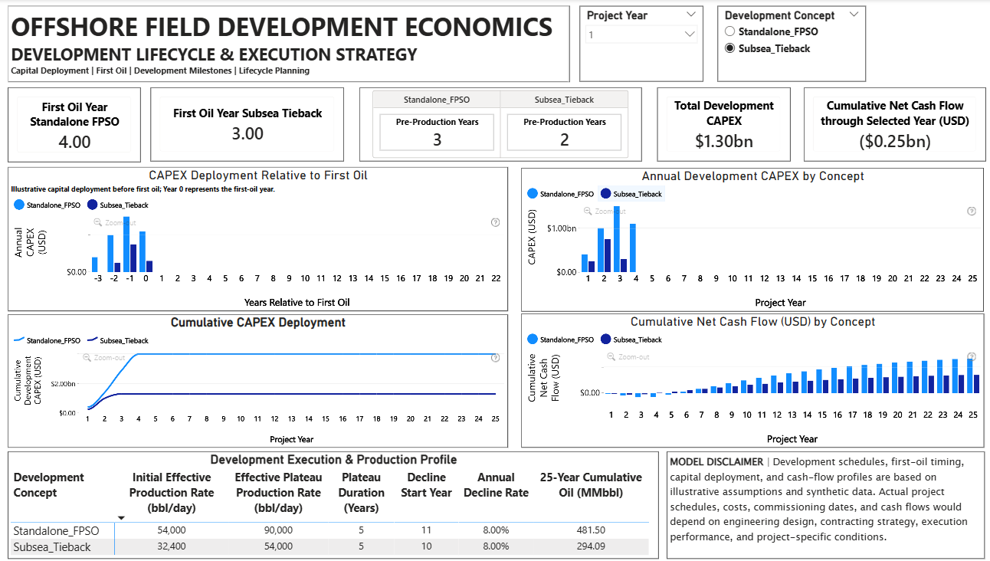
Power BI evidence | Execution Strategy
First-oil timing, CAPEX deployment, cumulative CAPEX, cumulative net cash flow, and production-phase assumptions
First-oil timing, capital deployment, production phases, and cumulative cash flows are based on synthetic development assumptions. Actual project schedules, costs, commissioning dates, and cash-flow profiles would depend on engineering design, contracting strategy, execution performance, and project-specific conditions.
21

