Slide 1
OFFSHORE FIELD DEVELOPMENT
ECONOMICS INTELLIGENCE
Technical implementation, economic methodology, data architecture, and quality assurance
TECHNICAL PORTFOLIO PRESENTATION
Synthetic analytical case study • Illustrative economics • October 2026

Slide 2
01 | SCOPE
Technical objectives and scope
• Compare two modeled development concepts under a consistent economic framework.
• Produce annual production and economic records, calculate investment metrics, and evaluate oil-price scenarios.
• Persist outputs in SQLite, expose analytical SQL views, and deliver decision-support analysis through Power BI.
• Validate key assumptions and calculations through automated checks and cross-layer reconciliation.
OFFSHORE FIELD DEVELOPMENT ECONOMICS INTELLIGENCE
02

Slide 3
01 | SCOPE
Problem framing and decision requirements
• Investment screening requires multiple indicators: NPV, IRR, payback, breakeven, production, and capital intensity.
• Metrics must be traceable to assumptions, annual cash flows, and a defined discounting convention.
• Scenario selection must update the relevant scenario-dependent outputs consistently.
• Ambiguous numerical results must be flagged rather than silently forced into a single value.
OFFSHORE FIELD DEVELOPMENT ECONOMICS INTELLIGENCE
03

Slide 4
02 | ASSUMPTIONS
Development concepts and boundaries
• Standalone FPSO represents a higher-CAPEX, higher-modeled-volume concept in this synthetic case.
• Subsea Tieback represents a lower-CAPEX concept with modeled dependence on a host-facility strategy.
• The model compares economic outcomes; it does not prove reservoir deliverability, subsea feasibility, or host capacity.
• No real field, operator, contract, or sanctioned project is represented by these synthetic outputs.
OFFSHORE FIELD DEVELOPMENT ECONOMICS INTELLIGENCE
04

Slide 5
02 | ASSUMPTIONS
Economic assumptions and scenarios
• Evaluation horizon: 25 years.
• Discount rate: 10%.
• Low oil-price case: $55/bbl; Base: $75/bbl; High: $95/bbl.
• Assumptions are controlled model inputs and should be versioned and validated before calculations run.
• Do not interpret these scenario prices as a market forecast or probability distribution.
OFFSHORE FIELD DEVELOPMENT ECONOMICS INTELLIGENCE
05

Slide 6
03 | PRODUCTION AND ECONOMICS
Production modeling workflow
• Production profiles are generated as annual records for each development concept.
• The recorded pipeline generated 50 annual production-profile records.
• Production volumes feed the annual economic model and cumulative production metrics.
• The model's outputs are only as credible as the assumptions embedded in the synthetic profile generation.
OFFSHORE FIELD DEVELOPMENT ECONOMICS INTELLIGENCE
06

Slide 7
03 | PRODUCTION AND ECONOMICS
Production volume comparison
• Standalone FPSO cumulative modeled production: approximately 481.50 MMbbl.
• Subsea Tieback cumulative modeled production: approximately 294.09 MMbbl.
• The larger FPSO volume contributes to its higher absolute modeled NPV, but volume alone does not determine economic superiority.
• Production timing and cost assumptions also influence discounted cash flow.
OFFSHORE FIELD DEVELOPMENT ECONOMICS INTELLIGENCE
07

Slide 8
03 | PRODUCTION AND ECONOMICS
Economic input structure
• Core input families include annual production, oil-price assumptions, CAPEX, OPEX, timing, and discount rate.
• Inputs should remain distinct from calculated outputs to preserve traceability.
• Dimension and fact structures provide consistent identifiers and analytical grain.
• Any additional cost, tax, royalty, fiscal, abandonment, or uncertainty components should be explicitly modeled rather than assumed to exist.
OFFSHORE FIELD DEVELOPMENT ECONOMICS INTELLIGENCE
08

Slide 9
03 | PRODUCTION AND ECONOMICS
Annual economic model
• Annual records combine production assumptions with price and cost inputs to form the modeled cash-flow series.
• The recorded annual economic model contains 50 records.
• Annual grain supports time-series inspection and discounted-cash-flow calculations.
• Validation checks test expected structure and key economic behaviors before metrics are finalized.
OFFSHORE FIELD DEVELOPMENT ECONOMICS INTELLIGENCE
09

Slide 10
03 | PRODUCTION AND ECONOMICS
Revenue logic and unit discipline
• A simplified gross-revenue relationship is production volume multiplied by realized oil price.
• Unit consistency is essential: barrel volumes and dollars per barrel must be aligned before aggregation.
• If differentials, quality adjustments, shrinkage, royalties, or fiscal terms are not represented, they must not be implied by the headline outputs.
• Revenue is an input to modeled cash flow, not equivalent to project value.
OFFSHORE FIELD DEVELOPMENT ECONOMICS INTELLIGENCE
10

Slide 11
03 | PRODUCTION AND ECONOMICS
Operating and capital cash flows
• Operating economics should distinguish revenue, operating costs, capital investment, and any other explicitly modeled cash-flow components.
• CAPEX timing matters because early and late investments have different present values.
• Base-case modeled CAPEX is $4.0B for FPSO and $1.3B for Tieback.
• The technical deck reports only model components supported by the project evidence; omitted fiscal or abandonment terms are limitations.
OFFSHORE FIELD DEVELOPMENT ECONOMICS INTELLIGENCE
11

Slide 12
04 | INVESTMENT METRICS
Discounted cash flow methodology
• For period t, discount factor = 1 / (1 + r)^t, where r is the discount rate.
• Present value of a period's cash flow = CF_t / (1 + r)^t.
• NPV is the sum of discounted cash flows under the model's timing convention.
• The chosen period origin and investment timing convention must be applied consistently across concepts and scenarios.
OFFSHORE FIELD DEVELOPMENT ECONOMICS INTELLIGENCE
12

Slide 13
04 | INVESTMENT METRICS
NPV: definition and interpretation
• Net present value aggregates cash flows after discounting them to a common valuation date.
• At the 10% discount rate, modeled base-case NPV is $7.729B for FPSO and $4.797B for Tieback.
• NPV is an absolute-value measure and is affected by scale, production, price, cost, and timing.
• NPV comparisons are only meaningful when the concepts use comparable boundaries and assumptions.
OFFSHORE FIELD DEVELOPMENT ECONOMICS INTELLIGENCE
13

Slide 14
04 | INVESTMENT METRICS
IRR: definition and caveats
• IRR is a discount rate that makes the NPV of a cash-flow series equal to zero.
• Base-case modeled IRR: 39.62% for FPSO and 62.44% for Tieback.
• IRR can be non-unique when cash flows change sign more than once; multiple roots can exist.
• IRR should be interpreted with NPV, scale, and the structure of the underlying cash flows.
OFFSHORE FIELD DEVELOPMENT ECONOMICS INTELLIGENCE
14

Slide 15
04 | INVESTMENT METRICS
Payback calculations
• Undiscounted payback tracks when cumulative nominal cash flow recovers the investment.
• Discounted payback applies the discounting convention before tracking cumulative recovery.
• FPSO: 6.44 years undiscounted and 6.91 years discounted in the base case.
• Tieback: 4.77 years undiscounted and 5.01 years discounted in the base case.
• Payback is a timing indicator; it does not measure all value generated after recovery.
OFFSHORE FIELD DEVELOPMENT ECONOMICS INTELLIGENCE
15

Slide 16
04 | INVESTMENT METRICS
Breakeven oil price
• Breakeven price is a model-dependent price threshold under the chosen cash-flow definition.
• Base-case reported breakeven: $29.11/bbl for FPSO and $32.03/bbl for Tieback.
• The exact meaning depends on whether the model defines breakeven using NPV=0 and on the included cash-flow components.
• Documentation should state the implemented definition and its limitations before external use.
OFFSHORE FIELD DEVELOPMENT ECONOMICS INTELLIGENCE
16

Slide 17
04 | INVESTMENT METRICS
Base-case economic comparison
• FPSO: NPV $7.729B; IRR 39.62%; discounted payback 6.91 years; CAPEX $4.0B.
• Tieback: NPV $4.797B; IRR 62.44%; discounted payback 5.01 years; CAPEX $1.3B.
• FPSO leads on absolute NPV and modeled cumulative production.
• Tieback leads on IRR, payback, and initial capital requirement in this synthetic base case.
OFFSHORE FIELD DEVELOPMENT ECONOMICS INTELLIGENCE
17

Slide 18
05 | SCENARIOS AND NUMERICAL DIAGNOSTICS
Scenario engine design
• The scenario layer evaluates Low, Base, and High oil-price assumptions across the modeled concepts.
• The recorded pipeline produced 150 annual scenario records, six scenario metrics, and 150 discounted-cash-flow records.
• Scenario outputs should be keyed to concept, scenario, and period so filters resolve unambiguously.
• Scenario calculations should be reconciled to the underlying annual cash-flow logic.
OFFSHORE FIELD DEVELOPMENT ECONOMICS INTELLIGENCE
18

Slide 19
05 | SCENARIOS AND NUMERICAL DIAGNOSTICS
Scenario interpretation and controls
• Low/Base/High price cases are deterministic sensitivities, not likelihood-weighted outcomes.
• The scenario slicer should affect metrics designed to respond to oil price; invariant measures should be labeled accordingly.
• Regression tests should confirm that relevant measures change when the selected scenario changes.
• Always test slicers, visual interactions, filter reset, and cross-page consistency in the actual PBIX.
OFFSHORE FIELD DEVELOPMENT ECONOMICS INTELLIGENCE
19

Slide 20
05 | SCENARIOS AND NUMERICAL DIAGNOSTICS
IRR root diagnostics: why this matters
• An IRR solver may find more than one root for a non-conventional cash-flow series.
• Low-price cases in the project include roots classified as numerically ill-conditioned near −100%.
• The model leaves a scalar IRR blank for multiple-root cases rather than selecting an arbitrary root.
• This avoids presenting a false impression of precision and is a deliberate analytical safeguard.
OFFSHORE FIELD DEVELOPMENT ECONOMICS INTELLIGENCE
20

Slide 21
05 | SCENARIOS AND NUMERICAL DIAGNOSTICS
Numerical reliability and reporting policy
• A mathematical root is not automatically a stable or economically meaningful reported metric.
• Independent NPV checks are used for well-conditioned reported roots.
• Roots near −100% are classified separately because ordinary floating-point NPV evaluation is unreliable in that region.
• Reporting status, root count, and metric value should be kept distinct in data outputs.
OFFSHORE FIELD DEVELOPMENT ECONOMICS INTELLIGENCE
21

Slide 22
06 | DATA ENGINEERING
Python pipeline architecture
• The end-to-end workflow separates assumptions, generation, economic calculation, scenario analysis, persistence, and QA.
• The recorded pipeline completed 14 of 14 steps in 26.29 seconds in the existing environment.
• Validation stages run at multiple layers rather than relying on a single final check.
• A clean-checkout rebuild has not yet been performed, so that remains an explicit reproducibility task.
OFFSHORE FIELD DEVELOPMENT ECONOMICS INTELLIGENCE
22

Slide 23
06 | DATA ENGINEERING
Data model and analytical grain
• Dimension tables hold descriptive entities and stable keys; fact tables hold observations or events at defined grains.
• Annual production and economics records should not be mixed with event-grain records without a clear aggregation rule.
• Primary-key uniqueness and foreign-key integrity protect joins and avoid duplicate inflation.
• The semantic model should preserve grain and avoid ambiguous many-to-many filter paths.
OFFSHORE FIELD DEVELOPMENT ECONOMICS INTELLIGENCE
23

Slide 24
06 | DATA ENGINEERING
SQLite persistence and integrity
• SQLite stores the analytical outputs used by downstream SQL views and QA.
• The recorded database integrity check returned “ok”.
• Persisted outputs make it possible to inspect and reconcile model results independently of Power BI.
• A fresh-run database should be recreated or updated through the documented pipeline, not edited ad hoc.
OFFSHORE FIELD DEVELOPMENT ECONOMICS INTELLIGENCE
24

Slide 25
06 | DATA ENGINEERING
Analytical SQL views
• The project creates six analytical SQL views to expose downstream-ready economic and scenario data.
• Views separate reusable analytical logic from individual report visuals.
• View definitions should be version-controlled and their output grain documented.
• Exact view names and SQL expressions should be confirmed directly from the current repository before quoting code in a final technical review.
OFFSHORE FIELD DEVELOPMENT ECONOMICS INTELLIGENCE
25

Slide 26
06 | DATA ENGINEERING
Cross-layer reconciliation
• Independent SQL reconciliation reported 10 of 10 checks passed.
• SQL-view QA reported 15 of 15 checks passed.
• Reconciliation should compare record counts, totals, scenario outputs, and key metrics across source calculations and persisted views.
• A successful check proves the tested relationship—not every possible behavior or the validity of all assumptions.
OFFSHORE FIELD DEVELOPMENT ECONOMICS INTELLIGENCE
26

Slide 27
07 | POWER BI
Power BI semantic model
• Keep fact and dimension responsibilities distinct and relationships intentional.
• Use stable keys and validate cardinality, active relationships, and filter direction.
• Measures should calculate from the intended fact grain and avoid double-counting across joins.
• Documented model QA should be supplemented with a review of the actual PBIX before final publication.
OFFSHORE FIELD DEVELOPMENT ECONOMICS INTELLIGENCE
27

Slide 28
07 | POWER BI
DAX measure governance
• Financial measures should have explicit definitions, units, filter context, and aggregation behavior.
• Scenario-sensitive measures should read the selected scenario from the model's scenario context.
• Measures intended to be invariant should not accidentally depend on a disconnected or ignored slicer.
• Use independent Python or SQL calculations as benchmarks for key Power BI outputs.
OFFSHORE FIELD DEVELOPMENT ECONOMICS INTELLIGENCE
28

Slide 29
07 | POWER BI
Slicer and visual interaction testing
• Regression checks should verify oil-price scenario changes, concept selection, cross-visual interactions, and filter reset.
• The project's documented Power BI regression QA reports 10 of 10 checks passed.
• A visual may remain unchanged legitimately if it is explicitly a base-case comparison; its title and behavior must make that scope clear.
• Do not assume all visuals should change with every slicer—test and document intended behavior.
OFFSHORE FIELD DEVELOPMENT ECONOMICS INTELLIGENCE
29

Slide 30
07 | POWER BI
Power BI report design principles
• Lead with a concise executive comparison, then provide detail for production, economics, and scenario diagnostics.
• Use consistent units, explicit titles, meaningful number formats, and clearly labeled scenario context.
• Keep unavailable or ambiguous IRR values distinct from zero and from missing data.
• Use annotations to communicate the model's synthetic nature and avoid implying real-asset recommendations.
OFFSHORE FIELD DEVELOPMENT ECONOMICS INTELLIGENCE
30

Slide 31
08 | VALIDATION AND GOVERNANCE
QA framework and recorded results
• Assumptions: 81/81 checks passed.
• Annual economic model: 34/34; investment metrics: 17/17.
• Scenario QA: 16/16; scenario IRR QA: 9/9.
• SQL-view QA: 15/15; independent SQL reconciliation: 10/10.
• These are recorded outcomes from the existing environment and documented test runs.
OFFSHORE FIELD DEVELOPMENT ECONOMICS INTELLIGENCE
31

Slide 32
08 | VALIDATION AND GOVERNANCE
End-to-end QA interpretation
• The pipeline's 14/14 completion confirms the documented run reached each defined step.
• Layered QA helps detect structural, calculation, scenario, and persistence problems.
• Passing tests does not validate the realism of synthetic assumptions or prove field-development feasibility.
• The test suite should be rerun after changes to inputs, formulas, SQL views, relationships, or DAX measures.
OFFSHORE FIELD DEVELOPMENT ECONOMICS INTELLIGENCE
32

Slide 33
08 | VALIDATION AND GOVERNANCE
Reproducibility and repository workflow
• The project has repository QA documentation and a committed/pushed Power BI scenario-economics QA update.
• The documented reproducibility status explicitly says a clean-checkout rebuild has not been performed.
• Recommended closure: clone into a clean directory, install pinned dependencies, run the full pipeline, and compare outputs.
• Archive environment details and expected outputs so future changes can be evaluated consistently.
OFFSHORE FIELD DEVELOPMENT ECONOMICS INTELLIGENCE
33

Slide 34
09 | CONCLUSIONS
Limitations and future technical enhancements
• Synthetic production, price, CAPEX, and OPEX assumptions limit external generalization.
• Potential enhancements include fiscal terms, royalties, taxes, abandonment, inflation, price differentials, and uncertainty distributions.
• Risked economics could add probabilistic production, cost, schedule, and price cases.
• A robust investment workflow should document model boundaries, assumptions, sensitivities, and independent review.
OFFSHORE FIELD DEVELOPMENT ECONOMICS INTELLIGENCE
34

Slide 35
09 | CONCLUSIONS
Technical conclusions and handover
• The project integrates economic modeling, Python automation, SQLite/SQL analytics, Power BI, and layered QA.
• The base case illustrates the trade-off between absolute modeled value and capital efficiency.
• Numerical IRR diagnostics and explicit limitations strengthen the credibility of the analysis.
• Before final public release: complete the clean-clone rebuild, capture current PBIX screenshots, and verify code snippets against the repository.
OFFSHORE FIELD DEVELOPMENT ECONOMICS INTELLIGENCE
35

Slide 36
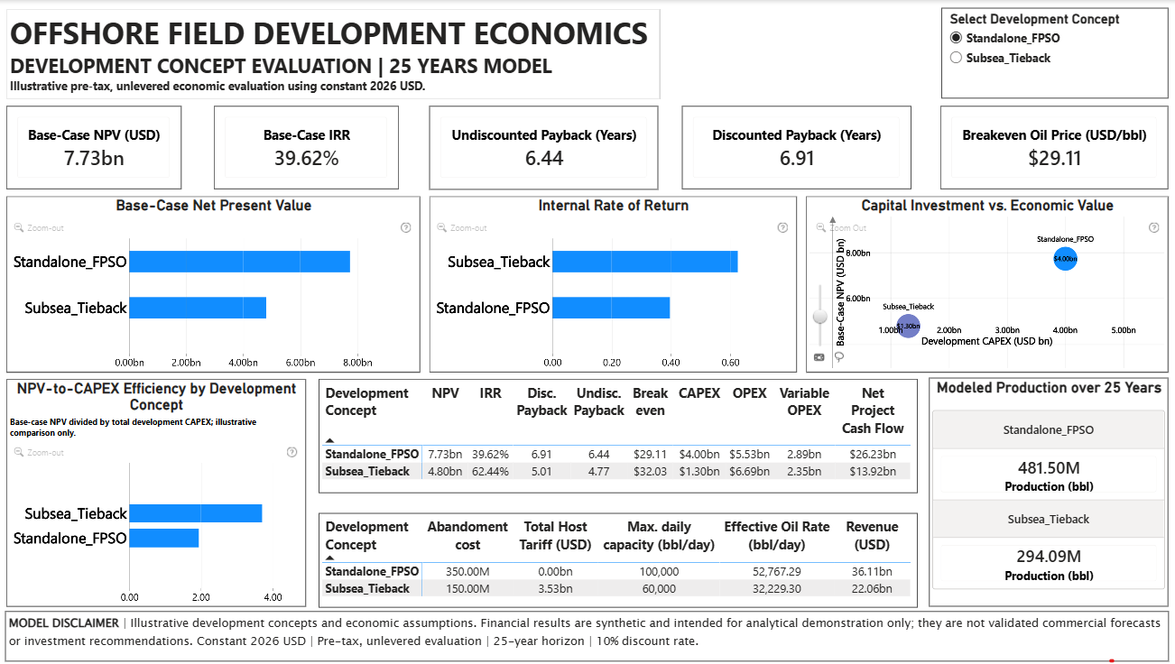
Power BI implementation evidence | Economic command center
Report-level KPI cards, development concept slicer, base-case comparison charts, and economic summary tables
KPI values and comparison visuals are derived from the project's economic model and Power BI semantic layer. Base-case indicators use the documented 25-year evaluation horizon and 10% discount rate. Metric definitions, aggregation logic, and scenario behavior should be interpreted according to the implemented model and its documented QA results.
36

Slide 37
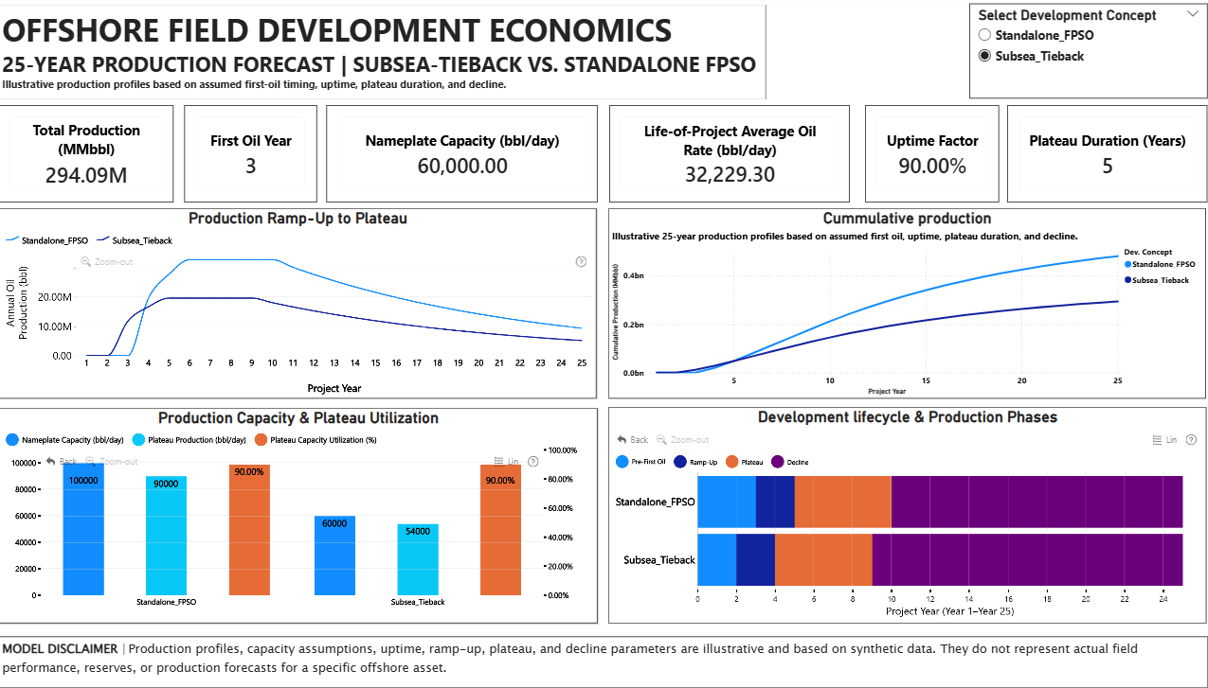
Power BI implementation evidence | Production model outputs
Annual ramp-up, cumulative production, capacity utilization, lifecycle phases, and concept selection
Production curves and lifecycle indicators represent synthetic annual production profiles. Cumulative volumes are aggregated over the modeled horizon. The profiles demonstrate the analytical workflow and visualization logic; they do not constitute reservoir forecasts or independently validated engineering production forecasts.
37

Slide 38
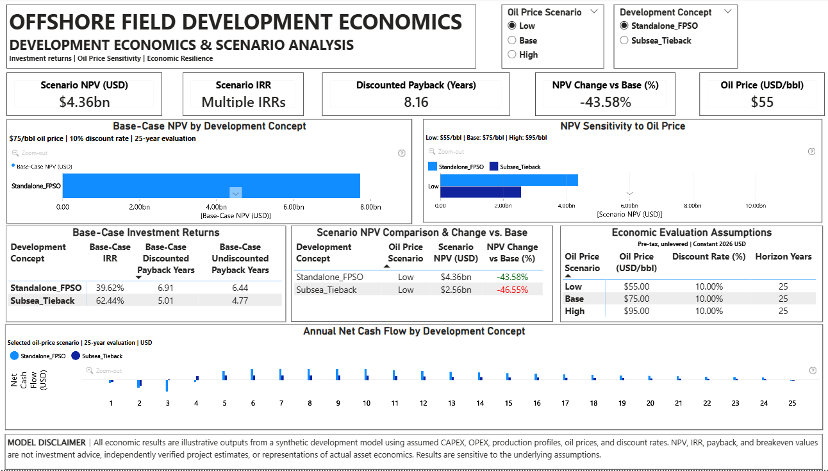
Power BI implementation evidence | Scenario interaction
Oil-price scenario and development concept slicers; scenario NPV, IRR status, discounted payback, and annual cash flow
Scenario-dependent measures are evaluated under the selected oil-price assumption and development concept. The Low, Base, and High cases use assumed oil prices of $55/bbl, $75/bbl, and $95/bbl, respectively. IRR diagnostics distinguish single-root, multiple-root, and numerically ill-conditioned cases; a scalar IRR is not reported when a single reliable result cannot be established.
38

Slide 39
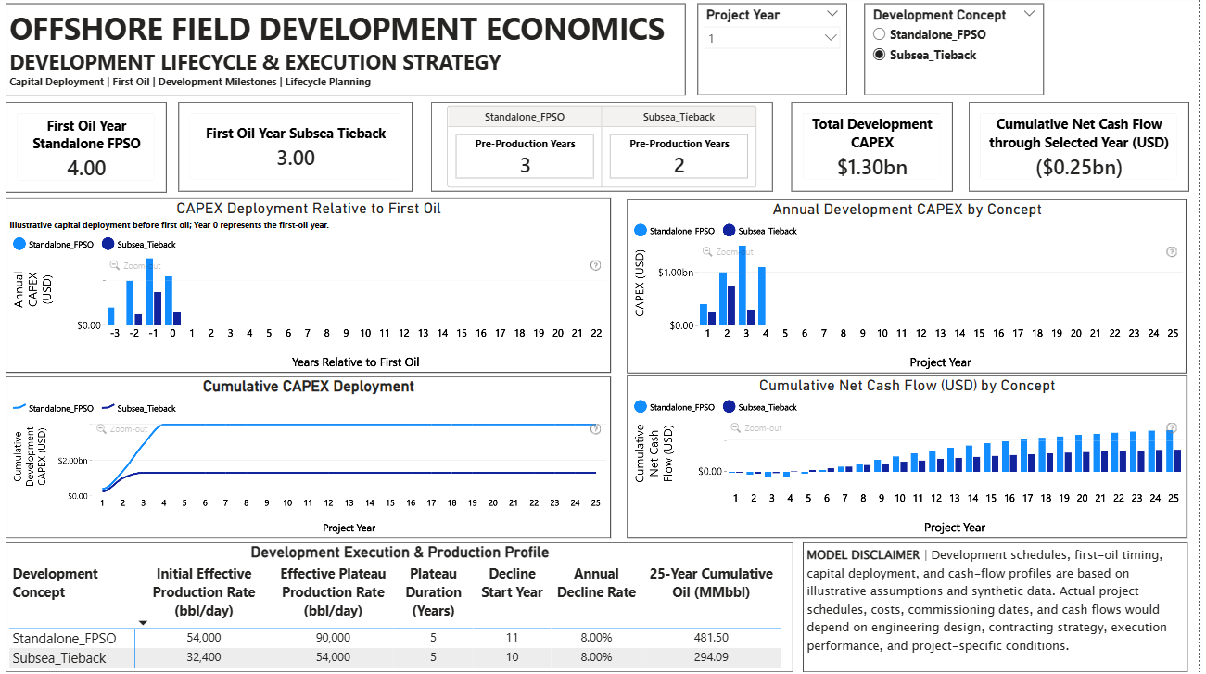
Power BI implementation evidence | Capital deployment and lifecycle
First-oil timing, CAPEX deployment, cumulative CAPEX, cumulative net cash flow, and production-phase assumptions
Annual and cumulative CAPEX, first-oil timing, production phases, and net cash-flow profiles are model-generated outputs. Interpret these visuals within the documented timing conventions, synthetic input assumptions, and economic-model boundaries. Reconciliation to the annual economic model should be confirmed before external publication..
General Disclaimer: This project is a synthetic offshore field development economics case study developed for engineering analytics and decision-support demonstration. All production profiles, costs, oil prices, schedules, and financial results are illustrative model outputs. They do not represent actual offshore asset performance, independently verified project estimates, investment advice, or commercial forecasts. Results are sensitive to the underlying assumptions and model boundaries.
39

