Slide 1

CoverageIQ: LLM-Based Insurance Policy Assistant
AI-Powered Insurance Policy Analysis, Retrieval & Recommendation System
Team
1: Prithviraj Shamrao Patil
2: Shravan Sambhaji Kapare
3: Samarjeet Sambhaji Sabale
4: Yash Shankar Nimbalkar
Guide
[Faculty Name]
Department
Computer Science & Engineering
Academic Year
2024–2025

Slide 2



PROBLEM STATEMENT
The Insurance Comprehension Gap
Lengthy & Complex Documents
Policies run hundreds of pages with dense legal and technical terminology
Critical Clauses Are Hidden
Exclusions, conditions, and coverage limits are hard to locate manually
Comparison Is Exhausting
Evaluating multiple policies side-by-side is time-consuming and error-prone
Generic AI Hallucinates
Standard LLMs generate plausible but unsupported, unverified answers
Motivation: Build an AI assistant that delivers evidence-backed, user-friendly answers from real policy documents.

Slide 3







PROPOSED SOLUTION
An Intelligent Policy Assistant — Grounded in Evidence
Ingest & Structure
Semantic Search
Upload insurance PDFs — system extracts sections, clauses, and tables automatically
Creates intelligent embeddings for precise, context-aware retrieval
Evidence-Based QA
Plain-Language Summaries
Answers questions with direct citations from retrieved policy clauses
Condenses complex policies into simple, readable overviews
Policy Recommendation
Evaluator Verification
Matches user requirements to the most suitable available policies
Every answer is verified before presentation — no ungrounded claims
🔒 Core Principle: NO EVIDENCE = NO CLAIM

Slide 4

SYSTEM ARCHITECTURE
Proposed System Workflow
Semantic Chunking
Processing & Eval
Structured Output
Ingest & OCR
Structuring
Each output carries a Decision · Confidence Score · Conditions · Page & Clause Citations — no answer is presented without verified retrieval evidence.

Slide 5
TECHNOLOGY STACK
Built on a Modern, Production-Ready Stack
📄 Document Processing
⚙️ Backend
🗄️ Database
PyMuPDF · PaddleOCR
NodeJS, Python · FastAPI
PostgreSQL · pgvector
🔍 Retrieval
🤖 AI / LLM
📊 ML Models
Vector Search · BM25 · Hybrid · Cross-Encoder Reranker
Embedding Models · Large Language Models · Grounded Generation
LightGBM · XGBoost
🖥️ Frontend
ReactJS / NextJS

Slide 6
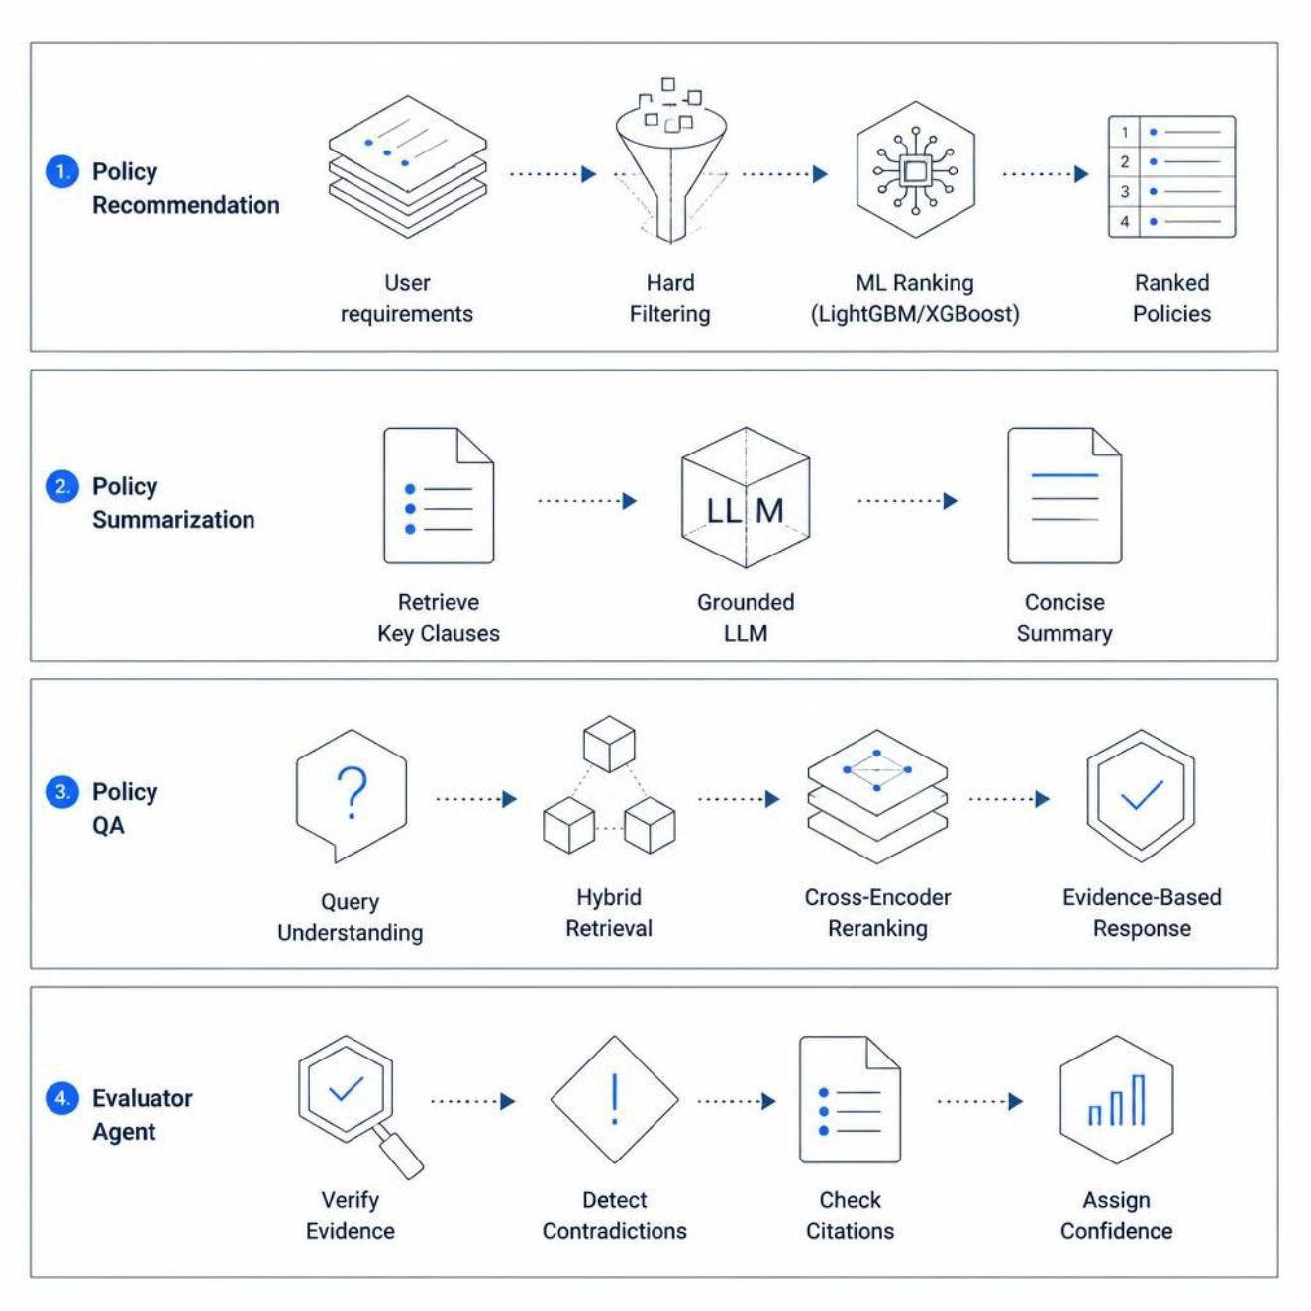

CORE MODULES
Four Intelligent Components Powered by AI
The AI Flow
1
Query Understanding
Intent parsed from user's natural language input
2
Retrieval & Reranking
Hybrid search surfaces the most relevant policy clauses
3
Grounded LLM Generation
LLM explains only what the retrieved evidence supports
4
Evaluator Verification
Agent checks citations, detects contradictions, assigns confidence — triggers re-retrieval if needed
Key Principle: Retrieval provides evidence → LLM explains it → Evaluator verifies it

Slide 7






EXPECTED OUTCOMES & FUTURE SCOPE
What CoverageIQ Delivers
Expected Outcomes
Future Scope
Example: User: "Is hospitalization covered?"
→ COVERED | High Confidence (Percentage) | Subject to policy terms | Page X, Clause Y
Multi-Provider Support
Health, Life, Car & Term policies across multiple insurers
Multilingual & Voice
Regional language support and voice-based query interface
Policy Comparison
Side-by-side comparison of plans across providers
Platform Integration
API-level integration with real-world insurance portals
Thank You
Faster Policy Understanding
Evidence-Backed Answers
Reduced Hallucination
Plain-Language Summaries
Seconds to find answers that would take hours to locate manually
Every response cites the exact page and clause from the policy document
Retrieval + Evaluator Agent ensures grounded, verified outputs only
Complex exclusions and conditions explained in simple terms

