Slide 1


IMDB Movie Analysis

Slide 2
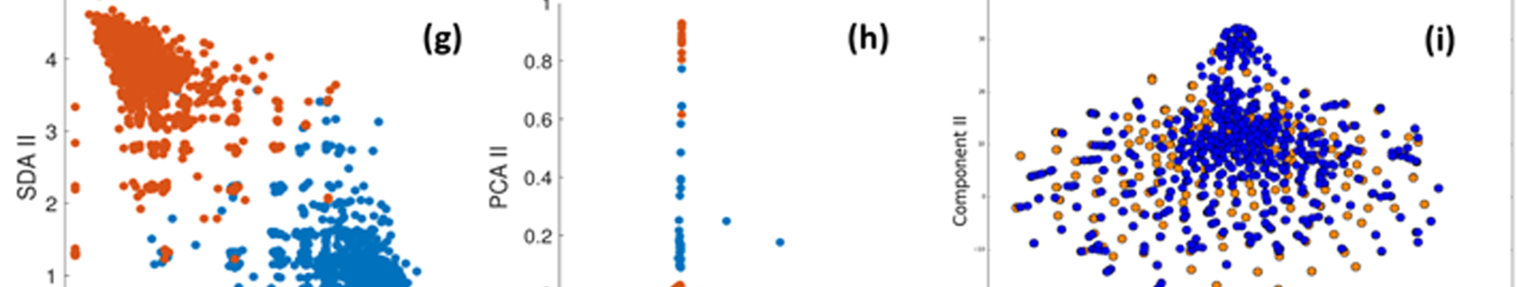
Project Description
The project aimed to investigate the factors influencing the success of movies on IMDb, focusing on determining what attributes correlate with higher IMDb ratings. By analyzing IMDb movie data, the objective was to provide insights to aid movie producers, directors, and investors in making informed decisions for future projects.

Slide 3

Approach
1
Data Collection
Describe how the IMDb movie dataset was obtained and its characteristics.
2
Data Cleaning
Detail the steps taken for data preprocessing, including handling missing values, duplicates, data type conversion, and feature engineering.
3
Data Analysis Techniques
Explain the methods used to explore relationships between variables (correlation analysis, statistical modeling, etc.).

Slide 4

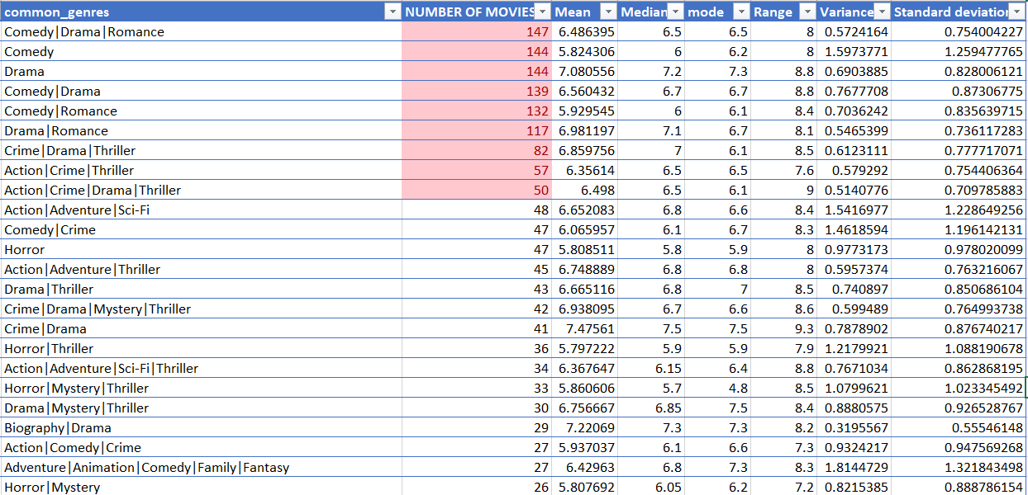
Data Analytics Tasks
1
Movie Genre Analysis
Analyze the distribution of movie genres and their impact on the IMDB score.
Top 10 Common Genres of Movies

Slide 5
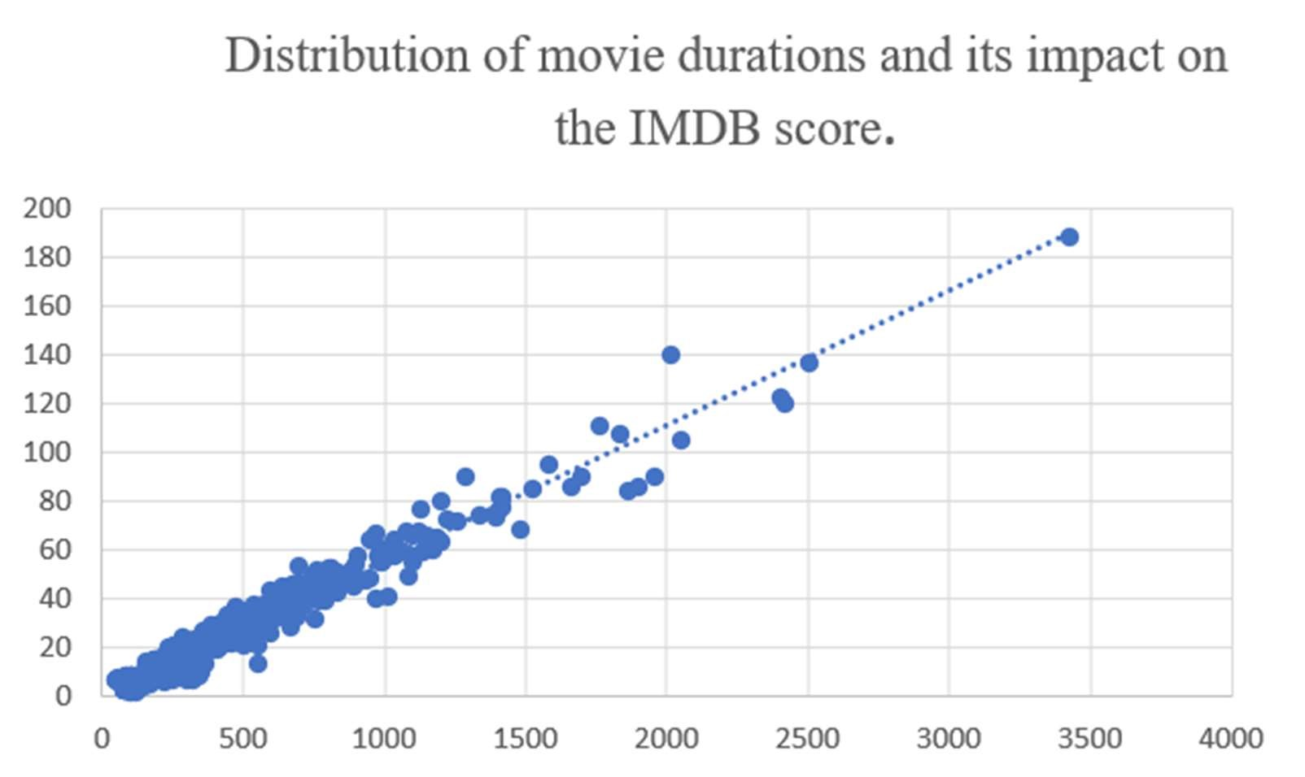
Data Analytics Tasks
2
Movie Duration Analysis
Analyze the distribution of movie durations and its impact on the IMDB score.

Slide 6
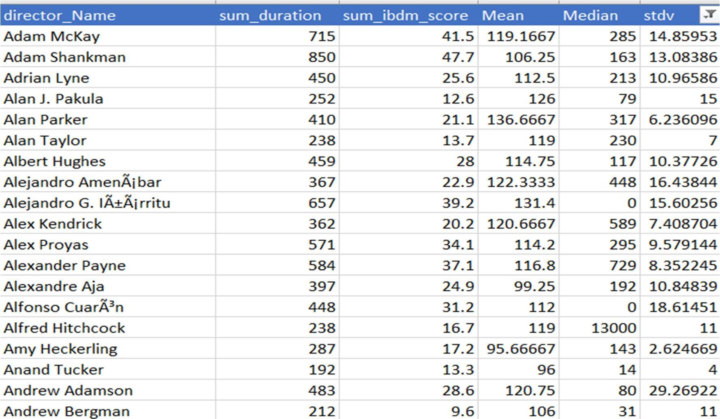
Data Analytics Tasks
3
Movie Duration Analysis
Analyze the distribution of movie durations and its impact on the IMDB score.

Slide 7

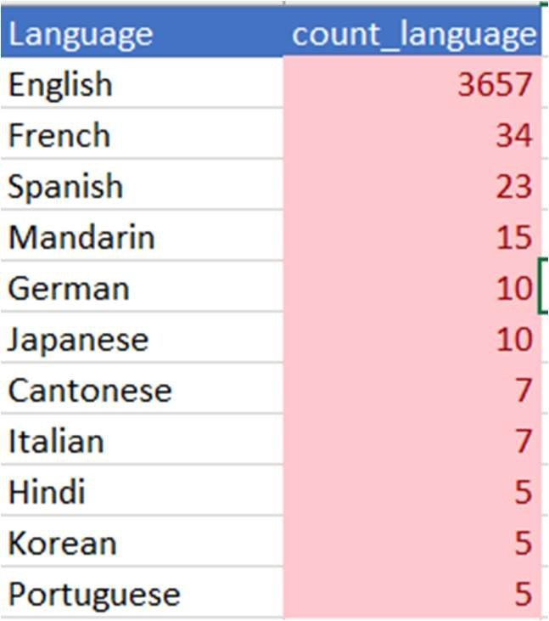
Data Analytics Tasks
4
Language Analysis
Situation: Examine the distribution of movies based on their language.

Slide 8
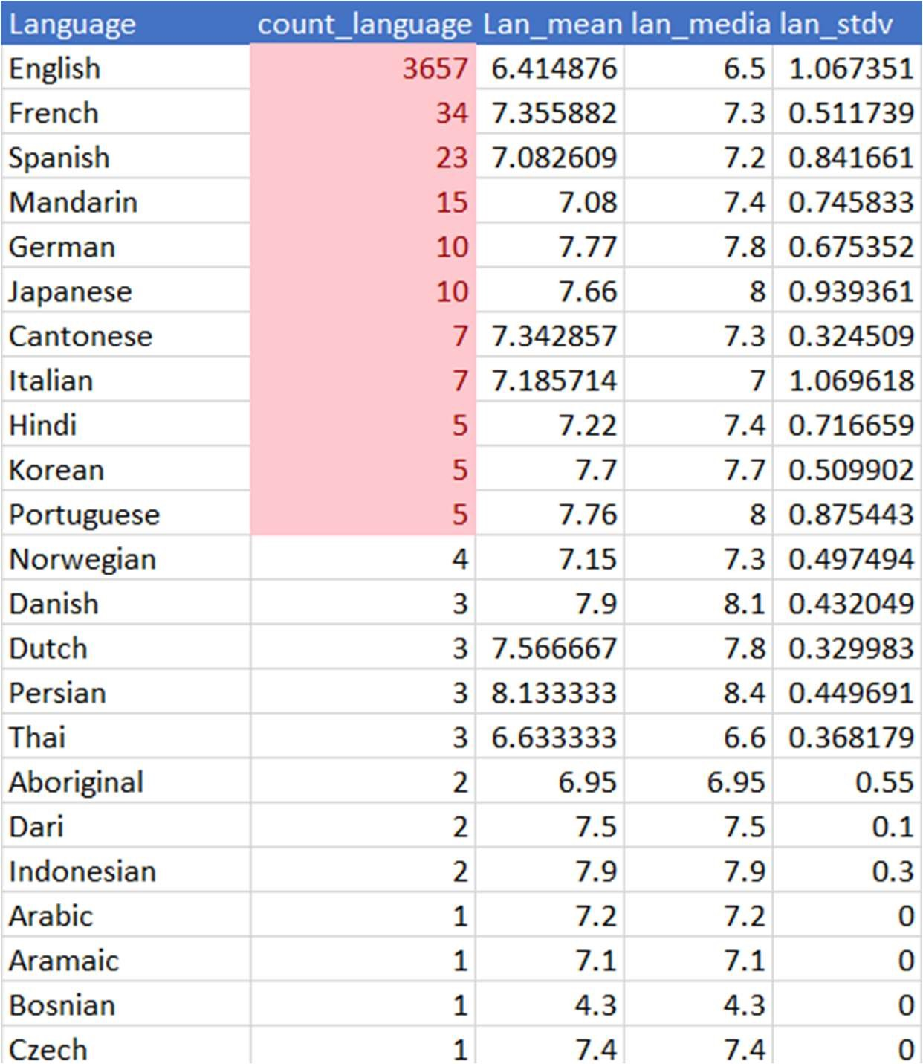
Data Analytics Tasks
Language Analysis
Situation: Examine the distribution of movies based on their language.

Slide 9

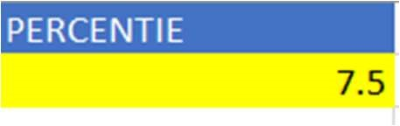
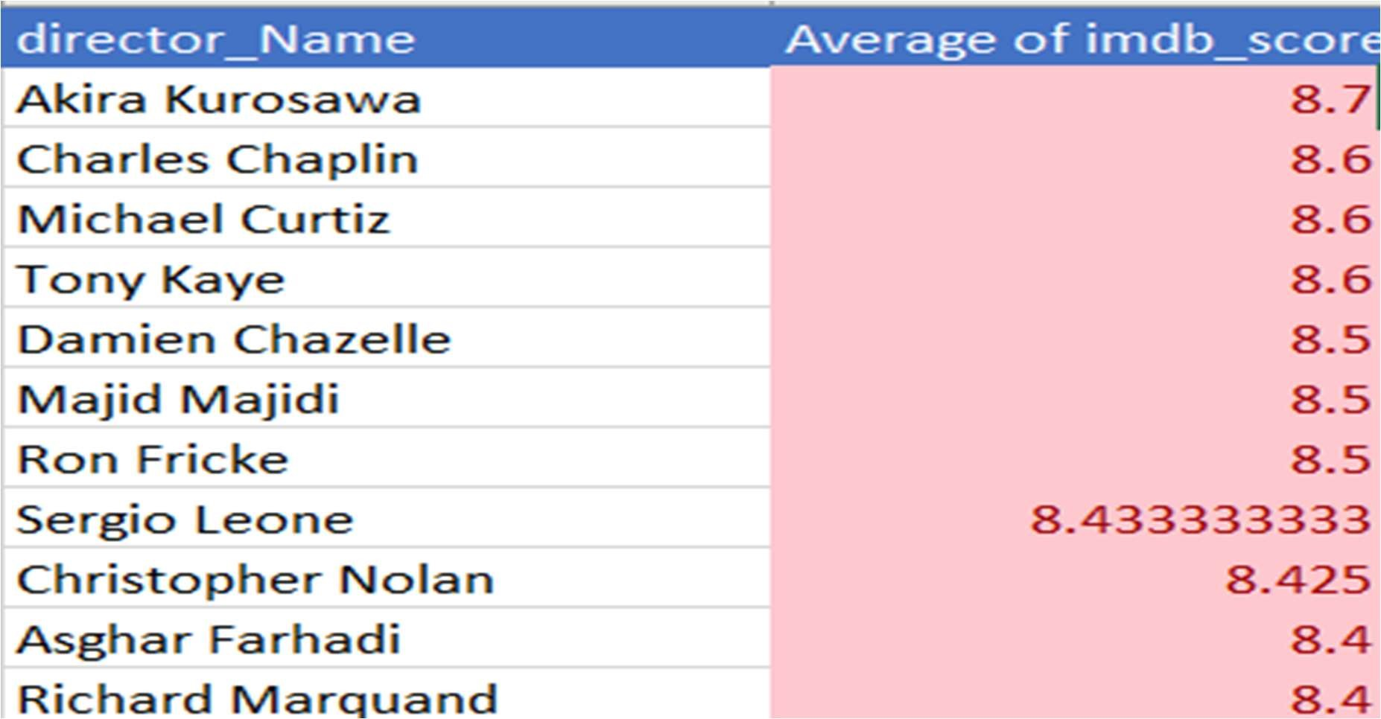

Data Analytics Tasks
5
Director Analysis
Influence of directors on movie ratings.

Slide 10

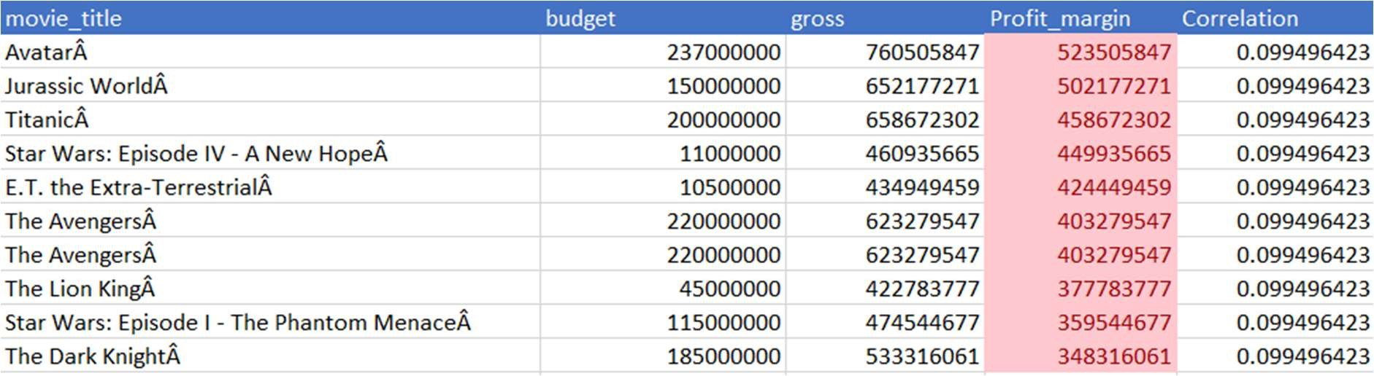
Data Analytics Tasks
5
Budget Analysis

Slide 11
Result
Describe the insights gained and their potential impact on decision-making for movie stakeholders.
Explain how the project contributes to understanding the factors influencing movie success on IMDb.

Slide 12
Drive Link
Excel link:
https://drive.google.com/file/d/1JsYhlcBSrf8f0G5taOYzf1eAoar3HHQ-/view?usp=sharing

