Slide 1
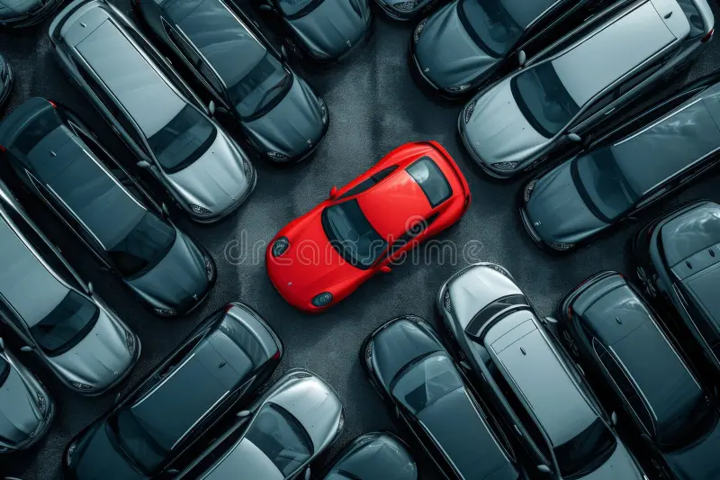
iParkVision Presented by xTrio Subject: Embedded IoT Systems Members: 23-NTU-CS-1051 23-NTU-CS-1091 23-NTU-CS-1089

Slide 2
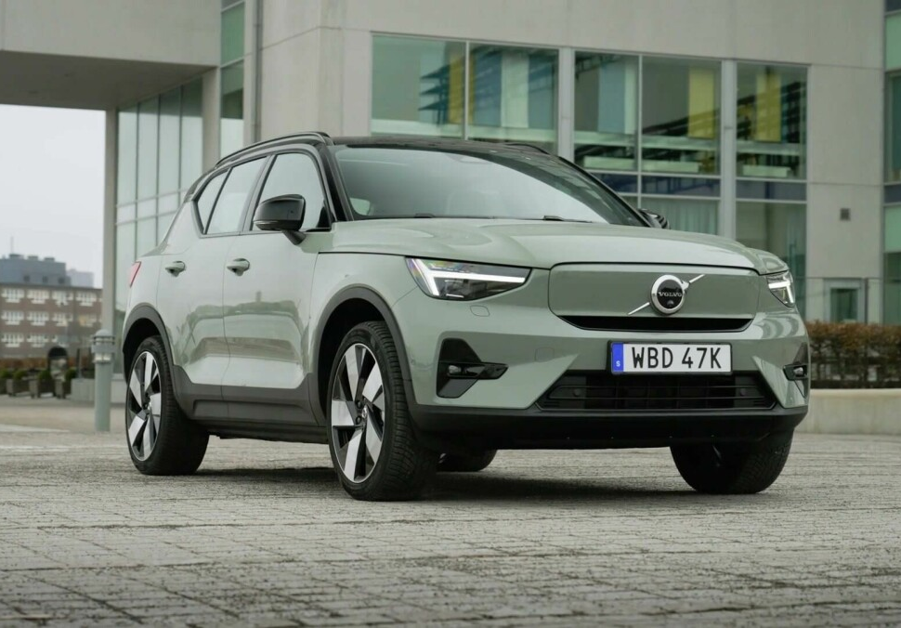
The Real-World Problem
40% of city traffic is caused by drivers searching for parking
Time wasted = fuel wasted = pollution increased
No real-time parking availability
Manual security = slow and unsafe

Slide 3
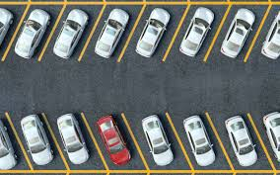
Our Solution : Introducing iParkVision
1=> Provide real-time monitoring of parking slot availability
2=> Automate gate control using RFID authentication 3=> Enable remote parking status monitoring via mobile application 4=> Reduce traffic congestion and parking search time 5=> Improve parking security and efficiency

Slide 4
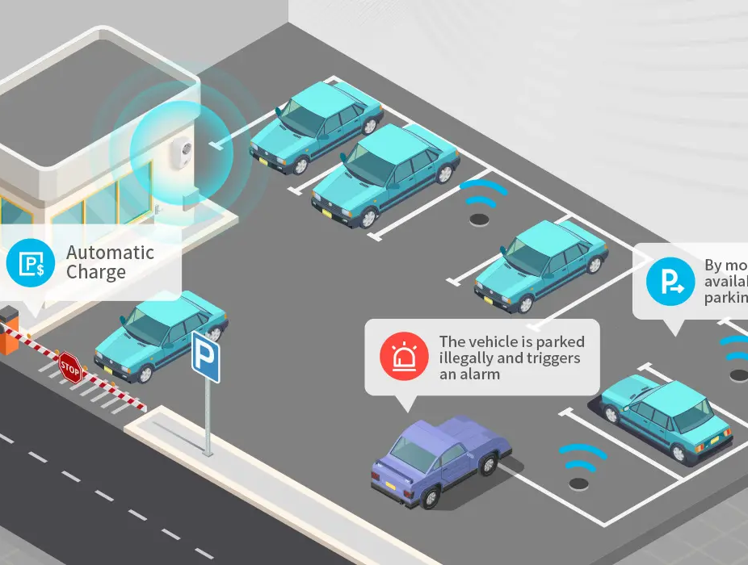
System Overview iParkVision = Hardware + Cloud + Mobile
COMPONENT | Real life Purpose
ESP 32 MICRO-CONTROLLER | Brain
RC522 RFID Reader | Security
Blynk | Cloud Dashboard
HC-SR04 Ultrasonic Sensors | Eyes
SG90 Servo Motor | Gate
Mobile App | Control Panel

Slide 5
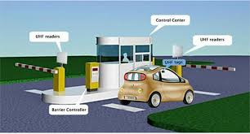
HARDWARE COMPONENTS USED
COMPONENT | FUNCTION
ESP 32 | Main Controller And WIFI
RC522 RFID Reader | Vehicle Authentication
OLED | Display Gate messages
HC-SR04 Ultrasonic Sensors | Slots and Gate detection
SG90 Servo Motor | Gate/barrier movement
I2C LCD | Slot status display
Batteries | Portable power

Slide 6
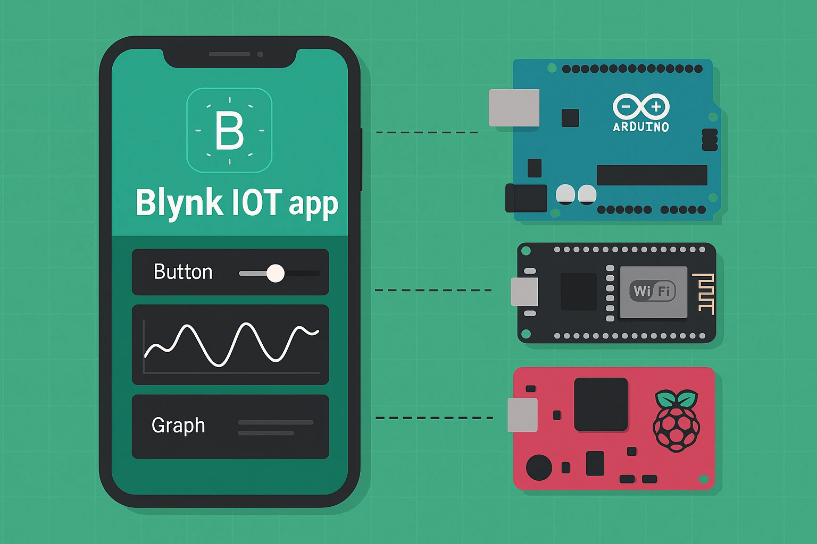
Software & Cloud
PLATFORMIO + VS Code
Embedded C++
Blynk IoT Cloud
Real-time mobile dashboard
Secure cloud communication

Slide 7
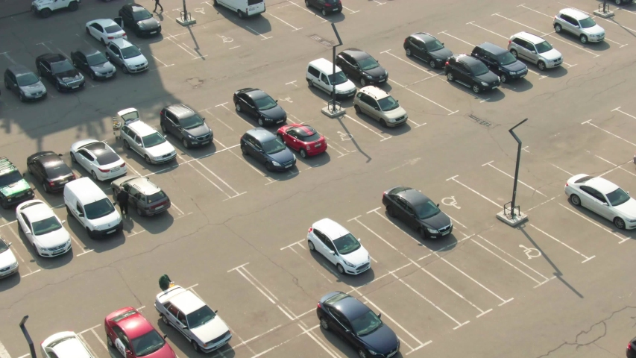
Mobile Dashboard (Blynk) 1=> Slot availability LEDs 2=> Free slots counter 3=> Gate open/close status 4=> Vehicle detection 5=> RFID access logs 6=> Manual gate control

Slide 8
Security System
Only authorized RFID cards can open the gate
Every card UID logged to cloud
Prevents unauthorized entry
Full traceability of vehicles

Slide 9
How It Works??
Vehicle arrives
Sensor detects presence
OLED asks for RFID
Valid card opens gate
5. Slot sensors detect occupancy
6. Data uploaded to cloud
7. User monitors on phone

Slide 10
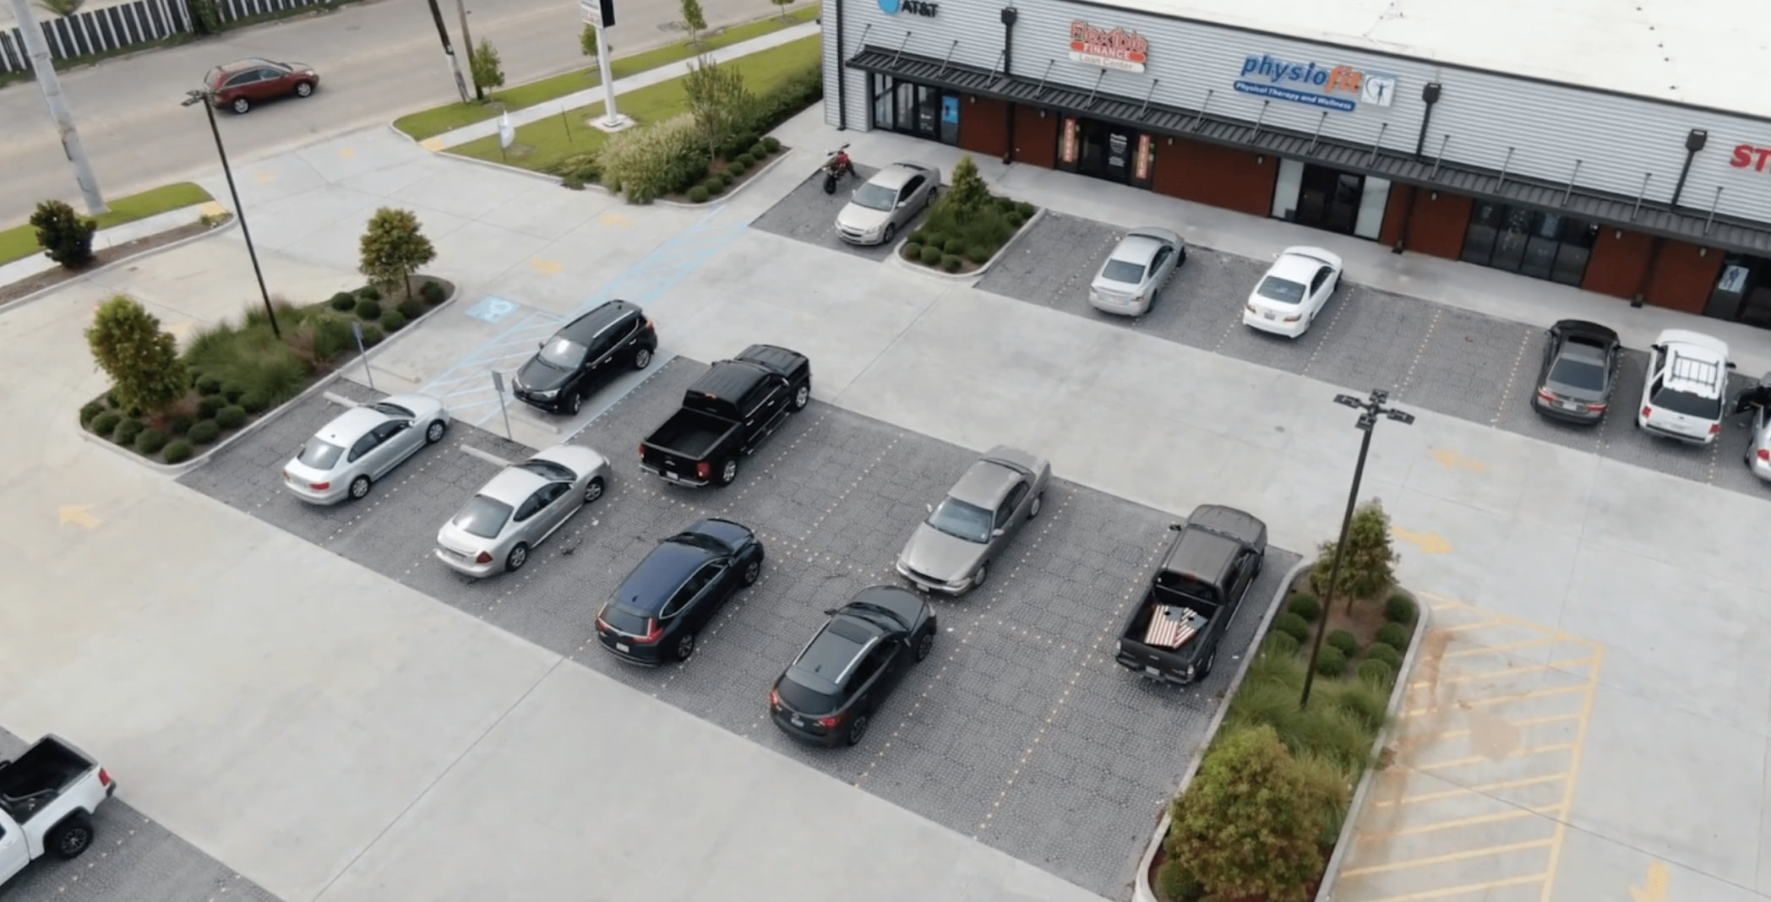
Applications
Shopping malls
Colleges
Hospitals
Smart cities
Residential societies
Corporate buildings

Slide 11
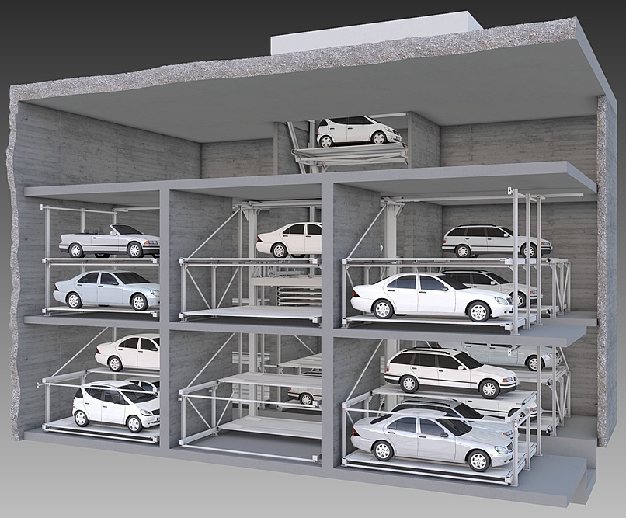
Future Enhancements
Online slot booking
Digital payment integration
License plate recognition
Multi-floor expansion
AI analytics

Slide 12
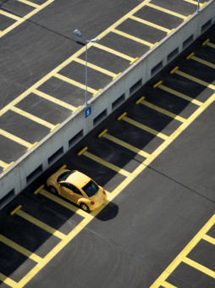
Thank you
*“The future of parking is no longer a problem . It’s iParkVision.”*

