Slide 1

Kafka

Slide 2
Big Data
Conventional processing, strategies fail
Cannot fit in single machines
Decoupled components
Simple, intuitive interfaces

Slide 3
Messaging and Big Data
Picture of the world on a real time basis
Consumers tuned into prime video, netflix
Taxis on the road
Inventory management

Slide 4
Types of Data Processing
Batch
Real time

Slide 5
Need for messaging queues
Microservices architecture to break systems into easier to develop, deploy and maintain components

Slide 6
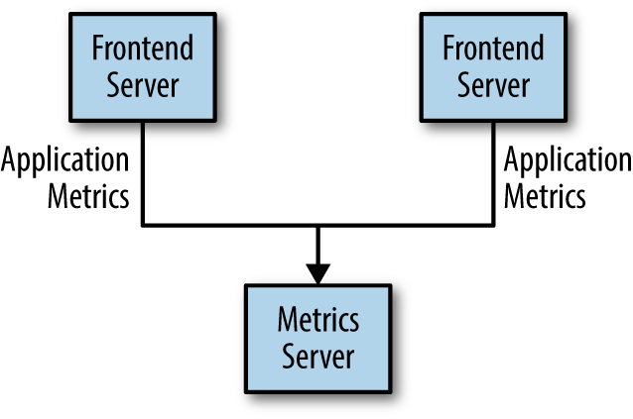
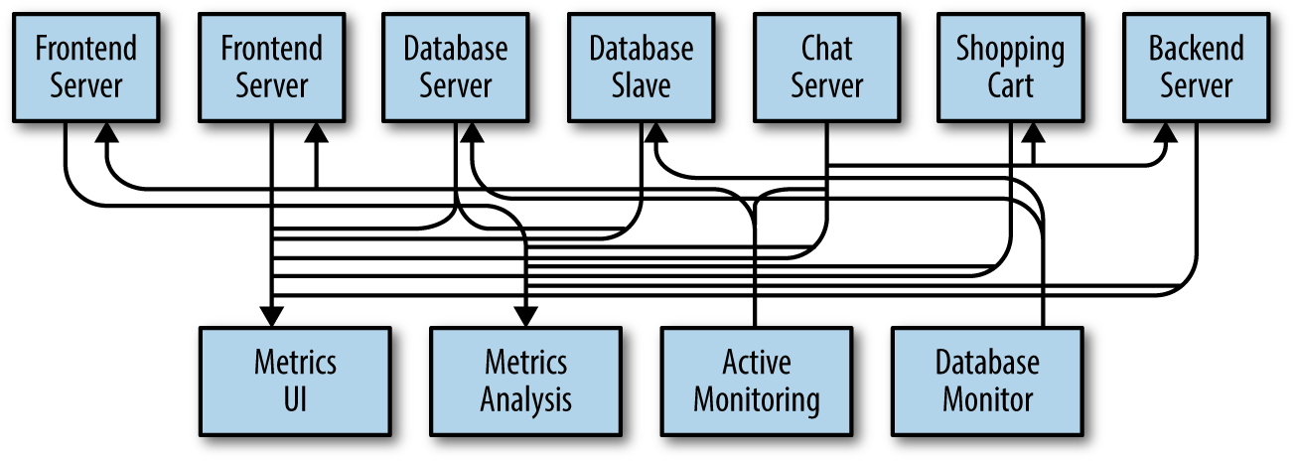
Need for messaging queues
Many use cases for pub/sub systems start out the same way
A monitoring application
Analyze Metrics
Receive, Store, Analyze Data
Let's add alerting too

Slide 7
Need for messaging queues
Message queues allow different parts of a system to communicate and process messages asyncrhonously
Decouple heavyweight processing
Buffer or batch work
Smooth spiky workloads

Slide 8
Need for distributed messaging queues
Large amount of log data generated at any sizable internet company
  User activity – logins, pageviews, clicks, likes, sharing, comments, search queries
  Operational metrics – service call stack, call latency, errors
  System metrics – CPU, memory, network , disk utilization

Slide 9
Need for distributed messaging queues
Activity data part of production data pipeline
  Search relevance
  Recommendations
  Ad targeting and reporting
  Security applications
  Newsfeed applications
Volume is orders of magnitue larger for log processing

Slide 10
Challenges with conventional messaging
Mismatch in features offered by enterprise systems
Rich set of delivery guarantees
  IBM Websphere MQ has transactional supports that allow an application to insert messages into multiple queues atomically
  The JMS specification allows each individual message to be acknowledged after consumption
Do not focus as strongly on throughput as the primary design constraint
Many messaging systems assume near immediate consumption of messages
  queue of unconsumed messages is small
  performance degrades significantly if messages are allowed to accumulate – data warehousing applications for example

Slide 11
What is Kafka
A single centralized system that allows for publishing generic types of data, the need for which always grows as the business grows
Often described as a “distributed commit log” or more recently as a “distributed streaming platform”
The unit of data within Kafka is a message, which one can consider, to approximate a row/record in a database
A message is simply an array of bytes with an optional bit of metadata, referred to as the key
Keys are used when messages are to be written to partitions in a more controlled manner
For efficiency, messages are written in batches into kafka

Slide 12
Motivation for Kafka
It's complicated
Source
Source
Source
Source
Target
Target
Target
Target

Slide 13
Motivation for Kafka
It's a lot less complicated with kafka
Source
Source
Source
Source
KAFKA
Target
Target
Target
Target

Slide 14
Motivation for Kafka
Big Data Ecosystem
Transaction Data
Logs
Metrics
IOT Data
KAFKA
Online Applications Solr, TSDB
Stream Processing
Offline Processing
NoSql
Databases

Slide 15
Kafka Use Cases
Activity tracking
Messaging
Metrics and Logging
Commit Log
Streaming applications

Slide 16
Kafka vs RabbitMQ
Kafka - Distributed event streaming platform
RabbitMQ – uses exchanges to push to specific queues
Kafka - Pull
RabbitMQ – Push
Kafka – Retention
RabbitMQ – Destructive – Retention is on the way
Kafka – Vast ecosystem – with Kafka Connect, KSQL, Kafka Streams
RabbitMQ – Focused, Limited
Kafka – pushing to architectures relying on event streams as source of truth
Kafka - THROUGHPUT, STREAMING

Slide 17
Kafka Architecture

Slide 18
Kafka Architecture
Schemas
Schemas aid in understanding of message content
Simplistic schemas such as json, xml may be used
These lack features such as robust type handling and compatibility between schema versions
Avro which provides a compact serialization format, separation of schema from message payload, schema evolution without need for code generation, and strong data typing, is often used for Kafka
A consistent data format allows writing and reading messages to be decoupled

Slide 19
Kafka Architecture
Topics and Partitions
Messages in Kafka are organized into topics
Closest analogies for a kafka topic are a databse table, file system folder
Topics are broken down into partitions
Going by the commit log description, a topic is a single log, written to in append only fashion and read in order from beginning to end
As a topic typically has multiple partitions there is no guarantee of message time ordering across the entire topic
Partitions are the means by which Kafka provides redundancy and scalability
Each partition can be hosted on a different server

Slide 20
Kafka Architecture
Producers and Consumers
Kafka clients are users of the system
There are two basic types – producers and consumers
Producers create new messages – analogous to publishers in a publish/subscribe system
By default the producer does not care which partition a message is written to and will balance the messages across the partitions of the topic
In some cases, the producer will send messages to a specific partition basis a custom partitioner that will map the hash of the key to a particular partition

Slide 21
Kafka Architecture
Producers and Consumers
Consumers read messages – analogous to subscribers, readers in a publish/subscribe system
Consumers subscribe to one or more topics and read messages in the order in which they are written
Consumers keep track of messages they have already consumed by maintaining an offset
Each message in a given partition has a unique offset
By storing the offset for the latest message consumed in either kafka or zookeeper a consumer can stop and restart without losing its place
Consumers work as a part of a consumer group which is one or more consumers that work together to consume a topic
The group assures that each partition is consumed by only one member

Slide 22
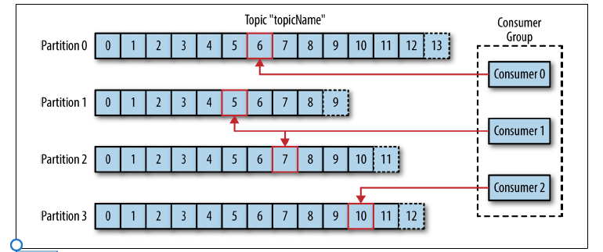
Kafka Archtiecture
Consumer group – partition consumed by one consumer

Slide 23
Kafka Architecture
Brokers and Clusters
A single Kafka server is called a broker
The broker receives messages from producers,assigns offsets to them, and commits the messages to storage on disk.
It also services consumers, responding to fetch requests for partitions and responding with the messages that have been committed to disk
Depending on the specific hardware and its performance characteristics, a single broker can easily handle thousands of partitions and millions of messages per second

Slide 24
Kafka Architecture
Brokers and Clusters
Kafka brokers are designed to operate as a part of a cluster
Within a cluster of brokers, one will serve as the cluster controller ( elected automatically from the live members of the cluster)
Controller is responsible for administrative ops – assigning partitions to brokers and monitoring for broker failures
A partition is owned by a single broker which becomes the leader of the partition
A partition may be assigned to multiple brokers resulting in replication of the partition
This provides redundancy – all producers, consumers have to first contact the leader of the partition

Slide 25
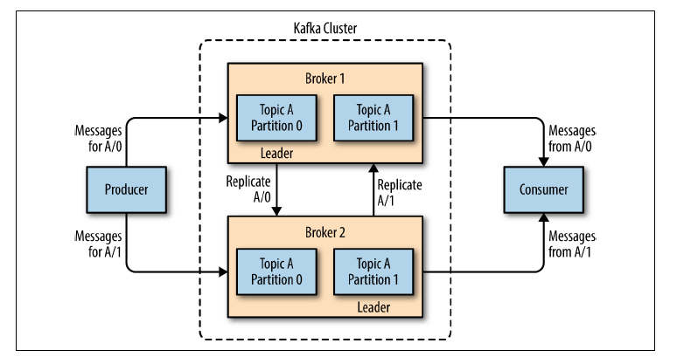
Kafka Architecture
Replication of Partitions

Slide 26
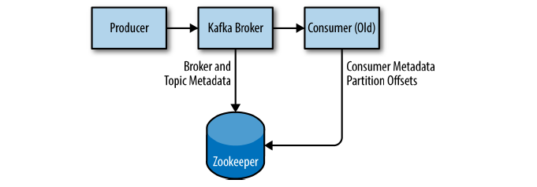
Kafka Architecture
Zookeeper – Metadata Storage, Coordinator

Slide 27
Kafka Producer API

Slide 28
Kafka Producer
Three mandatory properties
  bootstrap.servers – a list of host:port pairs of brokers
  key.serializer – expects byte arrays as keys and values of messages. Parametrized types – any Java objects are accepted but it also means that the producer has to know how to convert them to byte arrays. key.serializer should be set to a name of a class that implements the org.apache.kafka.common.serialization.Serializer interface
  value.serializer – has to implement the same class

Slide 29
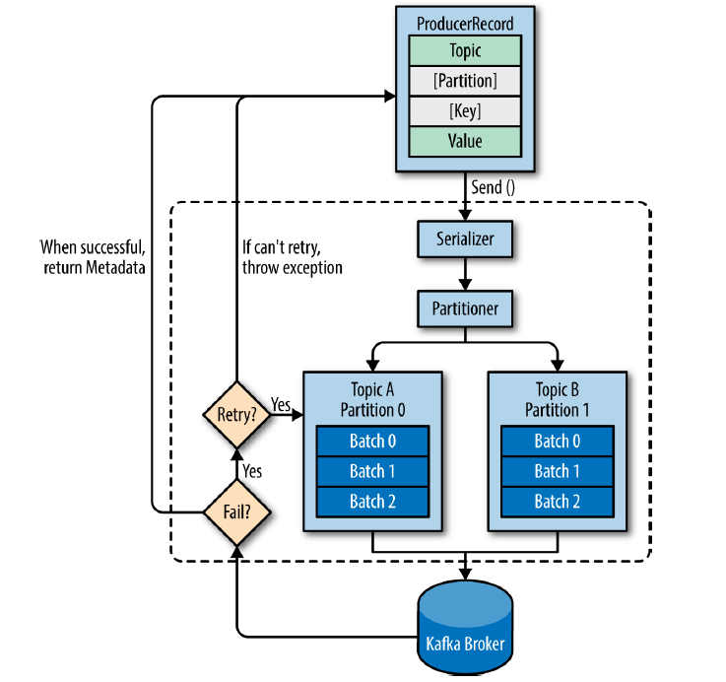
Sending data to Kafka Process

Slide 30
Creating a Kafka Producer
private Properties kafkaProps = new Properties();
kafkaProps.put("bootstrap.servers", "broker1:9092,broker2:9092");
kafkaProps.put("key.serializer",
"org.apache.kafka.common.serialization.StringSerializer");
kafkaProps.put("value.serializer",
"org.apache.kafka.common.serialization.StringSerializer");
producer = new KafkaProducer<String, String>(kafkaProps);

Slide 31
Three primary methods of sending messages
Fire and forget
Synchronous send – the send method returns a Future object and we use get() to wait on the future to see if send was successful or not
Asynchronous send – call the send method with a callback which gets triggered when it receives a response from the kafka broker

Slide 32
Fire and Forget
ProducerRecord<String, String> record = new ProducerRecord<>("CustomerCountry", "Precision Products", "France");
try {
producer.send(record);
} catch (Exception e) {
e.printStackTrace();
}
We ignore errors in the brokers or ones that could occur while sending messages. But we have to handle ones that may crop before sending messages to kafka – these may be serialization errors, a Buffer exhausted exception, as timeout exception or thread interrupted exception

Slide 33
Producer Synchronous Send
ProducerRecord<String, String> record = new ProducerRecord<>("CustomerCountry", "Precision Products", "France");
try {
producer.send(record).get();
} catch (Exception e) {
e.printStackTrace();
}
If there were any errors before sending data to Kafka, while sending, if the Kafka brokers returned a nonretriable exceptions or if we exhausted the available retries, we will encounter an exception. In this case, we just print any exception we ran into.

Slide 34
Producer Asynchronous Send
private class DemoProducerCallback implements Callback {
@Override
public void onCompletion(RecordMetadata recordMetadata, Exception e) {
if (e != null) {
e.printStackTrace();
}
}
}
ProducerRecord<String, String> record =new ProducerRecord<>("CustomerCountry", "Biomedical Materials", "USA");
producer.send(record, new DemoProducerCallback());
If Kafka returned an error, onCompletion() will have a nonnull exception. We print it here, we can take suitable actions as per the use case

Slide 35
Producer Configurations

Slide 36
Producer Configurations
Acks and min.insync.replicas
acks = 0
  Data loss
    Metrics collection, logs collection
acks = 1
  Default
  Leader response requested, replication is not guaranteed
    If the leader goes down and replicas have a lag, we have data loss
acks = all
  Leader + Replicas ack requested
    Safety and Latency

Slide 37
Producer Configurations
Acks and min.insync.replicas
Acks = all must be used in conjuction with min.insync.replicas
min.insync.replicas can be set at the broker or topic level
Replication factor – 3, min.insync.replicas – 2, only one broker can go down

Slide 38
Producer Configurations
Retries
Transient failures, such as NotEnoughReplicasException are expected to be handled by developers
retries setting
  default 0 for Kafka < 2.1
  default 2147483647 for Kafka >= 2.1
producer timeout – delivery.timeout.ms = 120000 ms
retry.backoff.ms setting of 100ms – the interval before retrying

Slide 39
Producer Configurations
Retries Ordering Compromised
Messages can be sent out of order
If key based ordering is used, can be a problem
Setting to control number of requests made in parallel
max.in.flight.requests.per.connection
Default 5
Can be set to 1 if total ordering required ( throughput may be affected)
Better solution ========================>

Slide 40
Duplicate Processing
Producer
1. produce
Kafka
2. commit
3. ack
1. produce
2. commit
3. Ack never reaches (network error)
5. commit
duplicate
4. Retry produce
5 ack !

Slide 41
Idempotent Producer
Kafka >= 0.11
Won't introduce duplicates on network error
Producer
1. produce
Kafka
2. commit
3. ack
1. produce
2. commit
3. Ack never reaches (network error)
4. Retry produce
^{5. detect,}
^{duplicate}
^{Don't commit twice}
5 ack !

Slide 42
Idempotent Producer
Retries = Integer.MAX_VALUE(2^31 -1 = 2147483647)
max.in.flight.requests=1 (Kafka == 0.11)
max.in.flight.requests=5 (Kafka >= 1.0 and keeps ordering)
props.put("enable.idempotence", true)

Slide 43
Producer Configurations
Compression, linger.ms and batch.size
Producers mostly send text data and compression can be very effective in increasing throughput
Compression enabled at the Producer level, no changes required in broker, topic
"compression.type" can be "none" (default), "gzip", "lz4" or "snappy"
Effectiveness increases directly with increase in batch size
Smaller message size, less traffic on the network, lower latency, better disk utilization at the cost of some cpu cycles for compression and decompression

Slide 44
Producer Configurations
Compression, linger.ms and batch.size
By default kafka tries to send records as soon as possible
5 requests in flight meaning 5 messages sent individually at a time
If more messages have to be sent, Kafka will smartly batch them and send at once
linger.ms – number of milliseconds a producer is willing to wait before sending a batch out (default 0)
  increase it to let the batch become larger
    If a batch is full before the linger.ms time is reached, it will be sent right away
batch.size – maximum number of bytes that will be included in a batch (default 16 KB)
  increase it to enhance compression effectiveness

Slide 45
Producer Configurations max.block.ms & buffer.memory
If producer is faster than the broker, records will be buffered in producer's memory
That setting is 32MB
If the buffer is full, the send() method will start to block – won't return right away
And if the period exceeds the max.block.ms setting which is 60000 ms i.e one minute, exceptions will start getting thrown

Slide 46
Producer Default Partitioner
Keys Hashing
Keys hashed using the murmur2 algorithm
Preferred not to override the partitioner, but it is possible to do so by specifying the "partitioner.class" config or ProducerConfig.PARTITIONER_CLASS_CONFIG value
Formula is
targetPartition = Utils.abs(Utils.murmur2(recordKey())) % numPartitions
Keys will go to the same partition and adding partitions will completely alter the formula

Slide 47
Kafka Consumer API

Slide 48
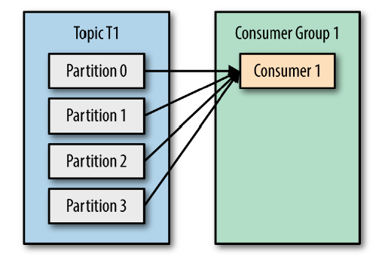
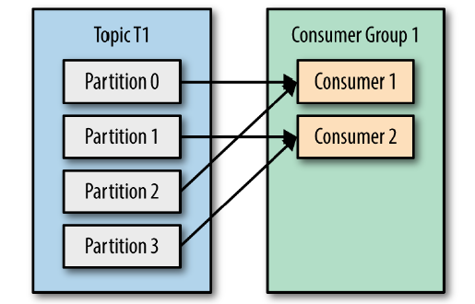
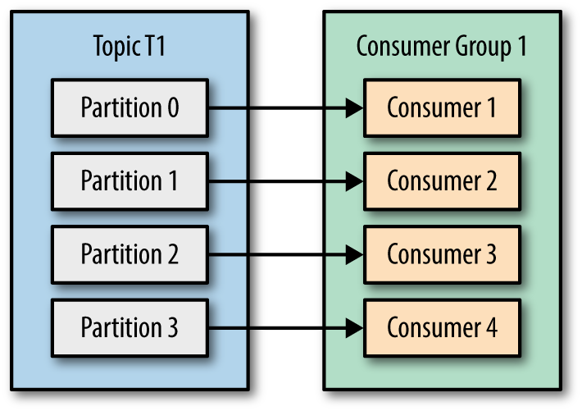

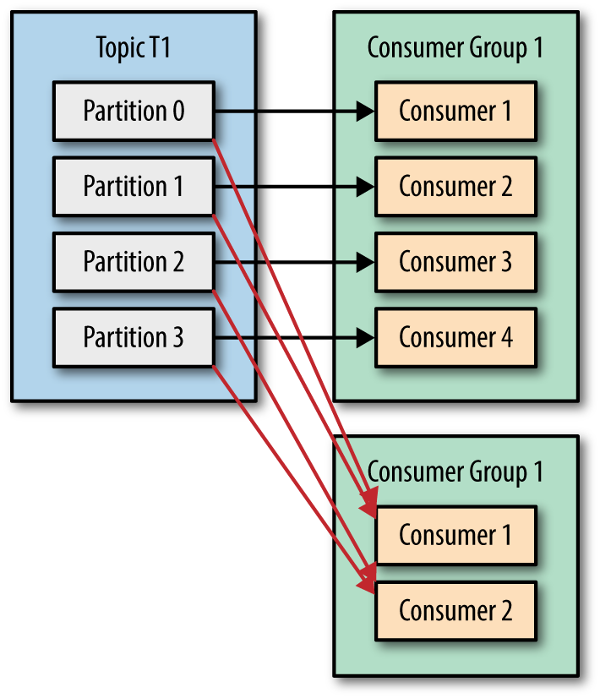
Kafka Consumers
Consumer groups –the tool to scale reading, consuming kafka data

Slide 49
Creating a Kafka Consumer
Properties props = new Properties();
props.put("bootstrap.servers", "broker1:9092,broker2:9092");
props.put("group.id", "CountryCounter");
props.put("key.deserializer", "org.apache.kafka.common.serialization.StringDeserializer");
props.put("value.deserializer", "org.apache.kafka.common.serialization.StringDeserializer");
KafkaConsumer<String, String> consumer = new KafkaConsumer<String,String>(props);
Subscribing to a topic
consumer.subscribe(Collections.singletonList("customerCountries"));

Slide 50
Kafka Consumer – Poll Loop
Once the consumer subscribes to topics, the poll loop handles all details of coordination, partition rebalances, heartbeats and data fetching, giving us a clean API that simply returns available data from the assigned partitions.
while (true) {
  ConsumerRecords <String, String> records = consumer.poll(100);
  ……
  ……
  } finally{
  consumer.close()
  }
poll() returns a list of records. Each record contains the topic and partition the record came from, the offset of the record within the partition, and of course the key and the value of the record
The poll loop does a lot more than just get data. First time we call poll() with a new consumer, it is responsible for finding the GroupCoordinator, joining the consumer group, and receiving a partition assignment

Slide 51
Consumer Poll Behaviour
Pull model
Consumer
Poll
Send Messages
Broker

Slide 52
Consumer Poll Behaviour
fetch.min.bytes (default 1)
fetch.wait.max.ms(default 500ms)
max.poll.records (default 500)
max.partition.fetch.bytes (default 1MB)
fetch.max.bytes (default 50MB)
session.timeout(default 3 seconds) related to hearbeat.interval.ms - timeout used to detect client failures - f no heartbeats are received by the broker before the expiration of this session timeout, then the broker will remove this client from the group and initiate a rebalance
heartbeat.interval.ms - expected time between heartbeats to the consumer coordinator - the value must be set lower than session.timeout.ms, but typically should be set no higher than 1/3 of that value

Slide 53
Consumer Configurations
Delivery Semantics
At most once – offsets are committed as soon as the batch is received. If processing goes wrong some or all data from the batch will be lost
At least once – default – offsets are committed after messages are processed. If processing goes wrong, messages will be read again leading to duplicate processing
  We have to make our processing idempotent
    Kafka Generic id
      record.topic() + "_" + record.partition() + "_" + record.offset()
    Data unique ids – TwitterId, OrderId, Uuids etc
Exactly once – possible for Kafka => Kafka workflows using the Kafka Streams API

Slide 54
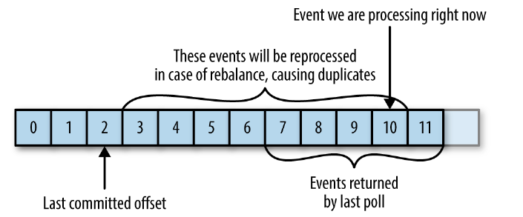
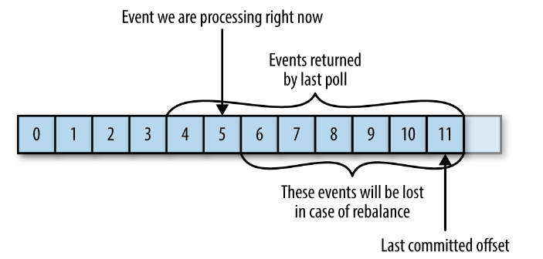
Consumer Offset Commits Strategies
2 Strategies
enable.auto.commit=true
  auto.commit.interval.ms =5000 default
  Commits canl be made before, after processing leading to the possiblity of both – missed, duplicate processing

Slide 55
Consumer Offset Commits Strategies
enable.auto.commit=false and synchronous processing of batches
Control when offsets are committed
Example – accumulating messages in a buffer and flushing the batch to a database and committing offsets then
ConsumerConfig.ENABLE_AUTO_COMMIT_CONFIG, false
while (true) {
batch += consumer.poll(Duration.ofMillis(100));
if (isReady(batch)){
doSomethingSynchronous(batch);
consumer.commitSync();
}
}
d

Slide 56
Consumer Exit
To exit the poll loop, we need another thread to call consumer.wakeup()
If we are running the consumer loop in the main thread, this can be done from ShutdownHook - the consumer.wakeup() is the only consumer method that is safe to call from a different thread
Calling wakeup will cause poll() to exit with WakeupException, or if consumer.wakeup() was called while the thread was not waiting on poll, the exception will be thrown on the next iteration when poll() is called
The WakeupException doesn’t need to be handled, but before exiting the thread, we must call consumer.close().

Slide 57
Kafka Guarantees
Order guarantees of messages in a partition- if message B was written after message A using the same producer in the same partition then offset of message B will be higher than A and consumers will read message B after message A
Produced messages are considered committed when they are written to all in-sync replicas
Producers can choose to receive acknowledgments of sent messages when the message was fully committed, when it was written to the leader, or when it was sent over the network
Messages that are committed will not be lost as long as one replica remains alive
Consumer can only read committed messages

Slide 58
Kafka Internals

Slide 59
Partitions and Segments
Topics are made up of partitions
Partitions are made up of segments (files)
Only one segment is active (the one that data is being written to)
Two segment settings
  log.segment.bytes – the max size of a segment in bytes
  segment.ms – time kafka will wait before committing the segment if it is not full (default 1 week)

Slide 60
Segments and Indexes
Segments have two index files
  An offset to position index
    The index file is memory mapped and binary search is used to find the nearest offset less than or equal to the target offset
  A timestamp to offset index enabling seek using timestamp
Therefore Kafka knows where to find data in constant time !
offset, position | offset, position, size, payload
0, 0 | 0, 0, 4, Then
1, 4 | 1, 4, 10, SOME STUFF
2, 14 | 2, 14, 9, BLAH BLAH

Slide 61
Segments - implications
A smaller log.segment.bytes (default 1 GB) implies:
  More segments per partition
  Log compaction happens more often
  Kafka has to keep more files opened
Check throughput and adjust this setting
And segment.ms in conjunction influences new segment creation

Slide 62
Log Cleanup Policies
Data expiration according to a policy
Policy 1: log.cleanup.policy=delete (Kafka default for all user topics)
  Delete based on age of data (default 1 week)
  Delete based on size of data (default -1 infinite)
Policy2: log.cleanup.policy=compact
  Delete based on message keys
  Will delete old duplicate keys after active segment is committed
Log cleaner checks every log.cleaner.backoff.ms default time of 15000 i.e 15 seconds

Slide 63
Log Cleanup Policy: Delete
log.retention.hours (default 168)
log.retention.bytes (default -1 infinite)
Two combinations
  Defaults above
  retention long – lets say 1440 hours (60 days)and size limit 500MB

Slide 64
Log Cleanup Pollicy: Compact
0-100
101-200
201-300
Active
0-300
* log.cleanup.policy=compact
* segment.ms (7 days) – max amount of time to wait before closing segment
* segment.bytes (1G)- max sixe of segment in bytes
* min.compaction.lag.ms (0) – wait before a message can be compacted
* delete.retention.ms (24 hours) wait before deleting messages marked for deletion
* min.cleanable.dirty.ratio (0.5) higher the value, less efficient

Slide 65
Request Handling
Kafka has a binary protocol (overTCP) that specifies the format of the requests and how brokers respond to them—both when the request is processed successfully or when the broker encounters errors while processing the request
All requests sent to the broker from a specific client will be processed in the order in which they were received—this guarantee is what allows Kafka to behave as a message queue and provide ordering guarantees on the messages it stores

Slide 66
Requests
Have a standard header that includes:
Request type (also called API key)
Request version (so the brokers can handle clients of different versions and respond accordingly)
Correlation ID: a number that uniquely identifies the request and also appears in the response and in the error logs (the ID is used for troubleshooting)
Client ID: used to identify the application that sent the request

Slide 67
Acceptor, Processor and IO Threads
For each port the broker listens on, the broker runs an acceptor thread that creates a connection and hands it over to a processor thread for handling
The number of processor threads (also called network threads) is configurable
Network threads are responsible for taking requests from client connections, placing them in a request queue, and picking up responses from a response queue and sending them back to clients
Once requests are placed on the request queue, IO threads (also called request handler threads) are responsible for picking them up and processing them

Slide 68
Client Request Types
Produce requests -Sent by producers and contain messages the clients write to Kafka brokers
Fetch requests - Sent by consumers and follower replicas when they read messages from Kafka brokers
Admin requests - Sent by Admin clients when performing metadata operations such as creating and deleting topics

Slide 69
How do the clients know where to send the requests?
The server response specifies which partitions exist in the topics, the replicas for each partition, and which replica is the leader
Metadata requests can be sent to any broker because all brokers have a metadata cache that contains this information
Clients typically cache this information and use it to direct produce and fetch requests to the correct broker for each partition
They also need to occasionally refresh this information (refresh intervals are controlled by the meta data.max.age.ms configuration parameter) by sending another metadata request so they know if the topic metadata changed

Slide 70
Avro, Schema Evolution and Schema Registry

Slide 71
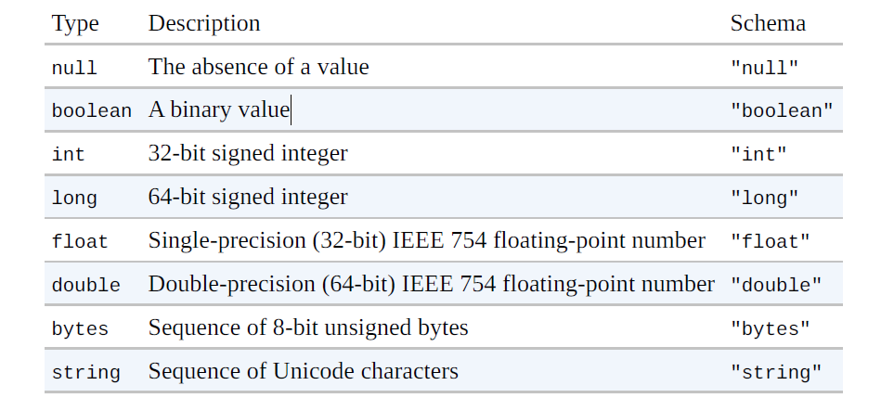
Avro Data Types
Primitive Types

Slide 72
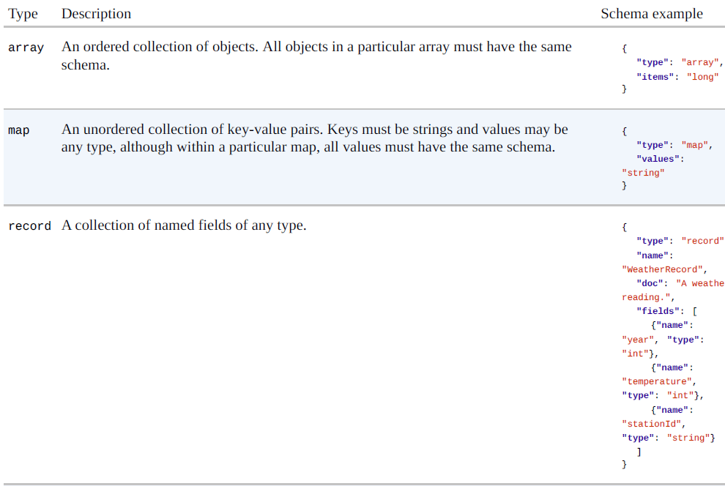
Avro Data Types
Complex Types

Slide 73
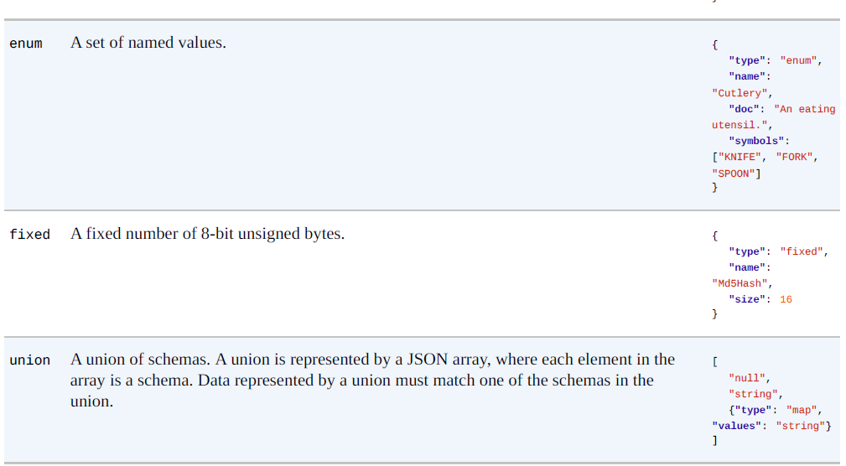
Avro Data Types
Complex Types

Slide 74
Language Representations
Each Avro language API has a representation for each Avro type that is specific to the language - Avro’s double type is represented in C, C++, and Java by a double, in Python by a float, and in Ruby by a Float
There may be more than one representation, or mapping, for a language -all languages support a dynamic mapping, which can be used even when the schema is not known ahead of runtime
  Java calls this the Generic mapping

Slide 75
Avro , Java Strings
Can be represented by either Java String or the Avro Utf8 Java type
  The reason to use Utf8 is efficiency: because it is mutable, a single Utf8 instance may be reused for reading or writing a series of values
  Also, Java String decodes UTF-8 at object construction time, whereas Avro Utf8 does it lazily, which can increase performance in some cases
Utf8 implements Java’s java.lang.CharSequence interface, which allows some interoperability with Java libraries
In other cases, it may be necessary to convert Utf8 instances to String objects by calling its toString() method
Utf8 is the default for Generic and Specific, but it’s possible to use String for a particular mapping
There are a couple of ways to achieve this
  The first is to set the avro.java.string property in the schema to String:
    { "type": "string", "avro.java.string": "String" }
  Alternatively, for the Specific mapping, you can generate classes that have String-based getters and setters
    When using the Avro Maven plug-in, this is done by setting the configuration property stringType to String

Slide 76
Avro Decimal Type
To use BigDecimal:
Version > 1.8.2
Users of the Java Specific API who have decimal logical types may now opt-in to having their generated classes use BigDecimal to represent values rather than the serialized ByteBuffer.
To use this feature with the avro maven plugin's code generation, set the configuration parameter enableDecimalLogicalType to true.

Slide 77
Schema Evolution
Data with some fields – version 1
We add more fields – twitter hash tag, facebook address, linked in profile – version 2, 3, ….
We'd like to expand the schema without breaking programs

Slide 78
Schema Evolution
Backward compatible – read old data with a new schema
Forward compatible – read new data with old schema
Fully compatible – read old data with new or old schemas and read new data with new or old schemas
Breaking – neither backward, nor forward compatible

Slide 79
Schema Evoluion
Not Compatible
Adding / Removing elements from an Enum
Changing the type of a field
Renaming a required field ( field without a default)

Slide 80
Schema Evolution Checklist
Primary key required
Default values for all fields that could be removed in future
Carefully evaluate Enums as they cannot be modified
Do not rename fields. Aliases can be added instead
When evolving a schema, always have default values
When evolving a schema, never delete a required field

Slide 81
Kafka Connect and Streams

Slide 82
Kafka Connect and Streams
Source => Kafka Producer API Kafka Connect Source
Kafka => Kafka Consumer Producer API Kafka Streams
Kafka => Sink Consumer API Kafka Connect Sink
Kafka => App Consumer API`

Slide 83
Kafka Connect and Streams
Architecture Design
Sources
Connect Cluster
Kafka Cluster
3
1
Streams App 1
2
Worker
Broker
Streams App 2
Worker
4
Broker
Sinks
5
Streams App 3
Worker
Broker

Slide 84
Kafka Connect - Concepts
Kafka Connect Cluster has multiple loaded Connectors
  Each connector is a reusable piece of java code
  Many connectors in the open source world
Connectors + User Configuration => Tasks
  A task is linked to a connector configuration
A job configuration may spawn multiple tasks
Tasks are executed by Workers (servers)
  A worker can be a standlone or in a cluster

Slide 85
Kafka Connect Workers
Standalone vs Distributed Mode
Standalone:
  Single process for connectors and tasks
  Configuration bundled with process
  No fault tolerance, no scalability
  Development and testing
Distributed:
  Multiple workers
  Configuration submitted using a REST API
  Scalable, fault tolerant (rebalancing in case a worker dies)
  Production deployment

Slide 86
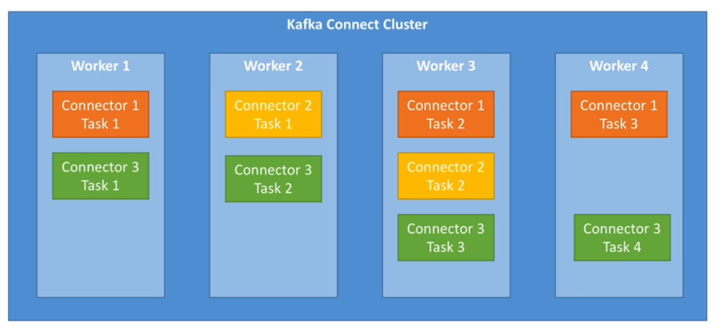

Slide 87
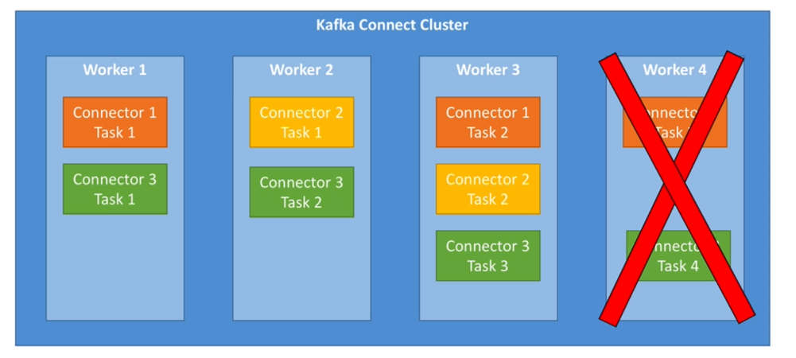

Slide 88
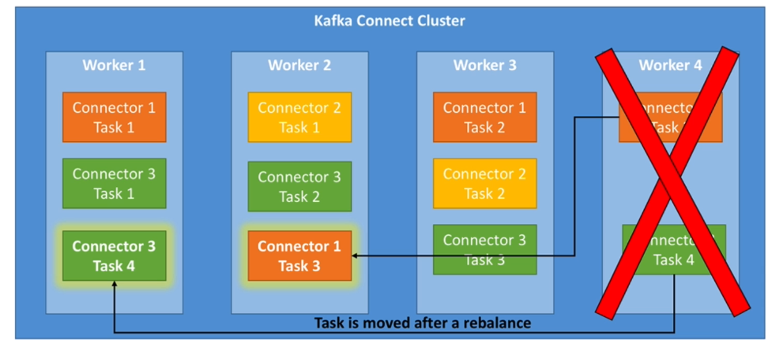

Slide 89
Kafka Connect Connector
Mandatory Parameters
name
connector.class
tasks.max

Slide 90
Kafka Streams

Slide 91
Stream Topology – Processors and Streams
Stream is an unbounded sequence of immutable records, fully ordered, replayable and fault tolerant
A stream processor is a node in the topology and transforms the stream and may create a new stream
A topology is a graph of processors chained together by stream
N
N
S
S
N
S
N
S
N

Slide 92
Stream Topology – Sources and Sinks
Source node – without a parent, a kafka topic
Sink node – a destination, without children
N
N
S
S
N
S
N
S
N

Slide 93
Kafka Streams – Internal Topics
Two types
  Changelog
  Repartition
Internal topics
  managed by Kafka Streams
  used to save / restore state and re-partition data
  prefixed by application.id parameter
  Should never be deleted, altered or published to

Slide 94
KStreams & KTables

Slide 95
KStreams
All inserts
Similar to a log
Infinite
Unbounded data streams

Slide 96
KTables
All upserts on non null values
Deletes on null values
Similar to a table
Parallel with log compacted topics

Slide 97
KStream vs KTable
Kstream reading from a topic that's not compacted
Ktable reading from a topic that's log compacted (aggregations)
KStream when data is partial , transactional (card inserted, password entered)
Ktable when every update is self sufficient (bank balance)

Slide 98
Stateless vs Stateful Operations
Stateless
  localized
    add 2
    square a number
    length of a word
Stateful
  external information required
    count
    sum

Slide 99
mapValues / map
Takes one record and produces one record
mapValues
  only affects values
  does not change keys
  does not trigger a repartition
  For KStreams and KTables
map
  Affects both keys and values
  Triggers a repartition
  For KStreams only
KStream<String, Long> squaredStream = stream.mapValues(v → v * v)

Slide 100
filter / filterNot
Takes one record and produces zero or one record
filter
does not change keys / values
does not trigger a re-partition
for KStreams and KTables
filterNot
  Inverse of filter
KStream<String, Long> evenNoStream = stream.filter(v → v % 2 ==0)

Slide 101
flatMapValues / flatMap
Takes one record and produces zero, one or more records
flatMapValues
  only affects values
  does not change keys
  does not trigger a repartition
  For KStreams only
flatMap
  changes keys
  Triggers a repartition
  For KStreams only
KStream<String, String> wordStream = stream.flatMapValues(v → Arrays.asList(v.split("\\W+"))

Slide 102
Branch
Split a Kstream based on one or more predicates
Predicates are evalauted in order
If no one matches, record is dropped
Result is multiple Kstreams

Slide 103
KStream selectKey
Assigns a new key to the record
Marks the data for re-partitioning

Slide 104
KStream & KTable
Reading from Kafka
Topic can be read as a KStream, KTable or a GlobalKTable
KStream<String, Long> wordCounts = StreamsBuilder.stream(
Serdes.toString(), Serdes.toLong(), "input-topic")
KTable<String, Long> wordCounts = StreamsBuilder.table(
Serdes.toString(), Serdes.toLong(), "input-topic")
GlobalKTable<String, Long> wordCounts = StreamsBuilder.globalTable(
Serdes.toString(), Serdes.toLong(), "input-topic")

Slide 105
KStream & KTable
Writing to Kafka
We can write any KStream or KTable back to Kafka
For writing back a KTable consider a log compacted topic
to: terminal operation – write records to a topic
stream.to("output-topic")
table.toStream().to("output-table-topic")
through – write to a topic and get back a stream/ table
KStream<String, Long> newStream = stream.through("output-topic")
Ktalbe<String, Long> newTable = table.through("output-table")

Slide 106
Streams marked for re-partition
As soon as an operation can possibly change the key the stream is marked for re-partitioning
  map
  flatMap
  selectKey
Use these only if need to change the key otherwise use
  mapValues
  flatmapValues
Repartitioning is done seamlessly behind the scenes but will incur a cost

Slide 107
KStream & KTable Duality
Stream as a table: Each stream can be considered as a changelog of a table where each data record in the stream captures a state change of the table
Table as Stream: A table can be considered a snapshot, at a point in time, of the latest value for each key in a stream

Slide 108
KStream & KTable Duality
Stream
Table
Table
(ram, 1)
(ram, 1)
(ram, 1)
(ram, 1)
(ram, 1)
(shyam, 1)
(shyam, 1)
(shyam, 1)
(ram, 10)
(ram, 10)
(ram, 10)
(shyam, 1)
(shyam, 1)
(ram, 10)
(ram, 10)
(shyam, 1)
(shyam, 1)
(mohan, 1)
(mohan, 1)
(mohan, 1)

Slide 109
Transforming a Ktable to a KStream
It is sometimes helpful to transform a KTable to a KStream in order to keep a changelog of all the changes to the KTable
One line of code
  Kstrream<String, Long> stream = table.toStream()

Slide 110
Transforming a KStream to a KTable
Two ways
  Chain a groupByKey and an aggregation step
    Ktable<String, Long> table = stream.groupByKey().count()
Write back to Kafka and read as a table
  stream.to("intermediate-topic")
  Kstream<String, Long> table = StreamsBuilder.table("intermediate-topic")

Slide 111
KTable groupBy
Allows more aggregations within a KTable
  KTables have inserts, updates, delete
With KStreams it is only addition, the count increases
Triggers a repartition as the key changes

Slide 112
KGroupedStream / KGroupedTable count
KGroupedStream obtained after a groupBy, groupByKey call on a KStream
Count counts the number of record by grouped key
If used on KGroupedStream
  Null keys or values are ignored
If used on KGroupedTable
  Null keys are ignored
  Null values are treated as delete(tombstones)

Slide 113
KGroupedStream, KGroupedTable aggregates
Initial value, an adder or an adder and a subtractor, a serde for the aggregate value type and a state store
KTable<String, Long> aggStream = grpdStream.aggregate(
() → 0L,
(aggKey, nVal, aggVal) → aggVal + nVal,
Serdes.Long(),
"aggregated-stream-store")

Slide 114
KGroupedStream, KGroupedTable aggregates
Initial value, an adder or an adder and a subtractor, a serde for the aggregate value type and a state store
KTable<String, Long> aggStream = grpdStream.aggregate(
() → 0L,
(agKey, nVal, aggVal) → aggVal + nVal,
(agKey, nVal, aggVal) → aggVal - nVal,
Serdes.Long(),
"aggregated-stream-store")

Slide 115
KGroupedStream, KGroupedTable reduce
(Int, Int) → Int
Return value has to be of the same type
KTable<String, Long> redcdStream = grpdStream.reduce(
(agKey, nVal, aggVal) → aggVal + nVal,
Serdes.Long(),
"reduce-stream-store")

Slide 116
KStream peek
Apply a side effect and get the same stream back
A side-effect could be
  printing to the console
  statistics collection
especially useful for debugging, printing
Kstream<byte[], String> stream = stream.peek(
(k, v) → System.out.println("Key is: " + k + " and value is: " + v)

Slide 117
Streams and Tables – RocksDB, Memory Management

Slide 118
RocksDB
Internal lookup table
  able to flush to disk if state does not fit in memory and the internal topic is created for fault tolerance reasons
The changelog is the source of truth for the state (log of the state)
RocksDB is used as the (non fault-tolerant) cache
  The internal changelog topic is used for fault tolerance

Slide 119
RocksDB
RocksDB is an embeddable key-value persistent store. It is a C++ and Java library that can be embedded into applications
RocksDB is natively designed to give high-end performance for fast storage and server workloads
A storage engine library that implements a key-value interface where keys and values are arbitrary bytes
RocksDB offers these following operations: Get(key), NewIterator(), Put(key, val), Merge(key, val), Delete(key), and SingleDelete(key)
Out of these operations, Kafka Streams specifically calls Get(key), NewIterator(), Put(key, val), and Delete(key)

Slide 120
RocksDB Operations
Can be organized into these common categories:
Updates – update keys via the Put and Delete API
  Put inserts a single key-value into the database, and Delete removes a single key-value from the database
Reads: Via the Get and NewIterator APIs
  Get allows an application to fetch a single key-value from the database
  An Iterator enables an application to do a RangeScan on the database.
  The Iterator API can seek to a specified key
  Then, the application can start scanning one key at a time from that point, and the keys are returned in sorted order
Merges: Incremental updates on existing data by avoiding reads
  RocksDb uses Atomic Read-Modify-Write operation to havle the I/O requirements for updates via the Merge"operation

Slide 121
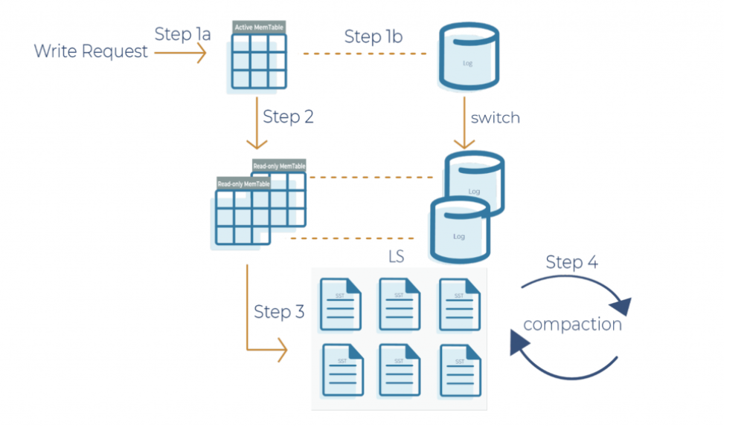
RocksDB – LSM, Log Structured Merge Archtiecture
Step 1a - Write request is written to an active memtable, also called a write buffer
Step 2 -When the memtable is full, it becomes a read-only memtable. From there, new writes continue to accumulate in a new memtable
Step 3 - As new writes accumulate in the new memtable, the read-only memtables are flushed into SST(Static Sorted Table) files on the storage system
  The data in a SST file is lexicographically sorted to facilitate easy key lookups and sequential scans
  SST files are organized in levels (L0, L1, and so on)
  Each level has an arbitrary number of SST files.
  Each SST file has metadata that describes the key range
Step 4 – Periodic compaction so that RocksDB performance is maintained

Slide 122
RocksDB Compaction
The log structured merge architecture is an append-only data structure
  For deleting a key the deleteion is marked and recorded but the key is not immediately removed
  Updates to a key are appended, but the previous value of the key is not updated in place
In order to keep the database size under control, all deleted keys and corresponding delete operations as well as the updated key-value pairs have to be removed
Compaction is a process of combining a set of SST files and generating new SST files with overwritten keys and deleted keys purged from the output files
  Compaction is crucial for securing high performance in RocksDB

Slide 123
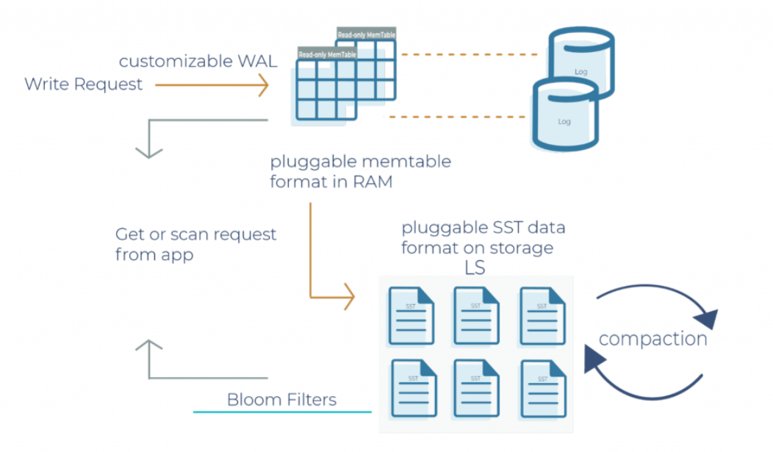
RocksDB – Highly Configurable
The transaction log can be enabled or disabled
  Kafka Streams doesn’t use the transaction log in RocksDB because the mentioned changelog topics on the Kafka brokers themselves behave as transaction logs
The memtable is a skip list by default
  It can be configured as a vector memtable instead if bulk data loading is required
Compaction is configurable

Slide 124
Memory Management
One can specify the total memory size used for internal caching and compacting of records
This caching happens before records are written to state stores or forwarded downstream to other nodes

Slide 125
Record Caches in the DSL
Total memory size can be specified for an instance of a processing topology
  Leveraged by the following KTable instances
    Source tables
    Aggregated tables
Input: A KStream<String, Integer> with the records <K,V>: <A, 1>, <D, 5>, <A, 20>, <A, 300>
  Without caching: <A, (1, null)>, <A, (21, 1)>, <A, (321, 21)>.
  With caching <A , (321, null)>

Slide 126
Caching Semantics
Data is flushed to the state store and forwarded to the next downstream processor node whenever the earliest of commit.interval.ms or cache.max.bytes.buffering (cache pressure) hits
Both commit.interval.ms and cache.max.bytes.buffering are global parameters
Properties streamsConfiguration = new Properties();
// Enable record cache of size 10 MB.
streamsConfiguration.put(StreamsConfig.CACHE_MAX_BYTES_BUFFERING_CONFIG, 10 * 1024 * 1024L);
// Set commit interval to 1 second.
streamsConfiguration.put(StreamsConfig.COMMIT_INTERVAL_MS_CONFIG, 1000);

Slide 127
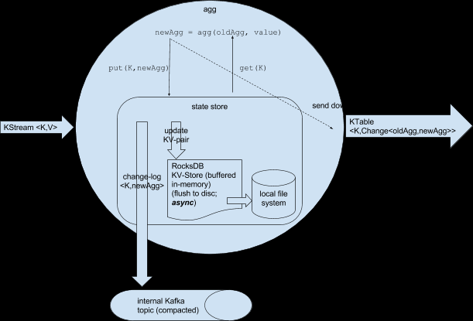
Record Caches and RocksDB

Slide 128
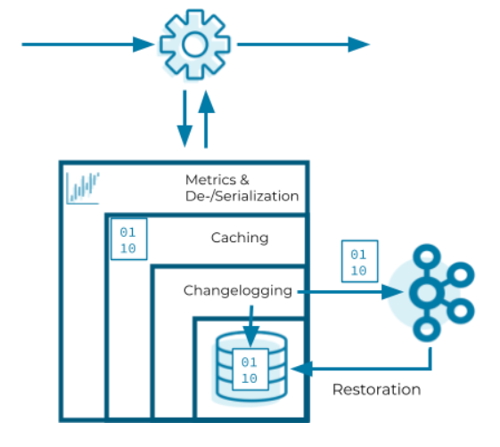
The outermost layer collects metrics about the operations on the state store and serializes and deserializes the records that are written to and read from the state store
Next layer caches the records
  If record with key exists – overwrite
  Else create new record
  Caching layer decreases downstream traffic because no updates are sent downstream unless the cache evicts records or is flushed
The changelogging layer sends each record updated in the state store to a topic in Kafka—the state’s changelog topic
The innermost layer updates and reads the local state store

Slide 129
Kafka Streams Exactly Once Guarantees

Slide 130
At Least Once Semantics
Not acceptable
  Getting the exact count by key for a stream
  Summing up bank transactions to compute customer/customers bank balance
  Any operation that is not idempotent
  Any financial computation
Acceptable:
  Operations on time windows
  Approximate operations

Slide 131
Kafka Stream: Exactly Once
props.put(StreamsConfig.PROCESSING_GUARANTEE_CONFIG,
StreamsConfig.EXACTLY_ONCE)
Trade-off
  Results published in transactions, which might incur a small latency
  Regulated using commit.interval.ms

Slide 132
Kafka Streams and Tables - Joins

Slide 133
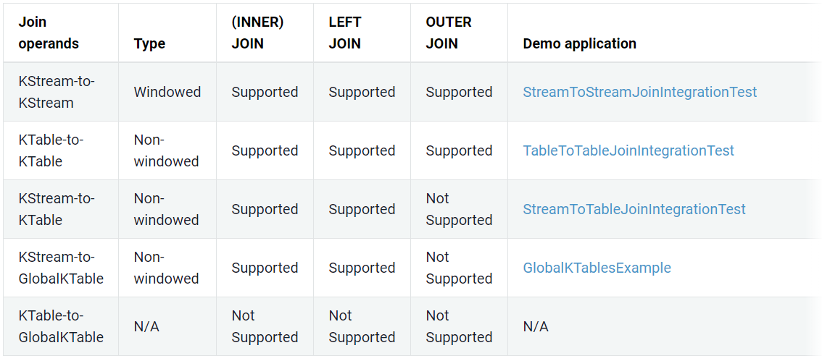
Kafka Stream Joins
https://docs.confluent.io/current/streams/developer-guide/dsl-api.html#streams-developer-guide-dsl-joins

Slide 134
Join Constraints
Co-partitioning of data
Three types of joins
  KStream / KStream
  KTable / KTable
  KStream / KTable
Data has to be co-partitioned – both entities should have the same number of partitions
To co-partition data if it is not so, write back the topics through kafka with the requisite partitions before the join
  Network Cost

Slide 135
Joins
GlobalKTable
If the data is small, it can be read as a GlobalKTable
GlobalKTable will be present in each application instance
It can be joined with even if number of partitions are different

Slide 136
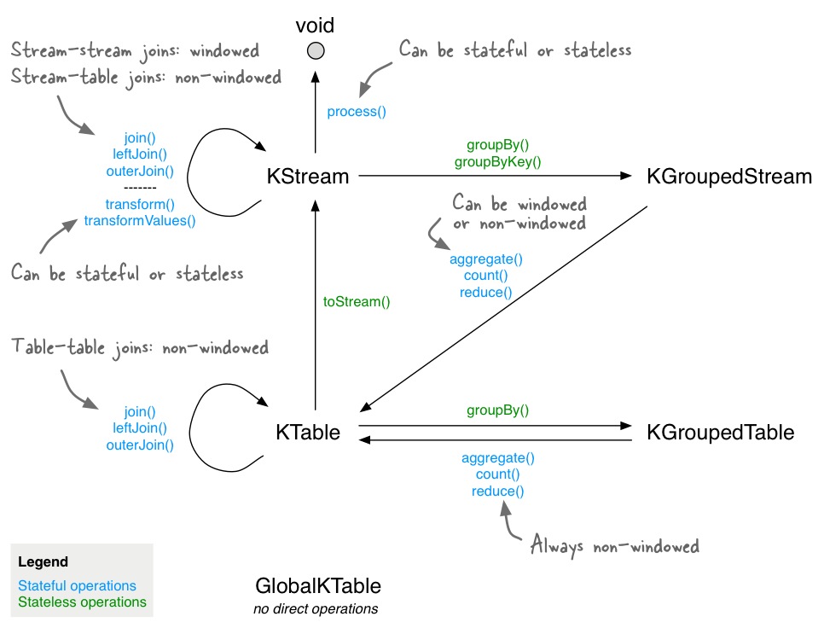
https://docs.confluent.io/current/_images/streams-stateful_operations.png

Slide 137
Kafka MirrorMaker

Slide 138
Use Cases of Cross-Cluster Mirroring
Regional and central clusters
  Company that modifies prices based on supply and demand
Redundancy(Disaster Recovery)
Cloud migrations

Slide 139
Multicluster Architectures
Relaities/Challenges of Cross-Datacenter-Communication
High latencies
Limited bandwidth
Higher costs

Slide 140
Multicluster Architectures
Design Considerations
Apache Kafka’s brokers and clients were designed, developed, tested, and tuned all within a single datacenter.
In most cases, it’s best to avoid producing data to a remote datacenter
If we need any kind of replication between clusters and we ruled out inter-broker communication and producer-broker communication, then we must allow for broker-consumer communication.

Slide 141
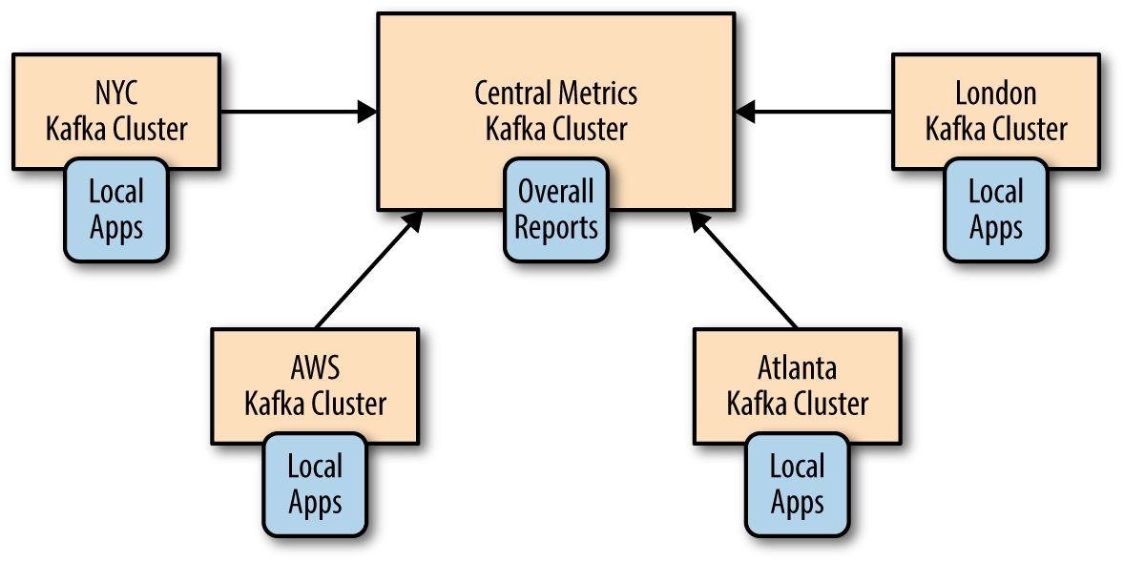
Hub and Spokes
When data is produced in multiple datacenters and some consumers need access to all the data
Data is always produced to the local datacenter and events from each center are mirrored only once to the central datacenter
Main drawback – processors in one datacenter can't access data in another
bank customers spread across geographies

Slide 142
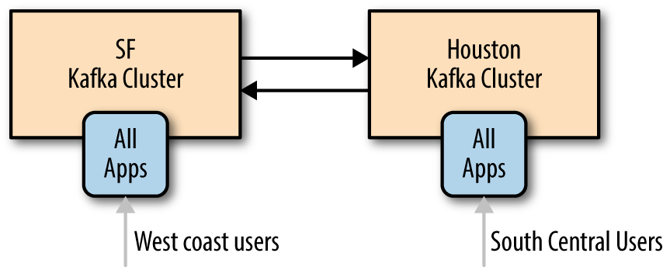
Active-Active
Two or more datacenters share some or all of the data and each datacenter is able to both produce and consume events
Main benefit – ability to serve users from a nearby datacenter
Secondary benefit – redundancy and resiliency
Main challenge, drawback - maintaining consistencey across asynchronous updates

Slide 143
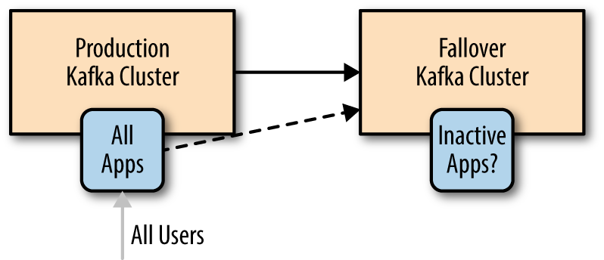
Active-Standby
Primary use – redundancy
A mirroring cluster in the same datacenter or in another geography
Main drawback – waste of a good cluster

Slide 144
Data loss and inconsistencies in unplanned failover
Asynchronous mirroring – DR cluster will not have the latest messages
In a busy system the DR cluster may be hundreds or thousands of messages behind
Capacity 1 million messages per second and 5 milliseconds latency between primary and DR – DR will be 5000 messages behind

Slide 145
Mitigating DR cluster lag
Store offsets in an external system – cassandra, mysql
Replicate _consumer_offsets through mirroring
Make application processing logically idempotent
Use timestamps to keep track of the time till which data is processed
Stretch clusters – brokers dispersed across datacenters in the same region
Use DNS pointers to switch to active, available brokers

Slide 146
The MirrorMaker
Simple tool for mirroring data between two datacenters
A collection of consumers, called streams, which are all part of the same consumer group and set data from the set of topics chosen for replication

Slide 147
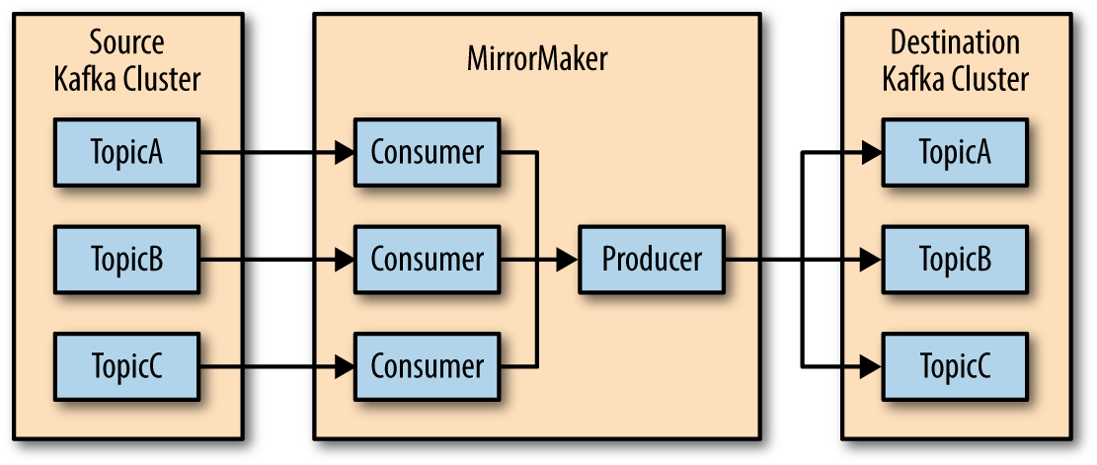
The MirrorMaker Process
MirrorMaker runs a thread for each consumer
Each consumer consumes from the assigned topics and partitions and uses shared producer to send them to the target cluster
Every 60 seconds (by default), the consumers will tell the producer to send all the events it has to the target cluster and wait until it acknowledges these events
Then the consumers contact the source Kafka cluster to commit the offsets for those events
This guarantees no data loss (messages are acknowledged by Kafka before offsets are committed to the source) and there is no more than 60 seconds’ worth of duplicates if the MirrorMaker process crashes.

