Slide 1
IPL Dashboard Analysis
Performance Insights from 2009–2019 Seasons
Prepared by: Samar Lohri

Slide 2
Introduction
The Indian Premier League (IPL) is one of the most popular cricket leagues globally.
This analysis covers data from 2009–2019 seasons.
Objective: To analyze trends, team performances, player stats, and match decisions.

Slide 3
Dashboard Overview
Total Matches: 636
Total Seasons: 10
Total Cities: 31
Dashboard provides key insights into performance trends.

Slide 4
Matches Per Season
Matches peaked in 2013 (80 matches).
Decline observed post-2013, stabilizing around 60 matches per season.
Possible reasons: team restructuring and format adjustments.

Slide 5
Toss Decision Preferences
57.08% of teams chose to Bat first after winning the toss.
42.92% of teams opted to Field first.
Toss decisions significantly influence match outcomes.

Slide 6
Matches Won by Teams
Royal Challengers Bangalore: 73 wins.
Rajasthan Royals: 63 wins.
Sunrisers Hyderabad: 42 wins.
Top teams consistently perform well across seasons.

Slide 7
Result Distribution
Victories achieved by Runs and Wickets are both significant.
Balanced results highlight strengths in both batting and bowling strategies.
Example: RCB has wins by both runs and wickets.

Slide 8
Top 10 Run Scorers
YK Pathan leads with 32K runs.
Virat Kohli and V Sehwag follow with 22K each.
Top players have a strong influence on match outcomes.

Slide 9
Key Insights & Recommendations
Teams prefer batting after winning toss, showing batting dominance.
Match count decreased after 2013 due to format changes.
Star players drive team success significantly.
Future dashboards should include bowling stats and venue-based analysis.

Slide 10
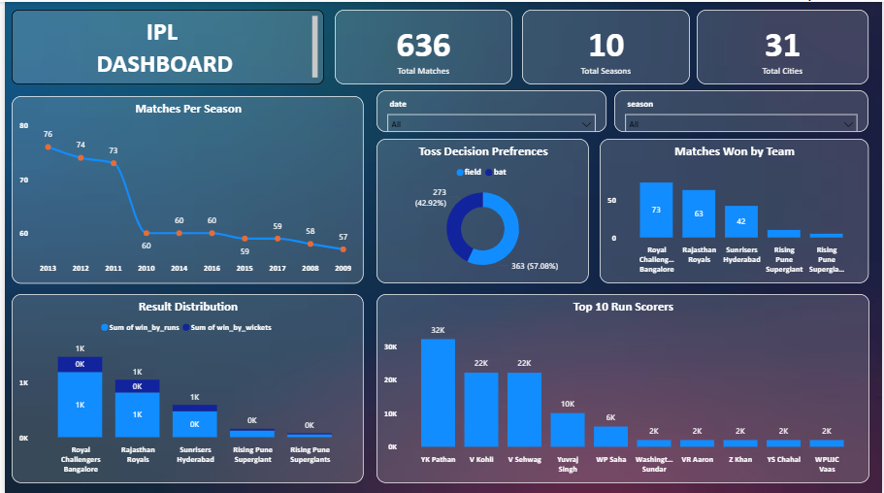
DASBOARD

Slide 11
Conclusion & Future Scope
IPL dashboard highlights important trends and team strategies.
Helps analysts and franchises make data-driven decisions.
Future scope: Add player strike rates, economy rates, and venue-based trends.

