Slide 1
Project Prometheus
Bridging the Intent Gap in Agentic Program Repair
via Reverse-Engineered Executable Specifications
Yongchao Wang & Zhiqiu Huang
Nanjing University of Aeronautics and Astronautics · April 2026 · arXiv:2604.17464
93.97%
74.4%
680
4.4×
Correct Patch Rate
Rescue Rate
Defects4J Bugs
vs. SOTA on hard bugs

Slide 2
Project Prometheus
The clarity of intent (What to fix) is often more critical than the perfection of the tooling (How to verify).
Prometheus succeeds not just because it builds tests, but because it forces the model to articulate and internalize the precise boundaries of the bug before writing a single line of code

Slide 3
OVERVIEW
Presentation Outline
01
The Problem — The Intent Gap in APR
06
Experimental Results — 680 Defects4J Bugs
02
Background — APR Evolution & Key Concepts
07
Qualitative Case Studies — Four Deep Dives
03
The Prometheus Framework — Architecture & Three Agents
08
Cost Analysis & Limitations
04
The RQA Loop — Specification Validation
09
Comparison with SOTA & Conclusions
05
Metrics & Formulas

Slide 4
PROBLEM STATEMENT
The Intent Gap
Why do capable agents still produce wrong fixes?
The Fundamental Paradox
Agents are increasingly proficient at generating code — but they remain remarkably fragile in understanding what code is intended to do. A generated patch may pass all tests yet violate the developer's original design intent.
Natural Language
Summaries
Adversarial
Test Sampling
Blind
Code Generation
Descriptive, not prescriptive.
Leaves boundary conditions ambiguous.
Probabilistic — expensive to generate,
non-deterministic outcomes.
Relies on pattern-matching from training
data rather than deterministic logic.
Intent Gap = distance between "what makes tests pass" and "what the developer intended"

Slide 5
BACKGROUND
APR Evolution — Three Generations
Gen 1
pre-2020
Gen 2
2020-2024
Gen 3
2025+
Search-Based
Neural Translation
Agentic Workflows
GenProg, RSRepair
AlphaRepair, SequenceR
Prometheus,
RepairAgent, TSAPR
Random mutation + test runs. Dumb, slow, no understanding.
Treat fix as machine translation. Faster, smarter, but still pattern-matching.
LLM + tools + autonomous planning. Human-like debugging loop.

Slide 6
KEY CONCEPT
BDD & Gherkin — Executable Intent
Behavior-Driven Development (BDD)
Gherkin example — Mockito-5
Introduced by Dan North, 2006
Writes requirements as executable scenarios
Given / When / Then structure
Both human-readable and machine-executable
Prescriptive (not just descriptive)
Feature:
VerificationOverTimeImpl should not depend on JUnit Scenario:
Loading without JUnit
Given a loader excluding junit
When I load VerificationOverTimeImpl
Then class loads successfully
And no NoClassDefFoundError thrown
Key insight: Gherkin transforms repair from a stochastic patch search into a deterministic contract satisfaction problem.

Slide 7
CORE HYPOTHESIS
The Intent-Behavior Mirroring Effect
❌ Berserker-Style
✓ Surgical-Style
Broad / vague requirement
→ Agent rewrites entire methods
→ Touches code beyond the defect
→ Introduces regressions
→ Fails semantic correctness
Precise BDD specification
→ Agent modifies exactly one thing
→ Respects adjacent logic
→ Satisfies all invariants
→ Formally aligned with intent
Gemini-3.0-Pro (Architect) writes the spec → Qwen-3.0-Coder (Fixer) operates within it — separation of concerns is the key.

Slide 8
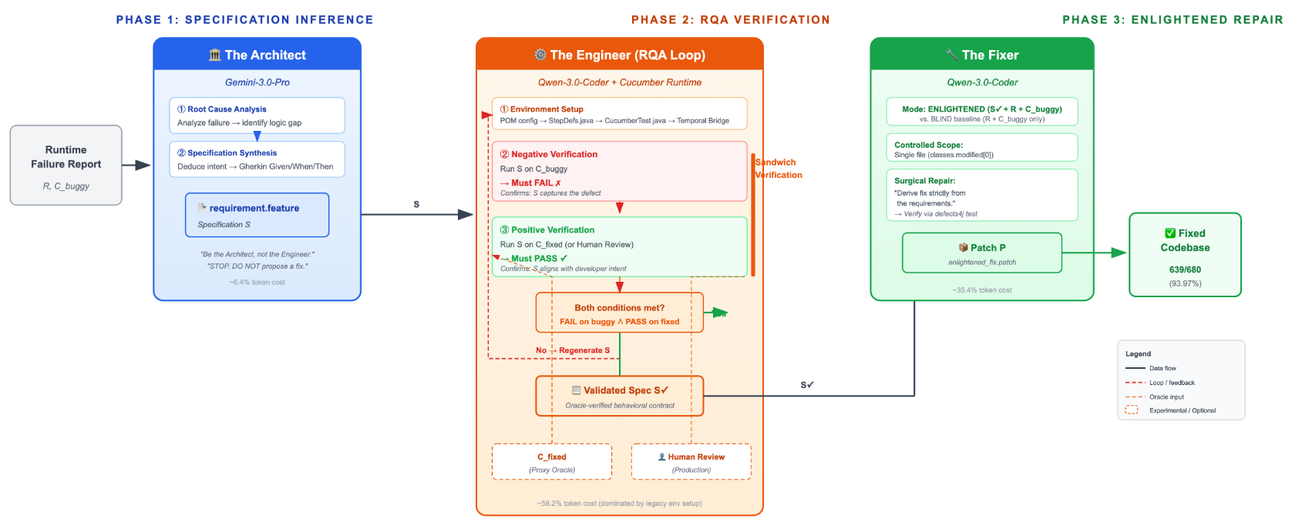
Prometheus — Three-Phase Architecture
Phase 1: The Architect (Gemini-3.0-Pro) performs root cause analysis and synthesizes a Gherkin specification S.
Phase 2: The Engineer validates S through Sandwich Verification—S must fail on Cbuggy and pass on Cfixed (or human review in production). If verification fails, S is regenerated.
Phase 3: The Fixer (Qwen-3.0-Coder) performs a specification-guided surgical repair, producing patch P.

Slide 9
PHASE 1
The Architect — Specification Inference
Powered by Gemini-3.0-Pro · Reasoning specialist · Produces .feature file
Two-Stage Cognitive Process (Chain-of-Thought)
Stage 1 — Root Cause Analysis
Stage 2 — Specification Synthesis
Analyze the execution failure. Identify the specific logical discrepancy between expected and actual behavior. Never write Gherkin until diagnosis is complete.
Formalize the intended behavior into Given / When / Then scenarios. Capture both functional requirements and architectural constraints (e.g., JUnit independence in Mockito-5).
Key advantage over prior work: Grounds inference in deterministic runtime data (stack traces, assertion errors) — not ambiguous natural language issue descriptions.

Slide 10


PHASE 2
The Engineer — Oracle-Guided RQA Loop
If the spec is wrong, the repair will be a correct implementation of the wrong requirement.
Sandwich Verification — Two conditions, both must hold:
Negative Verification
Positive Verification
Run spec S on C_buggy
Run spec S on C_fixed
Test MUST FAIL
→ Confirms spec captures the defect
Test MUST PASS
→ Confirms spec aligns with developer intent
Limitation: In experiment, C_fixed (ground truth) serves as oracle. In production, replaced by (a) human review of Gherkin scenarios, (b) existing BDD test suites, or (c) negative-only verification.

Slide 11
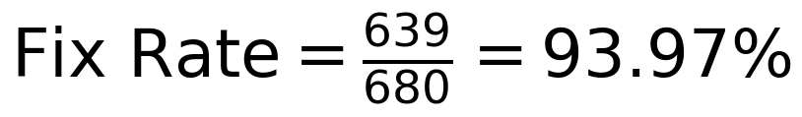
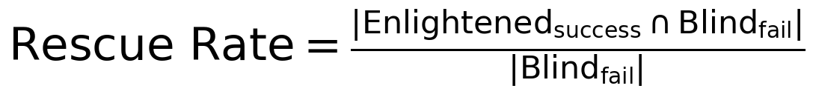
METRICS
Evaluation Metrics — Formulas
Fix Rate (= Correct Patch Rate)
Each fix validated by comparing agent patch against Defects4J developer ground-truth.
Rescue Rate
Composite methodology: Blind Fixer on all 680 → 520 success. Enlightened Fixer on the 160 failures → 119 rescued. Total = 639.

Slide 12
METRICS
Evaluation
RQ1 (Effectiveness)
RQ2 (Rescue Capability)
RQ3 (Quality & Interpretability)
RQ4 (Cost & Efficiency)
Composite methodology: Blind Fixer on all 680 → 520 success. Enlightened Fixer on the 160 failures → 119 rescued. Total = 639.

Slide 13

RESULTS — RQ1 & RQ2
Experimental Results — 680 Defects4J Bugs
Total fix rate
639 / 680 bugs
Blind baseline
520 / 680 bugs
Rescue rate
119 / 160 hard bugs
vs. TSAPR & RepairAgent
on hard bugs
93.97%
76.5%
74.4%
4.4×
Project | Bugs | Blind ✓ | Blind ✗ | Rescued | Total | Rate
Cli | 39 | 39 | 0 | 0 | 39 | 100.0%
JacksonCore | 26 | 26 | 0 | 0 | 26 | 100.0%
Mockito | 38 | 32 | 6 | 6 | 38 | 100.0%
Math | 106 | 48 | 58 | 39 | 87 | 82.1%
Compress | 47 | 29 | 18 | 14 | 43 | 91.5%
Jsoup | 93 | 59 | 34 | 25 | 84 | 90.3%
TOTAL | 680 | 520 | 160 | 119 | 639 | 93.97%

Slide 14
RESULTS — RQ3
Qualitative Case Studies — Four Insights
Chart-13 — Curing Hallucination
Chart-7 — Preventing Over-Simplification
Blind agent invented a non-existent variable 'constraint' by copying from a sibling method. BDD spec named the exact objects → agent created correct RectangleConstraint instead.
Blind agent removed a conditional check as a shortcut fix. BDD spec included an edge-case scenario → agent restored the guard and prevented regression.
JxPath-6 — Surpassing Ground Truth
Mockito-5 — Architectural Integrity
Blind agent failed entirely. BDD required arrays treated like Collections → agent added isArray() check. Developer's fix missed arrays — agent's fix was more complete.
Blind agent deleted the catch block, leaving assertion errors unhandled. BDD stated 'must not depend on JUnit' → agent used Java Reflection for conditional exception handling.
Pattern: Explicit specification prevents hallucination, lazy shortcuts, scope creep, and architectural violations.

Slide 15
RESULTS — RQ4
Cost Analysis — The Price of Thinking
Agent | Role | Avg Time | Avg Turns | Avg Tokens | Cost %
Architect | Intent Inference | 136.77s | 24.26 | 372,107 | 6.4%
Engineer | RQA Verification | 671.67s | 70.23 | 3,365,986 | 58.2%
Fixer | Enlightened Repair | 452.64s | 44.91 | 2,044,348 | 35.4%
TOTAL |  | 1,261.08s | 139.4 | 5,782,441 | 100%
Architect costs only 6.4% — reasoning is cheap relative to coding
Engineer (58.2%) is expensive due to 'Digital Archaeology': legacy JDK versions, non-standard build layouts, multi-round Cucumber execution
In production, per-defect Engineer cost drops ~60% once test harness is set up once per project
Serendipitous finding (Math-21): even when Cucumber fails to compile, the Gherkin text alone acts as a Cognitive Scaffold — agent still produces a correct patch

Slide 16
THREATS TO VALIDITY
Limitations — Where Prometheus Breaks
Fixed Code Oracle
The RQA Loop uses C_fixed (developer's ground truth fix) to validate specs. In real deployment, C_fixed does not exist before the repair. Result: 93.97% measures the theoretical upper bound, not production performance.
Single-File Constraint
Fixer restricted to one file to isolate BDD effect from fault localization. Multi-file bugs (e.g., Time-1) cause 'Cognitive Dissonance Hallucination' — agent knows what to do but cannot access the required file, producing irrational code with reasoning degradation (typos in comments).
Implicit Protocol Gap
BDD cannot capture low-level wire format changes (e.g., Collections-8: extra int in serialization buffer). Specifications describe API-level behavior; sub-API binary protocols are invisible.
Model Capability Ceiling
Correct spec does not guarantee correct implementation. Math-69: standard Fixer applied a heuristic clamp; only Gemini-3.0-Pro derived the rigorous Beta function solution. Performance scales with Fixer's reasoning depth.
Closure Excluded
Closure project excluded — legacy build incompatibility + excessive test suite overhead on the RQA Loop. Affects comparability with papers using full Defects4J.

Slide 17
COMPARISON
Comparison with State-of-the-Art
Search-strategy approaches
Problem-definition approach
TSAPR/RepairAgent optimize how to search (better needle-finding strategy)
They work harder at traversing the same incorrect search space
On simple bugs, search strategy is sufficient — and they do well
Prometheus narrows what to search for (redefine the problem)
A precise BDD contract transforms unbounded search into constraint satisfaction
On hard bugs requiring domain reasoning, intent definition is the bottleneck

Slide 18
Key distinction:
System | Approach | Full D4J | Our 680 | Hard 160 | Key Differentiator
TSAPR | Monte Carlo Tree Search | 201 | 173 | 22 | Optimizes search trajectory
RepairAgent | Autonomous debug tools | 164 | 137 | 27 | Mimics human debugging workflow
Prometheus | BDD Spec Inference | — | 639 | 119 | Narrows search space via intent

Slide 19
THREATS TO VALIDITY
Threats to Validity
Fixed Code Oracle
In a real-world scenario, the fixed code does not exist before the repair
human-in-the-loop review, where developers review concise Gherkin scenarios (typically <10 lines)—a task significantly less cognitively demanding than reviewing full code patches;
projects with existing BDD test suites can supply specifications directly, bypassing automated inference entirely;
negative-only verification
Controlled Scope
Fixer restricted to one file to isolate BDD effect from fault localization. Multi-file bugs (e.g., Time-1) cause 'Cognitive Dissonance Hallucination' — agent knows what to do but cannot access the required file, producing irrational code with reasoning degradation (typos in comments).
Data Leakage
BDD cannot capture low-level wire format changes (e.g., Collections-8: extra int in serialization buffer). Specifications describe API-level behavior; sub-API binary protocols are invisible.

Slide 20
Conclusions
The quality of the question determines the quality of the answer.
01
Specification-first beats code-first
Inferring intent before generating code reduces hallucination, scope creep, and architectural violations.
02
Problem formulation > model size
A smaller model with a perfect spec beats a large model with no spec on hard, domain-heavy bugs.
03
Specs have dual nature
BDD serves as both an Executable Contract (for RQA) and a Cognitive Scaffold (for the LLM's reasoning).
04
Intent scales with bug complexity
BDD's marginal utility grows exponentially as algorithmic complexity increases (Math: 45% → 82%).
Future: Detective agent for multi-file fault localization · Immune System of persistent BDD skill libraries
github.com/Nothing256/Prometheus-Unbound · arXiv:2604.17464

