Slide 1

International Institute of Information Technology Bangalore
Building a Movie Recommendation System using Neighborhood based approach/ Reduced SVD & K-means clustering approach and compare and contrast both the approaches.
Submitted by:
Subhankhi Maiti (MT2023113)
Samarpita Bhaumik (MT2023053)
Sunnidhya Roy (MT2023079)

Slide 2
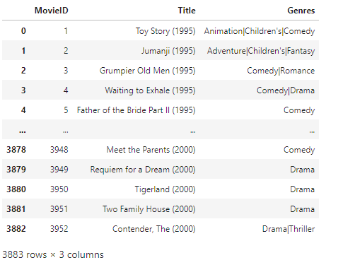
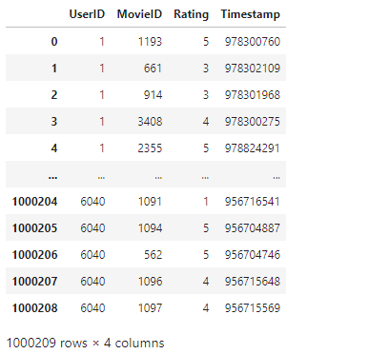
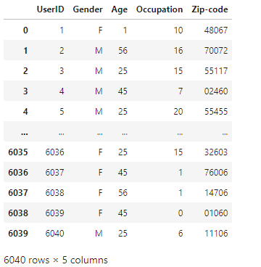
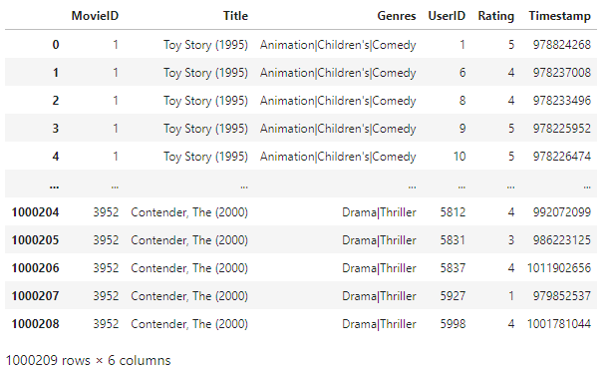
1M MovieLens Dataset
Movies
Ratings
Users
Entire Movie Data

Slide 3
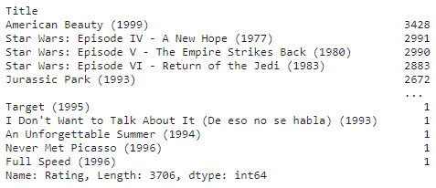
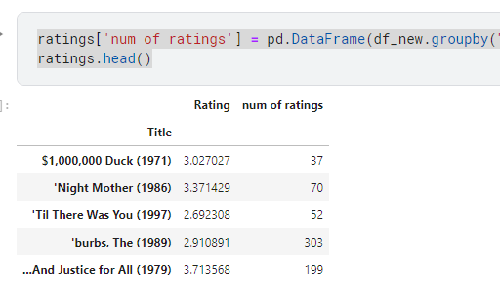
Performing EDA to understand the data
American Beauty is the most rated movie by the users.
Dataframe containing average movie rating and number of ratings for that movie.

Slide 4
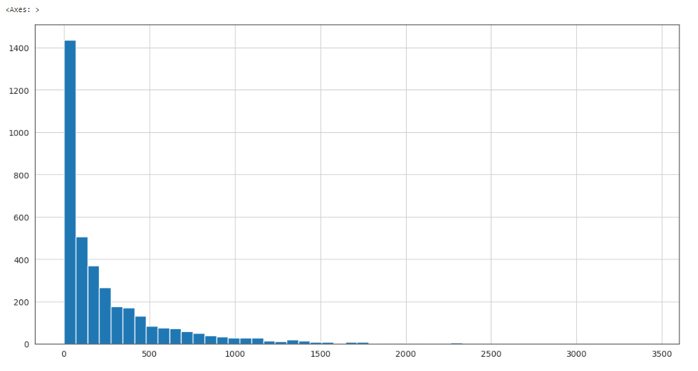
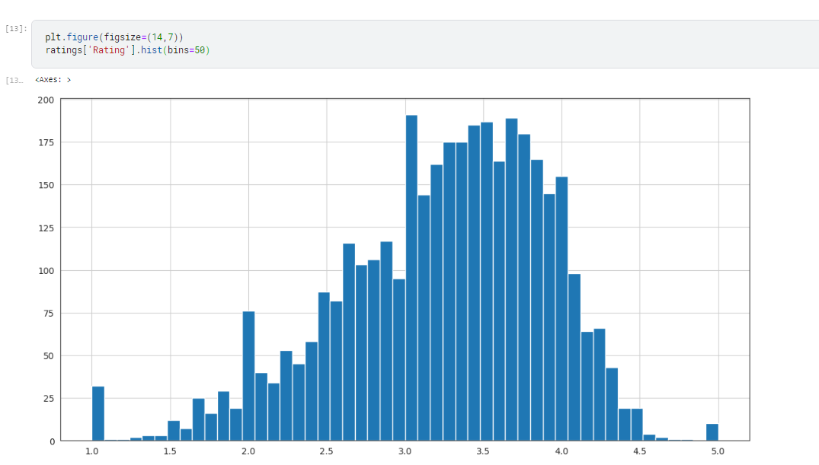
EDA continued…..
Distribution of the number of ratings for all the movies given by the users.
Distribution of the Ratings given by the User.
We can observe that the data almost follows a Normal Distribution (except few outliers).

Slide 5
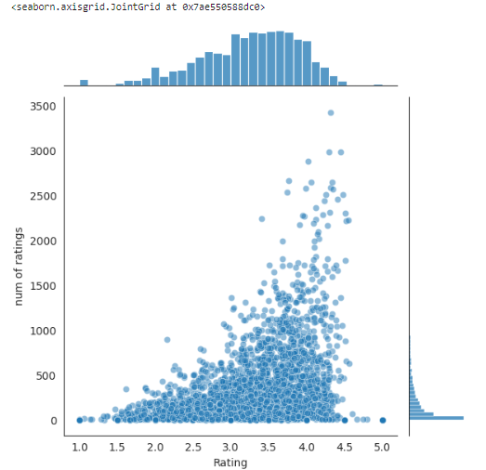
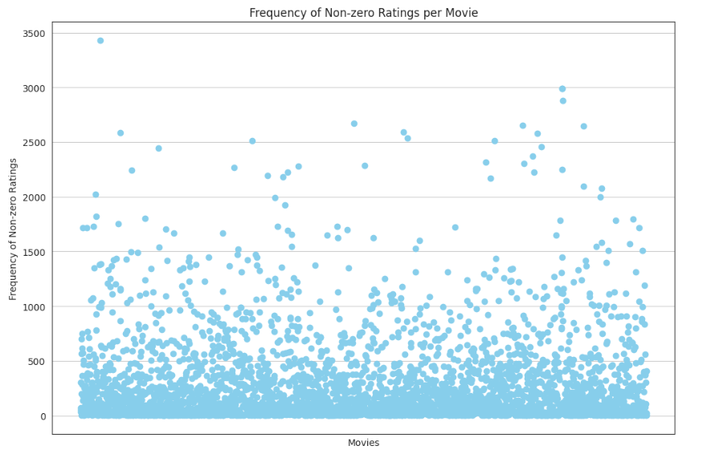
EDA continued…..
Joint plot between Ratings and Number of Ratings.
We can observe from the data that most of the ratings are concentrated around the range 3 to 4.5
Movies vs Frequency of Non-zero Ratings scatter plot.
We can observe from the data that most of the movies have count of non-zero ratings concentrated within ~800.

Slide 6
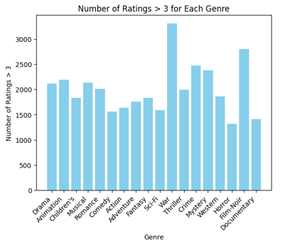
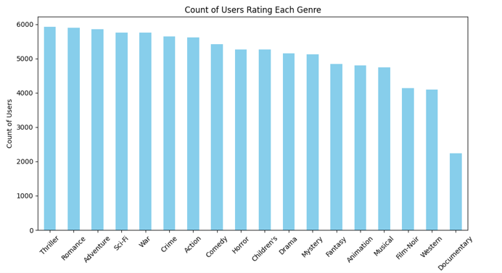
EDA continued…..
Genre vs Count of Users who have watched that genre.
We can observe from the data that Thriller, Romance, Adventure, Sci-Fi, War, Crime, Action are the most watched genres. This can impact the recommendation as most users would have watched these genres and so
Recommendations can be a bit biased ( may not be as well).
Genre vs Number of Ratings>3 Histogram plot.

Slide 7
Algorithm to implement Neigborhood based Approach(User Based)
Import the dataset and perform the required EDAs to analyze the data.
We then form the ‘UserID’ vs ‘Title’ dataframe(‘user_movie_matrix’) with cell values as ‘Ratings’ of the movies. This dataframe will be used for all the required computations we will be performing for recommendations.
We then take ‘n’ movie names and ratings as input from the user and add a new row with the new userid into the dataframe ‘user_movie_matrix’.
After that we normalize the ‘user_movie_matrix’ dataframe row-wise to remove the bias of all the user.
Using Pearson’s Coefficient we compute the similarity between the new user and all the users in the ‘user_movie_matrix’ dataframe. ( We have used both Pearson’s Coefficient and Cosine Similarity and observed Pearson’s correlation is giving better output).
We then take top 10 users with the highest correlation value.
Using the ‘movie_rating’ vector of those 10 users we compute the movie score using the formula: Summation(user_similarity_value * rating given by the user)/total number of similar users.
We then recommend top 20 movies based on the movie score.

Slide 8
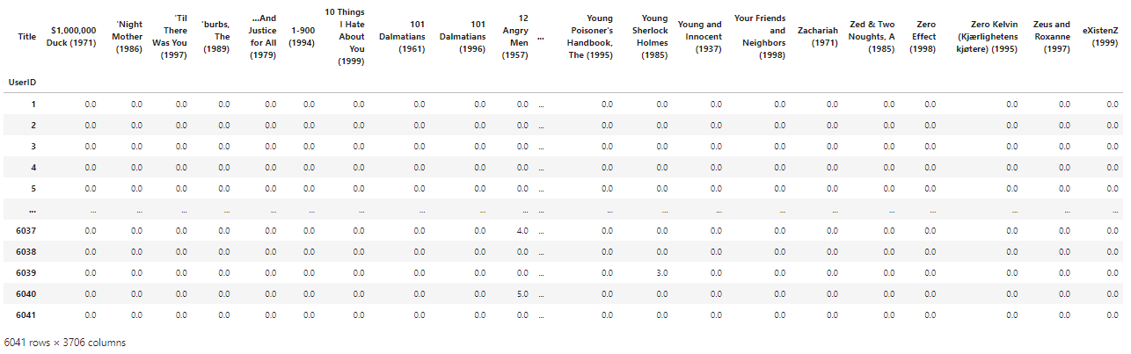
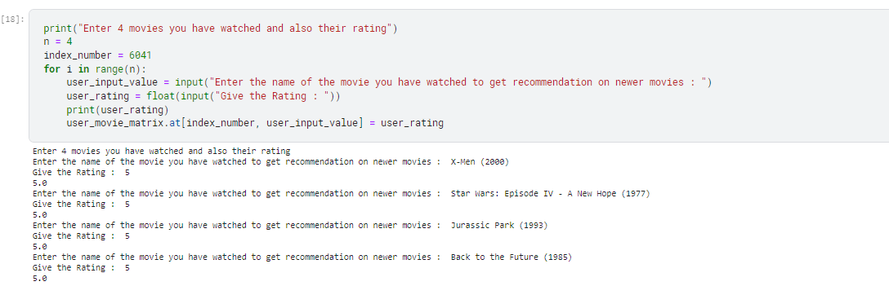
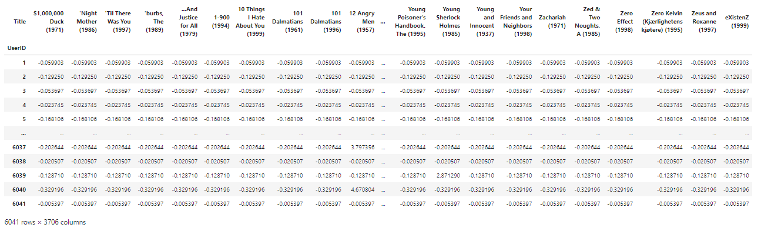
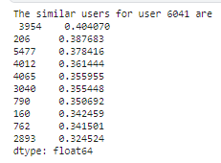
Input
Input as movie name and rating for the new user
Addition of new user 6041 to ‘user_movie_matrix’
Top 10 users similar to user with userid 6041
Normalizing the ‘user_movie_matrix’ to remove user bias.

Slide 9
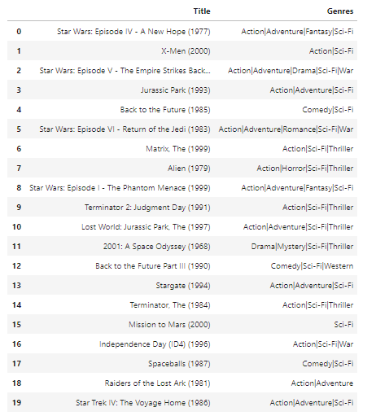
Output
These are the top 20 movie recommendations based on what the user has already watched. We can see a good overlap between the input movie genres and the recommended movie genres. Also movie suggested are very much similar to the input movies and even belong to the same Series.

Slide 10
Algorithm to implement Reduced SVD & K-means clustering approach(User vs Movie)
Import the dataset and perform the required EDAs to analyze the data.
We then take ‘n’ movie names, ratings and timestamp as input from the user and add a new row with the new userid into the dataframe ‘df_ratings’.
We then form the ‘UserID’ vs ‘MovieID’ dataframe(‘rating’) with cell values as ‘Ratings’ of the movies. This dataframe will be used for all the required computations we will be performing for recommendations.
After that we apply SVD on the ‘ratings’ dataframe where each rating is obtained as a weighted dot product between corresponding user vector and item vector with singular values as the weight. Sigma's with very small weight might be noise. So we just remove them. We have computed the eigen values and right eigen vectors using Power Iteration method with iterations=300. We observed that if we increase the iterations from 200 to 300 the recommendations significantly improved. Because of limitation in compute power we could not take high iteration value > 1000 which would have significantly improved the recommendations further.
We have then used kmeans approach to cluster the users and then find the cluster to which that user belongs and then we applied 2 approaches for recommending movies:
First Approach: Compute normalized distances between the given user and all other users in that cluster. Using the distances get movie recommendations from the top 30 users in that cluster.
Using Pearson’s Coefficient we compute the similarity between the given user and all the other users in that cluster. We then take top 20 users with the highest correlation value. Using the ‘movie_rating’ vector of those 20 users we compute the movie score using the formula: Summation(user_similarity_value * rating given by the user)/total number of similar users. We then recommend top 20 movies based on the movie score.

Slide 11
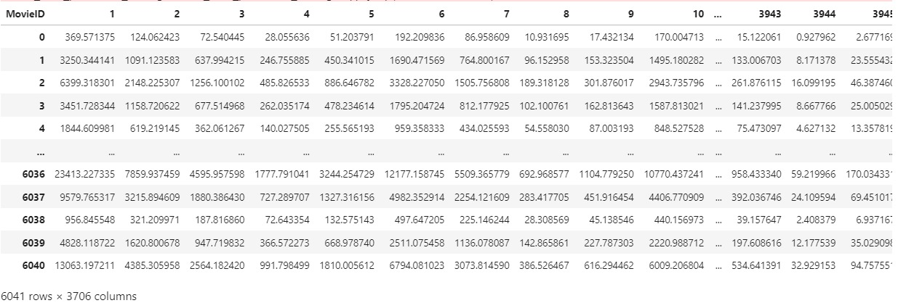
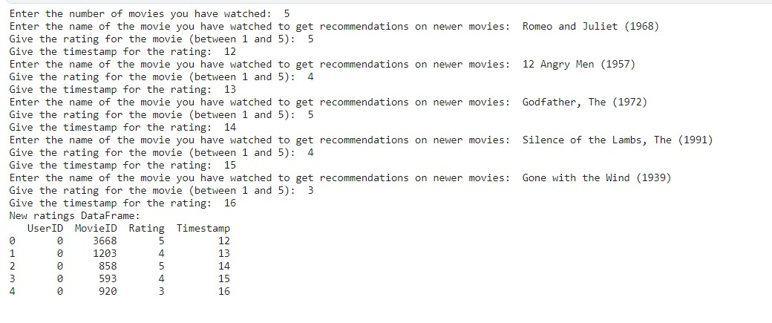
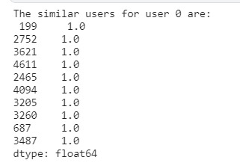
Input
‘all_user_predicted_ratings’ dataframe after applying SVD
Top 10 users similar to user with userid 6041
Input as movie name, rating and timestamp for the new user

Slide 12
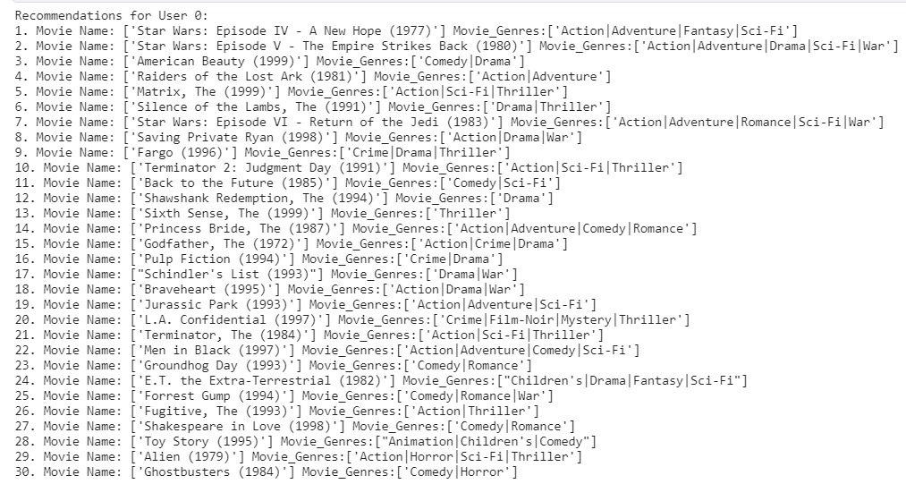
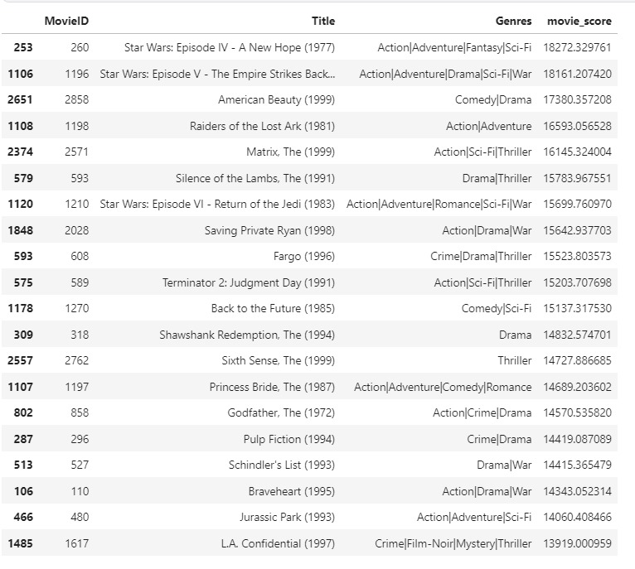
Output
Cluster Distance Based Approach
These are the top 30 movie recommendations based on what the user has already watched. We can see a good overlap between the input movie genres and the recommended movie genres. Also movie suggested are very much similar to the input movies and even belong to the same Series.
Pearson’s Correlation Based Approach
These are the top 20 movie recommendations based on what the user has already watched. We can see a good overlap between the input movie genres and the recommended movie genres. Also movie suggested are very much similar to the input movies and even belong to the same Series. We also get some novel recommendations as well.

Slide 13
Algorithm to implement Reduced SVD & K-means clustering approach(User vs Genre)
Import the dataset and perform the required EDAs to analyze the data.
We then take ‘n’ movie names and ratings as input from the user and add a new row with the new userid into the dataframes ‘df_users’(user info) and ‘df_ratings’(movie and ratings).
We then form the ‘UserID’ vs ‘Genre’ dataframe with cell values as mode of the ‘Ratings’ given by that userid to the particular genre. This dataframe will be used for all the required computations we will be performing for recommendations.
After that we apply SVD on the ‘result_df’ dataframe where each rating is obtained as a weighted dot product between corresponding user vector and item vector with singular values as the weight. Sigma's with very small weight might be noise. So we just remove them.
We have computed the eigen values and right eigen vectors using Power Iteration method with iterations=300. After applying SVD transform we get ‘svd_data_df’. We observed that if we increase the iterations from 200 to 300 the recommendations significantly improved. Because of limitation in compute power we could not take high iteration value > 1000 which would have significantly improved the recommendations further.
I am sampling 80% train data from ‘svd_data_df’(experimentally found out that this gave better recommendations).
We have then used kmeans approach to cluster the users and then find the cluster to which that user belongs.
We are marking the cluster to which the new user belongs.
Using Pearson’s Coefficient we compute the similarity between the new user and all the users in that cluster. The correlation coefficient will act as a weight for calculating the ratings given by the new user to that particular genre as a weighted mean. We now have all the ratings of the genres predicted by the new user.
For calculating the movies rating we will take the average of the genres rating of that movie. For movies with same ratings we will give priority to that movie which has higher value of the sum of its genres ratings.
Sort the movies according to their ratings and that priority.
Take top 20 movies as recommendation.

Slide 14
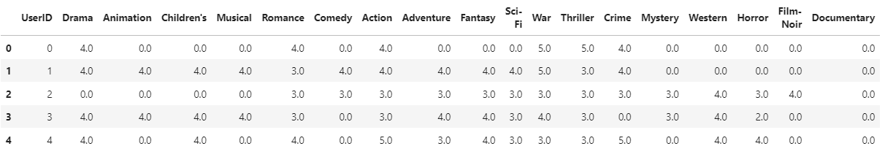
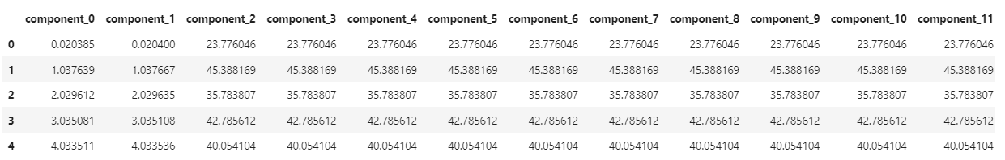
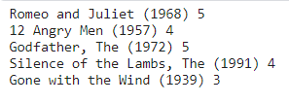
Input
‘result_df’ dataframe after applying mode
‘svd_data_df’ dataframe after applying SVD
Input as movie name and rating for the new user

Slide 15
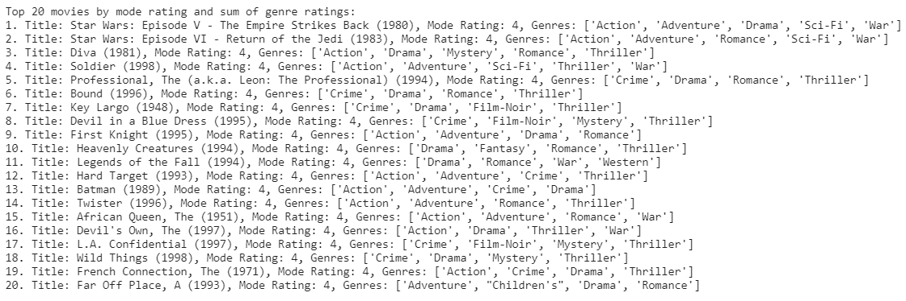
Output
Pearson’s Correlation Based Approach
These are the top 20 movie recommendations based on what the user has already watched. We got some novel recommendations from this approach.

Slide 16

Compare and Contrast the approaches
Cluster Distance Based Approach
Pearson’s Correlation Based Approach(User vs Movie)
Neighborhood Based Approach(User Based)
Pearson’s Correlation Based Approach(User vs Genre)

Slide 17
Compare and Contrast the approaches
From the various recommendations using different approaches we can easily identify that Neigborhood based approach gives greater weightage to the genres of the movies the user has already watched and recommends movie accordingly.
Using the Reduced SVD & K-means clustering approach where we consider User vs Genre / User vs Movie we can see that the recommendations given are much more novel meaning that movies are being recommended not only from the genres the user has watched but also from different genres because each rating is obtained as a weighted dot product between corresponding user vector and item vector with singular values as the weight. Sigma's with very small weight might be noise. So we just remove them. Thus we got better recommendations in terms of similar movies as well novel ones.
Online Recommendation: We can implement this solution as an online solution where initially we will take the user and their movies and given them initial recommendations using the Neighborhood based approach which is very fast, while parallelly giving that user’s data as input to our Reduced SVD and Kmeans approaches and then provide a recommendation using an ensemble method (offline computation) of all the approaches we have proposed in the project.

Slide 18
Thank You!!

