Slide 1

INFOSYS
Springboard Internship 5.0 Batch 2
Learning and Development (LGD) Management Application
PRESENTED BY
SAMARPITA DAS
TEAM LEADER (GROUP C)
04-NOV-24 — 07-JAN-25

Slide 2

MILESTONE 1
MODULE 1 : User Authentication and Role Management
Description:
Implementation of user authentication and role-based access control for different users (account managers, admins, and employees).

Slide 3
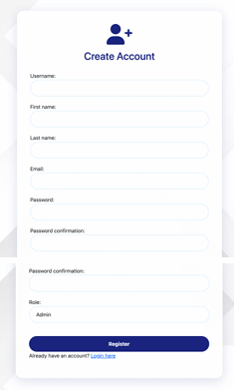
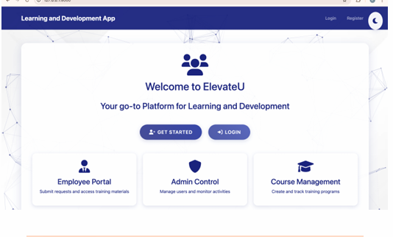
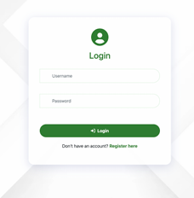


Slide 4
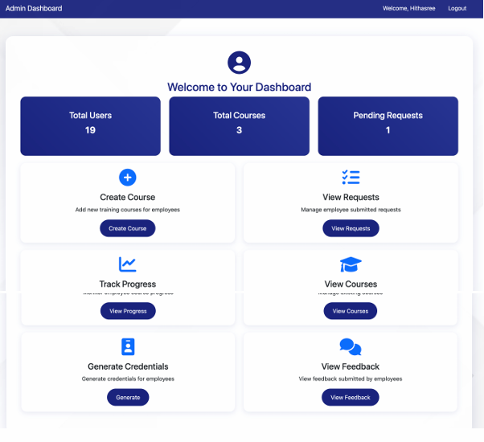


Slide 5
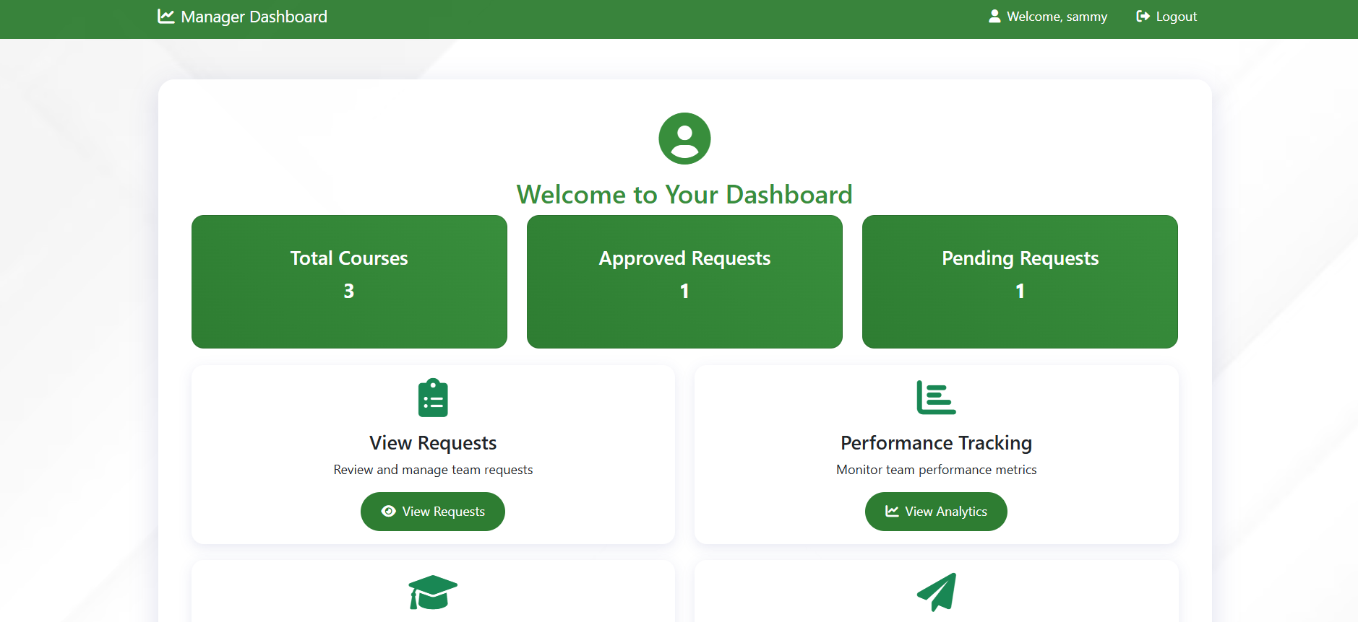
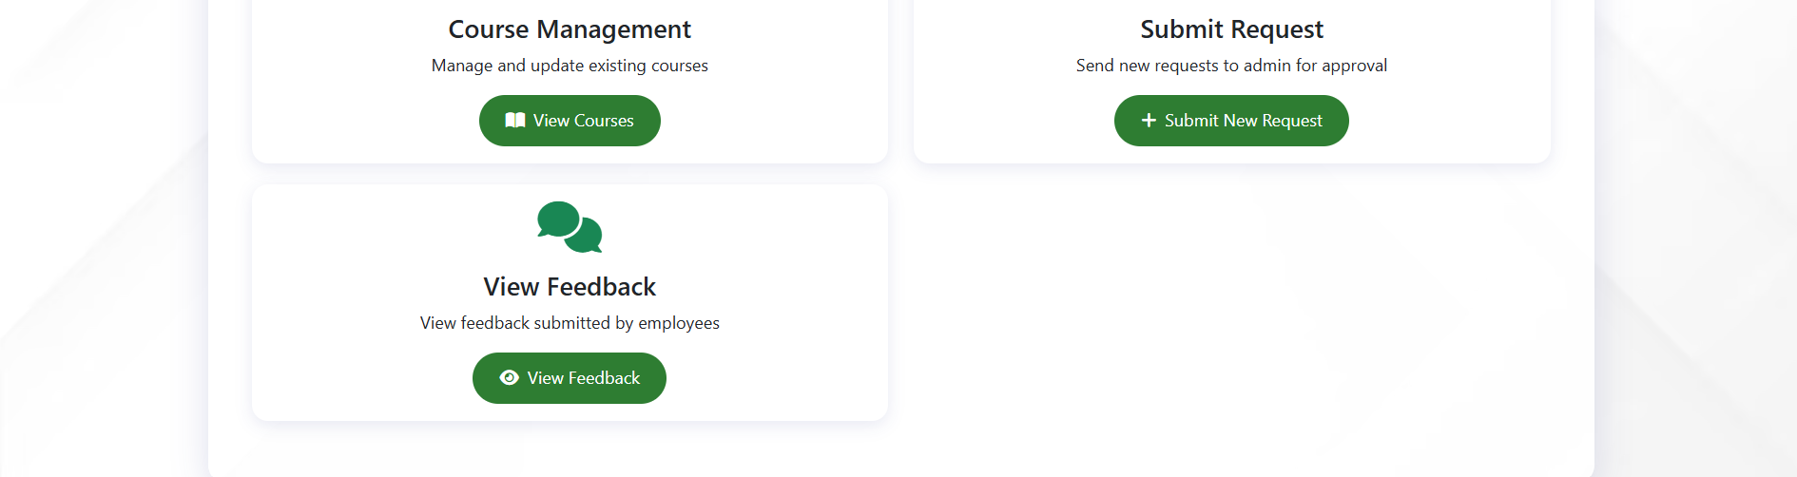


Slide 6
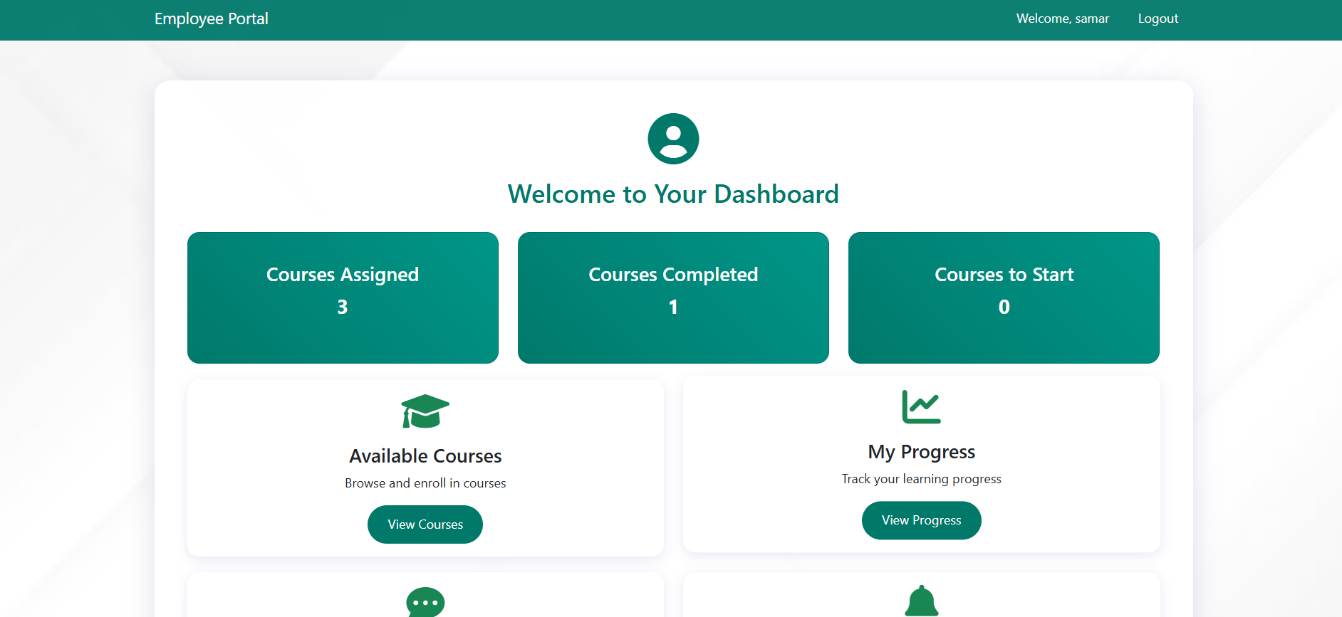



Slide 7

MILESTONE 1
MODULE 2: Training Request and Management
Description:
Account managers can submit training requests, and admins review, approve, and create training programs based on the requests.

Slide 8
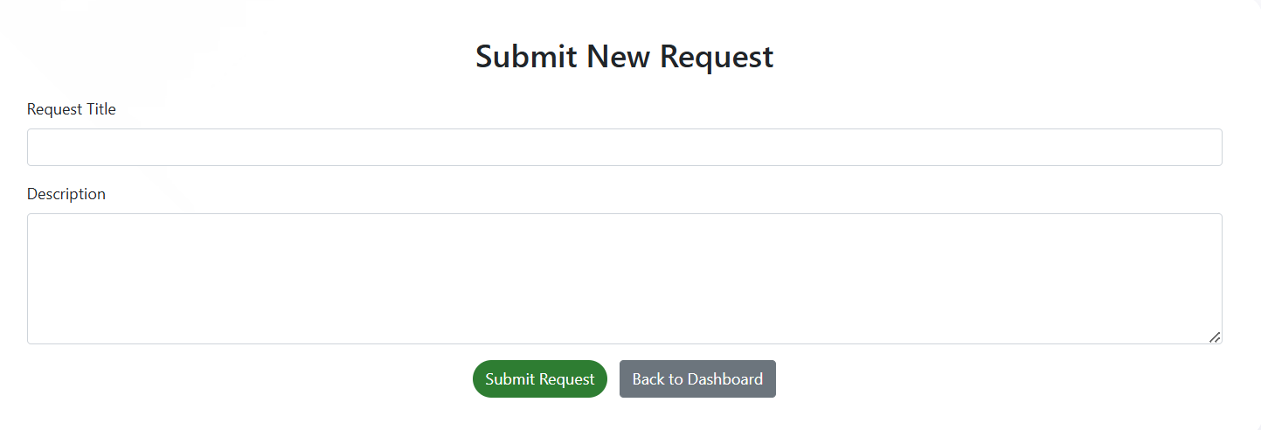
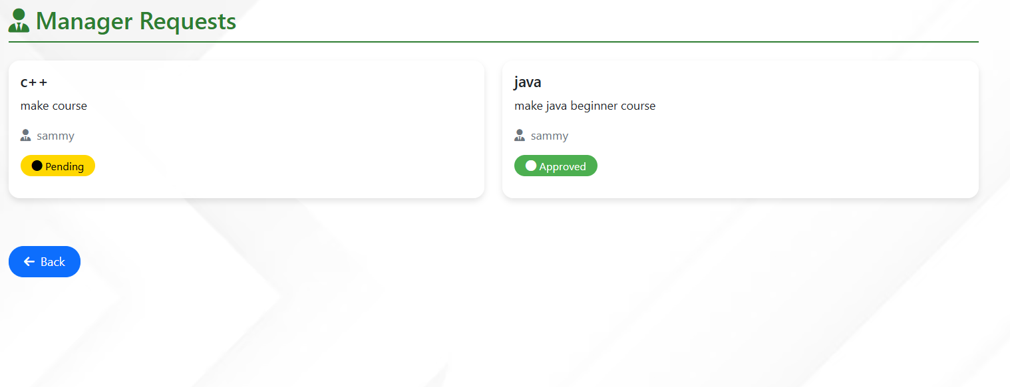


Slide 9
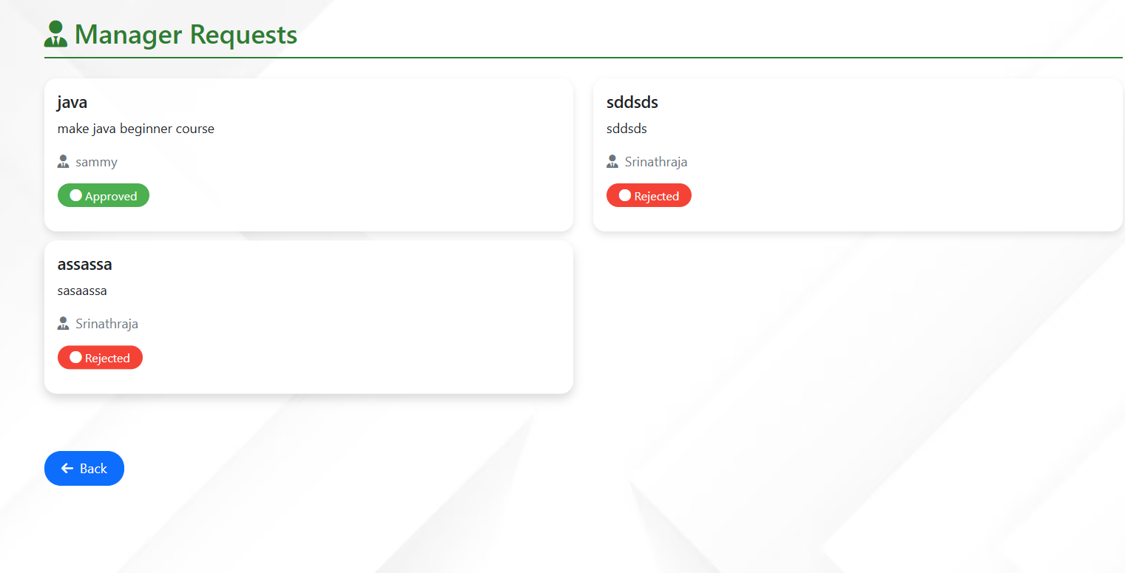


Slide 10
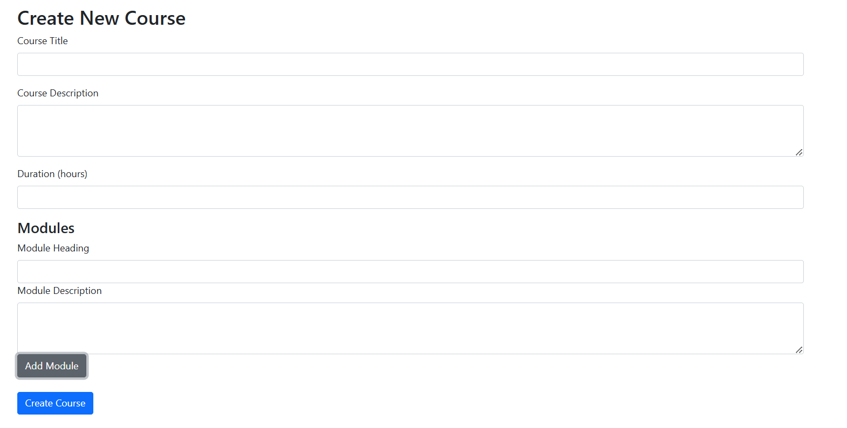


Slide 11
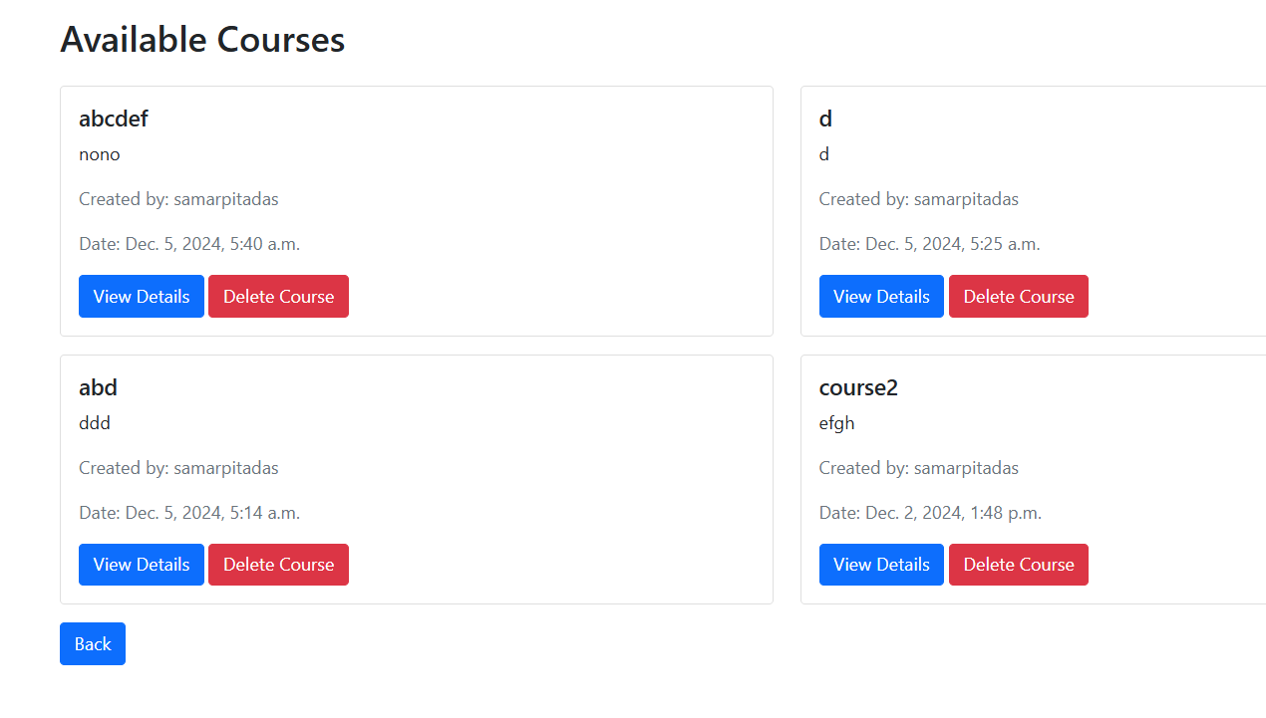


Slide 12
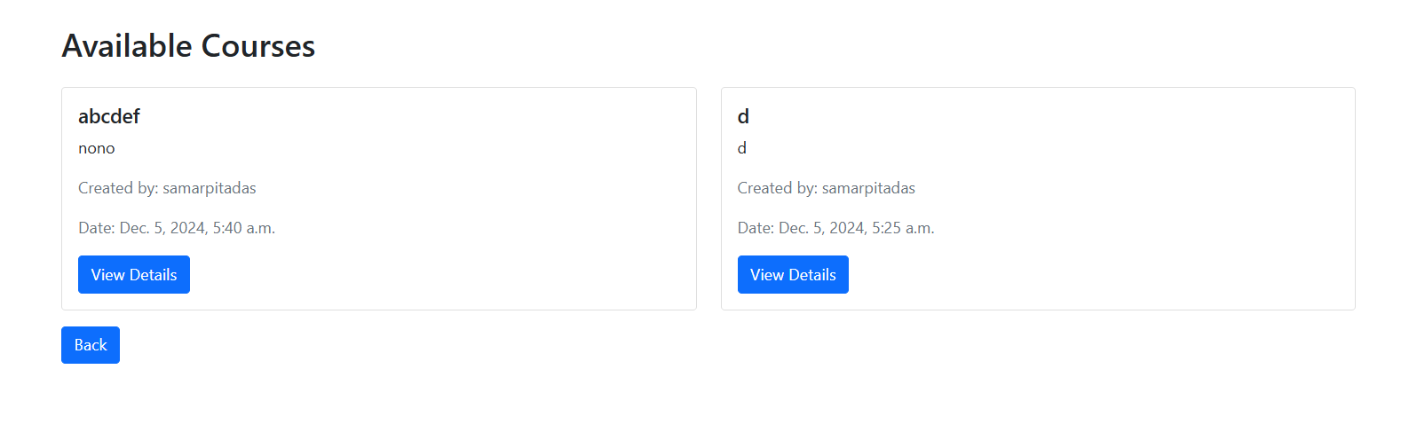


Slide 13
My Contributions
Milestone 1
Setting up the environment and maintaining GitHub repository
Home Page frontend

Slide 14

MILESTONE 2
MODULE 3: Course Creation and Assignment
Description:
Admins create courses based on approved requests, generate employee credentials, and assign courses.

Slide 15
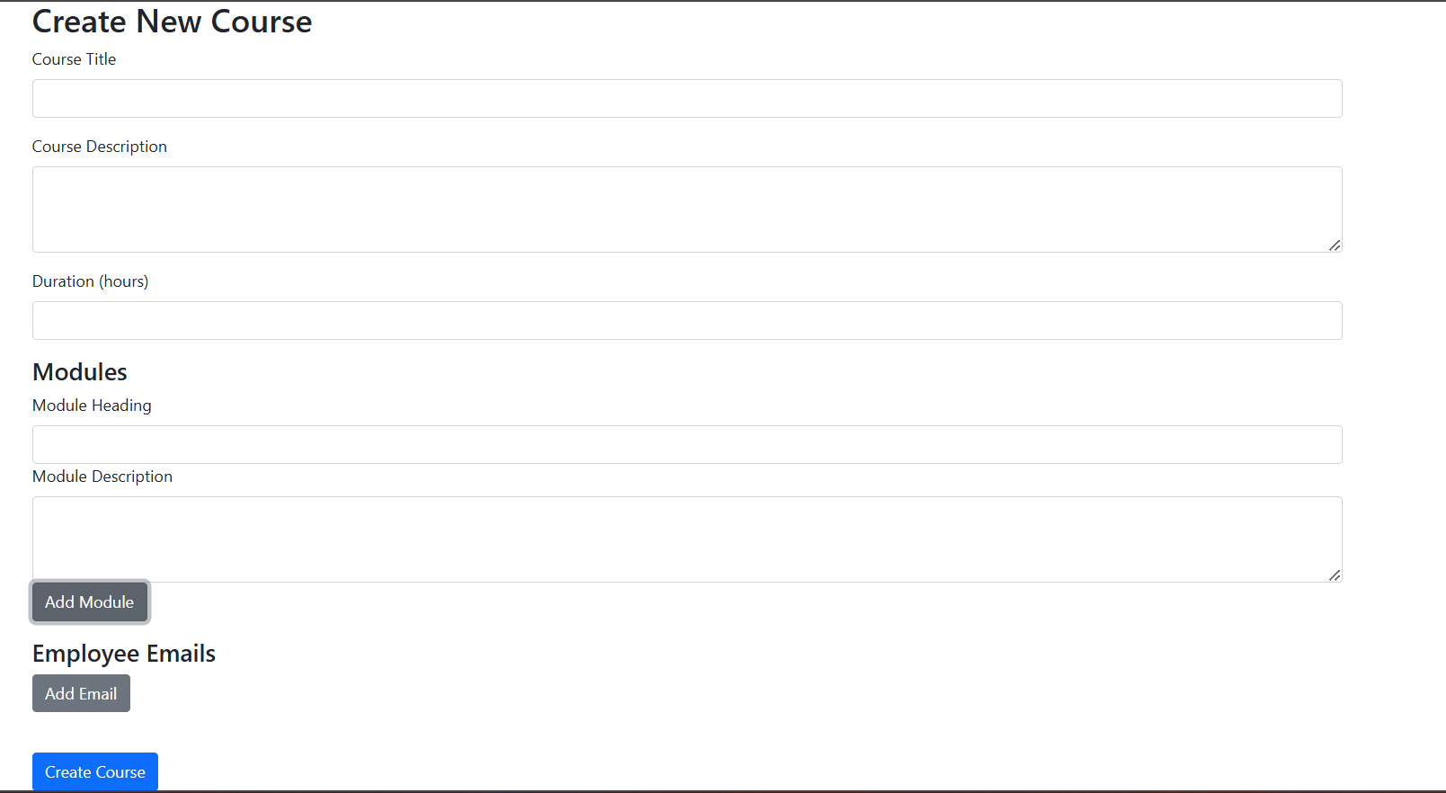


Slide 16
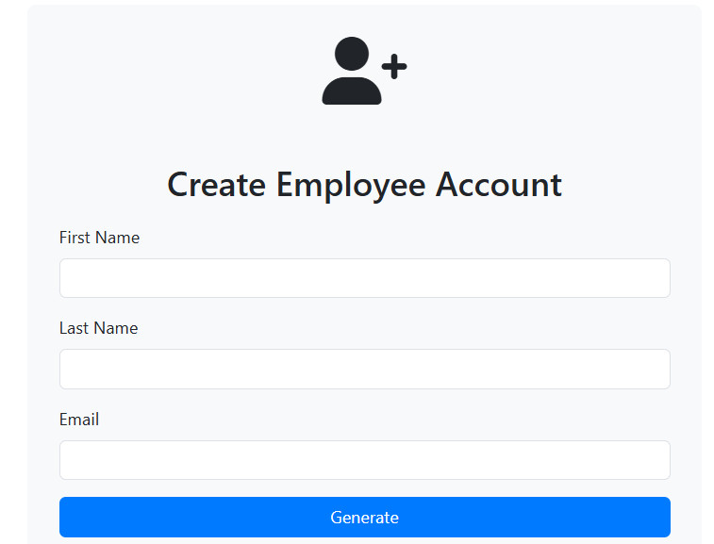


Slide 17
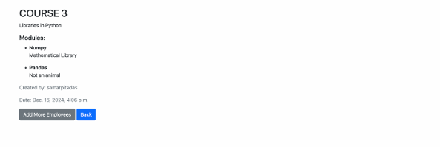


Slide 18



Slide 19

MILESTONE 2
MODULE 4: Employee Progress Tracking
Description:
Admins can track the progress of employees in their assigned courses.

Slide 20
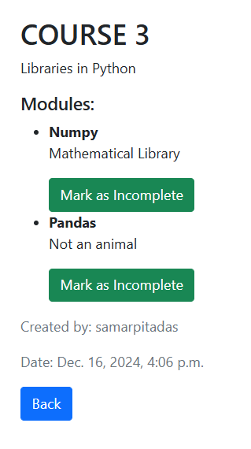
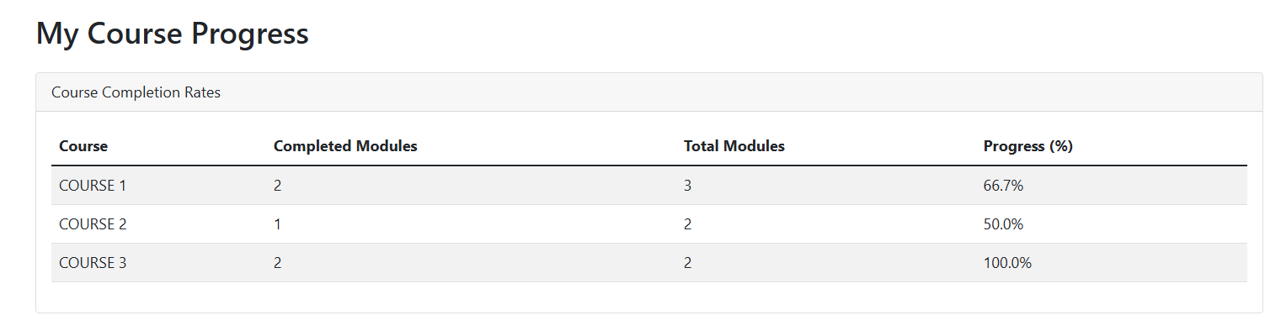

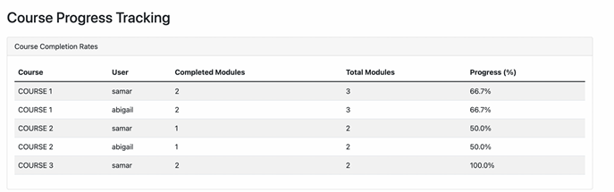


Slide 21
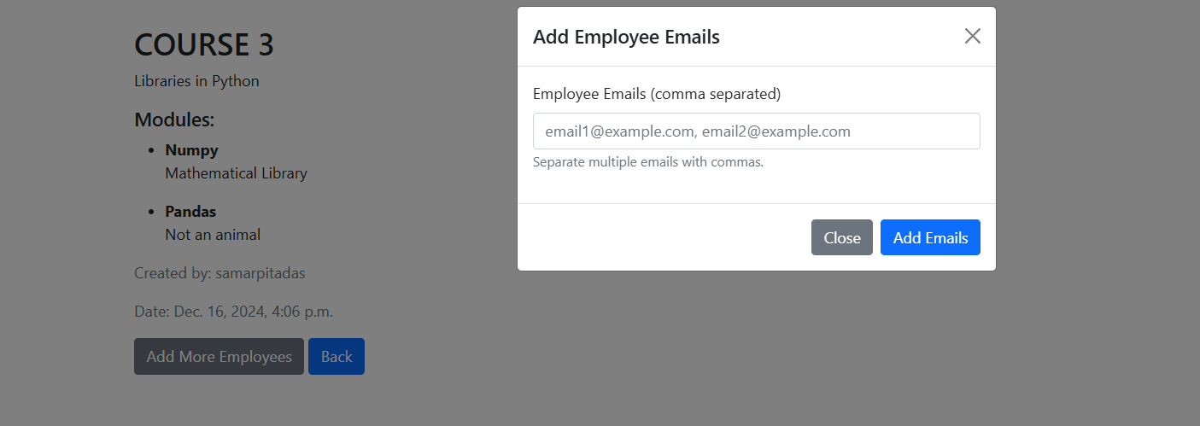


Slide 22
My Contributions
Milestone 2
Facilitated assigning of courses to employees
Enabled addition of modules
Made course details page
Tracked progress of employees (personal and overall)

Slide 23

MILESTONE 3
MODULE 5: Feedback Collection and Reporting
Description:
Employees provide feedback after completing each course, and admins analyze it to improve course content and structure.

Slide 24
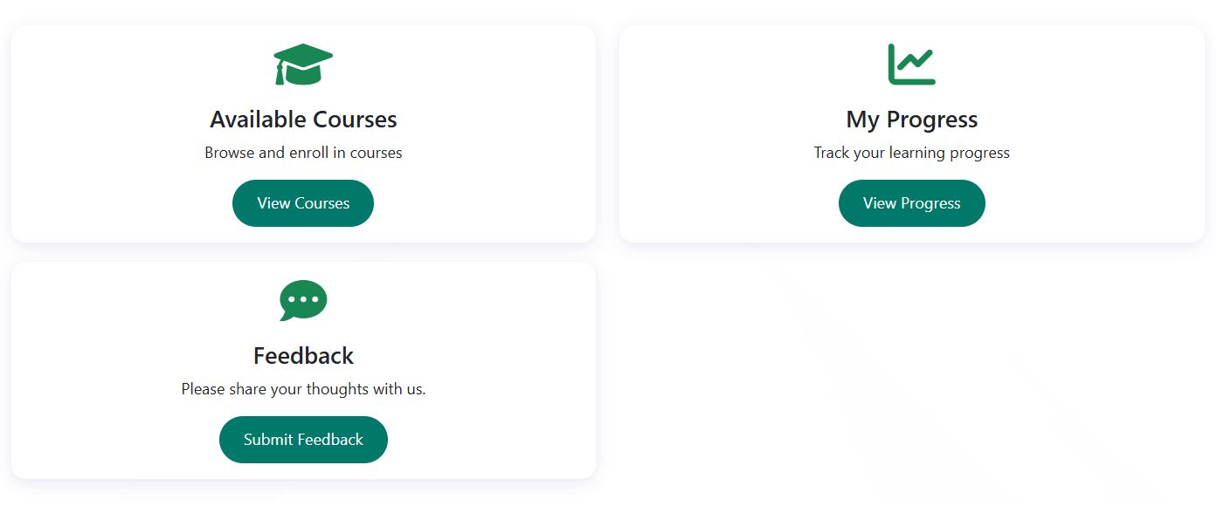
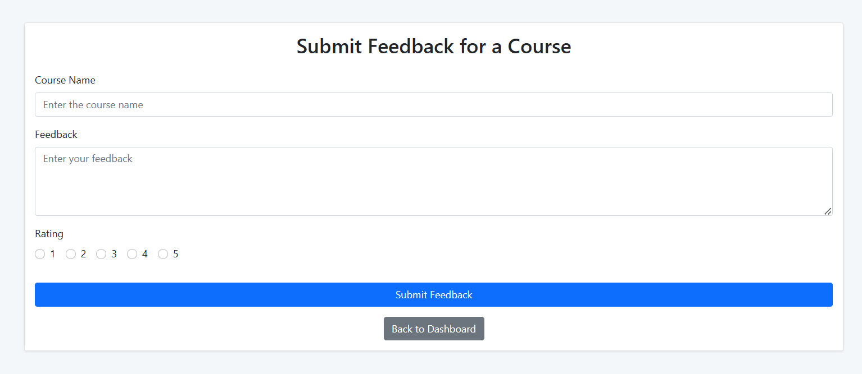


Slide 25
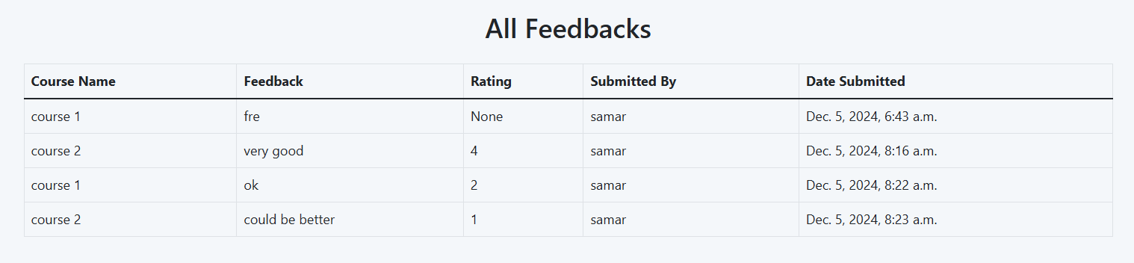
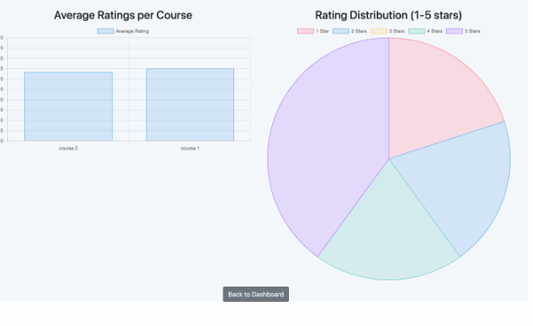


Slide 26

MILESTONE 3
MODULE 6: Dashboard Overview and Reporting
Description:
A central dashboard provides a snapshot of course statistics and employee progress, offering high level reporting..

Slide 27
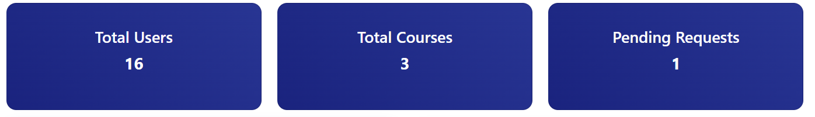
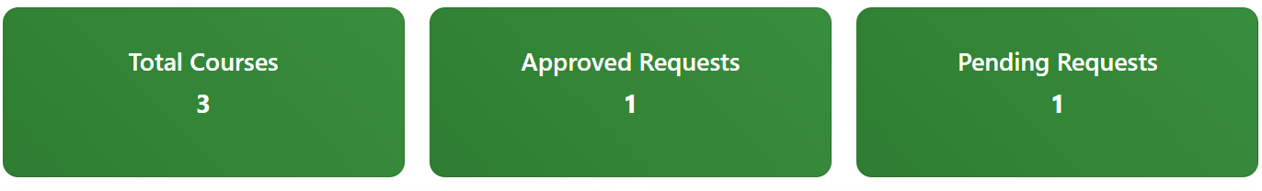
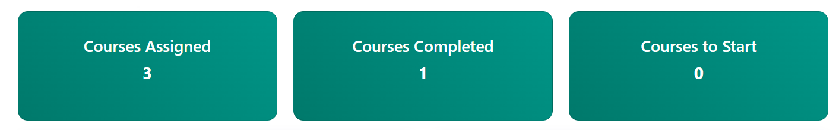


Slide 28
My Contributions
Milestone 3
Added feedback form
Added statistics to analyze ratings from feedback
Implemented dashboard statistics

Slide 29

MILESTONE 4
MODULE 7: Notification System
Description:
Sends automated notifications for course assignments, deadlines, and feedback submission reminders to employees.

Slide 30
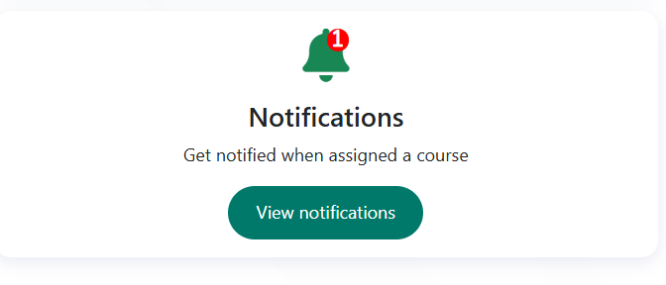
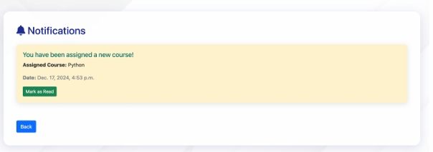


Slide 31

MILESTONE 4
MODULE 8: Course Progress Analytics
Description:
Provides analytics on employee performance across courses, allowing admins to monitorand adjust training effectiveness.

Slide 32
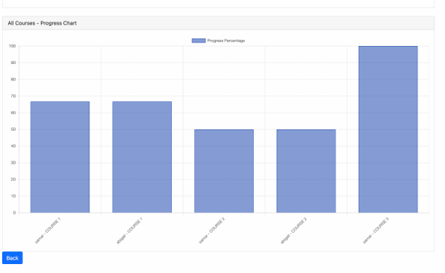


Slide 33
My Contributions
Milestone 4
Added notifications when course is assigned
Added mark as read feature to keep track of new notifications
Implemented tracking progress statistics

