Slide 1
MACHINE LEARNING | CONSULTING
Optimizing Delivery ETAs
with Graph-Based Network Intelligence
Data Science Consulting Project — Delhivery Logistics
Graph Construction • Bottleneck Audit • ETA Prediction • FTL vs Carting Framework
Hitesh Chandra • Kartik Khemani • Samarth Sharma | ABV — IIITM Gwalior
144,867
1,657
4.96%
Trip Records
Logistics Hubs
MAE Improvement
June 2026

Slide 2
The Challenge
⚠
OSRM Underestimates
THE ETA GAP
Assumes clean traffic & shortest paths — ignores real-world congestion and dwell time
OSRM Predicts
SLA Breaches
4.2 hrs
📦
When ETA is wrong, SLAs are missed and customers are dissatisfied
Actual Time
No Network View
6.1 hrs
🔗
No systematic way to identify which hubs and corridors cause the most delays
The Gap
Route Decisions
+1.9 hrs
🚛
FTL vs Carting decisions made without considering graph position or structural risk

Slide 3
Our Approach
Treating the logistics network as a connected graph — not independent point-to-point estimates
1
2
3
4
5
Graph Construction
Bottleneck Audit
Graph-Enhanced ETA
FTL vs Carting
Strategy Memo
Facilities as nodes
Corridors as edges
Edge weight = delay ratio
Betweenness centrality
PageRank & clustering
Top 5 chokepoints
Baseline XGBoost
vs Graph-Enhanced
4.96% MAE improvement
ML-backed framework
Distance buckets
Route-type decisions
Top 5 hubs identified
Revenue impact quantified
Actionable interventions
Final Output: A consulting deliverable — a strategy memo a real operations leader could act on

Slide 4
Dataset at a Glance
📊
🏭
⚙
🧠
144,867
1,657
25
56
Trip Records
Logistics Hubs
Raw Features
Model Features
Key Columns Used
Train / Test Split
Column | What it represents
actual_time | Ground truth delivery time (target)
osrm_time | Baseline OSRM predicted time
delay_ratio | actual / osrm — >1.2 means delayed
source / destination center | Hub identifiers (nodes in graph)
route_type | FTL or Carting
segment_factor / factor | Delay multipliers per segment
Using built-in data column
(not random split)
TRAIN
104,858
TEST
40,009
72% training | 28% test

Slide 5
Graph Construction
Modeling the entire logistics network as a directed weighted graph
Nodes
Graph Metrics Computed
1,657 facilities
Betweenness Centrality
Which hubs sit on the most paths?
High = chokepoint
Edges
Shipment corridors
PageRank
How important / influential is the hub?
High = critical hub
Edge Weight
Median delay ratio/corridor
Degree Centrality
How well connected is the hub?
In-degree + out-degree
Direction
Clustering Coefficient
Source → Destination
Is the hub in a tight local cluster?
Low = isolated, fragile
🟢 On-time 🟡 Delayed >20% 🔴 Severely delayed >50%

Slide 6
Top 5 Bottleneck Hubs
Ranked by betweenness centrality — with SLA breach contribution
Hub ID | Betweenness | SLA Breach% | Risk Level | Recommendation
IND000000ACB | 0.189 | 97.0% | 🔴 Critical | Capacity upgrade
IND562132AAA | 0.111 | 97.1% | 🟠 High | Congestion monitoring
IND501359AAE | 0.080 | 97.5% | 🟠 High | Alternate routing
IND712311AAA | 0.063 | 99.7% | 🟡 Medium | Resource allocation
IND421302AAG | 0.055 | 99.4% | 🟡 Medium | Backup route planning
💡 Key Insight
All top 5 hubs show >97% SLA breach rates — confirming these are the highest-priority facilities for intervention. IND712311AAA at 99.7% is the worst performer despite lower betweenness.

Slide 7
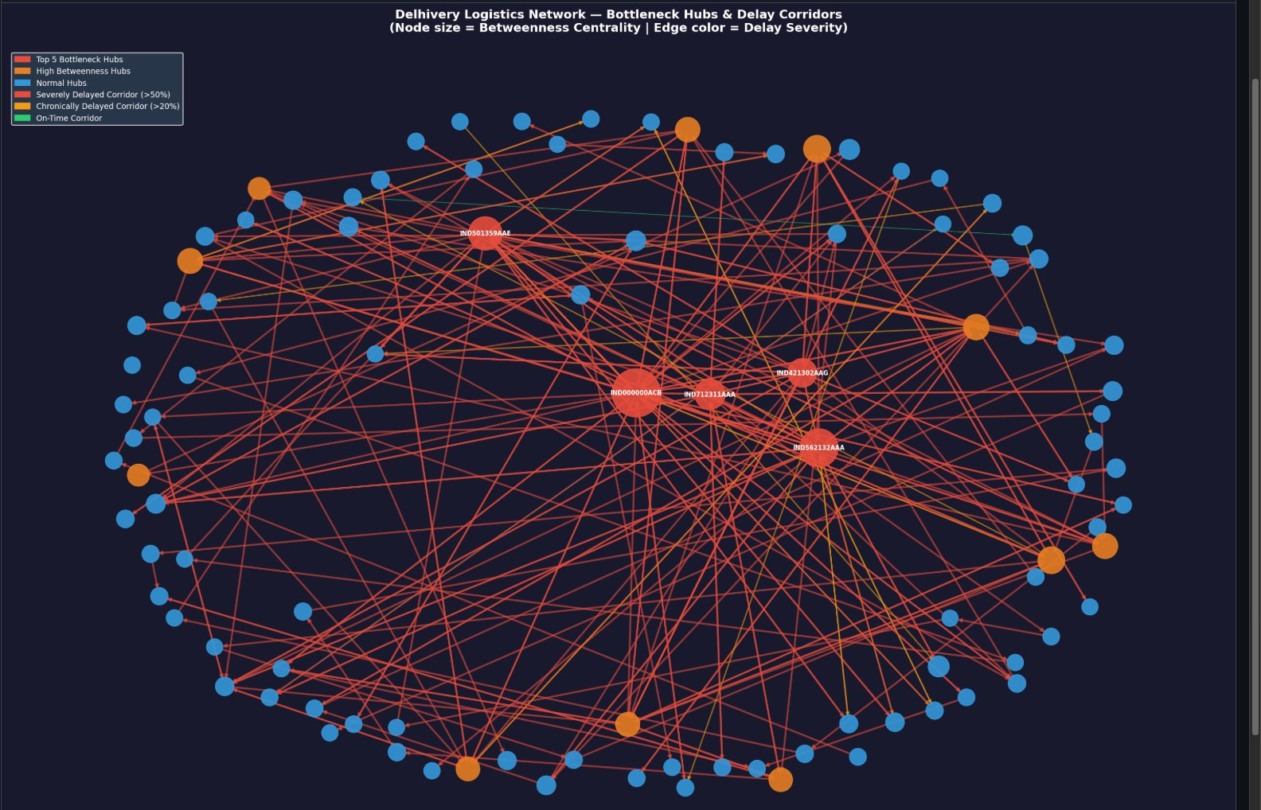
Logistics Network — Bottleneck Hubs & Delay Corridors
Node size = Betweenness Centrality | Edge color = Delay Severity
Top 5 Bottleneck Hubs
High Betweenness Hubs
Normal Hubs
Severely Delayed >50%
Chronically Delayed >20%
On-Time Corridor
💡 IND000000ACB sits at the center — largest node, most red corridors radiating from it. Highest priority for intervention.

Slide 8
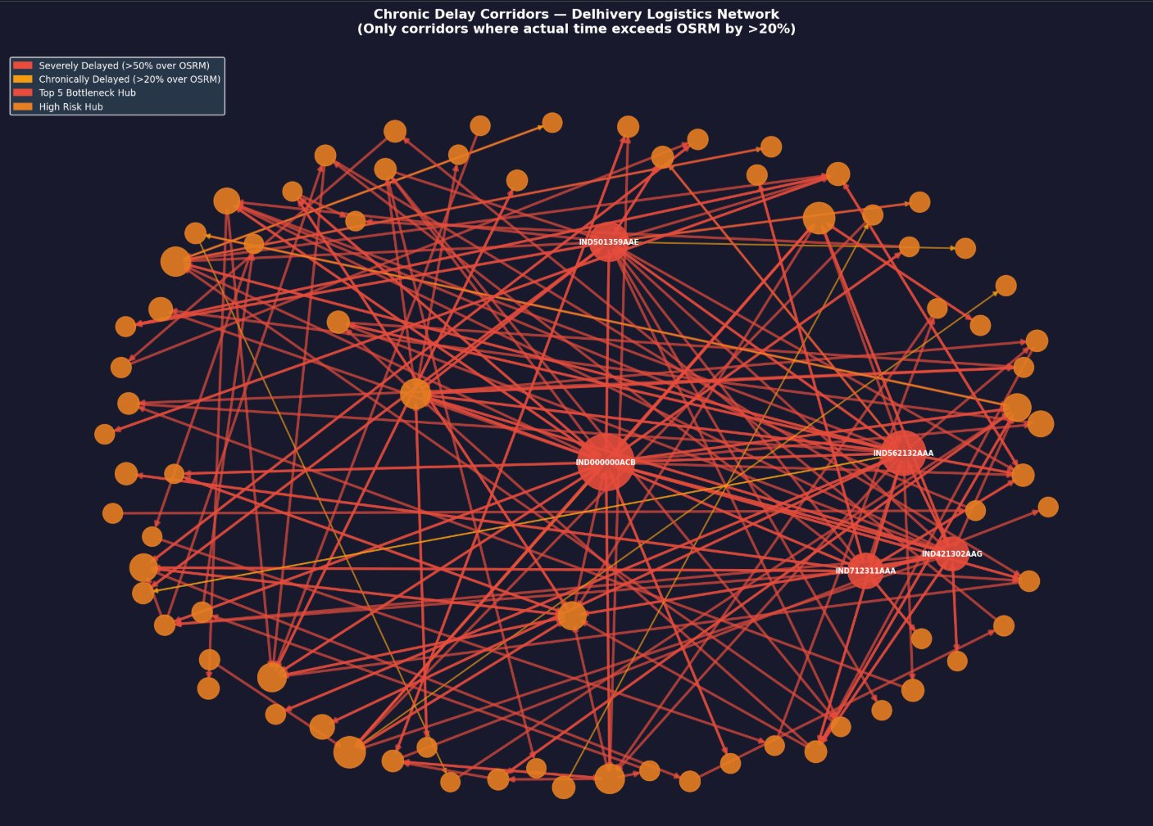
Chronic Delay Corridors
Only corridors where actual delivery time exceeds OSRM prediction by >20%
>20%
Delay threshold for flagging
>50%
Severely delayed corridors (red)
31.8x
Worst corridor delay ratio
⚠ Almost ALL corridors are chronically delayed — structural congestion is systemic, not isolated to a few routes.

Slide 9
Top Chronic Delay Corridors
Corridors ranked by median delay ratio — actual time vs OSRM prediction
# | Source Hub | Destination Hub | Delay Ratio | Risk Level
1 | IND212402AAA | IND211002AAB | 31.8x | 🔴 Critical
2 | IND785634AAA | IND785001AAA | 31.2x | 🔴 Critical
3 | IND208012AAA | IND209304AAA | 27.2x | 🔴 Critical
4 | IND416606AAA | IND416510AAA | 26.9x | 🟠 Severe
5 | IND842003AAB | IND482002AAA | 23.2x | 🟠 Severe
6 | IND424304AAC | IND424006AAA | 22.3x | 🟠 Severe
7 | IND425405AAA | IND424006AAA | 21.9x | 🟡 High
Worst Corridor
31.8x
delay ratio
Meaning
31.8x = actual time is 31x longer than OSRM predicted
Recommendation: These corridors require immediate investigation — a 31x delay ratio suggests operational failures beyond normal congestion.

Slide 10
ETA Model — Baseline vs Graph-Enhanced
Does graph intelligence improve predictions?
Baseline
Our Baseline
Graph Model
OSRM Raw
Baseline XGBoost
Graph-Enhanced
MAE
MAE
MAE
212.55 mins
7.26 mins
6.90 mins
% within 15%
% within 15%
% within 15%
N/A
98.82%
98.77%
📈 Graph Advantage
📊 Near-Ceiling Baseline
4.96% MAE reduction — graph structure adds measurable predictive value
Baseline achieves 98.82% within 15% — minimal room to improve this metric

Slide 11
Revenue Impact — Fixing Top 3 Hubs
Quantifying the business case for targeted hub interventions
39.9%
96.7%
40.8%
of all trips pass
through top 3 hubs
of those trips
are currently delayed
reduction in late
deliveries if hubs fixed
Recommended Interventions
Hub | Betweenness | Action | Expected Impact
IND000000ACB | 0.189 | Capacity upgrade | Highest ROI — reduces cascade delays
IND562132AAA | 0.111 | Congestion monitoring | Reduce delay propagation
IND501359AAE | 0.080 | Alternate routing | Improved ETA stability

Slide 12
Operational Recommendations
What operations should do — and when
IMMEDIATE
SHORT TERM
LONG TERM
0–1 Month
1–3 Months
3–6 Months
1
Deploy graph-enhanced ETA model to replace OSRM predictions
1
Upgrade IND000000ACB with capacity expansion
1
Build real-time Streamlit delay dashboard
2
Implement FTL decision framework on high-risk corridors
2
Add alternate routing for IND501359AAE
2
Integrate weather & traffic data into model
3
Set up daily monitoring alerts for top 5 bottleneck hubs
3
Review all Carting operations on 100–600 km corridors
3
Explore GraphSAGE for further MAE improvements

Slide 13
Limitations & Future Work
⚠ Limitations
🚀 Future Work
• No revenue/penalty data for exact ROI calculation
→ GraphSAGE / GAT neural networks for deeper graph learning
• 174 hubs missing from graph — filled with median values
→ Real-time Streamlit dashboard with live delay risk scores
• Real-time traffic, weather not incorporated
→ Weather & seasonality integration
• node2vec embeddings not explored
→ Expand graph to cover all 1,657 hubs fully
• RMSE shows no improvement (MAE is the correct metric per spec)
→ node2vec embeddings for richer hub representations

Slide 14
Key Takeaways
1
Graph Works
2
Top 5 Hubs Identified
4.96% MAE improvement proves graph structure adds real predictive value beyond trip-level features
IND000000ACB leads with betweenness 0.189 — fix this first for highest network-wide impact
3
FTL Wins Every Time
4
Deploy Immediately
FTL outperforms Carting across ALL distance ranges — shift high-priority shipments now
Graph-enhanced model + FTL framework ready for deployment — no further development needed
This project delivers both improved ETA predictions and actionable operational intelligence for Delhivery's logistics decision makers.

Slide 15
Thank You
Optimizing Delivery ETAs with Graph-Based Network Intelligence
Graph Construction
Bottleneck Audit
ETA Prediction
FTL vs Carting
Strategy Memo
June 2026 • ABV — IIITM Gwalior

