Slide 1
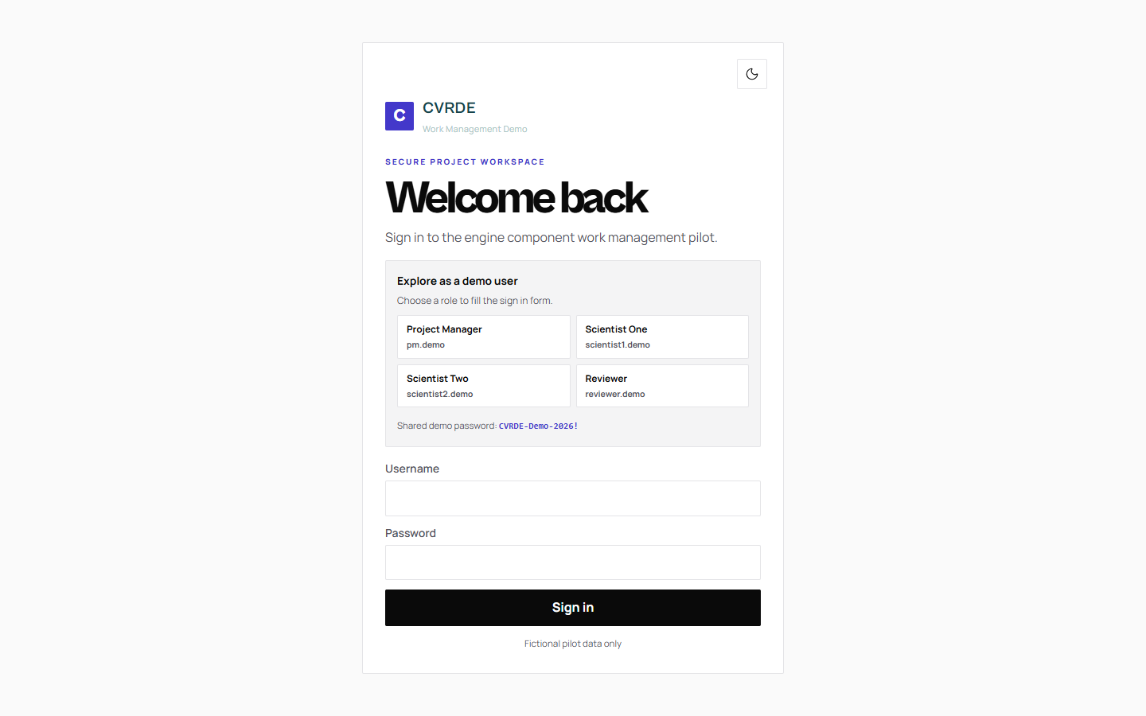
PILOT DEMONSTRATION
CVRDE Work Management
IN THIS VIEW
Four fictional accounts cover the PM, two scientists, and reviewer.
The login page includes the public demo password.
One Vercel project hosts the interface and API.
FICTIONAL DATA / OCT 2026
01 / 08

Slide 2
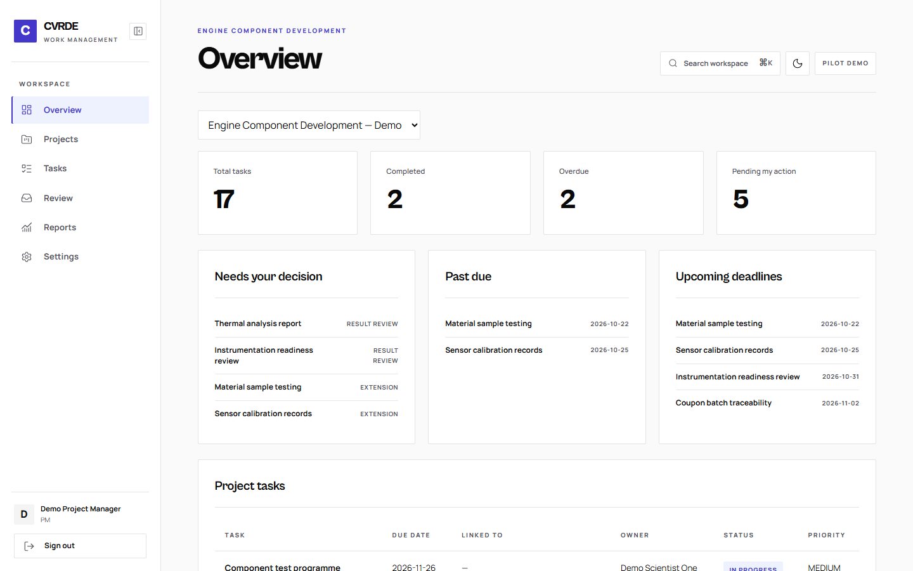
PROJECT MANAGER
Project overview
IN THIS VIEW
Dashboard totals come from current task and approval data.
Seventeen seeded tasks cover varied owners and deadlines.
Decision and overdue lists lead to the underlying work.
FICTIONAL DATA / OCT 2026
02 / 08

Slide 3
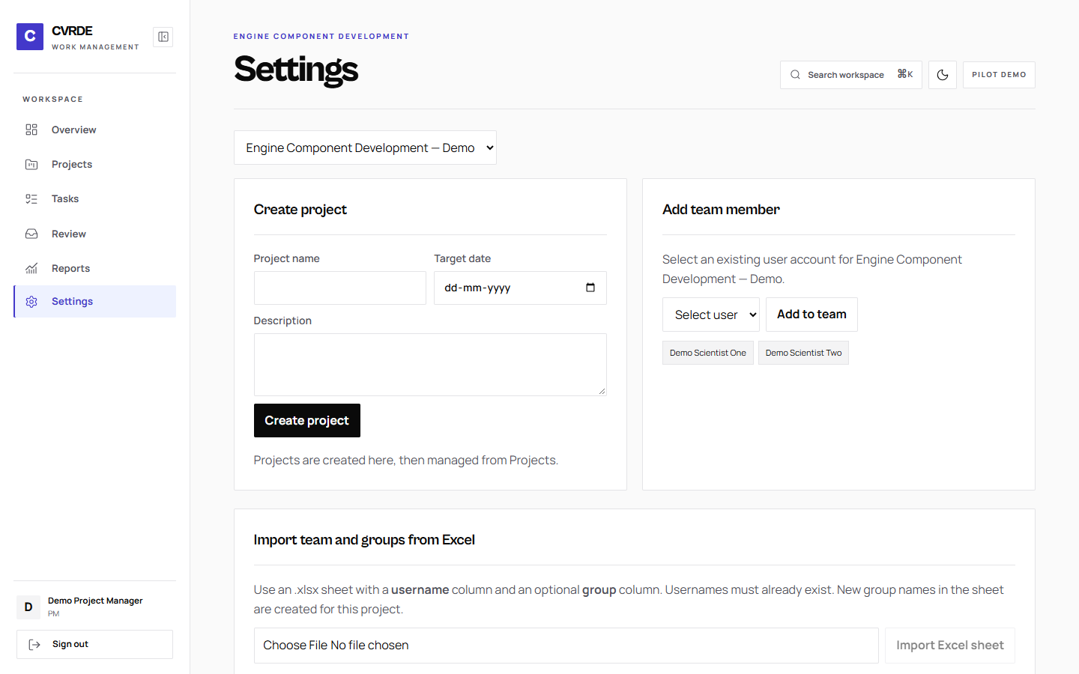
PROJECT MANAGER SETTINGS
Project setup and groups
IN THIS VIEW
Create projects and add existing team members.
Add groups manually or import an Excel sheet.
Group permissions control shared work.
FICTIONAL DATA / OCT 2026
03 / 08

Slide 4
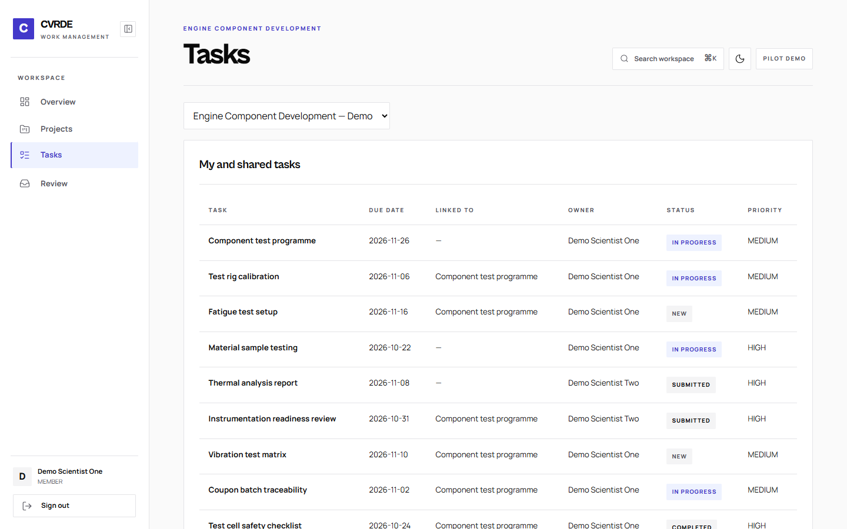
SCIENTIST ONE
Scientist workspace
IN THIS VIEW
The table shows task, due date, and linked work.
Members see owned and permitted shared tasks.
Status and results are updated inside task detail.
FICTIONAL DATA / OCT 2026
04 / 08

Slide 5
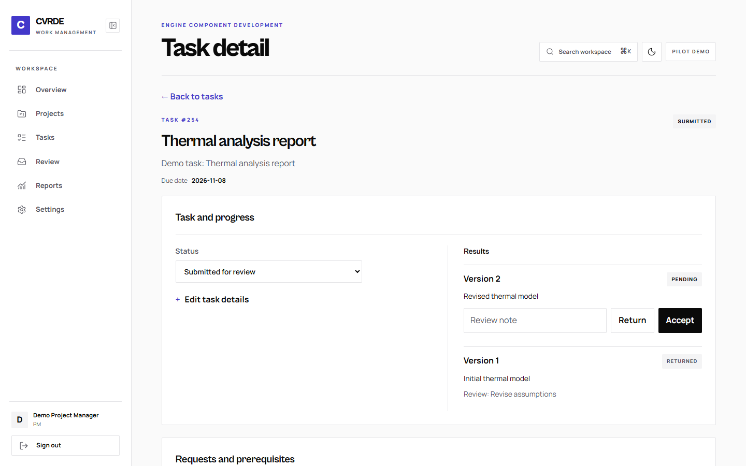
TASK DETAIL
Results and evidence
IN THIS VIEW
Status changes through a dropdown.
A single description submits each result version.
Prerequisites and reassignment live in task detail.
FICTIONAL DATA / OCT 2026
05 / 08

Slide 6
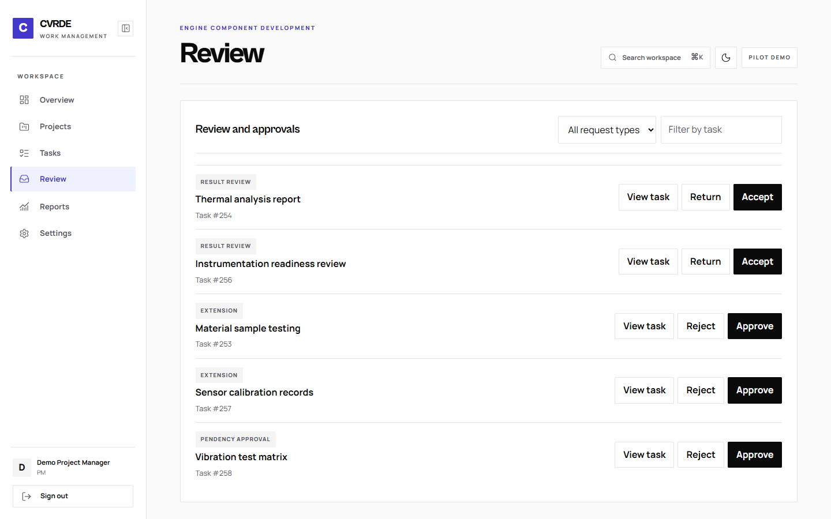
PROJECT MANAGER
Review and approvals
IN THIS VIEW
Filter decisions by request type and task.
Managers decide employee reassignment requests.
Results, extensions, and prerequisites share one queue.
FICTIONAL DATA / OCT 2026
06 / 08

Slide 7
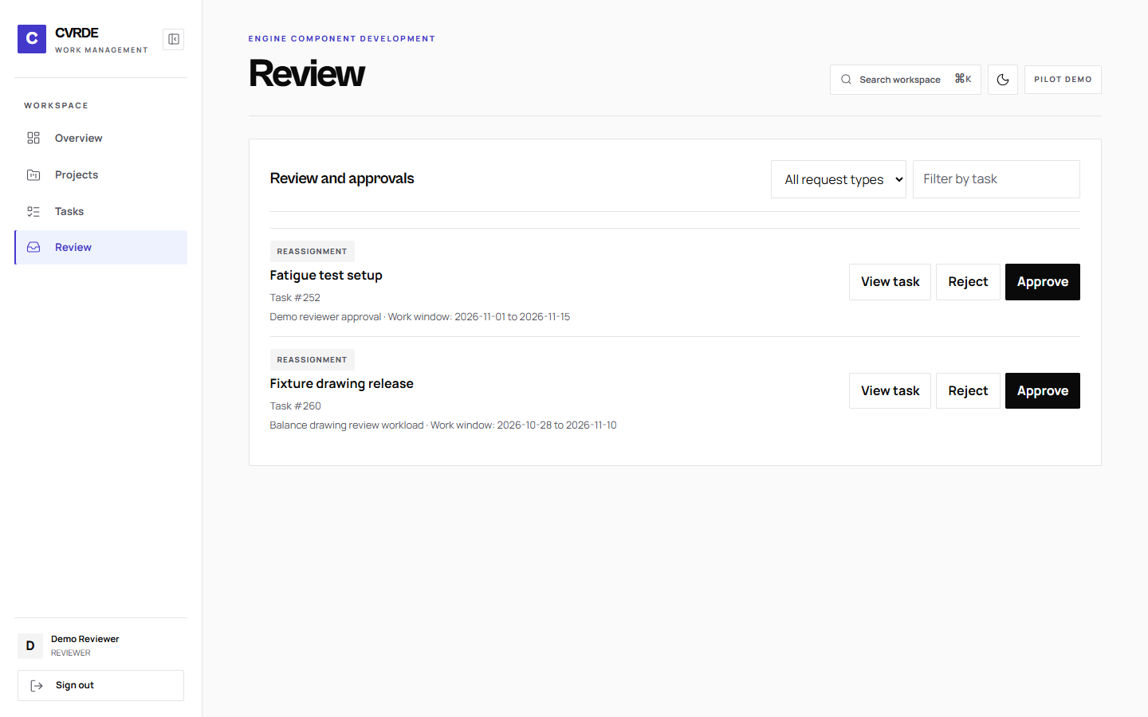
REVIEWER
Independent reviewer
IN THIS VIEW
A PM reassignment request reaches the reviewer.
The reason and work window are visible before a decision.
Approval changes ownership; rejection retains it.
FICTIONAL DATA / OCT 2026
07 / 08

Slide 8
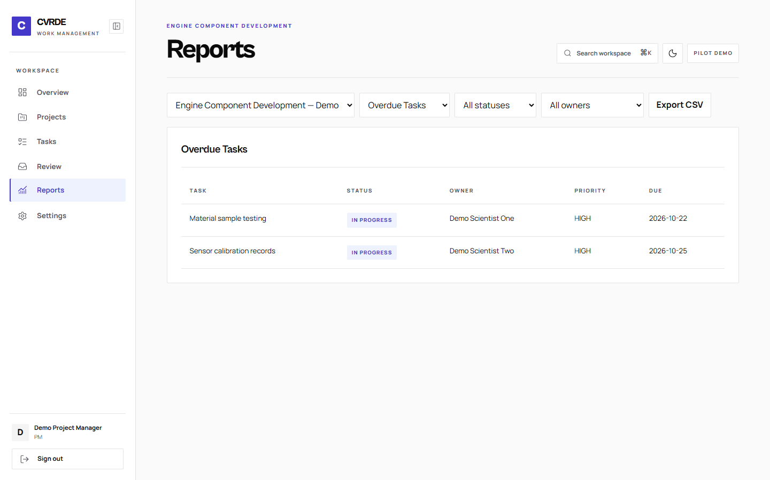
PROJECT MANAGER
Reports and pilot readiness
IN THIS VIEW
Overdue Tasks and Project Progress offer CSV export.
The HTTPS demo runs on biztel-ai-cvrde.vercel.app.
SMTP delivery requires controlled inboxes and settings.
FICTIONAL DATA / OCT 2026
08 / 08

