Slide 1
PRDA – 04 | DATA ANALYST PROJECT
Customer Data Analysis
Shopping behavior across 10 malls in Istanbul (2021–2023), analyzed using Power BI
Prepared by: Samarth Kawade

Slide 2
AGENDA
What this analysis covers
1
Dataset Overview
2
Gender Analysis
Scale of data and key headline metrics
Who shops more, buys more, and spends more
3
Age Group Analysis
4
Category Analysis
Which age segment drives the business
Best and worst performing product categories
5
Payment Method Analysis
6
Key Insights & Recommendations
How customers pay, and where
What the data means for the business
2

Slide 3
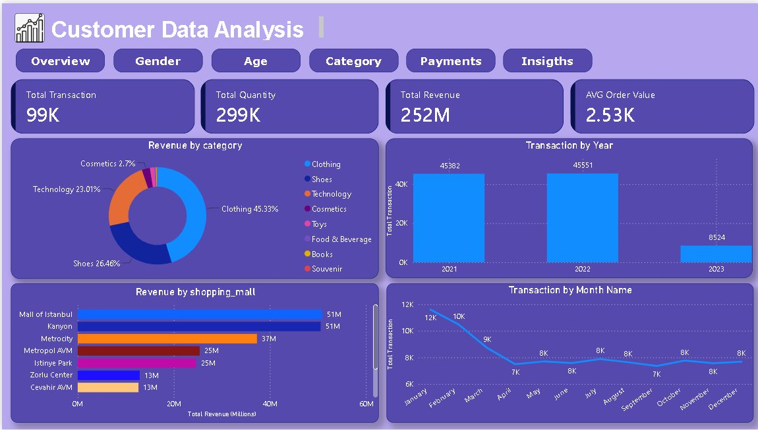
SECTION 1
Dataset Overview
3

Slide 4
SECTION 1
Dataset at a glance
99K
299K
₺252M
₺2.53K
Total Transactions
Total Quantity Sold
Total Revenue
Avg. Order Value
Coverage: 10 shopping malls across Istanbul, transactions recorded from 2021 to 2023 (2023 data spans January–March only).
Fields tracked per transaction
Invoice No. & Customer ID
Gender & Age
Product Category
Quantity & Price
Payment Method
Invoice Date & Shopping Mall
4

Slide 5
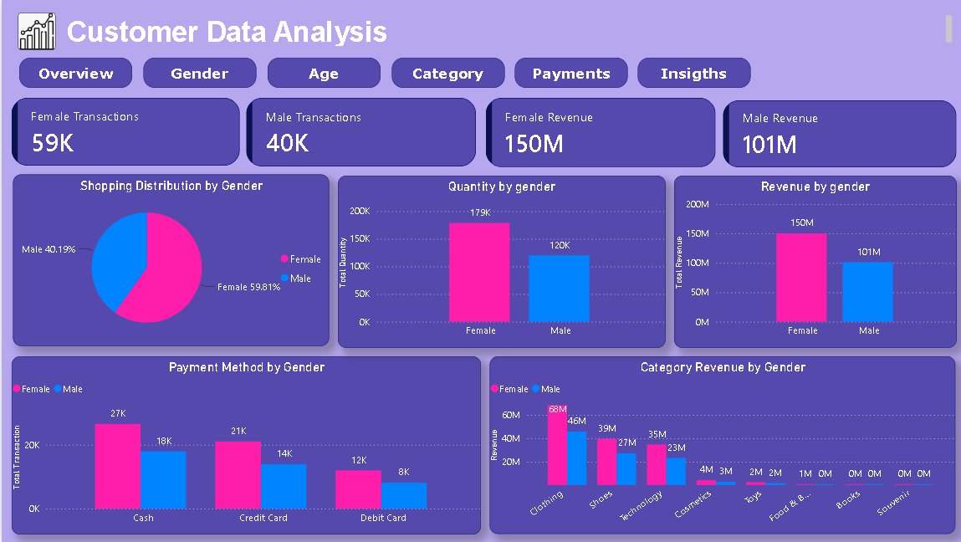
SECTION 2 — GENDER ANALYSIS
Power BI dashboard — Gender view
5

Slide 6
SECTION 2 — GENDER ANALYSIS
What the gender data tells us
59.81%
150M
179K
Female Transactions (59K)
Female Revenue (₺)
Female Quantity Purchased
40.19%
101M
120K
Male Transactions (40K)
Male Revenue (₺)
Male Quantity Purchased
Takeaway
Female customers dominate across every measure — transactions, quantity, and revenue — and lead in every product category and payment method. They generate roughly 60% of total revenue, almost 1.5x the contribution of male customers.
6

Slide 7
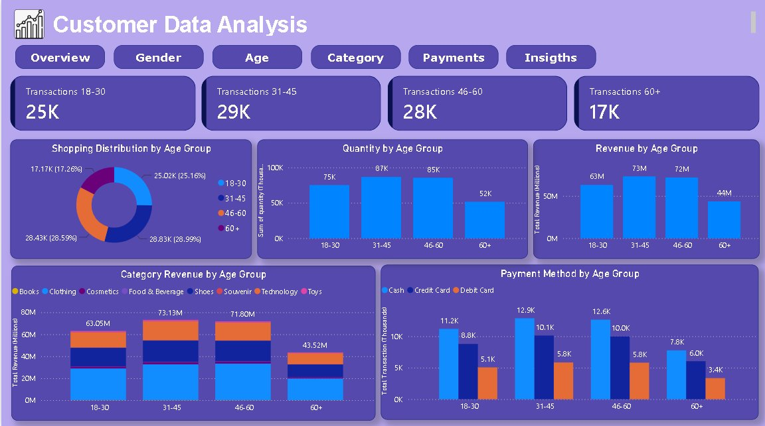
SECTION 3 — AGE GROUP ANALYSIS
Power BI dashboard — Age view
7

Slide 8
SECTION 3 — AGE GROUP ANALYSIS
What the age data tells us
25K
29K
28K
17K
18–30 transactions
31–45 transactions
46–60 transactions
60+ transactions
75K units
87K units
85K units
52K units
₺63M revenue
₺73M revenue
₺72M revenue
₺44M revenue
Takeaway
The 31–45 age group leads on every metric — transactions, quantity, and revenue — closely followed by 46–60. Clothing dominates spend across all age brackets. The 60+ segment trails significantly on every measure, making it the most under-monetized group and the clearest growth opportunity.
8

Slide 9
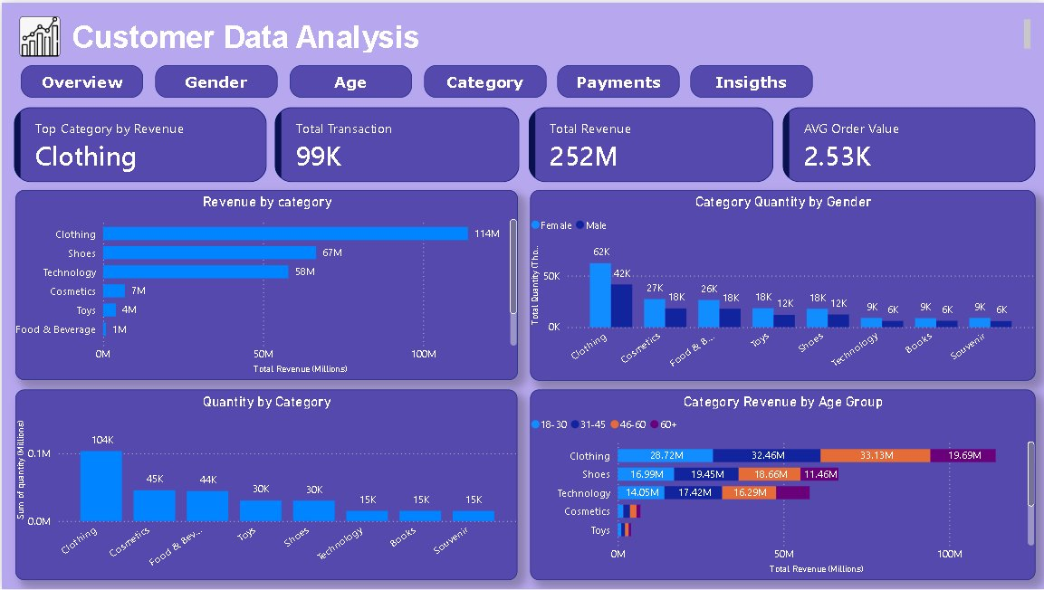
SECTION 4 — CATEGORY ANALYSIS
Power BI dashboard — Category view
9

Slide 10
SECTION 4 — CATEGORY ANALYSIS
What the category data tells us
45.33%
104K
₺58M
of total revenue comes from Clothing (₺114M)
units sold in Clothing — more than 2x any other category
Technology revenue from only 30K units
Takeaway
Clothing dominates both revenue and volume, contributing nearly half of all revenue and over 100K units sold — more than double the next-highest category. Technology stands out differently: despite a relatively low transaction count (30K units), it generates ₺58M in revenue, indicating a much higher average price per unit than any other category. The long tail — Cosmetics, Toys, Food & Beverage, Books, and Souvenirs — contributes only a small fraction of total revenue, with each falling below ₺10M.
10

Slide 11
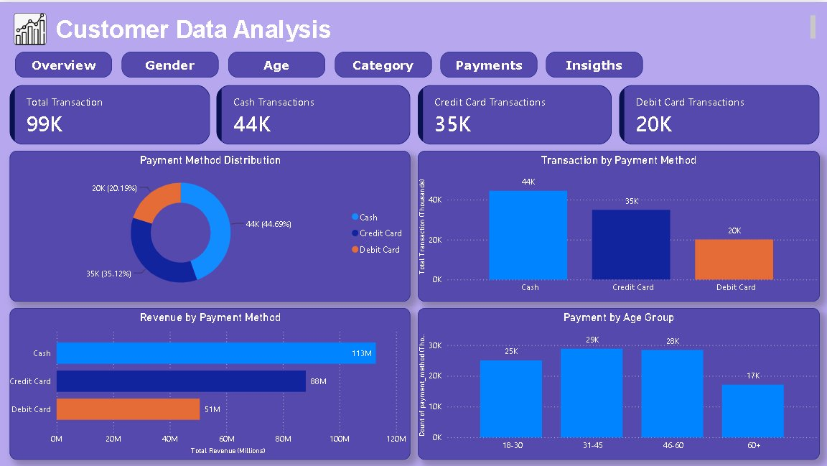
SECTION 5 — PAYMENT METHOD ANALYSIS
Power BI dashboard — Payments view
11

Slide 12
SECTION 5 — PAYMENT METHOD ANALYSIS
What the payment data tells us
44.69%
35.12%
20.19%
Cash (44K transactions / ₺113M)
Credit Card (35K / ₺88M)
Debit Card (20K / ₺51M)
Takeaway
Cash is the most preferred payment method, used in nearly 45% of transactions and generating the highest revenue (₺113M) of the three methods. This pattern holds consistently across every age group and both genders — Cash leads everywhere, followed by Credit Card and then Debit Card. The 60+ age group shows the lowest usage across all three payment types, reflecting its lower overall transaction volume rather than a distinct payment preference.
12

Slide 13
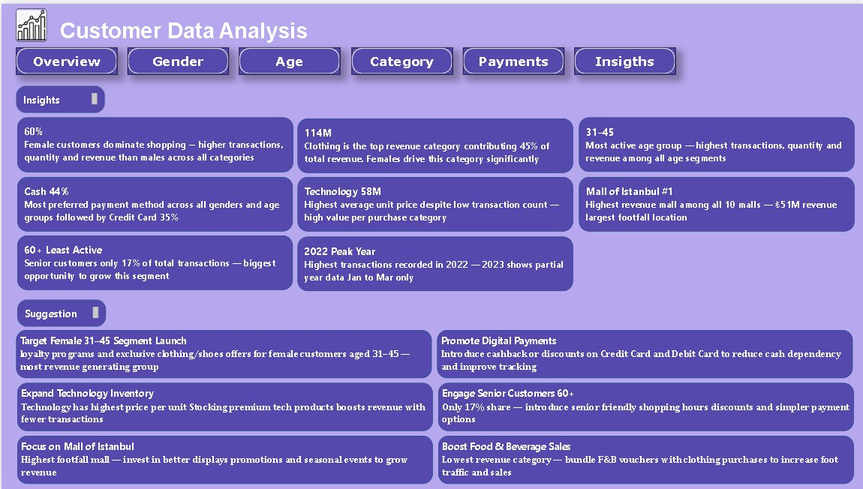
SECTION 6
Power BI dashboard — Insights & Suggestions
13

Slide 14
SECTION 6
Key Insights
60%
45%
31–45
Female customers lead across all dimensions — 60% of transactions, revenue & quantity — and outspend males in every category including Technology (₺35M vs ₺23M)
Clothing dominates across all genders and age groups — females drive ₺68M, and 31–45 segment alone contributes ₺33M; it is a universal demand driver, not a niche preference
31–45 and 46–60 segments together account for 57% of transactions and 58% of revenue — the mid-life demographic is the commercial backbone of all 10 malls
44%
₺58M
17%
Cash dominates uniformly — it leads across every age group and gender, signalling a structural habit; shifting 20% of this to card would unlock ₺22M+ in traceable digital transactions
Technology earns ~4x revenue per unit vs Clothing; a 10% volume increase would add ~₺5.8M — the highest-return expansion opportunity per incremental transaction
60+ segment is 40% below peak-age spend; low payment activity across all 3 methods confirms infrequent visits (not low spend-per-visit) as the core gap — a 20% visit increase = ~₺8.8M additional revenue
14

Slide 15
SECTION 6
Recommendations to the Company
1
Target Female 31–45 Segment
2
Promote Digital Payments
Tiered loyalty card for Clothing & Shoes; exclusive January campaigns (peak month); VIP events at Mall of Istanbul — protecting the highest-value segment
5–8% cashback on cards for Clothing & Technology; co-branded mall credit card; contactless terminals at top malls — target: shift cash share from 45% to 35%
3
Expand Technology Inventory
4
Engage Senior Customers (60+)
Expand premium tech (smartphones, wearables); add experiential trial zones; offer card-linked instalment plans — 10% volume increase = ~₺5.8M additional revenue
Dedicated senior hours with assisted checkout; 10–15% senior discount card; wellness events in malls — 20% visit increase = ~₺8.8M incremental revenue
5
Focus on Mall of Istanbul
6
Boost Food & Beverage Sales
Use as pilot site for all new campaigns before network rollout; premium merchandising in Clothing & Tech; analyse foot-traffic to deploy targeted off-peak promotions
Bundle F&B vouchers with Clothing purchases over ₺500; weekend family meal deals for 31–45 segment; relocate food courts to higher-visibility corridors — 30% lift = ~₺1.2M additional revenue
15

Slide 16
Conclusion
Female customers aged 31–45 are the core revenue-generating segment. Clothing leads as the top category and Cash remains the dominant payment method across demographics. Targeted growth in the 60+ segment and Food & Beverage category represents the biggest untapped opportunity.
Thank You
Prepared by Samarth Kawade | Power BI

