Slide 1
Data Mining Assignment
Group: P1DM6

Slide 2
Business Context & Problem Statement
S-1
Context
Important features of Amazing Zone’s business model are
Various products sold online
Retailer takes responsibility of the shipment of the product
Products delivered within promised timeline increase happiness among the customer
Customers are more inclined to purchase the products that has “Retailer fulfilled” tag associated with them
Problem Statement
The company Amazing Zone is facing issues with deliveries due to frequent absenteeism of the delivery personnel.
Due to heavy workload these delivery personnel are not able to perform their optimum limits, which results into their absenteeism from the work, which in turn increases the load on other delivery personnels.

Slide 3
Opportunity Identifications
S-2
In order to improve productivity, we need to take a close look at absenteeism record of delivery personnel’s, we must
Identify the factors causing the absenteeism at work
Suggest a model that can help to determine the absenteeism hours for an employee
Suggest ways by which absenteeism can be reduced

Slide 4
Data Understanding & Preparations
S-3
Data Acquisition
Data Pre-processing and EDA
Model Creation
Data Acquisition – Reading the data from CSV file and creating a dataframe
Data Pre-Processing and EDA
Check for null values
Identify and remove outliers
Encoding categorical features
Scaling
EDA with bar graphs, heatmap and pairplots
Model Creation
Splitting the data into training and test data
Linear Regression
Lasso
Model evaluation RMSE and R2

Slide 5
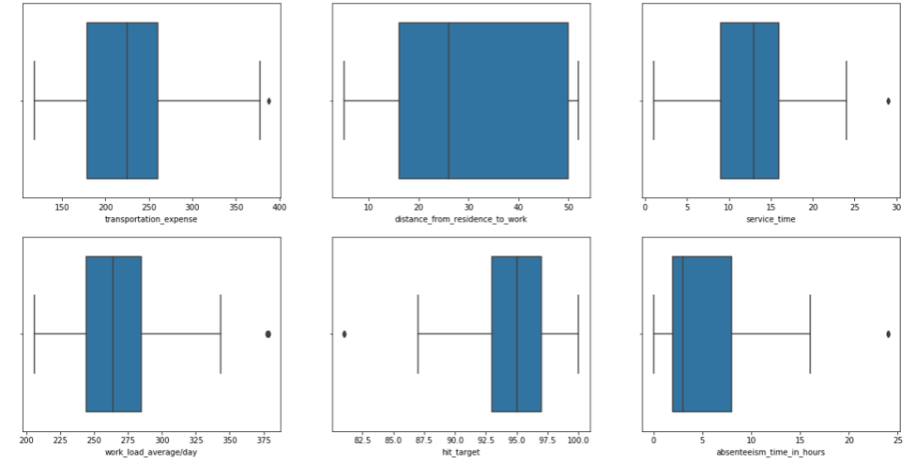
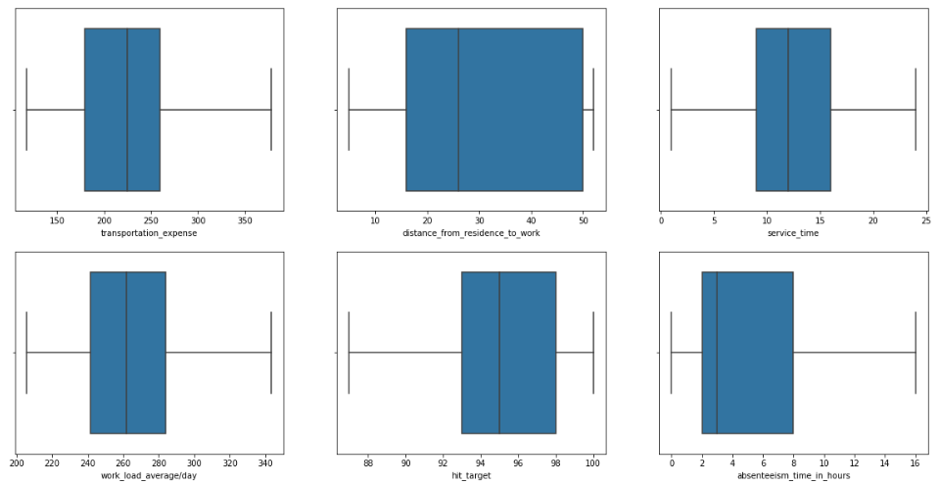
Data Understanding & Preparations
S-5
Outlier Analysis
Boxplot on Raw data Boxplot post removing outliers

Slide 6
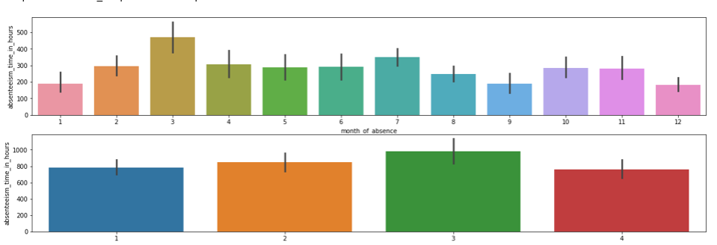
EDA
S-6
Data Visualization with Bar Graph

Slide 7
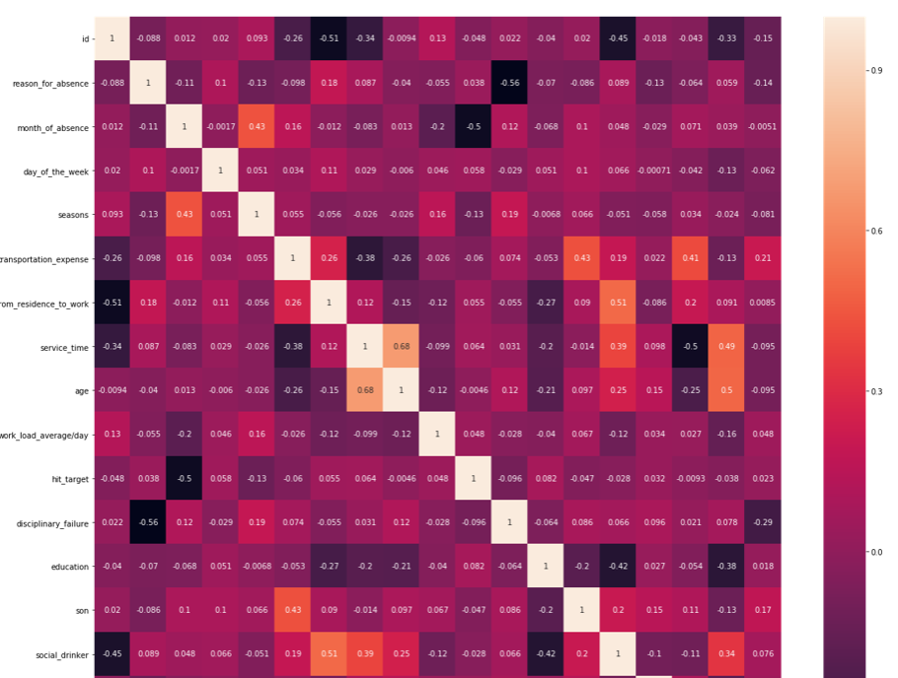
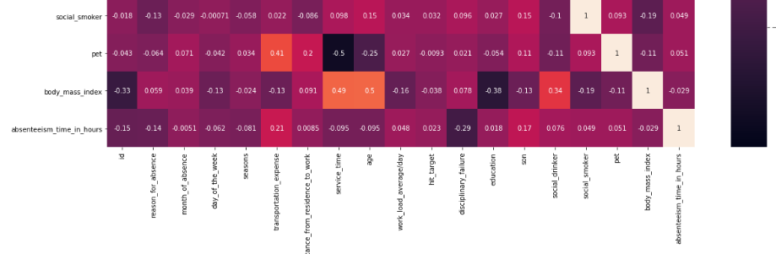
EDA
S-7
Heatmap

Slide 8
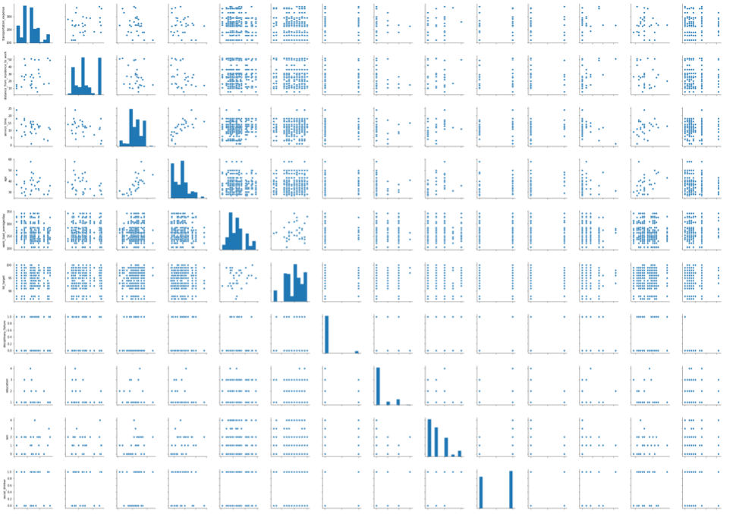
EDA
S-8
Pair plots

Slide 9
Data Preparation
S-9
Encoding Categorical Data
One Hot encoding has been performed on categorical features of the data to make it viable for analysis.
Encoding performed on below columns
Seasons
Reason for absence
Month of absence
Day of week

Slide 10
Feature selection and model creation
S-10
Calculating correlation coefficient for all the features
Selecting features with correlation coefficient greater than +/- 0.1
Splitting the data into dependent and independent features
Implemented Linear regression model to predict absenteeism
Implemented LASSO (Least Absolute Shrinkage Selector Operator) Model
Calculated “Root Mean Square Error” to evaluate the accuracy of the model
Calculated R2 Score to evaluate strength of correlation between dependent and independent variables
Displayed linear regression coefficient & intercept
Plotted feature importance with linear regression model

Slide 11
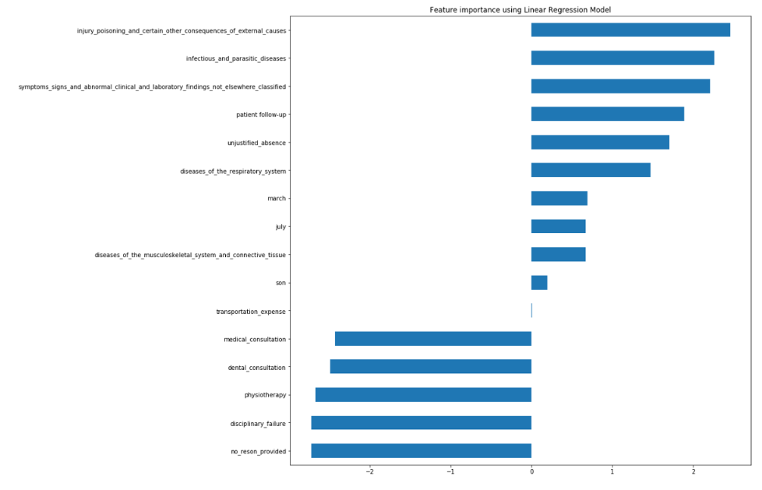
Feature selection and model creation
S-11

Slide 12
Suggestions for Improvement
S-12
Provide periodic medical consultation to the delivery persons which will reduce the occurrences of ailments
Provide physiotherapy, yoga and gym sessions which will not only reduce stress but increase productivity
Provide transportation or reimburse transportation expense
Periodic dental consultation

