Slide 1
JAVA SCRIPT

Slide 2
JavaScript: JavaScript is the world's most popular programming language. JavaScript is the programming language of the Web. JavaScript is easy to learn.

Slide 3
Why Study JavaScript?
JavaScript is one of the 3 languages all web developers must learn:
HTML to define the content of web pages
CSS to specify the layout of web pages
JavaScript to program the behavior of web pages

Slide 4
JavaScript Syntax
JavaScript syntax is the set of rules, how JavaScript programs are constructed:
var x, y, z; // Declare Variables x = 5; y = 6; // Assign Values z = x + y; // Compute Values

Slide 5
JavaScript Values:
The JavaScript syntax defines two types of values:
Fixed values
Variable values
Fixed values are called Literals.
Variable values are called Variables.
JavaScript Literals:
The two most important syntax rules for fixed values are:
Numbers are written with or without decimals:

Slide 6
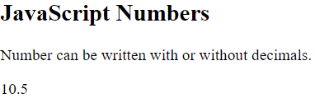
<!DOCTYPE html>
<html>
<body>
<h2>JavaScript Numbers</h2>
<p>Number can be written with or without decimals.</p>
<p id="demo"></p>
<script>
document.getElementById("demo").innerHTML = 10.50;
</script>
</body>
</html>

Slide 7
Strings are text, written within double or single quotes:
<!DOCTYPE html>
<html>
<body>
<h2>JavaScript Strings</h2>
<p>Strings can be written with double or single quotes.</p>
<p id="demo"></p>
<script>
document.getElementById("demo").innerHTML = 'John Doe';
</script>
</body>
</html>

Slide 8
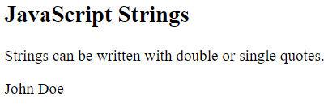
JavaScript Variables:
In a programming language, variables are used to store data values.
JavaScript uses the var keyword to declare variables.
An equal sign is used to assign values to variables.
In this example, x is defined as a variable. Then, x is assigned (given) the value 6:
var x;
x = 6;

Slide 9
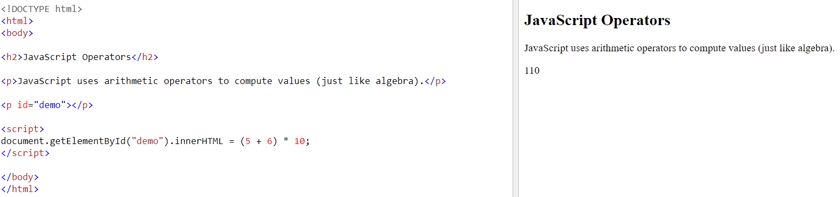
JavaScript Operators:
JavaScript uses arithmetic operators ( + - * / ) to compute values:

Slide 10
JavaScript uses an assignment operator ( = ) to assign values to variables.
var x, y;
x = 5;
y = 6;
JavaScript Expressions:
An expression is a combination of values, variables, and operators, which computes to a value.
The computation is called an evaluation.
For example, 5 * 10 evaluates to 50:

Slide 11
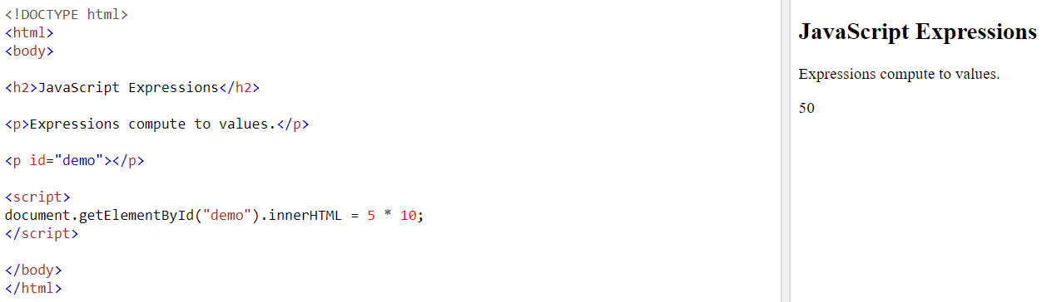

Slide 12
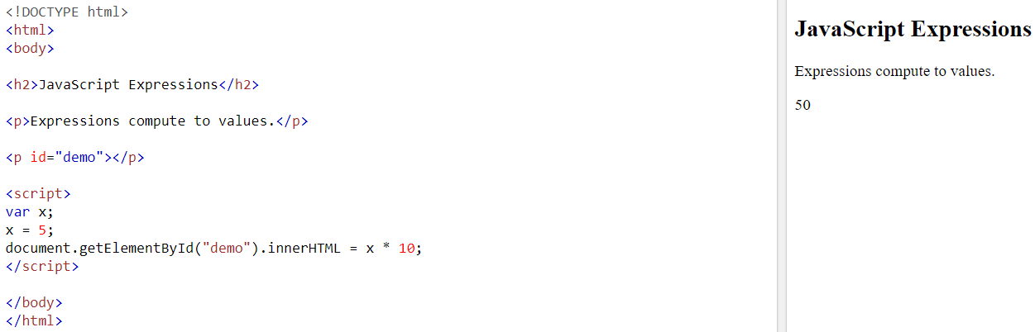
Expressions can also contain variable values:

Slide 13

The values can be of various types, such as numbers and strings.
For example, "John" + " " + "Doe", evaluates to "John Doe":

Slide 14
JavaScript Identifiers
Identifiers are names.
In JavaScript, identifiers are used to name variables (and keywords, and functions, and labels).
The rules for legal names are much the same in most programming languages.
In JavaScript, the first character must be a letter, or an underscore (_), or a dollar sign ($).
Subsequent characters may be letters, digits, underscores, or dollar signs.
JavaScript is Case Sensitive:

Slide 15
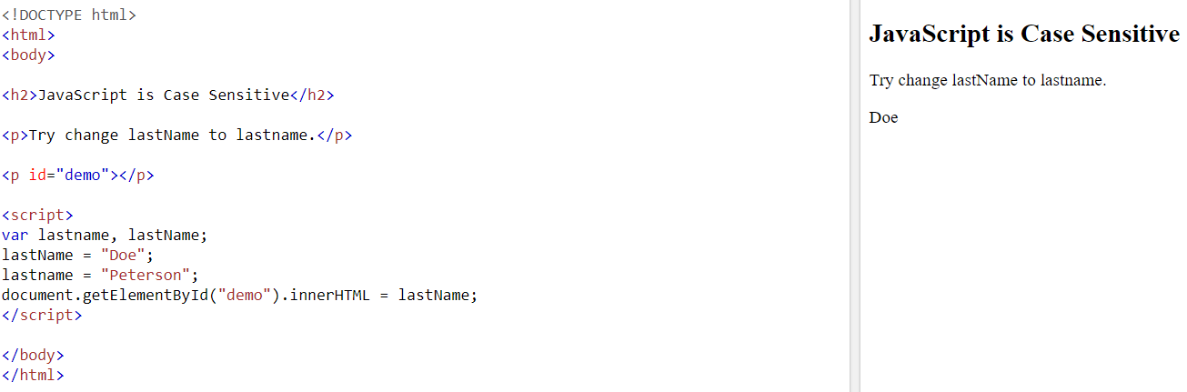

Slide 16
Use of the class Attribute in JavaScript:
The class name can also be used by JavaScript to perform certain tasks for specific elements.
JavaScript can access elements with a specific class name with the getElementsByClassName() method:
Eg: Click on a button to hide all elements with the class name "city":
<script>
function myFunction() {
var x = document.getElementsByClassName("city");
for (var i = 0; i < x.length; i++)
{
x[i].style.display = "none";

Slide 17
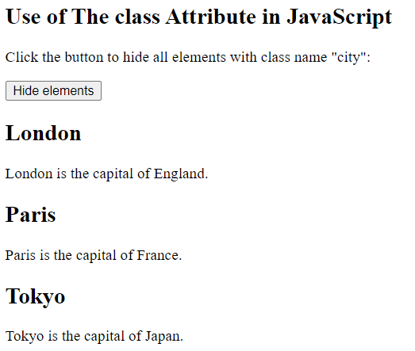
}
}
</script>
Output:

Slide 18
HTML id Attribute:
The HTML id attribute is used to specify a unique id for an HTML element.
We cannot have more than one element with the same id in an HTML document.
Using The id Attribute:
The id attribute specifies a unique id for an HTML element. The value of the id attribute must be unique within the HTML document.
The id attribute is used to point to a specific style declaration in a style sheet. It is also used by JavaScript to access and manipulate the element with the specific id.
The syntax for id is: write a hash character (#), followed by an id name. Then, define the CSS properties within curly braces {}.

Slide 19
Note: The id name is case sensitive!
The id name must contain at least one character, and must not contain whitespaces (spaces, tabs, etc.).
Eg:
<!DOCTYPE html>
<html>
<head>
<style>
#myHeader {
background-color: lightblue;
color: black;

Slide 20
padding: 40px;
text-align: center;
}
</style>
</head>
<body>
<h2>The id Attribute</h2>
<p>Use CSS to style an element with the id "myHeader":</p>
<h1 id="myHeader">My Header</h1>
</body>
</html>

Slide 21
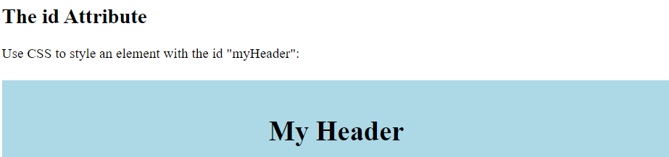
Output:
Difference Between Class and ID:
A class name can be used by multiple HTML elements, while an id name must only be used by one HTML element within the page:
Eg:

Slide 22
<!DOCTYPE html>
<html>
<head>
<style>
/* Style the element with the id "myHeader" */
#myHeader {
background-color: lightblue;
color: black;
padding: 40px;
text-align: center;
}

Slide 23
/* Style all elements with the class name "city" */
.city {
background-color: tomato;
color: white;
padding: 10px;
}
</style>
</head>
<body>
<h2>Difference Between Class and ID</h2>
<p>A class name can be used by multiple HTML elements, while an id name must only be used by one HTML element within the page:</p>

Slide 24
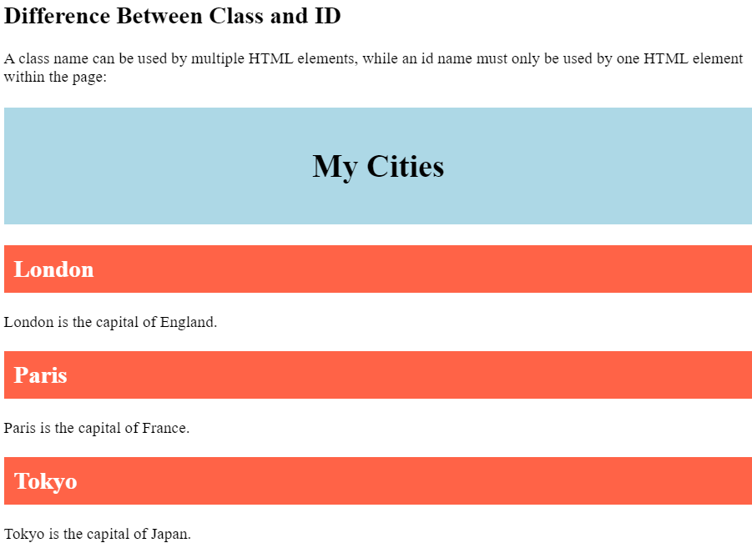
<!-- An element with a unique id -->
<h1 id="myHeader">My Cities</h1>
<!-- Multiple elements with same class -->
<h2 class="city">London</h2>
<p>London is the capital of England.</p>
<h2 class="city">Paris</h2>
<p>Paris is the capital of France.</p>
<h2 class="city">Tokyo</h2>
<p>Tokyo is the capital of Japan.</p>
</body>
</html>
Output:

Slide 25
HTML Bookmarks with ID and Links:
HTML bookmarks are used to allow readers to jump to specific parts of a webpage.
Bookmarks can be useful if your page is very long.
To use a bookmark, you must first create it, and then add a link to it.
Then, when the link is clicked, the page will scroll to the location with the bookmark.
Example: First, create a bookmark with the id attribute:
<h2 id="C4">Chapter 4</h2>
Then, add a link to the bookmark ("Jump to Chapter 4"), from within the same page:
Example:
<a href="#C4">Jump to Chapter 4</a>

Slide 26
Or, add a link to the bookmark ("Jump to Chapter 4"), from another page:
<a href="html_demo.html#C4">Jump to Chapter 4</a>
Using The id Attribute in JavaScript
The id attribute can also be used by JavaScript to perform some tasks for that specific element.
JavaScript can access an element with a specific id with the getElementById() method:
Example:
Use the id attribute to manipulate text with JavaScript:
<script>

Slide 27
function displayResult() {
document.getElementById("myHeader").innerHTML = "Have a nice day!";
}
</script>
HTML JavaScript:
JavaScript makes HTML pages more dynamic and interactive.
Eg:
<!DOCTYPE html>
<html>
<body>

Slide 28
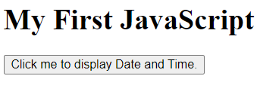
<h1>My First JavaScript</h1>
<button type="button"
onclick="document.getElementById('demo').innerHTML = Date()">
Click me to display Date and Time.</button>
<p id="demo"></p>
</body>
</html>
Output:

Slide 29
The HTML <script> Tag
The HTML <script> tag is used to define a client-side script (JavaScript).
The <script> element either contains script statements, or it points to an external script file through the src attribute.
Common uses for JavaScript are image manipulation, form validation, and dynamic changes of content.
To select an HTML element, JavaScript most often uses the document.getElementById() method.
This JavaScript example writes "Hello JavaScript!" into an HTML element with id="demo":
Eg:
<!DOCTYPE html>
<html>
<body>

Slide 30
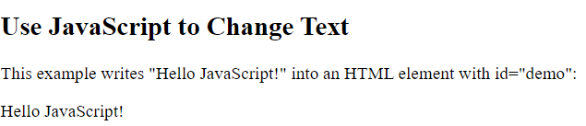
<h2>Use JavaScript to Change Text</h2>
<p>This example writes "Hello JavaScript!" into an HTML element with id="demo":</p>
<p id="demo"></p>
<script>
document.getElementById("demo").innerHTML = "Hello JavaScript!";
</script>
</body>
</html>
Output:

Slide 31
JavaScript Events:
HTML Events:
An HTML event can be something the browser does, or something a user does.
Eg for HTML events:
An HTML web page has finished loading
An HTML input field was changed
An HTML button was clicked.
HTML allows event handler attributes, with JavaScript code, to be added to HTML elements.
With single quotes:
<element event='some JavaScript'>
With double quotes:
<element event="some JavaScript">

Slide 32

Eg. an onclick attribute (with code), is added to a <button> element:
<!DOCTYPE html>
<html>
<body>
<button onclick="document.getElementById('demo').innerHTML=Date()">The time is?</button>
<p id="demo"></p>
</body>
</html>
Ouput:

Slide 33


JavaScript code changes the content of the element with id="demo".
Eg: Code changing the content of its own element (using this.innerHTML);
<!DOCTYPE html>
<html>
<body>
<button onclick="this.innerHTML=Date()">The time is?</button>
</body>
</html>
Output:
After selecting button:

Slide 34
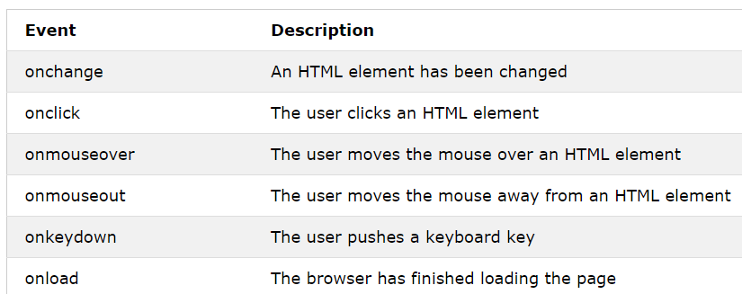
Common HTML Events:

Slide 35
What can JavaScript Do?
Event handlers can be used to handle and verify user input, user actions, and browser actions:
Things that should be done every time a page loads
Things that should be done when the page is closed
Action that should be performed when a user clicks a button
Content that should be verified when a user inputs data.
Many different methods can be used to let JavaScript work with events:
HTML event attributes can execute JavaScript code directly
HTML event attributes can call JavaScript functions
You can assign your own event handler functions to HTML elements
You can prevent events from being sent or being handled

Slide 36
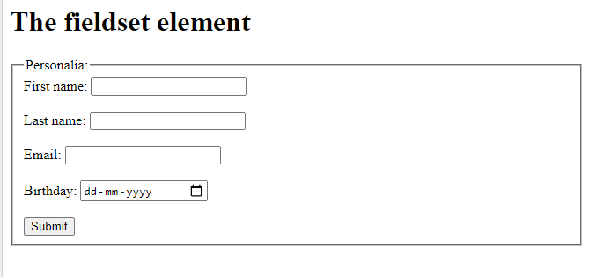
Note:
<fieldset> Tag : This tag is used to group related elements in a form.
This tag draws a box around the related elements.
The <legend> tag is used to define a caption for the <fieldset> Tag
<fieldset>
<legend>Personalia:</legend>
<label for="fname">First name:</label>
<input type="text" id="fname" name="fname"><br><br>
…
<input type="date" id="birthday" name="birthday"><br><br>
<input type="submit" value="Submit">
</fieldset>

Slide 37
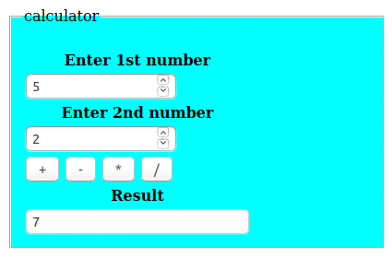
Lab pgm 7: Write a JavaScript to design a simple calculator to perform the following operations: sum, product, difference and quotient.

Slide 38
HTML:
…………………..
JS:
function performop(op) {
var result = 0;
var n1=parseInt(document.getElementById("num1").value);
var n2=parseInt(document.getElementById("num2").value);
if (op=="+") {
var result=n1+n2 ;
}
else if(op=="-") {
var result=n1-n2;
}
else if(op=="*") {
var result=n1*n2;
}
else
{
var result=n1/n2
}
document.getElementById("res").value=result;
}
CSS: ………………..

