Slide 1


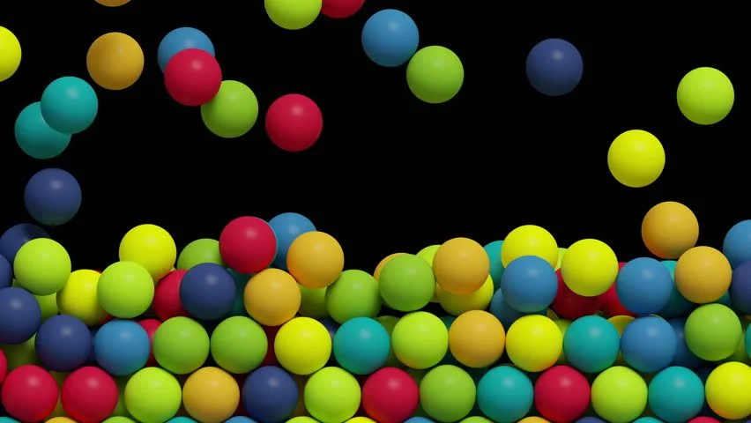
Free falling balls
Samarth Sudarshan Inamdar
CED18I045

Slide 2
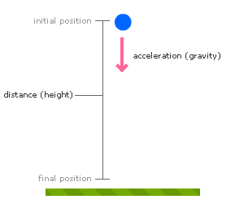
Free Falling Object
Free Fall is when an object solely moves under the influence of gravity regardless of its direction.
The acceleration of free-falling objects is called the acceleration due to gravity.
The acceleration due to gravity is constant on the surface of the Earth and has the value of 9.8 m/s²

Slide 3
Algorithms and FORMULAS USED
Mid-Point Circle Drawing Algorithm
For drawing the outline of the balls.
Newtons laws of motions
For finding the velocity of the ball at every instance as the ball moves close to the ground (when falling from it’s a certain height) and away from the ground (when it bounces off the ground).
For finding the displacement of the ball after every instance which is done with the help of velocity found above.

Slide 4
Assumptions made
Acceleration due to gravity (g) = 9.8 m/s².
Each pixel on the screen is equivalent to 1mm in real world.
Each ball is made of same material.
Ball reaches at 80% of its previous height after it bounces off the ground.
Number of balls and their color will be randomly generated.

Slide 5
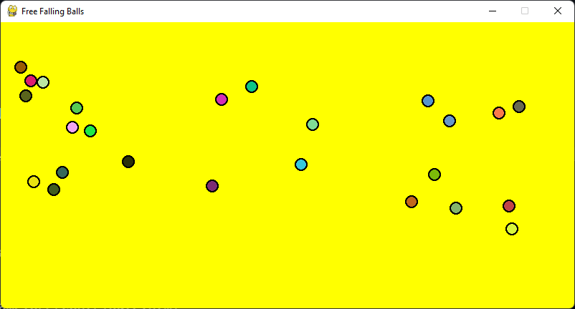
Free Falling Ball Output

Slide 6
Functions used
def mcd() : For drawing the perimeter (outline) of the ball.
def octet() : Finding the coordinate in the other octets (by mirroring them) with the help of coordinates found in one of the octet using mcd()
Class Ball() : This class holds the data for a single ball.
It holds the center, radius, velocity(at current instance), height(current), displacement(from initial position), direction in which the ball is moving, etc.
def repos_ball() : This function is the part of Class Ball and is responsible for the major part of the animation.

Slide 7
Functions Used
Here we check whether the centre[1] (y coordinate) is less than the radius and the direction is –1, if both are true then we change the direction to dir * -1 (i.e., the ball has touched the ground).
After that we check whether the centre[1] is greater than 0.8 * height of the ball (since ball reaches 80% of its previous height (assumption) ) and whether the direction is 1 then change it to dir * -1 (i.e., the ball has reached the maximum height).
We also find the displacement at every instance using displacement()
Also, we must bring the ball to the rest when its height becomes 1 hence, we check if height < 1, if true we do not bounce the ball any further and ball comes to rest.

Slide 8
Execution
Install python3 and pip
sudo apt-get install python3.8 python3-pip
Install PyOpenGL, pygame using
pip install PyOpenGL PyOpenGL_accelerate
pip install pygame
Add all the files to the same directory :
helper.py
Ball.py
main.py
Execute main.py and enjoy the animation of free-falling balls from the sky!!!!

Slide 9
Thank you

